Slide 1


I. Tutorial: ISS imaging
Arthur B. Weglein
May 27-30, 2014
Austin, TX
Notes:
1
1

Slide 2
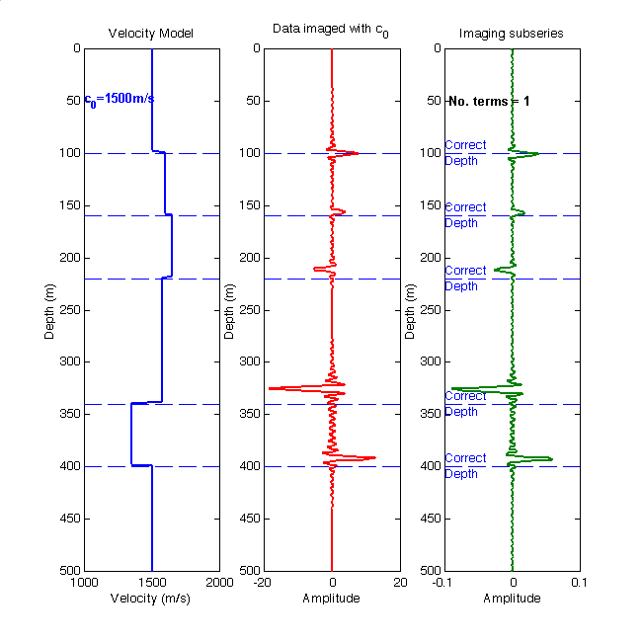


Slide 3
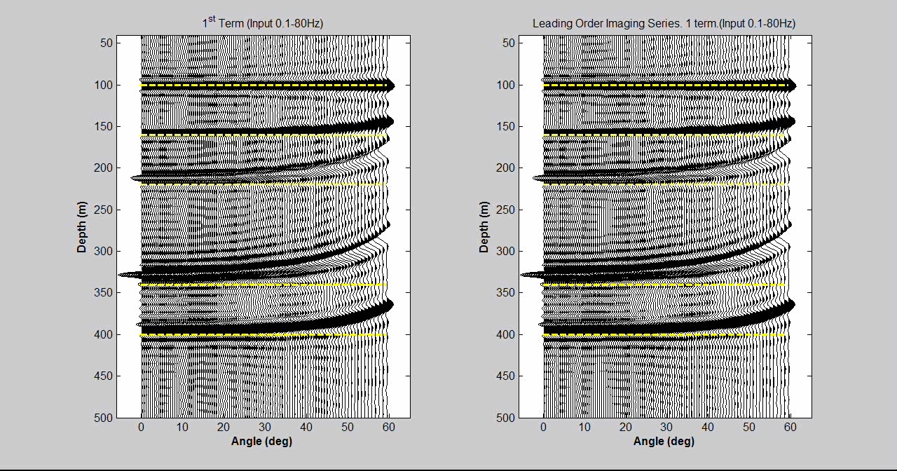
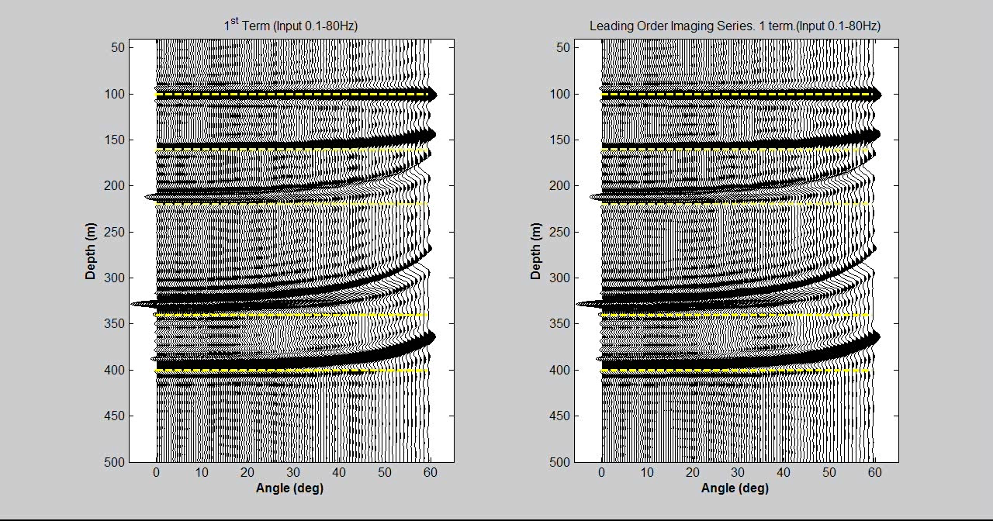

Slide 4
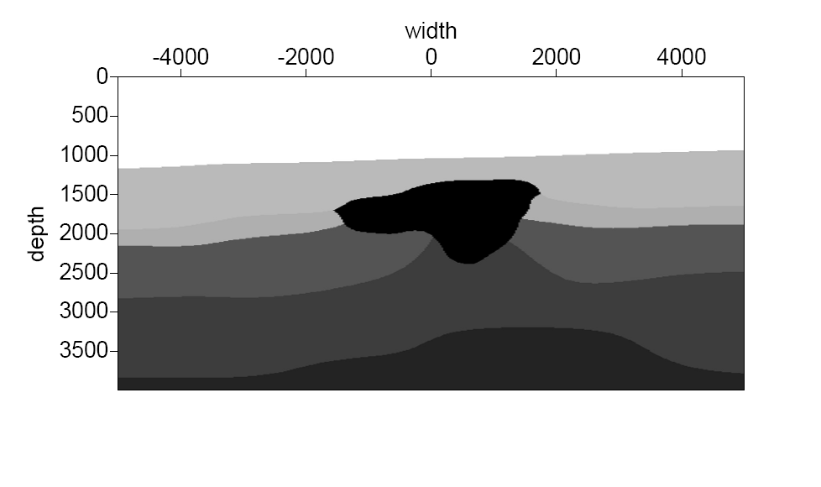
Salt model
1500 m/s
2329 m/s
4600 m/s
2464 m/s
3570 m/s
3855 m/s
4170 m/s
F. Liu et. al. (2006)

Slide 5
Salt model – Prestack water speed
FK migration

Slide 6
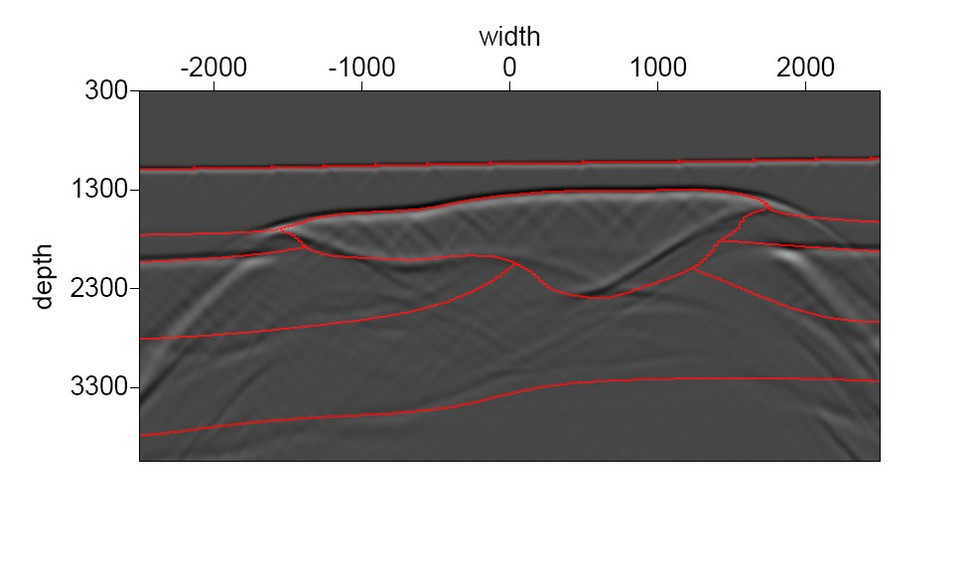
Salt model - HOIS
F. Liu et. al. (2006)
F. Liu et. al. (2006)

Slide 7
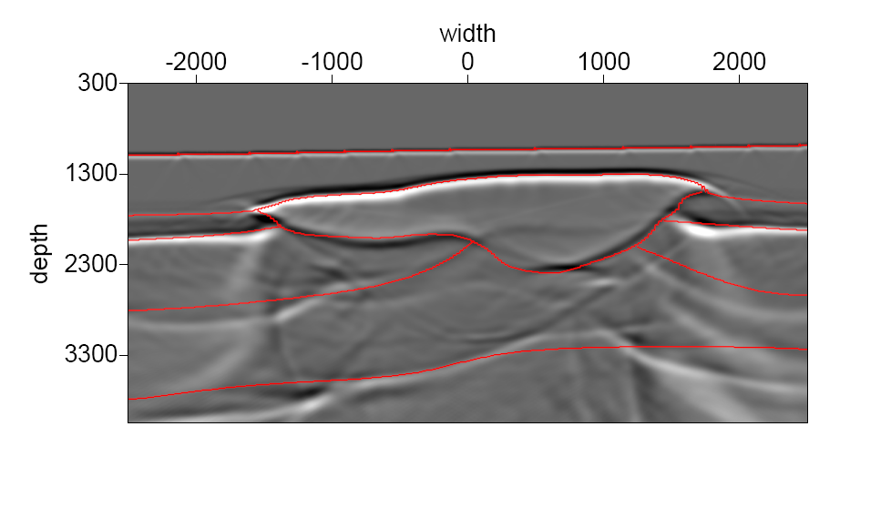
Salt model – HOIS +LE
Zhiqiang Wang et. al. (2011)
Zhiqiang Wang et. al. (2011)

Slide 8
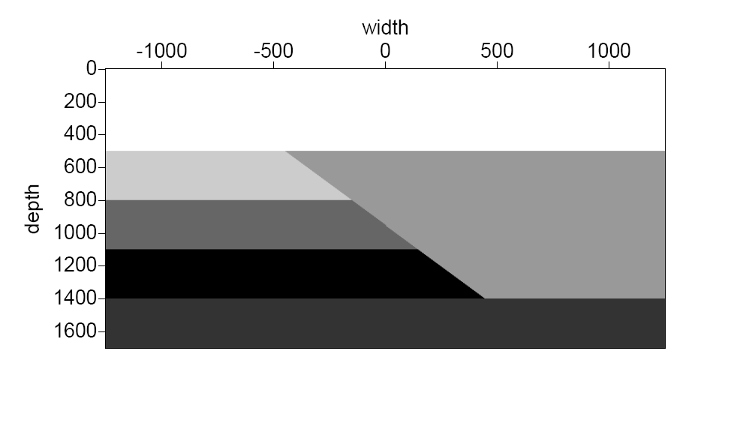
Fault model
1500 m/s
2000 m/s
3000 m/s
2500 m/s
4000 m/s
3500 m/s
F. Liu et. al. (2009)
F. Liu et. al. (2009)
Notes:
Here is a fault model Dr. Fang Liu had used. It has a fault which has a 45-degree dip angle.

Slide 9
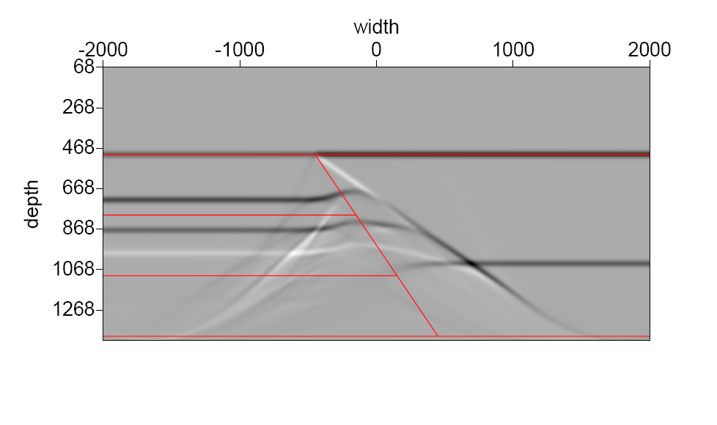
Fault model - Water speed FK migration
F. Liu et. al. (2009)

Slide 10
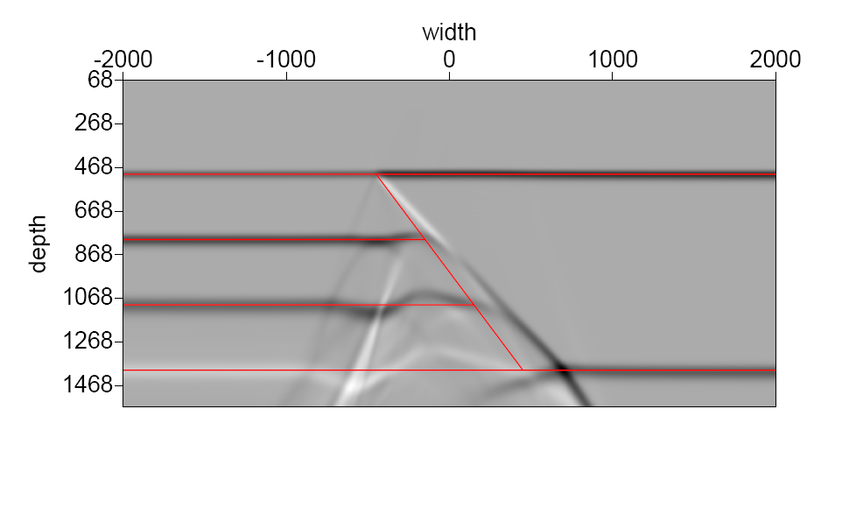
Fault model - HOIS
F. Liu et. al. (2009)

Slide 11
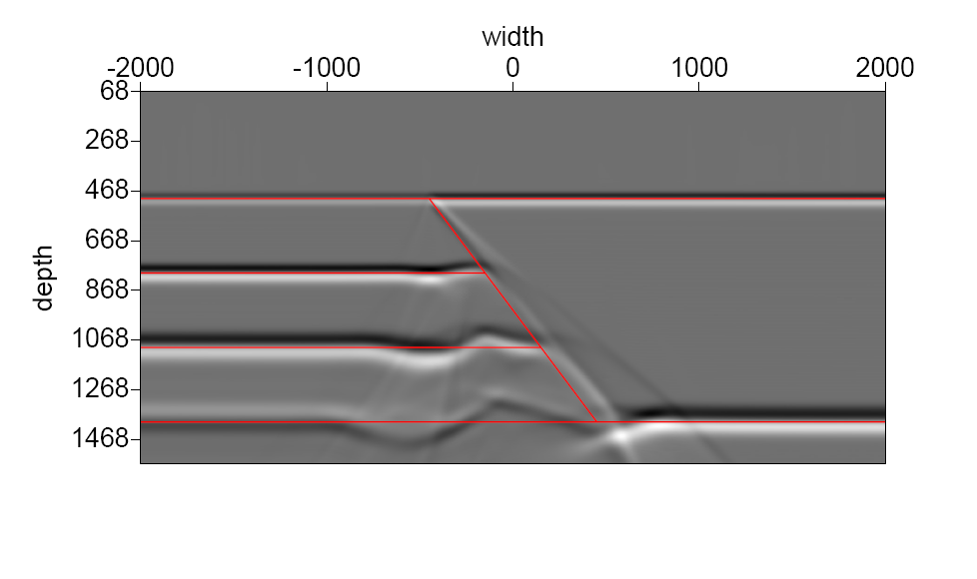
Fault model – HOIS+LE
Zhiqiang Wang et. al. (2011)

Slide 12
Multi-parameter imaging

Slide 13
Extending the imaging algorithm
Fang Liu’s high-order imaging algorithm
To extend HOIS to a multi-parameter earth where more than velocity can change.

Slide 14
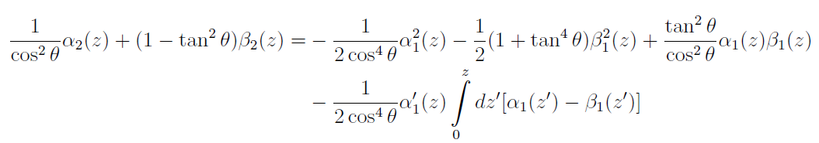
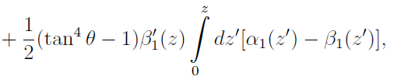

Now let’s look at Haiyan Zhang’s 2 parameter acoustic equations with velocity and density both varying.
What is ?

Slide 15
What is
For one reflector:
When ; is independent of

Slide 16
Elastic polarity reversals

Slide 17
Model I
Z₁=500 m
Z₂=1000 m

Slide 18
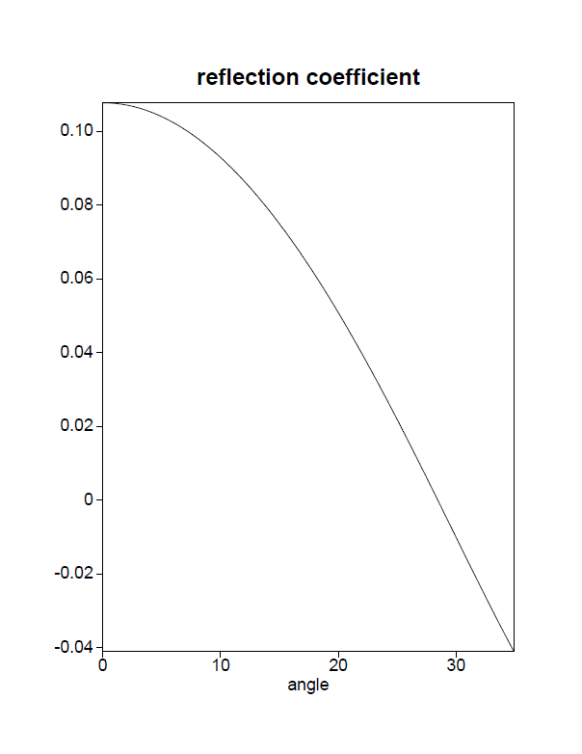
Zero crossing for model I and model II all happens at the second interface at

Slide 19
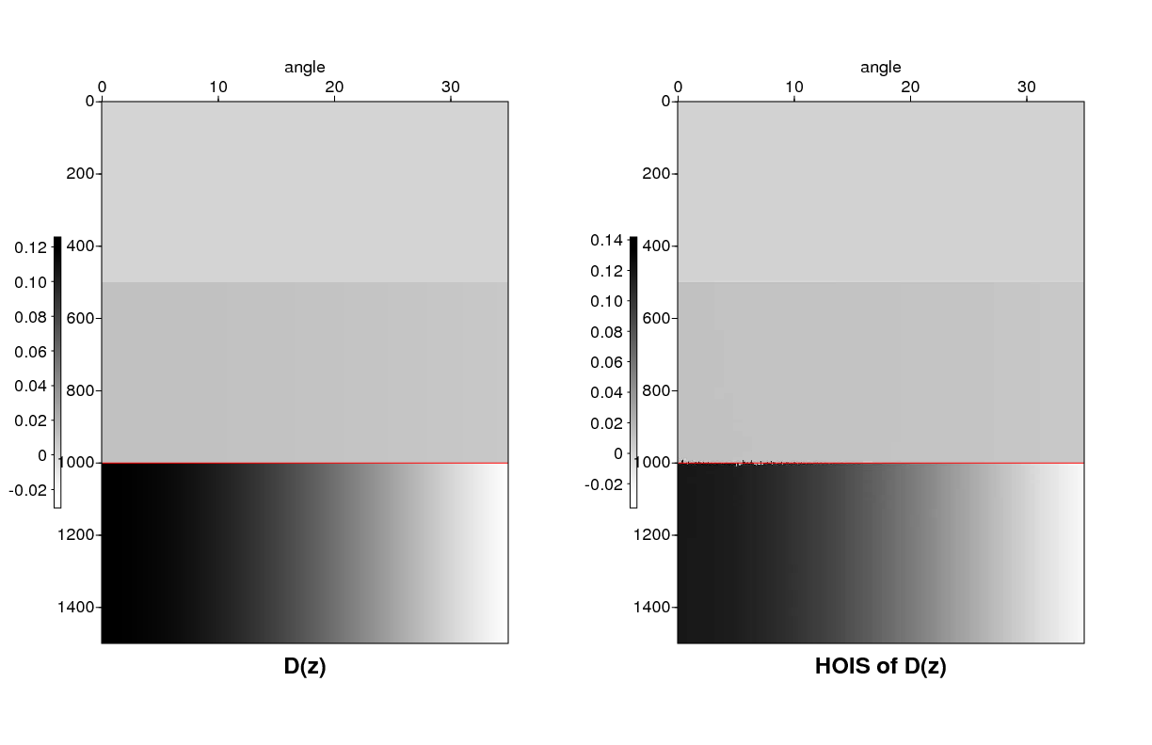
θ
θ
z
z

Slide 20

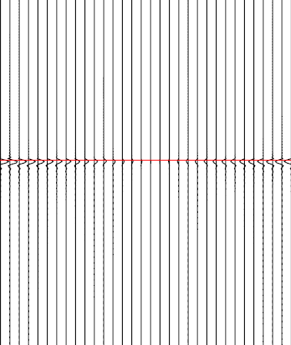
Dz
HOIS of Dz (ISS)

Slide 21
Model II
Z₁=500 m
Z₂=1000 m

Slide 22
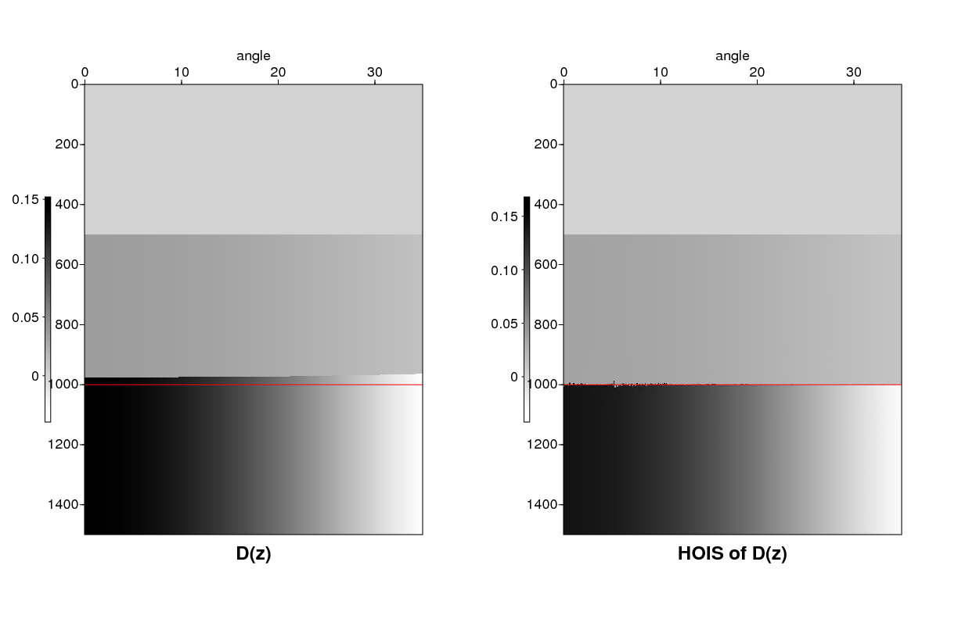
θ
θ
z
z

Slide 23

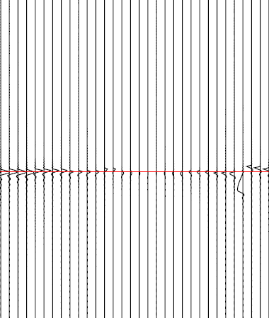
Dz
HOIS of Dz (ISS)

Slide 25
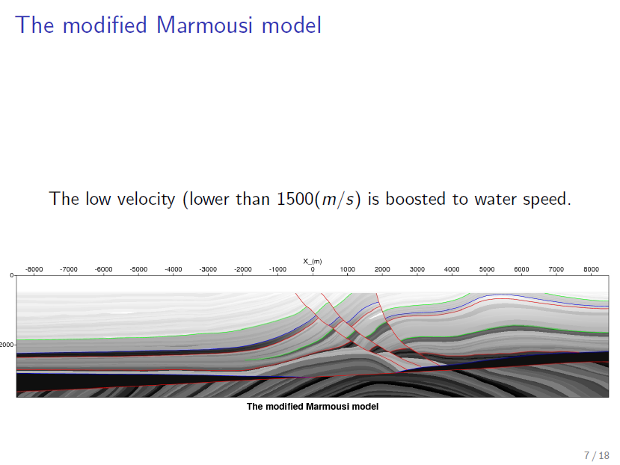

Slide 26
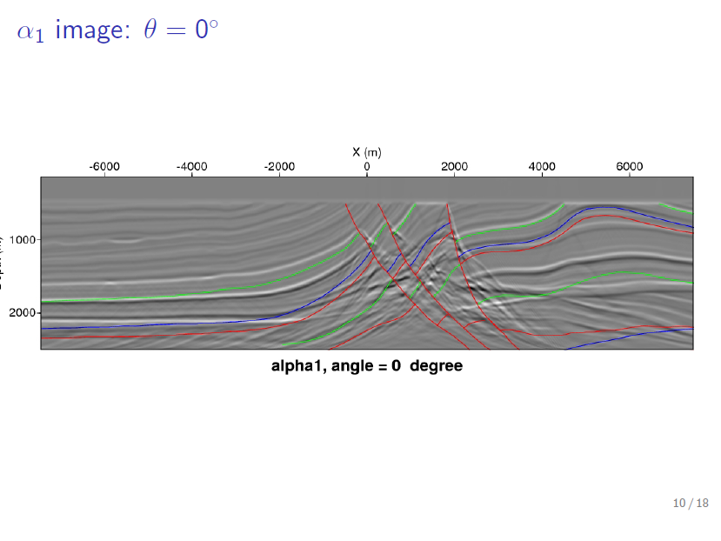

Slide 27
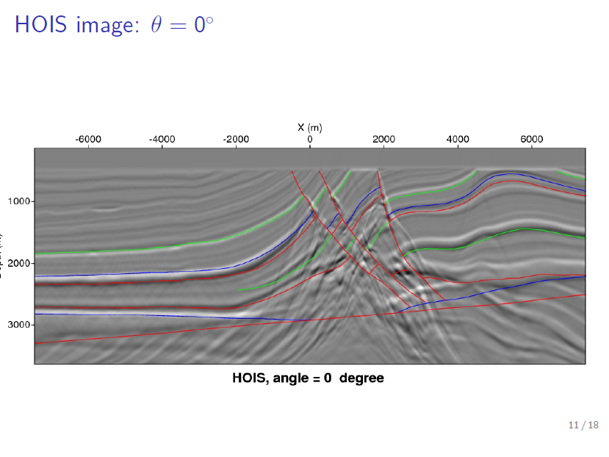

Slide 28
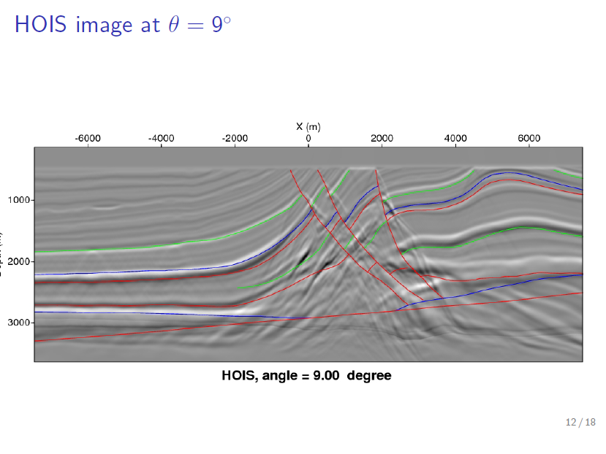

Slide 29
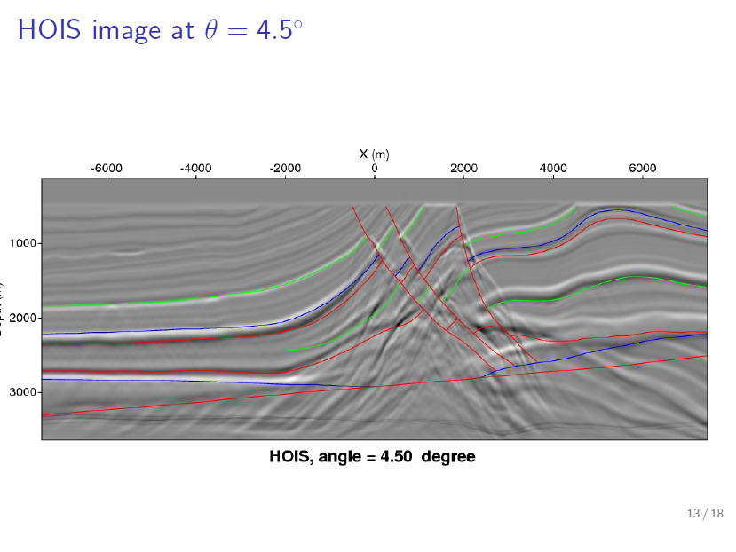

Slide 30
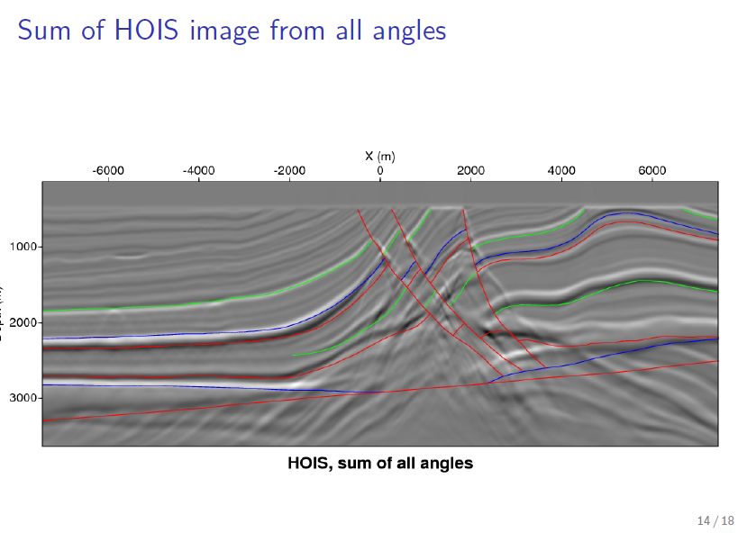

Slide 31
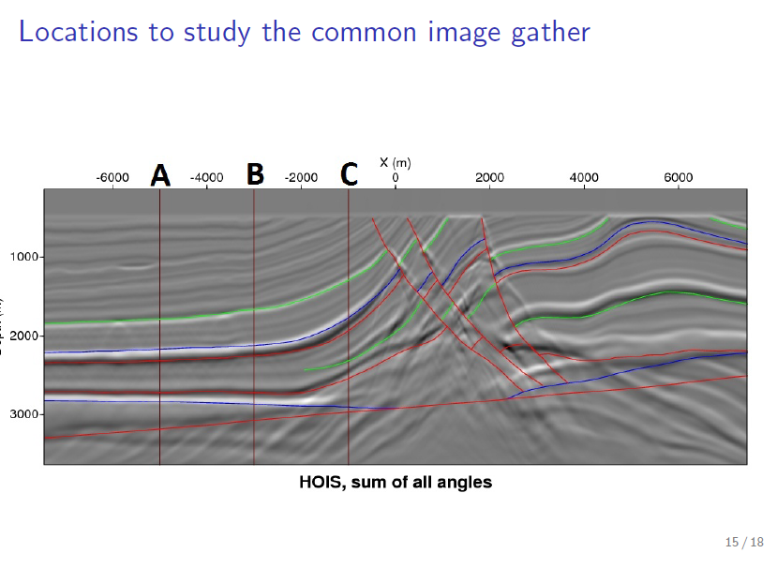

Slide 32
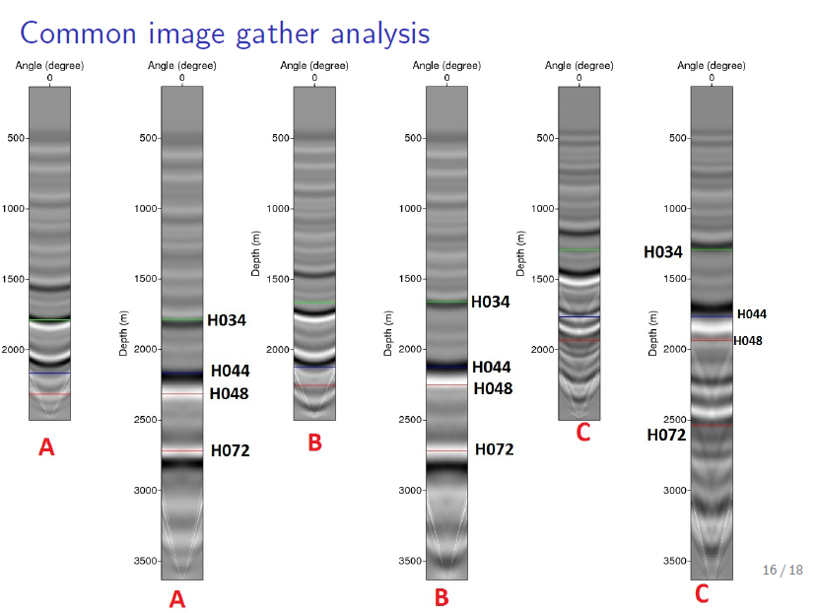

Slide 34
II. Kristin data ISS imaging: viability
Arthur B. Weglein
May 27-30, 2014
Austin, TX
Notes:
34
34

Slide 35
Criteria for ISS imaging to be effective in directly predicting the depth without a velocity model
Adequate capture/inclusion of ISS imaging terms for
the difference between actual and reference properties
and the duration of that difference
Data regularization for seismic band width
A model type match between the ISS imaging algorithm
and the earth that generated the data

Slide 36
2. The Kristin data results

Slide 37
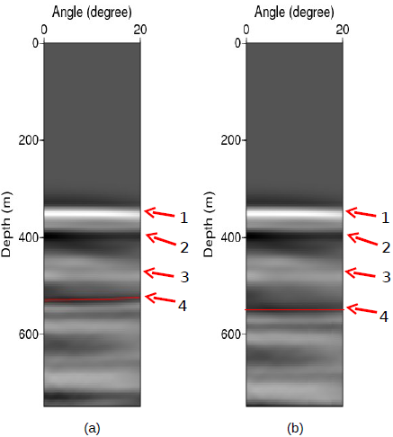
Kristin data ISS depth imaging result

Slide 38
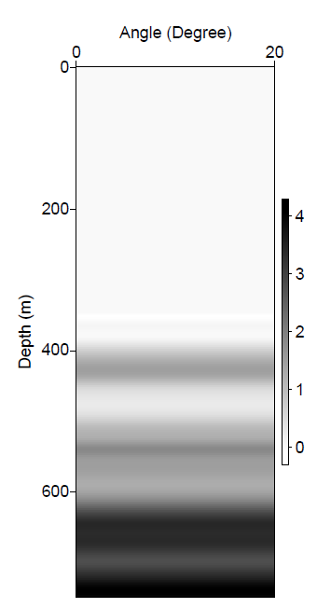
Kristin data ISS depth imaging result

Slide 39
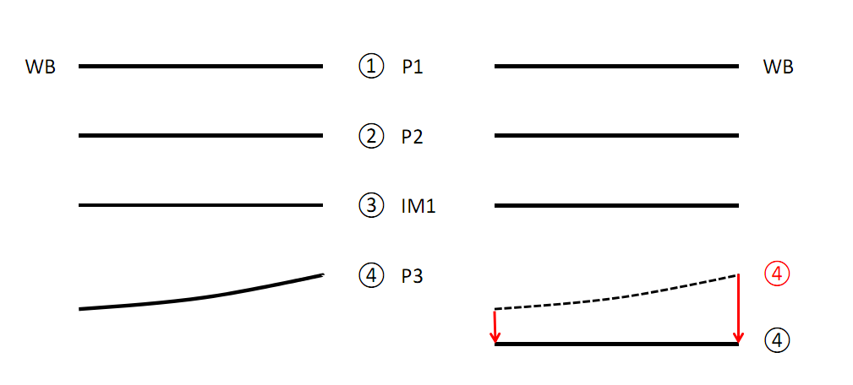
This figure summarizes the results of the initial ISS depth imaging tests on the very shallow, near ocean bottom section of the Kristin data.

Slide 40
Summary
Kristin data result demonstrates the viability of ISS depth imaging of filed data.

Slide 41
Plan
The idea is to extend the inverse scattering (coherent noise) multiple removal capability to the extraction of information from signal;
Just as top and base salt primaries are combined to remove internal multiples within salt, those two primaries can be used to depth image the base salt primary – both without subsurface information.

Slide 42
Multiple removal
…based on non-linear multiplication of events
FS
WB
Salt
Target

Slide 43
Imaging of primaries
…the deepest primary is imaged through non-linear multiplication of shallower primaries, without any subsurface information
FS
WB
Salt
Target

Slide 44
The rapid changes that generate reflections above the target
reflector are the source of collective communication that arranges
the deeper reflector to be located directly and without a velocity
model known, needed or determined.
That source of the ISS imaging capability (shallower reflectors) is
precisely the bane of the current RTM methods where smoothing
the rapid changes takes place.
Thus the ISS event communication is in some sense a response to
the current avoidance of that information, and precisely how to
use it. Without that communication you will need the velocity.

Slide 45
ISS depth imaging:
From viable to an added-value contribution to the seismic imaging toolbox
Move “spikes” rather than “boxes”
Model-type independent ISS depth imaging for a structure map
Consider P-only propagation in an elastic medium

Slide 46


