Slide 1

The significance of incorporating a
3D point source in the Inverse scattering series (ISS) internal multiple attenuator for a 1D subsurface
Xinglu Lin* and Arthur B. Weglein
M-OSRP, University of Houston
Oct. 19th, 2015

Slide 2
Background
The ISS internal-multiple attenuation algorithm:
  Is the only method that does not need any subsurface information and is earth model-type independent.
  Can predict all internal multiples at once.
  Is widely used by major service and oil companies.
  (e.g. CGG, PGS, Schlumberger, Petrobras, Aramco, KOC, BP…)

Slide 3
Background
Onshore effectiveness:
“Their performance was demonstrated with complex synthetic and challenging land field data sets with encouraging results; other internal multiple-suppression methods were unable to demonstrate similar effectiveness.”
—Yi Luo et al., 2011, TLE, 884-889
“Elimination of land internal multiples based on the inverse scattering series”

Slide 4
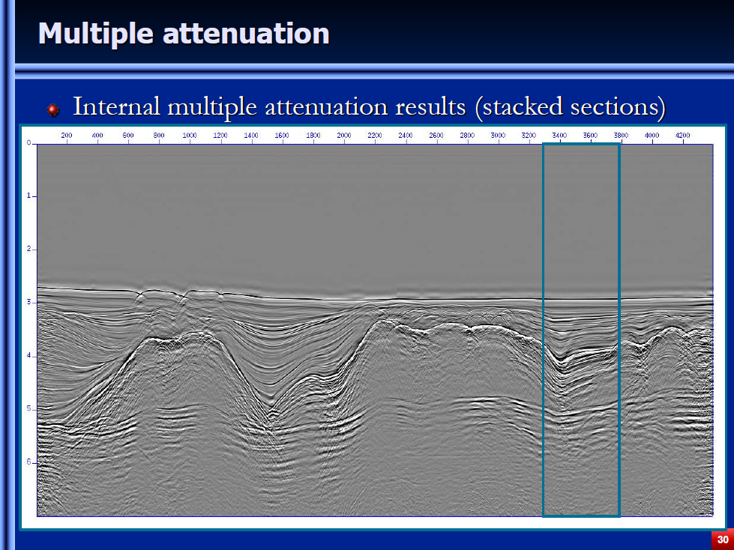
Offshore effectiveness: offshore Brazil data example
(A. Ferreira and A. Weglein, 2011; A. Ferreira et al., 2013, Petrobras)

Slide 5
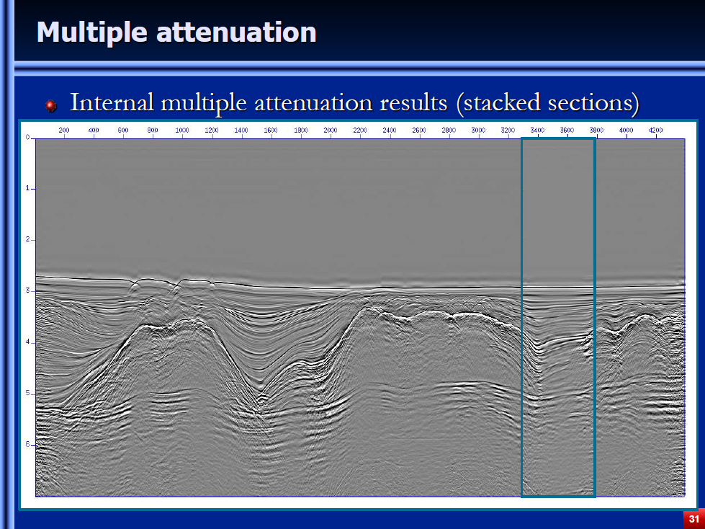
Offshore effectiveness: offshore Brazil data example
(A. Ferreira and A. Weglein, 2011; A. Ferreira et al., 2013, Petrobras)

Slide 6
Motivation and Highlight in this talk
There are on-shore and off-shore regions, which are close to 1D earth and have serious internal multiple problems. (e.g., Central North sea, Canada)
The frequently used ISS internal multiple attenuator for a 1D subsurface is reduced from a full 2D theory.
However, the source is better to be assumed as a 3D point source (e.g. dynamite, airgun).
The objective of this paper is to improve the internal-multiple prediction with incorporating a 3D point source in the ISS internal multiple attenuation algorithm for a 1D subsurface.

Slide 7
Theory
The ISS internal multiple attenuation algorithm is a multi-dimensional method (Araujo et al., 1994; Weglein et al., 1997).
Start with a complete 3D ISS internal multiple attenuator
Reduced it for a 1D subsurface

Slide 8
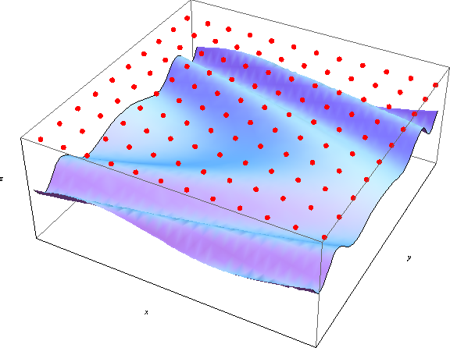
Iss internal multiple attenuator assuming a 3D point source and a 3D subsurface
3D theory requires:
3D earth-Properties vary in (x,y,z)
direction.
Z
Y
Source
Receiver
X

Slide 9
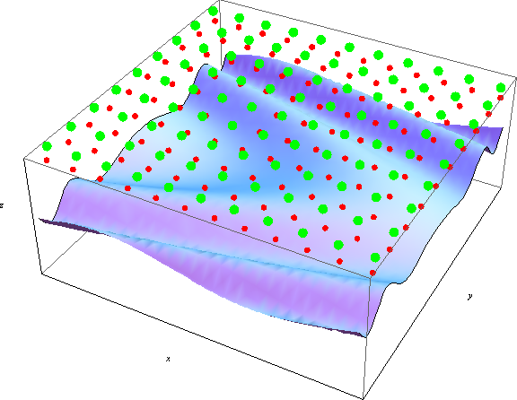
Iss internal multiple attenuator assuming a 3D point source and a 3D subsurface
3D theory requires:
Z
Y
Source
Receiver
X

Slide 10
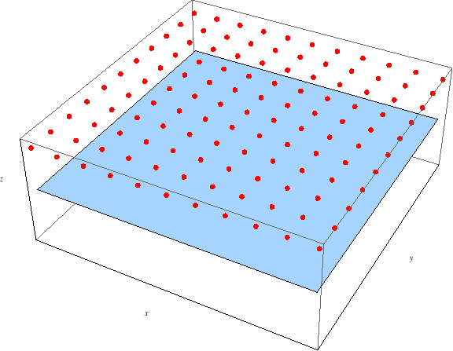
Iss internal multiple attenuator assuming a 3D point source and a 1D subsurface
3D source-1D earth algorithm requires:
Independent of azimuth angle
1D earth -Properties vary in z-direction.
Z
Y
Source
Receiver
X

Slide 11
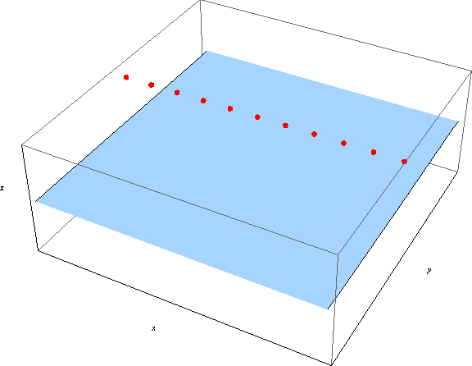
Iss internal multiple attenuator assuming a 3D point source and a 1D subsurface
3D source-1D earth algorithm requires:
r_{h}
Recorded Seismic data:
D(r_{h},t)
Z
Y
Source
Receiver
X

Slide 12
Iss internal multiple attenuator for a 1D subsurface
ISS internal multiple attenuator for 1D subsurface (Araujo et al., 1994; Weglein et al., 1997) :

Slide 13
Iss internal multiple attenuator for a 1D subsurface
ISS internal multiple attenuator for 1D subsurface (Araujo et al., 1994; Weglein et al., 1997) :
z₁

Slide 14
Iss internal multiple attenuator for a 1D subsurface
ISS internal multiple attenuator for 1D subsurface (Araujo et al., 1994; Weglein et al., 1997) :
z₂
z₁

Slide 15
Iss internal multiple attenuator for a 1D subsurface
ISS internal multiple attenuator for 1D subsurface (Araujo et al., 1994; Weglein et al., 1997) :
z₂
z₃
z₁

Slide 16
Iss internal multiple attenuator for a 1D subsurface
ISS internal multiple attenuator for 1D subsurface (Araujo et al., 1994; Weglein et al., 1997) :
z₂
z₃
z₁

Slide 17
Iss internal multiple attenuator for a 1D subsurface
ISS internal multiple attenuator for 1D subsurface (Araujo et al., 1994; Weglein et al., 1997) :
D(r_{h},t)
b₁(k_{h},z)
b₃(k_{h}, ω)
D₃(r_{h}, t)
Attenuate the internal multiples: D(r_{h},t)+D₃(r_{h}, t)

Slide 18
Iss internal multiple attenuator for a 1D subsurface
ISS internal multiple attenuator for 1D subsurface (Araujo et al., 1994; Weglein et al., 1997) :
D(r_{h},t)
b₁(k_{h},z)
b₃(k_{h}, ω)
D₃(r_{h}, t)
Input preparation
Output transform

Slide 19
Iss internal multiple attenuator assuming a 2D line source
Fourier transform
ISS prediction
Inverse Fourier transform
D(r_{h},t)
b₁(k_{h},z)
b₃(k_{h}, ω)
D₃(r_{h}, t)
Attenuate the internal multiples: D(r_{h},t)+D₃(r_{h}, t)

Slide 20
Iss internal multiple attenuator assuming a 3d point source
Hankel transform
ISS prediction
Inverse Hankel transform
D(r_{h},t)
b₁(k_{h},z)
b₃(k_{h}, ω)
D₃(r_{h}, t)
Attenuate the internal multiples: D(r_{h},t)+D₃(r_{h}, t)

Slide 21
Iss internal multiple attenuator assuming a 3d point source
Asymptotic transform
ISS prediction
Inverse asymptotic transform
D(r_{h},t)
b₁(k_{h},z)
b₃(k_{h}, ω)
D₃(r_{h}, t)
Attenuate the internal multiples: D(r_{h},t)+D₃(r_{h}, t)

Slide 22
Difference between
Iss internal multiple attenuator assuming a 3d point source v.s. a 2d line source
ISS prediction
D(r_{h},t)
b₁(k_{h},z)
b₃(k_{h}, ω)
D₃(r_{h}, t)
Assuming
a 2D line source
Fourier transform
Inverse Fourier transform
Hankel transform
Inverse Hankel transform
Assuming
a 3D point source
Asymptotic transform
Inverse asymptotic transform

Slide 23
Numerical tests
Numerical tests on a 3D source – 1D earth dataset:
  Internal multiple prediction assuming a 2D line source
    Fourier transform
  Internal multiple prediction assuming a 3D point source
    Hankel transform
    Asymptotic transform

Slide 24
Numerical tests on a 3D source-1D earth data
Acoustic model
V=1500m/s
V=2200m/s
V=8000m/s
3D point source broad-band data using reflectivity method
No ghosts; No free-surface multiples

Slide 25
Numerical tests on a 3D source-1D earth data
Synthetic data
3D point source data
Primaries
First-order internal multiple

Slide 26
Numerical tests on A 3D source-1D earth data
ISS internal multiple attenuator assuming a 2D line source
3D point source data
2D line source
IM prediction
(Fourier transform)
Very small scale
×10⁻⁷

Slide 27
Numerical tests on A 3D source-1D earth data
ISS internal multiple attenuator assuming a 3D point source
3D point source data
3D point source
IM prediction
(Hankel transform)

Slide 28
Numerical tests on A 3D source-1D earth data
ISS internal multiple attenuator assuming a 3D point source
3D point source data
3D point source
IM prediction
(Asymptotic transform)

Slide 29
Numerical tests on A 3D source-1D earth data
3D source VS. 2D source ISS internal multiple attenuator
(Near offset trace comparison, 100m)
3D point source
internal-multiple

Slide 30
Numerical tests on A 3D source-1D earth data
3D source VS. 2D source ISS internal multiple attenuator
(Near offset trace comparison, 100m)
3D point source
internal-multiple
2D line source ISS internal-multiple prediction
(Fourier transform)

Slide 31
Numerical tests on A 3D source-1D earth data
3D source VS. 2D source ISS internal multiple attenuator
(Near offset trace comparison, 100m)
×10⁻⁷
3D point source
internal-multiple
2D line source ISS internal-multiple prediction
(Fourier transform)

Slide 32
Numerical tests on A 3D source-1D earth data
3D source VS. 2D source ISS internal multiple attenuator
(Near offset trace comparison, 100m)
3D source ISS
internal-multiple prediction
(Hankel transform)
3D point source
internal-multiple
2D line source ISS internal-multiple prediction
(Fourier transform)

Slide 33
Numerical tests on A 3D source-1D earth data
3D source VS. 2D source ISS internal multiple attenuator
(Near offset trace comparison, 100m)
3D source ISS
internal-multiple prediction
(Hankel transform)
3D point source
internal-multiple
2D line source ISS internal-multiple prediction
(Fourier transform)
3D source ISS internal-multiple prediction
(Asymptotic Bessel)

Slide 34
Numerical tests on A 3D source-1D earth data
3D source VS. 2D source ISS internal multiple attenuator
(far offset trace comparison, 500m)
3D point source
internal-multiple

Slide 35
Numerical tests on A 3D source-1D earth data
3D source VS. 2D source ISS internal multiple attenuator
(far offset trace comparison, 500m)
3D point source
internal-multiple
2D line source ISS internal-multiple prediction
(Fourier transform)

Slide 36
Numerical tests on A 3D source-1D earth data
3D source VS. 2D source ISS internal multiple attenuator
(far offset trace comparison, 500m)
×10⁻⁷
3D point source
internal-multiple
2D line source ISS internal-multiple prediction
(Fourier transform)

Slide 37
Numerical tests on A 3D source-1D earth data
3D source VS. 2D source ISS internal multiple attenuator
(far offset trace comparison, 500m)
3D source ISS
internal-multiple prediction
(Hankel transform)
3D point source
internal-multiple
2D line source ISS internal-multiple prediction
(Fourier transform)

Slide 38
Numerical tests on A 3D source-1D earth data
3D source VS. 2D source ISS internal multiple attenuator
(far offset trace comparison, 500m)
3D source ISS
internal-multiple prediction
(Hankel transform)
3D point source
internal-multiple
2D line source ISS internal-multiple prediction
(Fourier transform)
3D source ISS internal-multiple prediction
(Asymptotic Bessel)

Slide 39
Analysis
3D source data
3D source prediction
2D source prediction
3D source prediction
(Asymptotic)
When the data comes from a 3D point source, the ISS internal multiple attenuation algorithm with a 2D line source assumption can make the prediction result significantly less effective.
Incorporating a 3D source in the algorithm can improve its effectiveness within the current ISS internal-multiple attenuation algorithm.

Slide 40
Multiple removal strategy
Pre-requisites: Onshore
(JingWu, 4:00pm, RM222)
Incorporate the source dimension
(This presentation)
Within the algorithm
Incorporate the radiation pattern
(Jinlong Yang, 1:55pm)
Three-pronged strategy
Internal-multiple-removal
Spurious event removal
(Chao Ma, 2:20pm)
Beyond the algorithm
Elimination algorithm
(Yanglei Zou, 2:45pm)
New adaptive criterion

Slide 41
Key points
The ISS internal-multiple prediction algorithm is the most capable method because it does not require subsurface information.
This paper shows
  its value of improving the effectiveness of internal-multiple attenuator;
  it matters for the methods beyond the current ISS internal multiple attenuator.
It is always important to incorporate the 3D source in the ISS internal multiple prediction.
Incorporate the right source dimension

