Slide 1
Thesis Overview
Hong Liang
M-OSRP Annual Meeting
May 2, 2013
Notes:
1
1

Slide 2
Outline
Model type dependency for ISS depth imaging and parameter estimation | The impact of matching and mismatching between the earth model type and the processing model type for ISS imaging and parameter estimation. Discussion of the impact of shear waves on the model type assumption for ISS imaging.

Slide 3
Outline
Model type dependency for ISS depth imaging and parameter estimation | The impact of matching and mismatching between the earth model type and the processing model type for ISS imaging and parameter estimation. Discussion of the impact of shear waves on the model type assumption for ISS imaging.
Effectiveness of ISS internal multiple method | Modeling subresolution internal multiples as a step towards introducing effective primaries. ISS for attenuating internal multiples generated by effective and actual primaries.

Slide 4
Outline
Model type dependency for ISS depth imaging and parameter estimation | The impact of matching and mismatching between the earth model type and the processing model type for ISS imaging and parameter estimation. Discussion of the impact of shear waves on the model type assumption for ISS imaging.
Effectiveness of ISS internal multiple method | Modeling subresolution internal multiples as a step towards introducing effective primaries. ISS for attenuating internal multiples generated by effective and actual primaries.
Inclusiveness of ISS internal multiple method | A general modification of the leading-order ISS attenuator of first-order internal multiples to accommodate primaries and internal multiples. Source wavelet effects on the ISS internal multiple leading-order attenuation algorithm and its higher-order modification.

Slide 5
Outline
Model type dependency for ISS depth imaging and parameter estimation | The impact of matching and mismatching between the earth model type and the processing model type for ISS imaging and parameter estimation. Discussion of the impact of shear waves on the model type assumption for ISS imaging.
Effectiveness of ISS internal multiple method | Modeling subresolution internal multiples as a step towards introducing effective primaries. ISS for attenuating internal multiples generated by effective and actual primaries.
Inclusiveness of ISS internal multiple method | A general modification of the leading-order ISS attenuator of first-order internal multiples to accommodate primaries and internal multiples. Source wavelet effects on the ISS internal multiple leading-order attenuation algorithm and its higher-order modification.

Slide 6
Initial tests for the impact of matching and mismatching between the earth model type and the processing model type for ISS imaging
and parameter estimation
Hong Liang
M-OSRP Annual Meeting
June 8, 2010
Notes:
6
6

Slide 7
Medium parameters and model type
The chosen set of medium parameters defines an earth model type.
Model type | Medium parameter
One-parameter acoustic
Two-parameter acoustic
Three-parameter elastic

Slide 8
Model type issues within ISS
Free surface multiple removal
Internal multiple removal
Depth imaging
Parameter estimation
Model-type independent
Currently model-type dependent
Model-type dependent

Slide 9
Matching and mismatching for ISS depth imaging and parameter estimation
Depth imaging
Parameter estimation
ISS imaging conjecture for acoustic medium
ISS imaging conjecture for elastic medium
ISS acoustic inversion
ISS elastic inversion
Elastic data
Elastic data

Slide 10
Summary
The consequences of using an inadequate model (acoustic
model for the elastic earth data) for ISS depth imaging and
parameter estimation have been studied.
For ISS depth imaging and inversion applications, it’s important
to match the processing algorithm’s model type to the model
that generates the data.
The issue of such kind of mismatch is not exclusively for the ISS
approaches, and other algorithms outside our group might also
benefit from our lesson of matching and mismatching.

Slide 11
Discussion of the impact of shear waves on the model type assumption for ISS imaging: how far below the water bottom might we expect value for a velocity and density varying acoustic ISS imaging algorithm
Hong Liang
M-OSRP Annual Meeting
June 8, 2011
Notes:
11
11

Slide 12
Ⅰ. Medium with only P wave velocity change
P
S
P
P
P
S
P
P
Elastic
Acoustic

Slide 13
Ⅱ. Medium with zero shear wave velocity
P
S
P
P
P
S
P
P
Elastic
Acoustic

Slide 14
Summary
We evaluate applicability domain of ISS acoustic imaging for elastic medium:
a). small density and shear modulus changes in the medium
b). small shear wave velocity in the medium
When elastic medium acts like an acoustic medium, ISS acoustic imaging could give reasonable results. Under this circumstance, the model type assumed in the processing algorithm matches the model type that generates the data in an approximate manner.

Slide 15
Outline
Model type dependency for ISS depth imaging and parameter estimation | The impact of matching and mismatching between the earth model type and the processing model type for ISS imaging and parameter estimation. Discussion of the impact of shear waves on the model type assumption for ISS imaging.
Effectiveness of ISS internal multiple method | Modeling subresolution internal multiples as a step towards introducing effective primaries. ISS for attenuating internal multiples generated by effective and actual primaries.
Inclusiveness of ISS internal multiple method | A general modification of the leading-order ISS attenuator of first-order internal multiples to accommodate primaries and internal multiples. Source wavelet effects on the ISS internal multiple leading-order attenuation algorithm and its higher-order modification.

Slide 16
Modeling subresolution internal multiples as a step towards introducing effective primaries
Hong Liang
M-OSRP Annual Meeting
May 30, 2012
Notes:
16
16

Slide 17
Motivation (1)
Velocity function
Synthetic trace
(P + IM)

Slide 18
Motivation (2)
Velocity function
Synthetic trace
(IM only)

Slide 19
Basic ingredients of reflectivity method
1
$$r_{d}$$
$$v(i)$$
$$∆z$$
$$v(i+1)$$
1
$$r_{u}$$
$$E_{U}$$
$$E_{D}$$
$r_{d}$ -- reflection coefficient for incident downgoing waves
$r_{u}$ -- reflection coefficient for incident upgoing waves
$E_{D }$-- phase change for downgoing waves
$E_{U}$ -- phase change for upgoing waves

Slide 20
Reflectivity method
Reflection coefficients due to velocity contrasts
Phase increments for waves traveling within a uniform layer
(Kennett, 2003)

Slide 21
Basic idea
$$v(i)$$
$$v(i+1)$$
separating the roles of reflection coefficients and phase changes
setting a reflection coefficient to zero without changing the velocity function

Slide 22
The concept of reflector spectrum (1)
Velocity
function
Original
reflectivity
Original trace

Slide 23
The concept of reflector spectrum (1)
Velocity
function
Original
reflectivity
Original trace
New
reflectivity
New
trace

Slide 24
The concept of reflector spectrum (1)
Velocity
function
Original
reflectivity
Original trace
New
reflectivity
New
trace
Difference trace 1

Slide 25
The concept of reflector spectrum (2)
Velocity
function
Original
reflectivity
Original trace
New
reflectivity
New
trace

Slide 26
The concept of reflector spectrum (2)
Velocity
function
Original
reflectivity
Original trace
New
reflectivity
New
trace
Difference trace 2

Slide 27
Original
reflectivity
Original trace
New
reflectivity
New
trace
Difference trace 2
Difference trace 1

Slide 28
Reflector spectrum for primaries only

Slide 29
Primaries generated by a specific reflector

Slide 30
Contributions from all reflectors

Slide 31
Reflector spectrum for primaries

Slide 32
Reflector spectrum for internal multiples

Slide 33
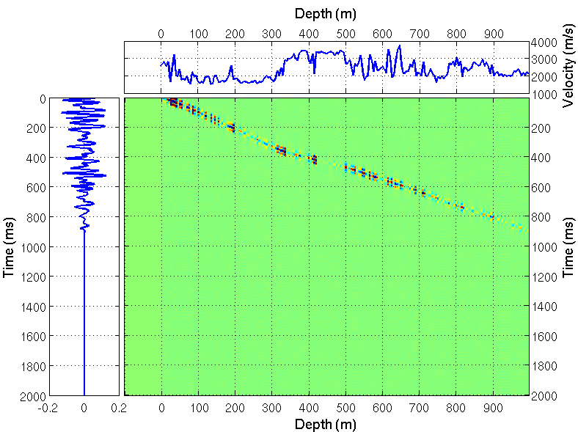
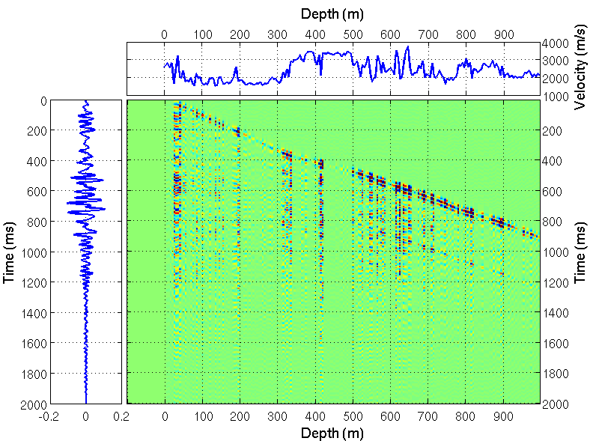
Contributions of a reflector
(a) Reflector spectrum for primaries only
(b) Reflector spectrum for internal
multiples only

Slide 34
Contributions of a reflector
(a) Primaries
(b) Internal multiples

Slide 35
Contributions to an arrival
(a) Reflector spectrum for primaries only
(b) Reflector spectrum for internal
multiples only

Slide 36
Contributions to an arrival
(a) Primaries
(b) Internal multiples

Slide 37
Shallow-reflector spectrum
Shallow-reflector spectrum: each multiple is only related to the shallowest corresponding reflector.
Free surface
①
Surface-related multiple
② Internal multiple
②

Slide 38
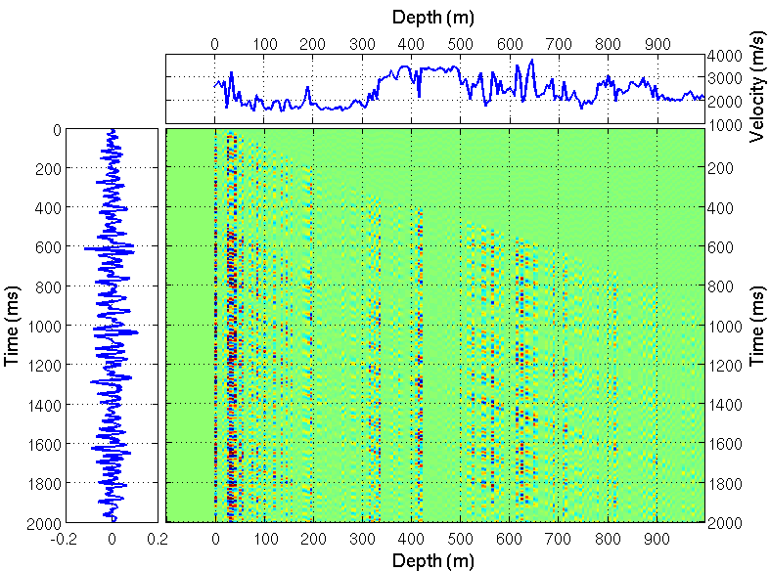
Reflector spectrum for surface-related multiples only

Slide 39
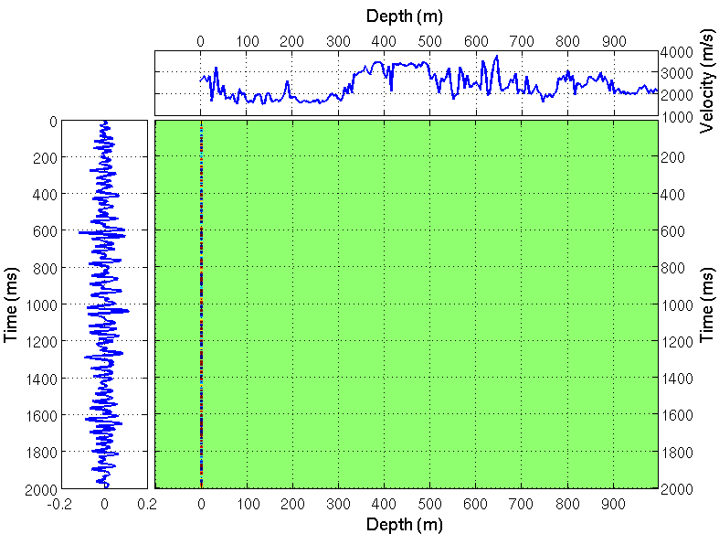
Shallow-reflector spectrum for surface-related multiples only

Slide 40
Reflector spectrum for internal multiples only

Slide 41
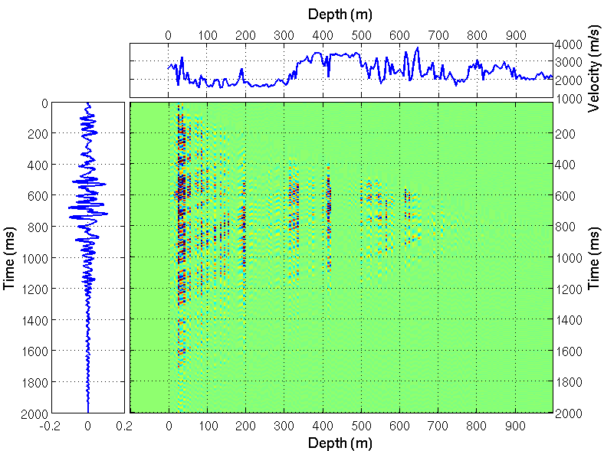
Shallow-reflector spectrum for internal multiples only

Slide 42
Shallow-reflector spectrum for internal multiples only

Slide 43
Summary
New concept of reflector spectrum and shallow-reflector spectrum
Providing insight into fundamental physics
Associating seismic events to geological formations
Indicating the minimum reflectors needed to be removed for reducing multiples
Internal multiples are contributed by many reflectors

Slide 44
ISS for attenuating internal multiples
generated by effective and actual primaries:
theory and well-log based tests
Hong Liang
M-OSRP Annual Meeting
May 30, 2012
Notes:
44
44

Slide 45
How to predict internal multiples?
Velocity function
Synthetic trace
(P + IM)

Slide 46
Forward modeling
$$Z_{1}$$
Internal multiples having their shallowest reflections at Z₁

Slide 47
Forward modeling
$$Z_{2}$$
Internal multiples having their shallowest reflections at Z₂

Slide 48
The ISS internal multiple algorithm (1)
$$S$$
$$D$$
$$E$$
$$R$$
$$B$$
$$A$$
$$C$$
$$T_{SABCR}=T_{SABE}+T_{DBCR}−T_{DBE}$$
ensures
and
(Araújo et al., 1994 and Weglein et al., 1997)

Slide 49
The ISS internal multiple algorithm (2)
The ISS internal multiple attenuation algorithm
is fully data-driven.
does not require any information about the reflectors that generate internal multiples or the medium where the multiples propagate.
can predict internal multiples for all horizons at once.

Slide 50
Velocity model

Slide 51
Forward modeling .vs. ISS prediction
ISS prediction with primary-only trace input
Forward modeling

Slide 52
Very-short-delay multiples
$$M_{1}$$
$$M_{2}$$
$$M_{3}$$
$$P$$
The very-short-delay multiples are indistinguishable from the primary reflections and should be included in the primary reflections in the theoretical seismogram calculation (O’ Doherty and Anstey, 1971; Trorey, 1962).

Slide 53
Forward modeling with
M.S.

Slide 54
P .vs. Very-short-delay 1st-order IM

Slide 55
P .vs. P + very-short-delay 1st-order IM

Slide 56
Forward modeling with .vs ISS prediction
ISS first-order internal multiple prediction (primary-only input)
Forward modeling of first-order internal multiples with

Slide 57
ISS prediction with full trace input
ISS prediction with full trace input
Forward modeling of all internal multiples with

Slide 58
Summary
In a thin layer model, the very-short-delay multiple reflections cannot be distinguished from primary reflections, and should be considered as part of “effective primaries”.
Taking the “effective primaries” as wanted signal, the rest distinguishable internal multiples can be predicted by the ISS internal multiple algorithm.

Slide 59
Outline
Model type dependency for ISS depth imaging and parameter estimation | The impact of matching and mismatching between the earth model type and the processing model type for ISS imaging and parameter estimation. Discussion of the impact of shear waves on the model type assumption for ISS imaging.
Effectiveness of ISS internal multiple method | Modeling subresolution internal multiples as a step towards introducing effective primaries. ISS for attenuating internal multiples generated by effective and actual primaries.
Inclusiveness of ISS internal multiple method | A general modification of the leading-order ISS attenuator of first-order internal multiples to accommodate primaries and internal multiples. Source wavelet effects on the ISS internal multiple leading-order attenuation algorithm and its higher-order modification.

Slide 60
A general modification of the leading-order ISS attenuator of first-order internal multiples to accommodate primaries and internal multiples when an arbitrary number of reflectors generate the data: theory, development, and examples with analytic and synthetic data
Hong Liang
M-OSRP Annual Meeting
May 31 , 2012
Notes:
60
60

Slide 61
Summary
The leading-order attenuator is the leading-order term of the subseries that removes the first-order internal multiple.
The first-order internal multiples can be predicted from primaries in the data.
The entire data consisting of primaries and internal multiples enter the algorithm.
Adding the further terms to the current leading-order attenuator provides a modified ISS internal multiple algorithm.
The modification retains the strength of the original algorithm.
It can accommodate both primaries and internal multiples in the input data.

Slide 62
Source wavelet effects on the ISS internal multiple leading-order attenuation algorithm and its higher-order modification that accommodate issues that arise when treating internal multiples as subevents
Hong Liang
M-OSRP Annual Meeting
May 1st ~ May 2nd , 2013
Notes:
62
62

Slide 63
Summary
Source wavelet can affect the amplitude and shape of
internal multiple and spurious event prediction.
By including the source wavelet deconvolution, the
amplitude and shape of the prediction can be improved.
The accuracy of source wavelet is important, and it could be
estimated using Green’s theorem method.

Slide 64
Outline
Model type dependency for ISS depth imaging and parameter estimation | The impact of matching and mismatching between the earth model type and the processing model type for ISS imaging and parameter estimation. Discussion of the impact of shear waves on the model type assumption for ISS imaging.
Effectiveness of ISS internal multiple method | Modeling subresolution internal multiples as a step towards introducing effective primaries. ISS for attenuating internal multiples generated by effective and actual primaries.
Inclusiveness of ISS internal multiple method | A general modification of the leading-order ISS attenuator of first-order internal multiples to accommodate primaries and internal multiples. Source wavelet effects on the ISS internal multiple leading-order attenuation algorithm and its higher-order modification.

Slide 65
Acknowledgement
M-OSRP sponsors for support of research
Internships at Schlumberger/WesternGeco (Summer 2011
and Fall 2012), Saudi Aramco (Spring 2012), and Total
(Summer 2012)
Dr. Arthur Weglein and all M-OSRP colleagues

