Slide 1


Identification of an elimination subseries for the surgical removal of first-order internal multiples with downward reflection at the shallowest interface
Wilberth Herrera
San Antonio, Texas
May 2, 2013
Notes:
1
1

Slide 2
Key points in this presentation
A subseries of the ISS is identified, whose specific task is to eliminate internal multiples of first-order, with downward reflection at the shallowest reflector.
2. This method is capable of surgical removal of the
corresponding internal multiples.
The algorithm presented here can provide added value in complex geological configurations, where the attenuation of internal multiples is not enough, and current methods such as the energy-minimization adaptive subtraction fail.

Slide 3
OUTLINE
Introduction
Why and when do we need to eliminate internal multiples?
3. The Leading Order Attenuator: A three-interface
example.
4. The Internal Multiple Elimination Subseries.
5. Comments and conclusions.

Slide 4
Earlier work in processing of Internal multiples
using the ISS
Using the ISS and the concept of specific-task subseries, a multidimensional and direct algorithm was derived in Araujo (1994), Araujo et al. (1994) and Weglein et al. (1997), to predict and attenuate internal multiples present in the data.
However, there are situations in which the attenuation of internal multiples is not enough for a correct interpretation of the seismic data, and elimination of internal multiples becomes necessary.

Slide 5
Contribution of this work
In this work a subseries of the Inverse Scattering Series (ISS) is identified, to eliminate internal multiples of first-order, with downward reflection at the shallowest reflector. We also apply this subseries to surgically remove the internal multiple, when it is interfering with a primary.

Slide 6
OUTLINE
Introduction
Why and when do we need to eliminate internal multiples?
3. The Leading Order Attenuator: A three-interface
example.
4. The Internal Multiple Elimination Subseries.
5. Comments and conclusions.

Slide 7
Definition of an internal multiple and its order
An internal multiple is a seismic event with at least one downward reflection, and with all of the downward reflections created below the air/water interface. The order of the internal multiple is the number of downward reflections anywhere in the earth.
Air/water interface
Internal multiple of 1st. order

Slide 8
Internal multiple interfering with a primary
A situation in which the Energy-minimization adaptive subtraction is not useful anymore
Attenuation of the IM amplitude might not be enough:
Amplitude attenuation
P + IM
P + IM’
P
IM
Internal multiple interfering destructively with a primary

Slide 9
What if we have a method for surgical removal
of Internal Multiples?
P
IM
P + IM
P
IM
IM
P

Slide 10
Previous work on removal of internal multiples
Early ideas to move from attenuation towards elimination of 1st. Order IM were discussed in Ramírez, Weglein (2007).
Internal multiple of
1st. order

Slide 11
Main point addressed in this work:
Elimination subseries of 1st. Order IM (with downward reflection at the shallowest interface).
A different approach will be presented by Zou, which can help to understand and identify subseries for the elimination of any internal multiple of first-order.

Slide 12
OUTLINE
Introduction
Why and when do we need to eliminate internal multiples?
3. The Leading Order Attenuator: A three-interface
example.
4. The Internal Multiple Elimination Subseries.
5. Comments and conclusions.

Slide 13
Some features of the leading-order attenuator:
It is completely data-driven.
Predicts the exact time of all first order internal multiples.
Predicts an approximate and well understood amplitude for all first-order internal multiples.
It also predicts the exact time and an approximate and well understood amplitude for internal multiples with converted waves.

Slide 14







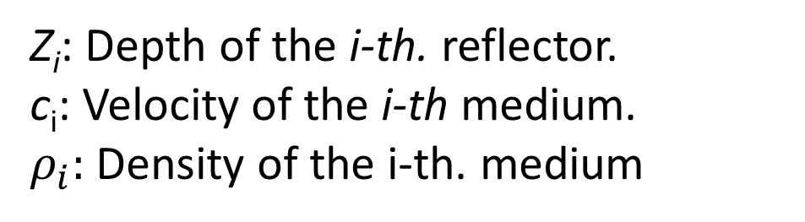
The model
$$c_{0}, { ρ}_{0}$$
$$Z_{1}$$
Water bottom
$$c_{1},{ ρ}_{1}$$
$$Z_{2}$$
Top salt
$$c_{2},{ ρ}_{2}$$
$$Z_{3}$$
Target
$$c_{3},{ ρ}_{3}$$
Z_{i}: Depth of the i-th. reflector.
c_{i}: Velocity of the i-th medium.
$ρ_{i}:$ Density of the i-th. medium

Slide 15
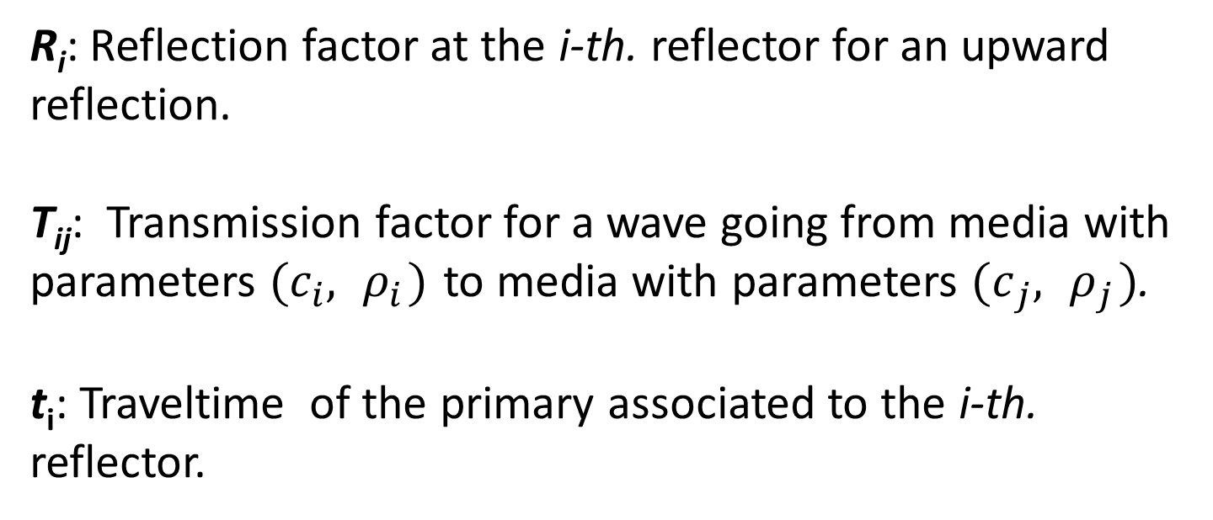


The data of the model
Data: Primaries and internal multiples created by spike
waves at normal incidence.
$$D\left(t\right)=R_{1}δ\left(t−t_{1}\right)+ T_{01}R_{2}T_{10}δ\left(t−t_{2}\right)+T_{01}T_{12}R_{3}T_{21}T_{10}δ\left(t−t_{3}\right)+IM$$
$$R_{2}^{′}$$
$$R_{3}^{′}$$
R_{i}: Reflection factor at the i-th. reflector for an upward reflection.
T_{ij}: Transmission factor for a wave going from media with parameters ${(c}_{i}, { ρ}_{i})$ to media with parameters ${(c}_{j}, { ρ}_{j})$.
t_{i}: Traveltime of the primary associated to the i-th. reflector.

Slide 16













$$c_{0}, { ρ}_{0}$$
$$T_{01}$$
$$R_{1}$$
$$Z_{1}$$
Water bottom
$$T_{10}$$
$$c_{1},{ ρ}_{1}$$
$$T_{12}$$
$$R_{2}$$
Top salt
$$Z_{2}$$
$$T_{21}$$
$$c_{2},{ ρ}_{2}$$
$$R_{3}$$
$$Z_{3}$$
Target
$$c_{3},{ ρ}_{3}$$

Slide 17

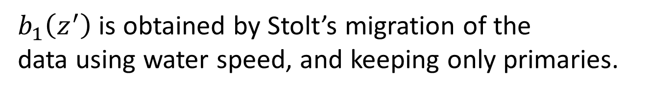

The analytic expression of the attenuator
The analytic expression of the leading-order attenuator
for the 1D case with normal incidence is:
$b_{1}\left(z^{′}\right)$ is obtained by Stolt’s migration of the
data using water speed, and keeping only primaries.
Internal multiple of 1st. order
$$V_{1}G_{0}V_{1}G_{0}V_{1}$$

Slide 18





Preparing the input data for the attenuator

Slide 19
The prediction of the attenuator

Slide 20

The prediction of the attenuator in the time domain

Slide 21
Why does the leading-order attenuator is
actually an attenuator of internal multiples?
$$b_{1}\left(z\right)+attenuator=primaries+\left[1−T_{01}T_{10}\right]{\left(IM\right)}_{j=1}+⋯$$
Attenuation Factor

Slide 22
OUTLINE
Introduction
Why and when do we need to eliminate internal multiples?
3. The Leading Order Attenuator: A three-interface
example.
4. The Internal Multiple Elimination Subseries.
5. Comments and conclusions.

Slide 23
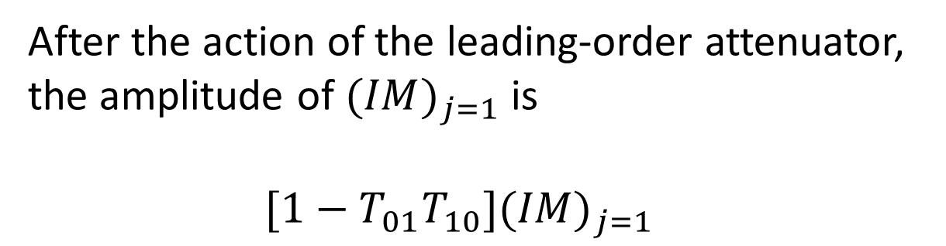
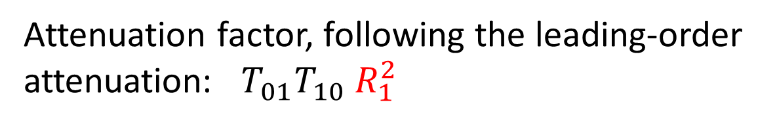
The physics behind the elimination
After the action of the leading-order attenuator,
the amplitude of ${(IM)}_{j=1}$ is
$[1−T_{01}T_{10}]{(IM)}_{j=1}$
Is it possible to take this attenuation to a total elimination?
Attenuation factor, following the leading-order
attenuation: $T_{01}T_{10} R_{1}^{2}$

Slide 24












Localization within the ISS of the attenuation
$T_{01}T_{10}R_{1}^{2}$
$$V_{1}G_{0}V_{1}G_{0}V_{1}$$
$$V_{1}G_{0}V_{3}G_{0}V_{1}$$
$$R_{1}$$
$${(R_{1})}^{3}$$
$$R_{2}$$
$$R_{2}$$
$$R_{3}$$
$$R_{3}$$
$$b_{3}(z)$$
$$R_{1}^{2}b_{3}(z)$$

Slide 25

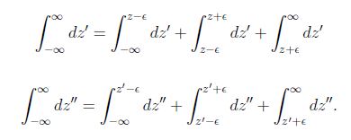




Extraction of the interactions
$$V_{1}G_{0}V_{1}G_{0}V_{1}$$
$$z^{′′}=z^{′}=z$$
$$ε$$
$$ε$$

Slide 26

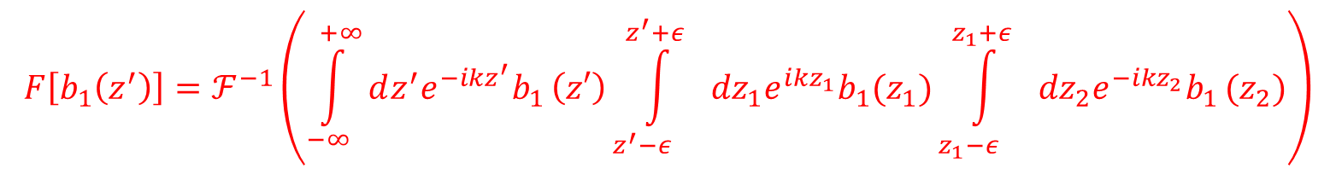



The term containing the interactions
$$z=z^{′}$$
$$z^{′′}=z^{′}$$
$$z^{′′}=z^{′}=z$$
$${F\left[b_{1}\left(z^{′}\right)\right]=ℱ}^{−1}\left(\int_{−∞}^{+∞}{dz^{′}e^{−ikz^{′}}b_{1}}\left(z′\right)\int_{z^{′}−ε^{}}^{z^{′}+ε^{}}{{dz}_{1}e^{ikz_{1}}b_{1}(z_{1})\int_{z_{1}−ε^{}}^{z_{1}+ε^{}}{{dz}_{2}e^{−ikz_{2}}b_{1}}(z_{2})}\right)$$

Slide 27
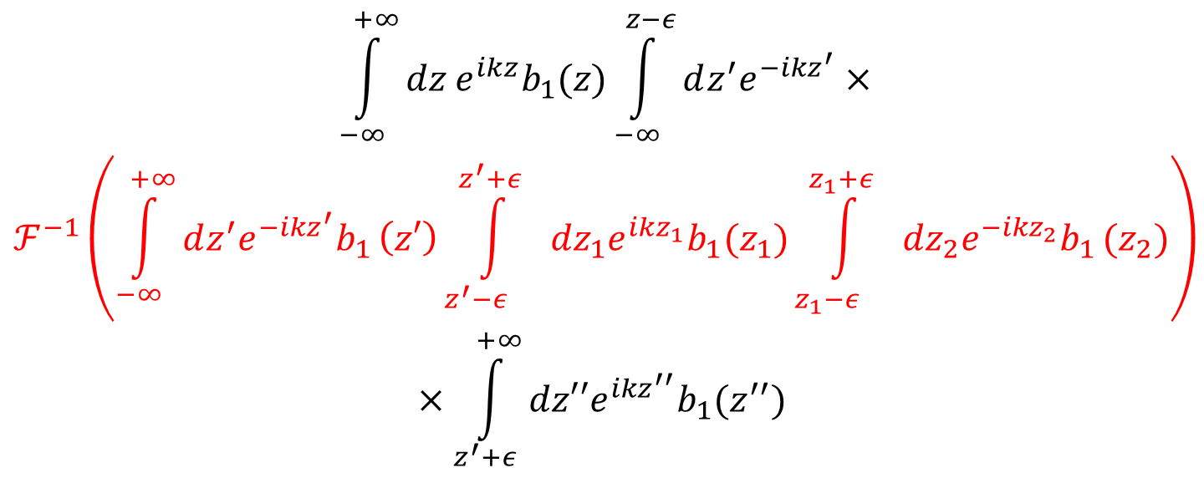
The second term in the eliminator subseries
$${\begin{aligned}\int_{−∞}^{+∞}{dz e^{ikz}b_{1}(z)}\int_{−∞}^{z−ε}{dz^{′}e^{−ikz^{′}}×} \\ ℱ^{−1}\left(\int_{−∞}^{+∞}{dz^{′}e^{−ikz^{′}}b_{1}}\left(z′\right)\int_{z^{′}−ε^{}}^{z^{′}+ε^{}}{{dz}_{1}e^{ikz_{1}}b_{1}(z_{1})\int_{z_{1}−ε^{}}^{z_{1}+ε^{}}{{dz}_{2}e^{−ikz_{2}}b_{1}}(z_{2})}\right)\end{aligned}}_{}$$
$$×\int_{z^{′}+ε}^{+∞}{dz′′e^{ikz^{′′}}b_{1}(z^{′′})}$$

Slide 28
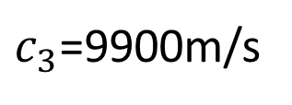
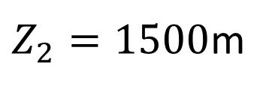
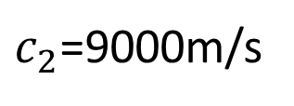
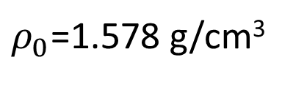
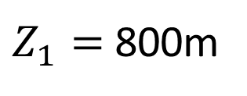
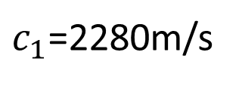
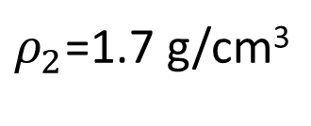
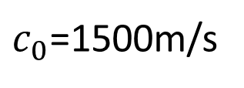
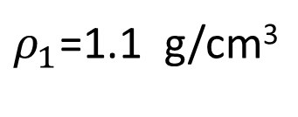
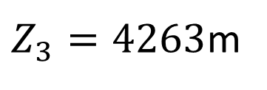
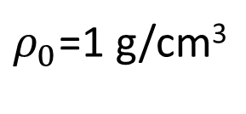
A particular three-interface model
$c_{0}$=1500m/s
$ρ_{0}$=1 g/cm³
$Z_{1}=$ 800m
Water bottom
$c_{1}$=2280m/s
$ρ_{1}$=1.1 g/cm³
$Z_{2}=1500$m
Top salt
$c_{2}$=9000m/s
$ρ_{2}$=1.7 g/cm³
$Z_{3}=4263$m
Target
$c_{3}$=9900m/s
$ρ_{0}$=1.578 g/cm³

Slide 29
Primaries of the model
Data (including only primaries)
P₁
P₂
Zoom of P₃
P₃
P_{i} : Primary with reflection at reflector with depth $Z_{i.}$

Slide 30
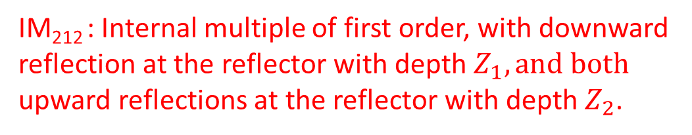
DATA
P₁
P₂
P₃ + IM₂₁₂
IM₂₁₂ : Internal multiple of first order, with downward
reflection at the reflector with depth $Z_{1}, and both$
upward reflections at the reflector with depth $Z_{2}$.

Slide 31
Effect of the leading-order attenuator
Data (after attenuation)
P₁
P₂
Zoom
Zoom of the interfering event

Slide 32
Data after attenuation and the second term
in the elimination subseries
Data (after the first two terms of the elimination subseries)
P₁
P₂
P₃

Slide 33
Data
Leading-order
attenuator
Adaptive subtraction

Slide 34
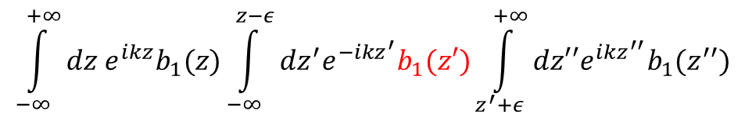

Some words regarding the computational cost
Leading-order attenuator
$$\int_{−∞}^{+∞}{dz e^{ikz}b_{1}(z)}\int_{−∞}^{z−ε}{dz^{′}e^{−ikz^{′}}b_{1}(z′)\int_{z^{′}+ε}^{+∞}{dz′′e^{ikz^{′′}}b_{1}(z^{′′})}}$$
2nd. Term of the elimination
subseries
$${\begin{aligned}\int_{−∞}^{+∞}{dz e^{ikz}b_{1}(z)}\int_{−∞}^{z−ε}{dz^{′}e^{−ikz^{′}}×} \\ ℱ^{−1}\left(\int_{−∞}^{+∞}{dz^{′}e^{−ikz^{′}}b_{1}}\left(z′\right)\int_{z^{′}−ε^{}}^{z^{′}+ε^{}}{{dz}_{1}e^{ikz_{1}}b_{1}(z_{1})\int_{z_{1}−ε^{}}^{z_{1}+ε^{}}{{dz}_{2}e^{−ikz_{2}}b_{1}}(z_{2})}\right)\end{aligned}}_{}$$
$$×\int_{z^{′}+ε}^{+∞}{dz′′e^{ikz^{′′}}b_{1}(z^{′′})}$$

Slide 35
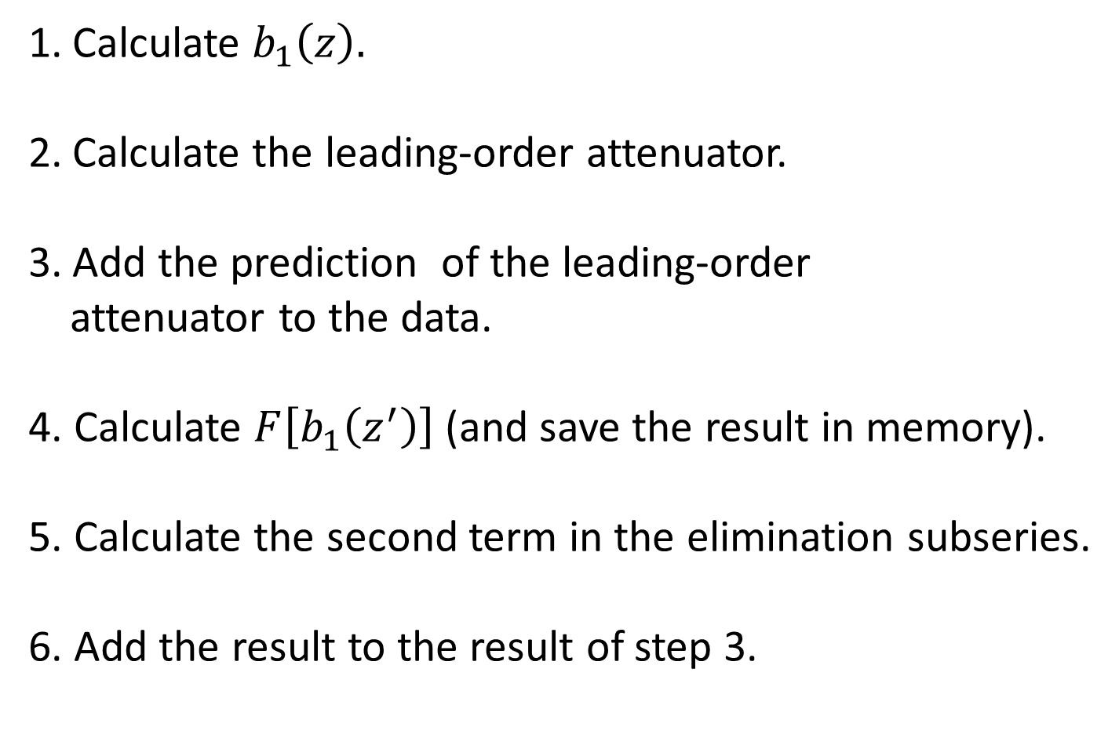
General steps for the implementation
of the algorithm
Calculate $b_{1}\left(z\right).$
Calculate the leading-order attenuator.
Add the prediction of the leading-order
attenuator to the data.
4. Calculate $F\left[b_{1}\left(z^{′}\right)\right]$(and save the result in memory).
5. Calculate the second term in the elimination subseries.
6. Add the result to the result of step 3.

Slide 36
Key points in this presentation
A subseries of the ISS is identified, whose specific task is to eliminate internal multiples of first-order, with downward reflection at the shallowest reflector.
2. This method is capable of surgical removal of the
corresponding internal multiples.
The algorithm presented here could provide added value in complex geological configurations, where the attenuation of the internal multiple is not enough, and current methods such as the energy-minimization adaptive subtraction fail.

Slide 37
OUTLINE
Introduction
Why and when do we need to eliminate internal multiples?
3. The Leading Order Attenuator: A three-interface
example.
4. The Internal Multiple Elimination Subseries.
5. Comments and conclusions.

Slide 38
We have proposed an algorithm whose objective is to eliminate first-order internal multiples, with downward reflection at the shallowest interface.
We have also presented, using an analytic model, how this method is capable of surgical removal of internal multiples.
The analysis in this work can also be applied to remove, rather than to attenuate, the spurious event identified by Y. Luo and studied by Chao Ma and Hong Liang.

Slide 39
Future work...
To derive the multidimensional version of the
algorithm presented in this work.
To test the algorithm with synthetic and field data.
To deliver a code in six months.

Slide 40

Further work is necessary in order to isolate subseries to eliminate first-order internal multiples, with downward reflection at deeper interfaces. This is in close connection with the next talk (Zou).

