Slide 1
Green’s theorem preprocessing and multiple attenuation;
Acquisition configuration impact and determining
the reference velocity for on shore application
Lin Tang
San Antonio, TX
May 1st, 2013

Slide 2
Key points
Presenting two factors of acquisition design that will affect the wave separation result based on Green’s theorem: (1)the depth difference between the over/under cable, (2) the depth difference between the cable chosen as the measurement surface and the predicted cable.
Presenting a criteria for determining the reference velocity on land —the property of invariance of predicting source wavelet for a point source.

Slide 3
Outline
Motivation
Introduction of Green’s theorem in preprocessing
Factors
The depth difference between the over/under cable
The depth difference between the measurement surface and the predicted cable Δz
Reference velocity
Conclusions

Slide 4
Motivation
Data
Reference wave removal
Wavelet estimation
Ghosts removal
Preprocessing
Multiple removal
air
Imaging
water
Earth
Notes:
The reference wave is actually the direct arrival from the source to the receiver, plus the wave which comes from the source, making a downward reflection at the free surface and then goes to the receiver.

Slide 5
Motivation
Data
Reference wave removal
Wavelet estimation
Ghosts removal
Preprocessing
Multiple removal
Imaging
Earth
Notes:
The thing we call a wavelet here is the factor that separates P0 vs. G0, and hence includes instrument response that we call the acquisition wavelet.

Slide 6
Motivation
Data
Reference wave removal
Wavelet estimation
Ghosts removal
Preprocessing
Multiple removal
Imaging
Earth

Slide 7
Motivation
Data
Reference wave removal
Wavelet estimation
Ghosts removal
Preprocessing
Multiple removal
Green’s theorem
Imaging

Slide 8
Outline
Motivation
Introduction of Green’s theorem in preprocessing
Factors
The depth difference between the two cables
The depth difference between the measurement surface and the predicted cable Δz
Reference velocity
Conclusions

Slide 9
Green’s theorem
Depending on how we choose the volume, Green’s theorem can remove reference wave, estimate source signature, or deghost without knowing subsurface information.
It can work in multi-dimensional environment.
Pioneered by Jingfeng Zhang, developed by Jim Mayhan in M-OSRP and published to the sponsors.

Slide 10
Green’s theorem
In marine exploration, for the purpose of separating P₀ and P_{s}, we choose the reference medium as a half-space of water plus a half space of air.
So
air
G₀^{FS}
water
G₀^{d}
Notes:
Scattering theory, reference medium + perturbation, P=P0+Ps…

Slide 11
Green’s theorem
air
water
Measurement surface
V
Earth
S

Slide 12
Green’s theorem
air
water
Measurement surface
V
Earth
S

Slide 13
Green’s theorem
air
water
Measurement surface
V
Earth
S
Notes:
From the above equations, we can see that given the wavefield P and its normal derivative Pn on the measurement surface, we
can easily calculate the reference wave P0 and the scattered wave Ps, depending on the observation point we choose. In
other words, the reference wave and the scattered wave are separated by using Green’s theorem.

Slide 14
Outline
Motivation
Introduction of Green’s theorem in preprocessing
Factors
The depth difference between the over/under cable
The depth difference between the measurement surface and the predicted cable Δz
Reference velocity
Conclusions

Slide 15
FS
5m
Δx=5m
45m
5m
50m
P
1500m/s
300m
2500m/s
400m
3000m/s

Slide 16
FS
5m
Δx=5m
49m
50m
1m
P
1500m/s
300m
2500m/s
400m
3000m/s

Slide 17
FS
5m
20m
P_{s}
Δx=5m
49m
50m
1m
P
80m
P₀
1500m/s
300m
2500m/s
400m
3000m/s

Slide 18
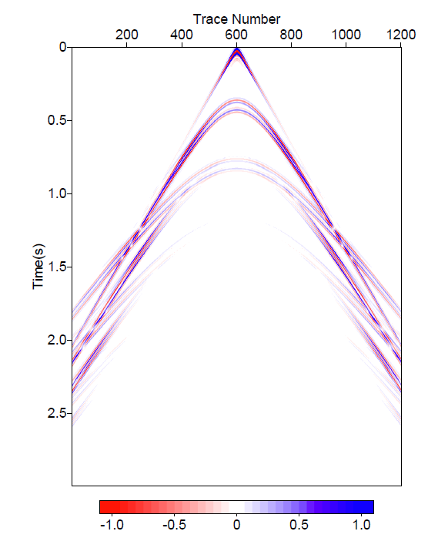
Data modeling
2D source, reflectivity data
Total P at 50m

Slide 19
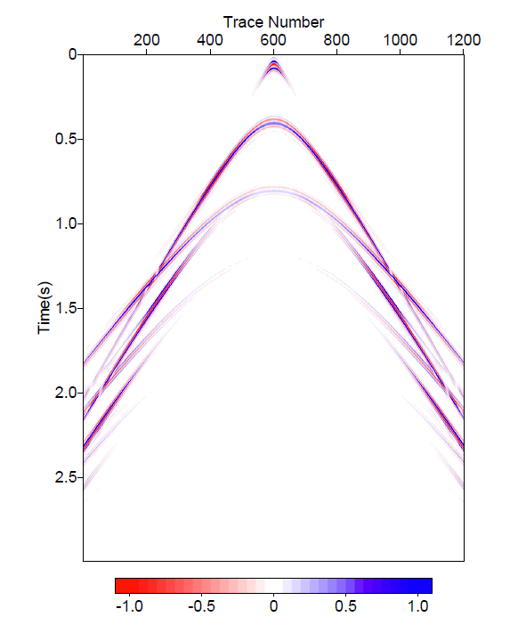
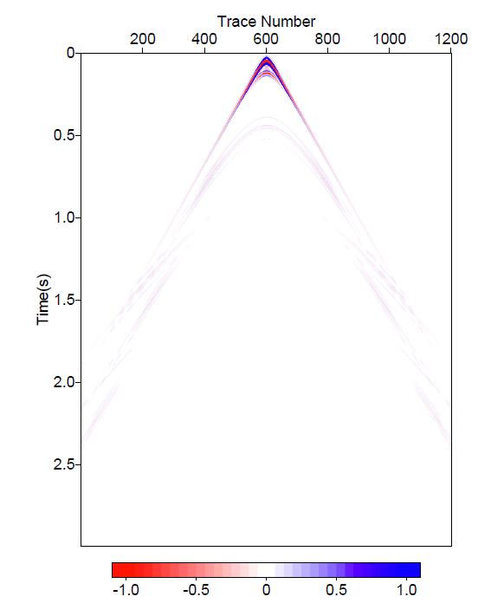
Depth difference= 5m
P_{s} at 20m
P₀ at 80m

Slide 20
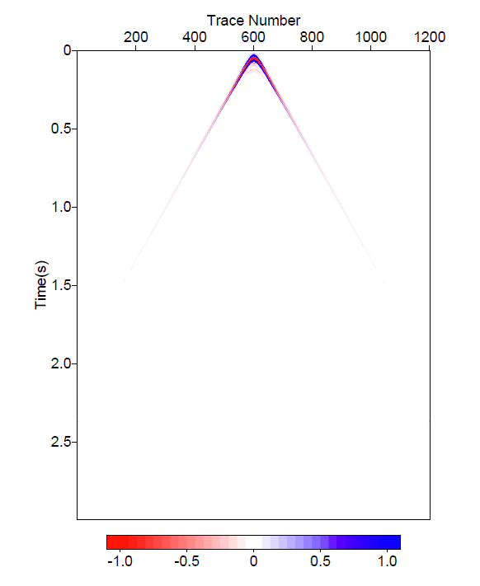
Depth difference= 1m
P_{s} at 20m
P₀ at 80m
Notes:
1m

Slide 21
The depth difference between the two cables
The input of Green’s theorem is the wavefield P as well as its normal derivatives P_{n} at the measurement surface.
When using over/under cable, an easy way to calculate the normal derivatives is using finite difference, i.e. subtracting the data of the upper cable from those of the lower cable and then divided by their depth difference, i.e.

Slide 22
The depth difference between the two cables
As the above equation shows, the normal derivative of P here is at the depth of (z₁+z₂)/2 but rather z₁ or z₂, where wavefield P is measured.
This mismatch of the location may affect the wave separation results.
How to address the mismatch of the locations of P and dP/dz ?

Slide 23
How to address the mismatch of the locations of P and dP/dz ?
if we have 3 cables at different depths with equal depth difference
Then we propose a method to calculate dP/dz at the middle cable
So now we have P(50) and .
45m
5m
50m
P
5m
55m

Slide 24
Using 3 cables
P_{s} at 20m
P₀ at 80m

Slide 25
Using 2 cables (5m)
P_{s} at 20m
P₀ at 80m
Notes:
5m

Slide 26
How to address the mismatch of the locations of P and dP/dz ?
if we have 3 cables at different depths with different depth difference
Then we propose a method to calculate dP/dz at the middle cable (fitting of a parabola)
So now we have and P(50).
43m
7m
50m
P
5m
55m

Slide 27
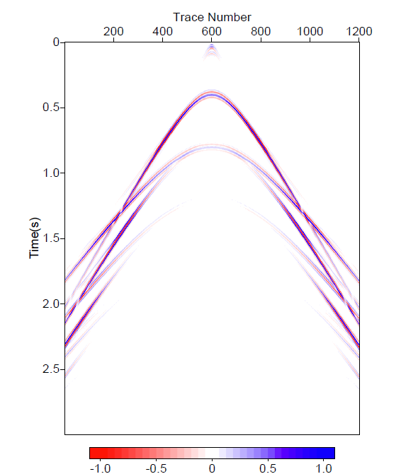
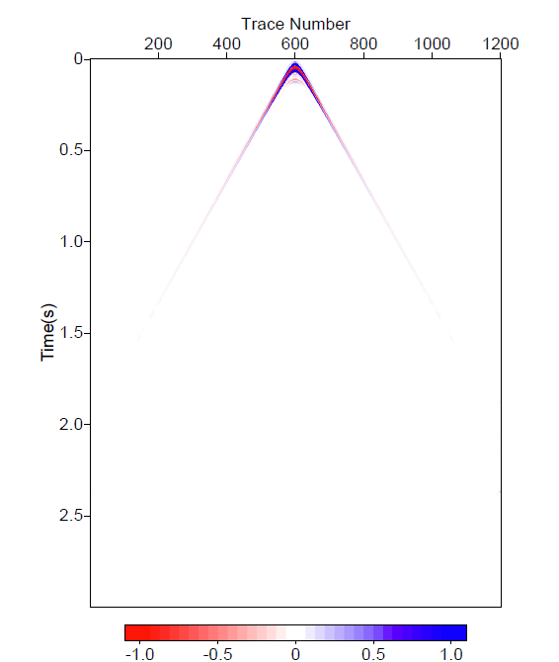
Using 3 cables
P_{s} at 20m
P₀ at 80m

Slide 28
Using 2 cables (5m)
P_{s} at 20m
P₀ at 80m

Slide 29
Outline
Motivation
Introduction of Green’s theorem in preprocessing
Factors
The depth difference between the two cables
The depth difference between the measurement surface and the predicted cable Δz
Reference velocity
Conclusions

Slide 30
FS
5m
P_{s}
49m
Δz
50m
P
Δx=12.5m
1500m/s
300m
2500m/s
400m
3000m/s

Slide 31
FS
5m
P_{s}
Δz
49m
50m
P
Δx=12.5m
1500m/s
300m
2500m/s
400m
3000m/s

Slide 32
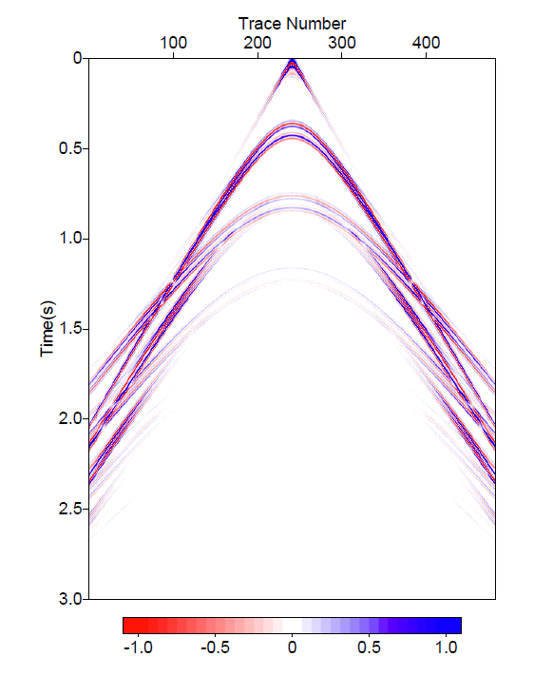
P_{s} at 48.4m
(Δz =1/8Δx)
Notes:
fine

Slide 33
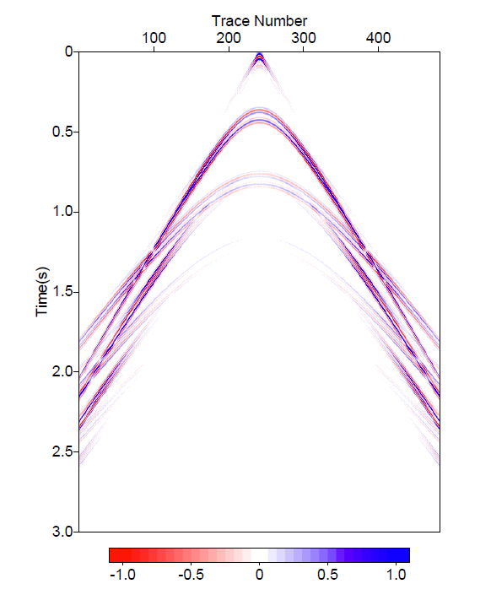
P_{s} at 46.9m
(Δz =1/4Δx)
Notes:
fine

Slide 34
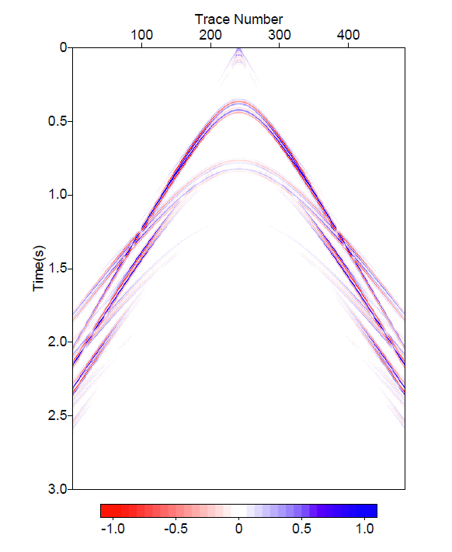
P_{s} at 43.8m
(Δz =1/2Δx)
Notes:
fine

Slide 35
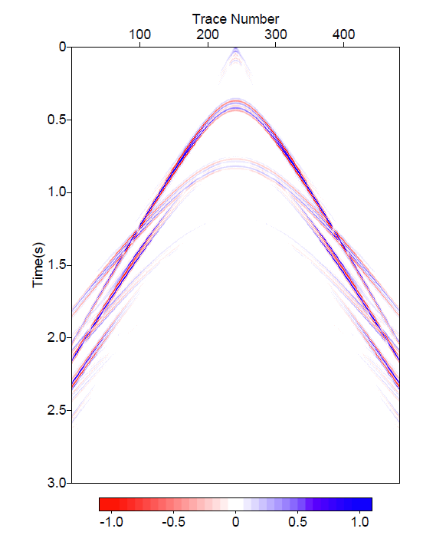
P_{s} at 37.5m
(Δz =Δx)
Notes:
fine

Slide 36
FS
5m
49m
50m
P
Δz
P₀
Δx=12.5m
1500m/s
300m
2500m/s
400m
3000m/s

Slide 37
FS
5m
49m
50m
P
Δz
Δx=12.5m
P₀
1500m/s
300m
2500m/s
400m
3000m/s

Slide 38
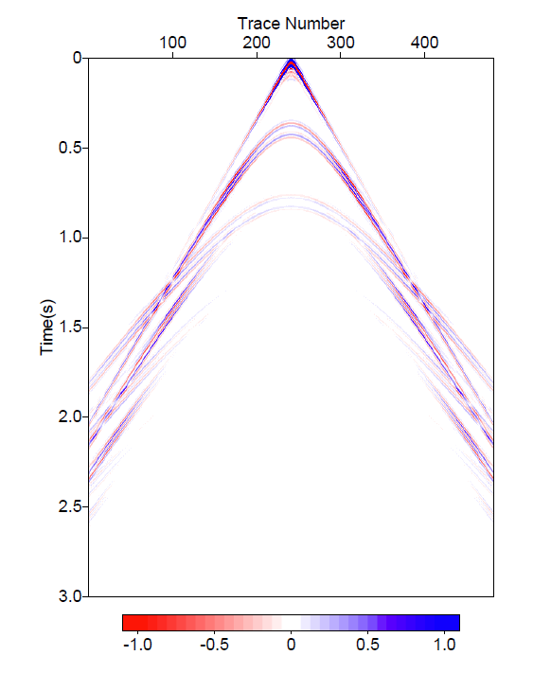
P_{s} at 51.6m
(Δz =1/8Δx)

Slide 39
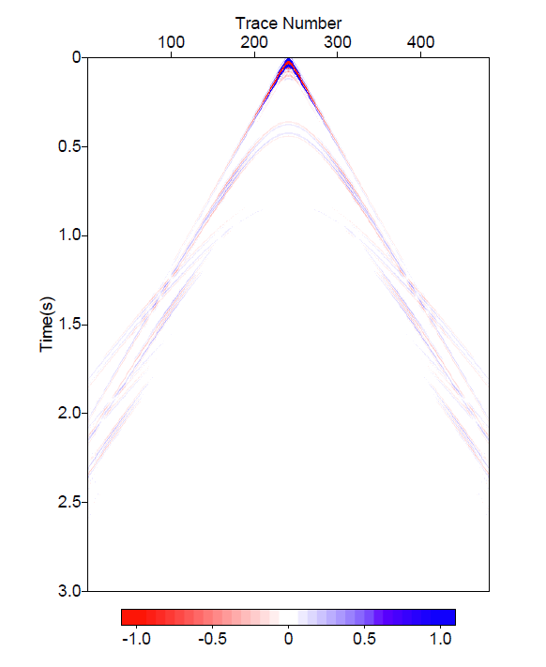
P₀ at 53.1m
(Δz =1/4Δx)

Slide 40
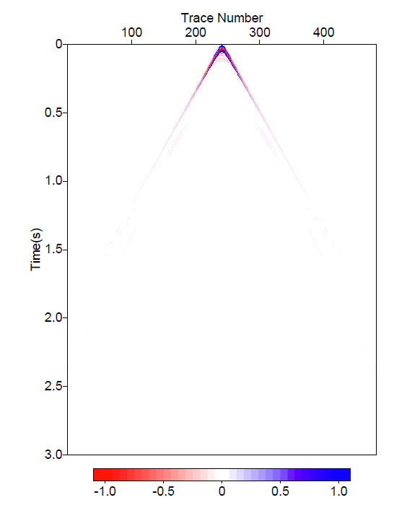
P₀ at 56.3m
(Δz =1/2Δx)
P₀ at 156m
(Δz =1/2Δx=6m)

Slide 41
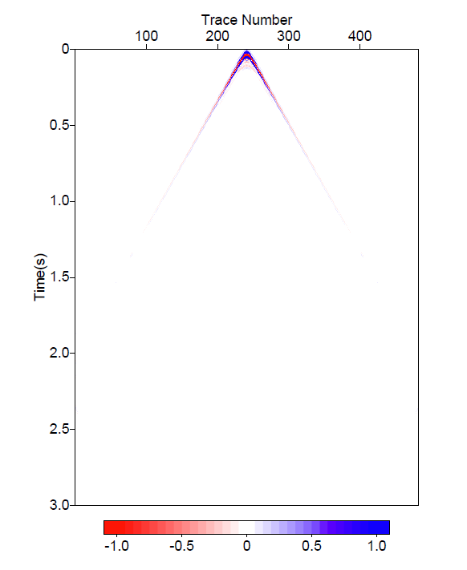
P₀ at 62.5m
(Δz =Δx)
P₀ at 162m
(Δz =Δx=12m)

Slide 42
Factor Δz
Only when the depth difference between the predicted cable and the actual cable Δz is larger than 1/2 of the interval of receivers Δx, the predicted reference or scattered wave has less artifacts.
The condition is empirically observed, with numerical issues lies in the (r, ω) domain of the Green’s function and its normal derivatives.

Slide 43
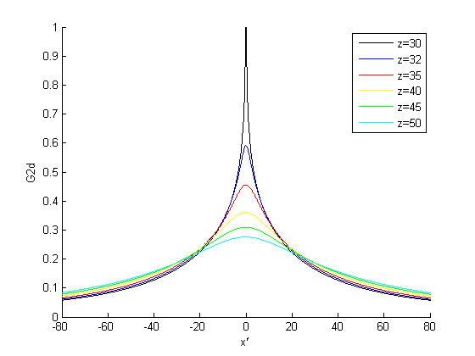
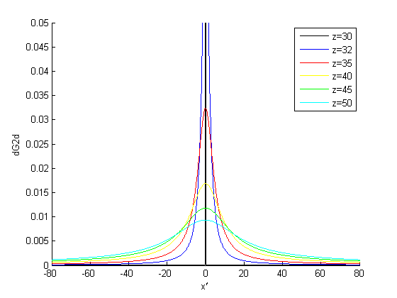
When the depth between the measurement surface and the cable gets closer, dG₀/dz becomes more concentrated at a local point. Unless having a very small sampling interval △x, the value of dG₀/dz cannot be picked up.
Notes:
Here I am plotting the Green’s function and its normal derivatives with respective of x’. Different color corresponds to different distances between the measurement surface and the predicted wave, which is defined as delta z. Notice that the black line means the predicting wave closest to the cable, and cyan one means a larger delta z.

Slide 44
Outline
Motivation
Introduction of Green’s theorem in preprocessing
Factors
The depth difference between the two cables
The depth difference between the measurement surface and the predicted cable Δz
Reference velocity
Conclusions

Slide 45
Wavelet estimation
In marine exploration, for the purpose of source signature estimation, we choose the reference medium as a half-space of water plus a half space of air.
(Weglein & Secrest 1990)
air
G₀^{FS}
water
G₀^{d}

Slide 46
Wavelet estimation
However, on land acquisition, to determine the reference velocity is not as easy as in the marine case.
Can we have a criteria of finding the correct reference velocity?
For a point source, the source wavelet is invariant at different angles.

Slide 47
Wavelet estimation
Modeled using 2D the Cagniard-de Hoop method
Two cables located at 149m and 150m, source at 30m
Reflector at 300m, with c₀=1500, c₁=2500.
Wavelet estimation using Green’s theorem with different reference velocity in G₀
c₀=1500
c₀=1490
c₀=1450

Slide 48
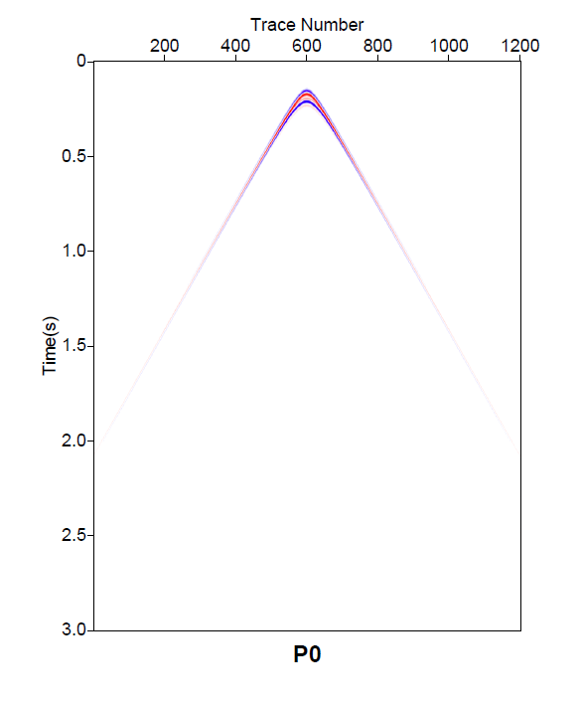
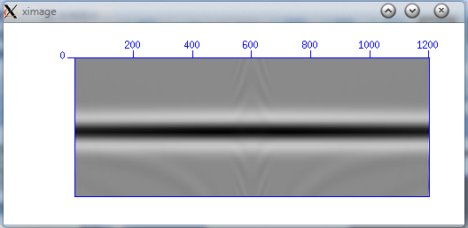
c₀=1500 (correct)
P₀
A(t)
Notes:
Cdh_p0_z162.su

Slide 49
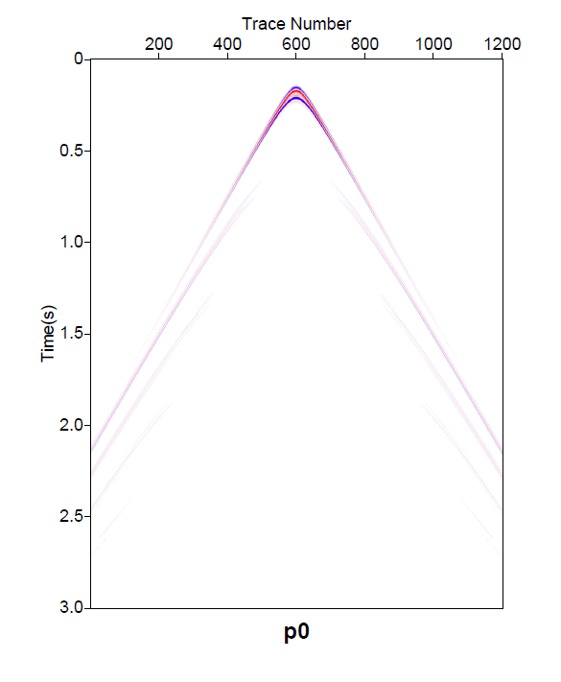
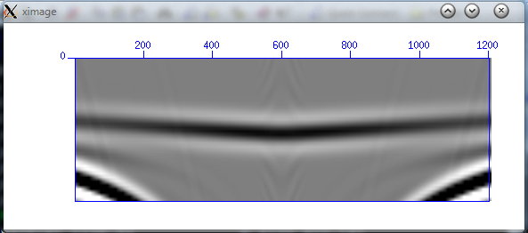
c₀=1490 (wrong)
P₀
A(t)
Notes:
Cdh_p0_z162.su

Slide 50
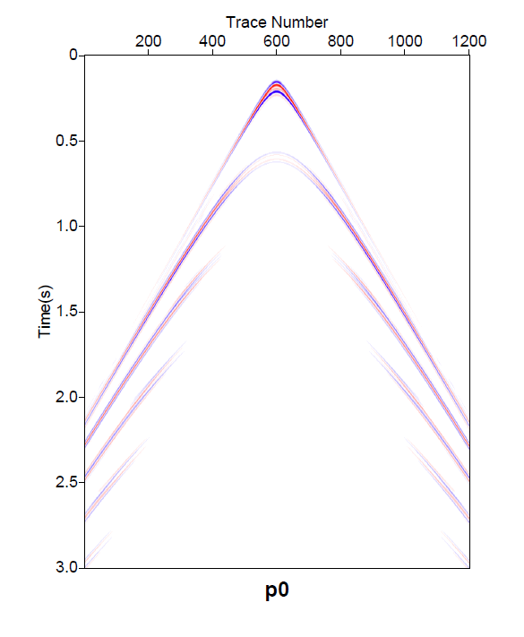
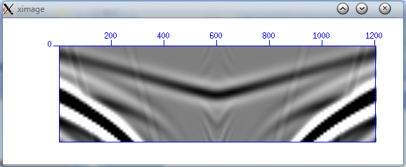
c₀=1450 (wrong)
P₀
A(t)
Notes:
Cdh_p0_z162.su

Slide 51
Wavelet estimation using different reference velocities
Angle invariance →
1450
1490
1500
c

Slide 52
Outline
Motivation
Introduction of Green’s theorem in preprocessing
Factors
The depth difference between the two cables
The depth difference between the measurement surface and the predicted cable Δz
Reference velocity
Conclusions

Slide 53
Conclusions
We studied the impact of several practical acquisition design issues on Green’s theorem derived wave separation methods.
The wave separation results improve when the over/under cables are closer to each other, allowing a more accurate finite difference approximation of dP/dz.
A third cable can help mitigate the finite difference approximation used for dP/dz, resulting in a better wave separation result.

Slide 54
Conclusions
In order to get acceptable wave separation result (e.g., to predict the scattered wave at a point above the cable), the depth difference between the cable and the predicted cable, Δz, is required to be larger than ½ Δx.
The results of wavelet estimation using wrong reference velocities show that the property of invariance of source wavelet can be a criteria of choosing reference velocity. This could be useful for land application to separate the reference wave (including ground roll) from reflection data.

