Slide 1
A first step towards the
P wave only modeling plan
Xinglu Lin
San Antonio, Texas
May 2nd ,2013
Notes:
1
1

Slide 2
Outline
Basic methods of implementation
Initial Numerical Tests
Conclusions and Future works

Slide 3
Outline
Basic methods of implementation
Initial Numerical Tests
Conclusions and Future works

Slide 4
The formalism for modeling P-wave-only-history
The Born series expansion for P-wave field can be obtained (complete form),
where
If the events experienced only P-wave in history are our interest, the formula can be reduced to,
(Weglein, 2012)
Notes:
If we define a new form of the perturbation, responsible for self-coupling and inter-channel coupling of the propagating P-wave, as
The equation on the top is a complete form for all the wave who arrives at receivers as a P-wave, including converted and unconverted wave.
For the specific reason to model the p-wave0-only events, we ignore the contribution from the converted wave perturbation, only keep the vpp left in the equation. So that the formalism for p-only history is obtained.

Slide 5
Basic methods of implementation
Finite Difference modeling:
Based on velocity-stress equations;
Expect an accurate phase and acceptable amplitude on primary wave.
Born series modeling:
Based on Born series
Do not expect an accurate phase and amplitude estimation on Born term. However, a higher-order term modeling has the potential to provide a good wave-theory based result.
Notes:
We inject an analytical field as source. Propagate the anallytical field in a fd numerical scheme,

Slide 6
Finite-difference modeling

Slide 7
Finite Difference Modeling
Velocity-stress equations in 2D isotropic medium:
(Virieux, 1986;
Levander, 1988)
Notes:
The velocity components for the time-differentiated displacements. The equations can be easily solved by finite-difference because the equations are all first-order in their derivatives.

Slide 8
Finite Difference Modeling
Instead of the source, analytical P-only displacement fields are used as sources.
Regular grid; fourth-order accuracy finite-difference; f₀=30Hz.
(F. Liu, 2012)
(Matson, 1997)

Slide 9
Born modeling based on Born series

Slide 10
Born Term Modeling
In this initial step, we only take a look into the first linear Born term in Born series. This kind of approximation assumes that the perturbation of the medium is small and the modeling aperture is small,
where and .

Slide 11
Result of Asymptotic Born Approximation
Step 1:
Step 2: FFT over omega , so that modeling data back to time domain.
(Nita, Matson & Weglein,2004)
Notes:
The r here is the travel length of the wave from source to reflector and from the reflector back to receivers. So that the formalism reduced to ray theory with a asymptotic result.
Assumptions: 1) constant reference medium;
2) horizontal reflectors;
3) 1D properties vary.

Slide 12
Outline
Basic methods of implementation
Initial Numerical Tests
Conclusions and Future works

Slide 13
Elastic model
1000m

Slide 14
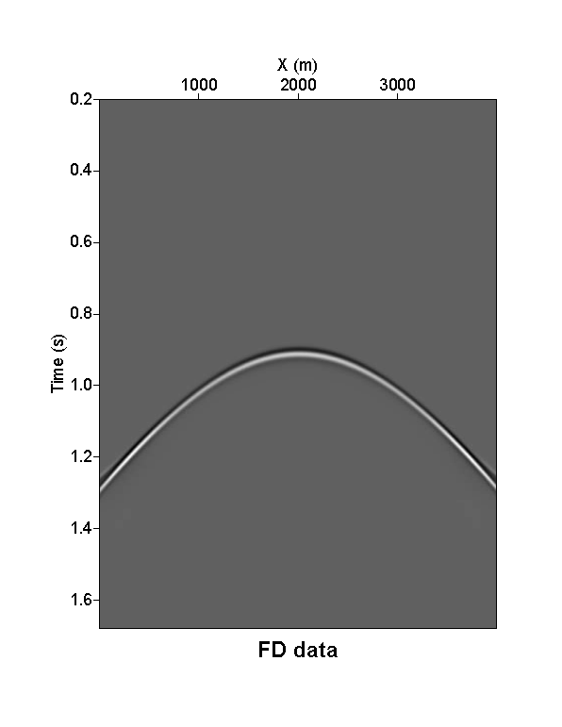
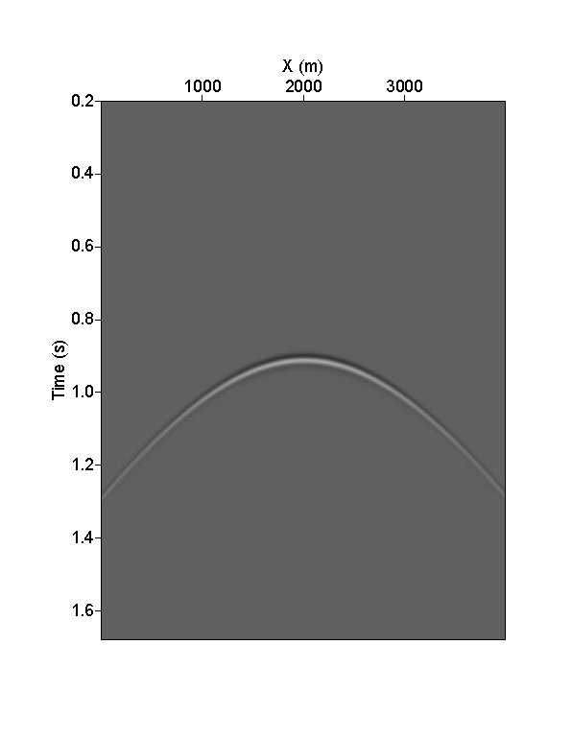
P-only Born Approximation Modeling
Finite-difference
P pressure data
GVppG High-frequency approximation result
Notes:
Set these two results in same color scale

Slide 15
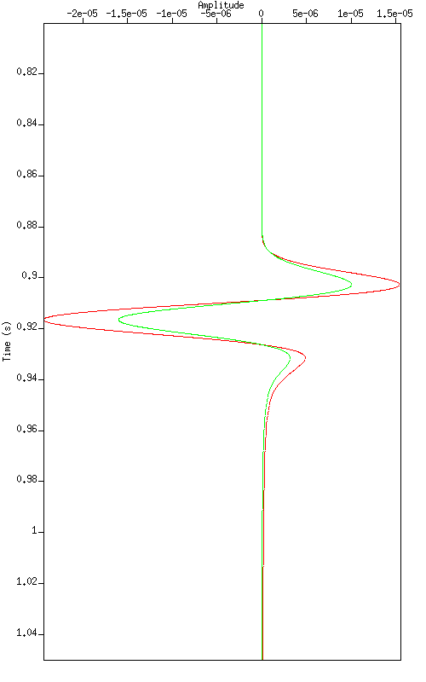
Wiggle Comparison (offset=190m)
Red Line : Finite-difference result
Green Line : Asymptotic Born modeling result

Slide 16
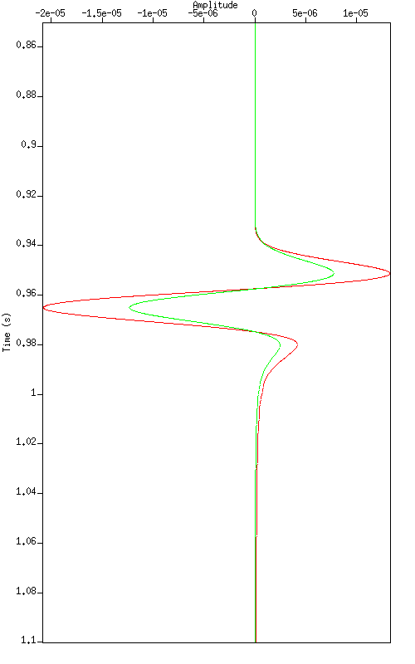
Wiggle Comparison (offset=690m)
Red Line : Finite-difference result
Green Line : Asymptotic Born modeling result

Slide 17
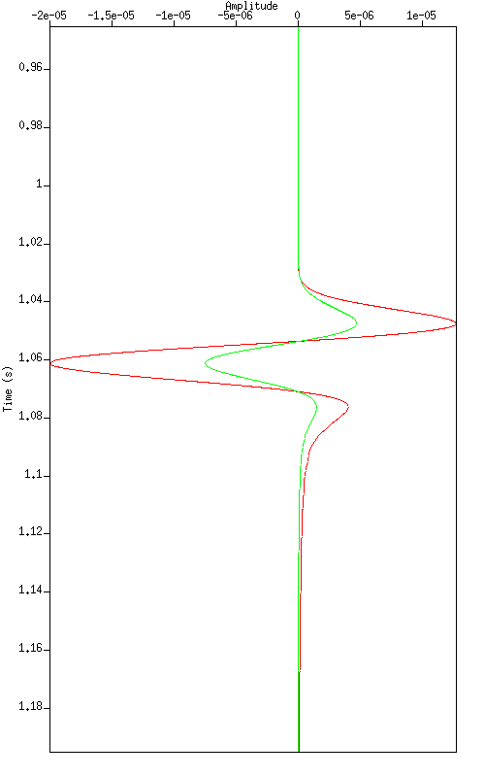
Wiggle Comparison (offset=1190m)
Red Line : Finite-difference result
Green Line : Asymptotic Born modeling result
Notes:
The far offset issue is generated by the limitation of Born approximation

Slide 18
Outline
Basic methods of implementation
Initial Numerical Tests
Conclusions and Future works

Slide 19
Conclusions
This is the first and elementary test comparing a P-only modeling with finite-difference calculation. Plans include P-only modeling for layered elastic media.
Asymptotic Born term modeling can provide a P-wave-only event with accurate phase and approximate amplitude in this initial numerical test.
Notes:
In multi-layer model, we cannot expect accurate phase the second and third primary for Born approximation especiallly using constant velocity model as reference.

Slide 20
Acknowledge

Slide 21
Reference
Clayton, Robert W. and David Brown. The Choice of Variables for elastic wave extrapolation. Technical Report 06, SEP, 1979.
Matson, K. H. An inverse-scattering series method for attenuating elastic multiples from multicomponent land and ocean bottom seismic data. PhD thesis, University of British Columbia, 1997.
Weglein, Arthur B., Shot note: A formalism for (1) modeling the amplitude and phase of pressure waves from a heterogeneous elastic medium and (2) selecting and predicting P-wave events that has only experienced p-wave episodes in their history." Mission-Oriented Seismic Research Program Annual Report (2012): 364-370.
Weglein, Arthur B. and R.H. Stolt. Approaches on linear and non-linear migration-inversion. Personal Communication." (1992).
Zhang, H. Direct non-linear acoustic and elastic inversion: Towards fundamentally new comprehensive and realistic target identification. PhD thesis, University of Houston, 2006.
Forward scattering series and seismic events: far-field approximation, critical and postcritical reflections
, 2004

