Slide 1
Notes:
Good afternoon everyone. My name is Jinlong Yang. I am a fourth year graduate student. I expect to graduate next year.
Thanks for Dr. Weglein’s introduction. Thanks for coming our annual meeting.
Today I will talk about the multiple removal.
My topic is ….

Slide 2
Notes:
The key points in this talk are …

Slide 3
Notes:
Let’s look at the first part.
Here, I will show you how to incorporate the source array into the inverse scattering series free-surface multiple elimination algorithm.
and what is its effect if you include or ignore it for the data that have interfering primaries and multiples.

Slide 4
Notes:
This the outline of my talk. First, Second, Third, finally

Slide 5
Notes:
Let’s look at the first part.
Why do we want to accommodate the source array in the algorithm.

Slide 6
Notes:
From the title, we can see that the data have interfering events.
The ISS method predicts the free-surface multiples accurately. Therefore, the ISS method can remove the free-surface multiples through a simple subtraction.
For example,

Slide 7
Notes:
The second point is that the data we measured are usually source array data, because …
increase the power of the source, broaden the bandwidth, and reduce the random noise
While the current …. So for the point source data, the current FSME algorithm has the ability to accurately predict free-surface multiples. Then we can surgically remove them through a simple subtraction. But for source-array data, it is not sufficient, so to …

Slide 8
Notes:
Next,

Slide 9
Notes:
If we know $P_0^d$ everywhere, Fourier transforming over $x$ and $z$ gives $\rho(k_x,k_z,\omega)$, but we don't know $P_0^d$ in every depth $z$, we can only Fourier transform over $x$ and obtain $\rho(k_x,q,\omega)$, where $k_x^2+q^2=\omega^2/c_0^2$. Hence, only the projection of the source function can be solved and it is sufficient for the ISS FSME algorithm.
How to incorporate the source array rho into FSME algorithm? Comparing with Carvalho’s algorithm, there some added values.

Slide 19
Notes:
Designed for point source. Extended to source array.
The algorithm is fully driven. It only requires the source signature and the deghosted data and doesn’t require any subsurface information.
Here, rho(k,q,w) is the projection of the source signature. The deghosted data can be obtained by Green’s theorem method.
Jingfeng Zhang pioneered this method and Jim Mayhan developed it. The fsm is calculated order by order, then adding them together, we can get the free-surface demultipled data.

Slide 20
Notes:
This the data processing flow from the measured data, first we separate them into reference wave and scattered wave.
Deghosting.
From the reference to direct reference.

Slide 21
Notes:
Here are some comments: Both the current and modified algorithms are …
FSME is fully data driven.

Slide 23
Notes:
This is the list of tests that I am going to do. The check mark means we will removing the FSMs using the corresponding algorithm.

Slide 24
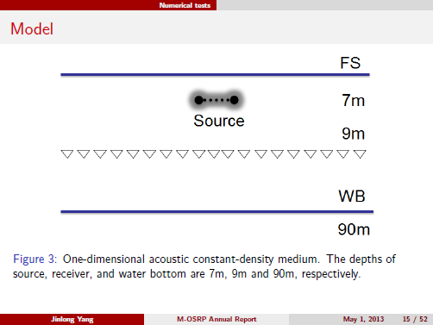
Notes:
1D acoustic model with varying velocity and constant density. It has one shallow reflector at 90m,
so the primary is interfering and overlapping with the free-surface multiples.
The depths of the source and receiver are 7m and 9m, respectively.

Slide 25
Notes:
Using the Cagniard-de Hoop method, we generate the synthetic data for this model by applying two kinds of source separately: one is a point source and the other is a source array. The range of the source array is 24m.
The advantage of the Cagniard-de Hoop method is that we can accurately calculate any specific event we are interested in, so that we can compare it with the results predicted by our ISS FSME algorithm.

Slide 27
Notes:
The first test is
First, we generate the data without ghosts. Only the primary and the first-order free-surface multiple are generated.

Slide 29
Notes:
Since we do not generate ghosts in the data, we do not need to remove them.
The primary and free-surface multiple are overlapping when the offset exceeds approximately 1000m. Furthermore, it can be seen that they are destructively overlapping. The right side is the wiggle plot in the box part.
Therefore, the adaptive subtraction method cannot deal with this kind of situation, because the method is based on the energy-minimization criterion, which assumes that the energy of the data will be minimized after the multiples are removed. However, in this case, the energy increases after removal of the multiples.

Slide 30
Notes:
The inverse scattering series method has the ability to accurately predict free-surface multiples, thus, we apply the current FSME algorithm here to predict free-surface multiples. Then, through a simple subtraction, the free-surface multiples can be removed completely.
For details, picking one trace (offset = 1800m) from each of the two figures and comparing them, we can see that the amplitude of the primary increases after the free-surface multiples are removed.

Slide 31
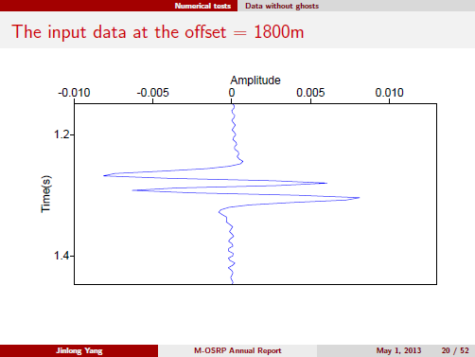
Input
removal
primary
Notes:
This is one trace of the input data at offset 1800m.
we can see that the amplitude of the primary increases after the free-surface multiples are removed.

Slide 32
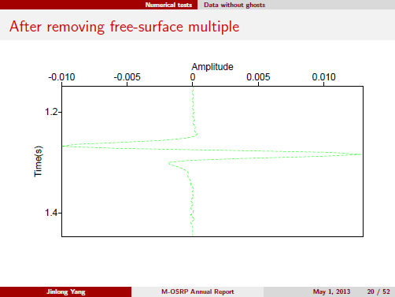
Input
removal
primary
Notes:
After removing the FSM using the current algorithm.
we can see that the amplitude of the primary increases after the free-surface multiples are removed.

Slide 33
Input
removal
primary
Notes:
This is the original primary that we generated using cargniard de hoop method.

Slide 34
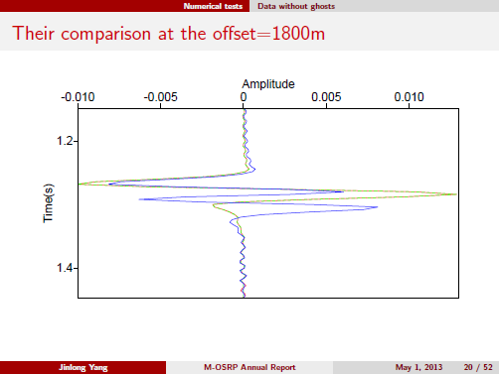
Input
removal
primary
Notes:
We plot them together. 1. after removing the FSM, the primary is boosted. 2. the current works very well for the point source data.
The result matches the primary generated by CdH method.

Slide 35
Notes:
What about the source-array data? We generate the source array data without ghosts, and then removing the FSMs using both algorithms and compare their results.

Slide 37
Notes:
The source-array data are generated by nine point sources. using the Cagniard-de Hoop method, only the primary and the rst-
order free-surface multiple are produced. The primary and multiple are overlapping and interfering destructively.

Slide 38
Notes:
For the source-array data, we first apply the current FSME algorithm to predict the free-surface multiples. It predicts phase accurately but only an approximate amplitude. After removing the free-surface multiple, we can see that most multiples are removed, but there are still some residual multiples.
we can see that the primary is still affected by the residual multiple
If the amplitude is not critical, then this method is sucient.
For cases like AVO analysis and inversion, in which the amplitude is important, such residual multiples could produce serious errors in the prediction.

Slide 39
Notes:
we apply the modied FSME algorithm. It can predict both amplitude and phase very accurately for the source-array data. After a simple subtraction, all the multiples are eliminated completely, the modied FSME algorithm works very well for the source-
array data that have interfering events.
The primary remains untouched as the original primary.

Slide 41
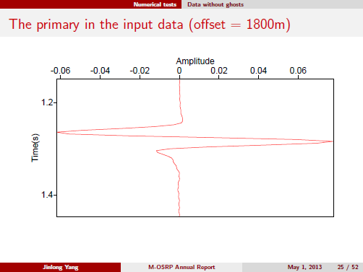
Primary
Modified
Current
Notes:
For detail, we pick one trace (offset = 1800m) from each of these two figures and compare them.
The primary is weaker than that in figure 8(c), and this amplitude error will seriously affect AVO analysis.

Slide 42
Primary
Modified
Current
Notes:
For detail, we pick one trace (offset = 1800m) from each of these two figures and compare them.
The primary is weaker than that in figure 8(c), and this amplitude error will seriously affect AVO analysis.

Slide 43
Primary
Modified
Current
Notes:
For detail, we pick one trace (offset = 1800m) from each of these two figures and compare them.
The primary is weaker than that in figure 8(c), and this amplitude error will seriously affect AVO analysis.

Slide 44
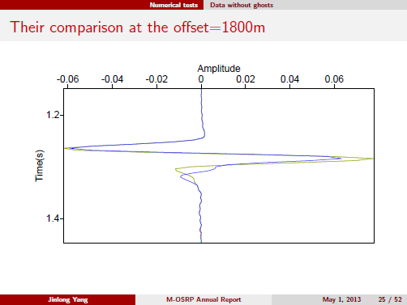
Primary
Modified
Current
Notes:
For detail, we pick one trace (offset = 1800m) from each of these two figures and compare them.
The primary is weaker than that in figure 8(c), and this amplitude error will seriously affect AVO analysis.

Slide 45
Notes:
What will happen, if the input data include ghosts.

Slide 50
Notes:
Jim Mayhan and Jing Wu have talked about the Green’s theorem deghosting method in the morning. Here, I will apply them to my data.

Slide 76
Notes:
These numerical tests for the synthetic data with interfering events have demonstrated the effectiveness and advantages of the ISS method.
The point-source data the current FSME algorithm is sufficient to remove free-surface multiples, while for source-array data the modified FSME algorithm leads to very accurate results.

Slide 78
Notes:
Good afternoon everyone. Thanks for your time to attend my APE talk. In this talk, my goal is to extend our current FSME method from a point source to a source array by incorporating an angle dependent source signature. I will show the modified algorithm and some test examples.

Slide 92
Original
Predicted

Slide 93
Original
Predicted

Slide 97
Notes:
Finally I would like to thank all our sponsors for their support of this research and to Dr. Arthur Weglein for his teaching and guidance.
My colleagues.

