Slide 1
Initial asymptotic acoustic RTM imaging results for a salt model
Xinglu Lin
San Antonio, Texas
May 2nd,2013
Notes:
1
1

Slide 2
Reverse Time Migration (RTM)
Original reverse-time migration (RTM) concept is a velocity model-dependent method which can migrate two-way waves in depth using the reverse-time backward propagated wave-field.
(Baysal, 1983; McMechan, 1983; Whitmore, 1983).
Notes:
However, when lateral velocity varies significantly, Kirchhoff migration based on the high-frequency approximation assumption suffers from difficulties in imaging and severe artifacts.

Slide 3
Reverse-time migration work-flow

Slide 4
Reverse Time Migration (RTM)
The original RTM first propagate the source function based on wave-equation and then store it (P₀(x, z, t)) . From the receiver side, the recorded data is backward propagated producing the scattered/receiver wave-field (P_{s}(x, z, t)). Finally the image is obtained by applying an imaging condition in asymptotic RTM, as for example:
(Claerbout, 1971;
Biondi and Shan,2002;
Kaelin and Guitton, 2006; McMechan, 2008;etc. )
The expression is the source wave-field and
is the receiver wave-field;
represents the cross-correlation.
Notes:
In signal processing, cross-correlation is a measure of similarity of two waveforms as a function of a time-lag applied to one of them. This is also known as a sliding dot product or sliding inner-product. It is commonly used for searching a long-signal for a shorter, known feature.

Slide 5
Work-flow
Source wave-field
0
it
nt
Imaging condition: Waves in two wave-fields arrive at reflector at the same time (it) or not?
Receiver wave-field
0
it
nt
Yes or No
No
Yes
Can give an imaging point.
Cannot give an imaging point.
---- wavelet;
---- finite-difference synthetic modeling data;
nt ---- maximum number of time samples;
it ---- index for one time sample.
represents the cross-correlation.
Notes:
Call the corresponding wave-field at same time (it). The smoothed model keeps the wave arrive at the reflector at a time which is roughly equals to actual time.
Only when the down-going waves come across down-going waves the I can give us the imaging point.
That is also the reason why conventional rtm only take the primaries into account, with the assumption that all the multiples and ghosts have been removed.

Slide 6
Work-flow
Source wave-field
0
it
nt
Imaging condition: Waves in two wave-fields arrive at reflector at the same time (it) or not?
Receiver wave-field
0
it
nt
Yes or No
No
Yes
Can give an imaging point.
Cannot give an imaging point.
---- wavelet;
---- finite-difference synthetic modeling data;
nt ---- maximum number of time samples;
it ---- index for one time sample.
represents the cross-correlation.
Notes:
Call the corresponding wave-field at same time (it). The smoothed model keeps the wave arrive at the reflector at a time which is roughly equals to actual time.
Only when the down-going waves come across down-going waves the I can give us the imaging point.
That is also the reason why conventional rtm only take the primaries into account, with the assumption that all the multiples and ghosts have been removed.

Slide 7
Source wave-field
Using finite-difference scheme to implement the source wave-field as following wave-equation:
where is Ricker wavelet, and is the migration velocity model. Here, I specify it as a Gaussian smoothed model.
Notice that the source term here is same as the source using in generating synthetic data.

Slide 8
Work-flow
Source wave-field
0
it
nt
Imaging condition: Waves in two wave-fields arrive at reflector at the same time (it) or not?
Receiver wave-field
0
it
nt
Yes or No
No
Yes
Can give an imaging point.
Cannot give an imaging point.
---- wavelet;
---- finite-difference synthetic modeling data;
nt ---- maximum number of time samples;
it ---- index for one time sample.
represents the cross-correlation.
Notes:
Call the corresponding wave-field at same time (it). The smoothed model keeps the wave arrive at the reflector at a time which is roughly equals to actual time.
Only when the down-going waves come across down-going waves the I can give us the imaging point.
That is also the reason why conventional rtm only take the primaries into account, with the assumption that all the multiples and ghosts have been removed.

Slide 9
Receiver wave-field
Using the same finite-difference scheme to implement the backward propagating following wave-equation.
is the data recorded by all the receivers and acts as a time-dependent surface boundary conditions at each geophone position. Always people treat the signals in dataset as “sources”.
Waves are backward propagated in which is the migration velocity model. Here, I specify it as a Gaussian smoothed model.
(Baysal, 1983)
Notes:
Take the data as a boundary condition, back-propagate the data signal in reverse time., the data is assume to be preprocessed, like de-ghosting and multiples removal.
However, in my experiment, all the events remain in data.

Slide 10
Work-flow
Source wave-field
0
Source 1 it
nt
Imaging condition: Waves in two wave-fields arrive at reflector at the same time (it) or not?
Receiver wave-field
0
Source 2 it
nt
Yes or No
No
Yes
Can give an imaging point.
Cannot give an imaging point.
---- wavelet;
---- finite-difference synthetic modeling data;
nt ---- maximum number of time samples;
it ---- index for one time sample.
represents the cross-correlation.
Notes:
Call the corresponding wave-field at same time (it). The smoothed model keeps the wave arrive at the reflector at a time which is roughly equals to actual time.
Only when the down-going waves come across down-going waves the I can give us the imaging point.
That is also the reason why conventional rtm only take the primaries into account, with the assumption that all the multiples and ghosts have been removed.

Slide 11
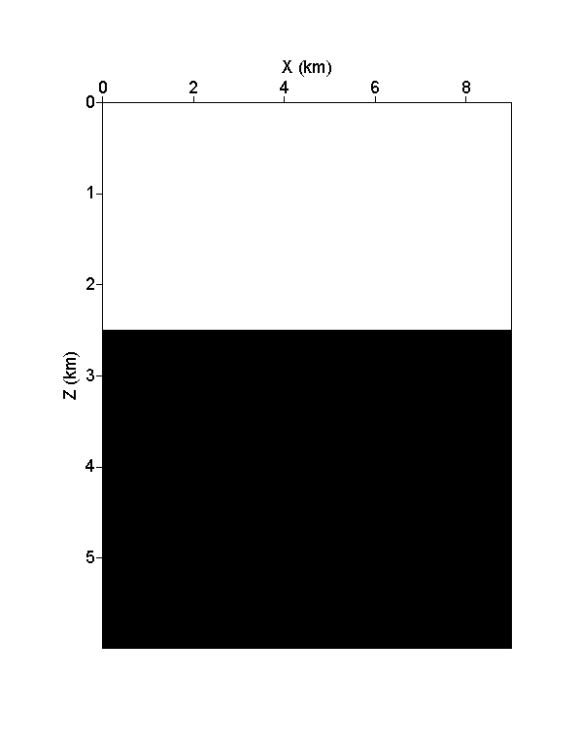
Two-layer model example
Model size:
6km*9km;
Velocity contrast:
1500m/s vs. 2500m/s;
Acoustic;
Dominant frequency: 15Hz;
Absorbing boundaries.
Two-layer simple model

Slide 12
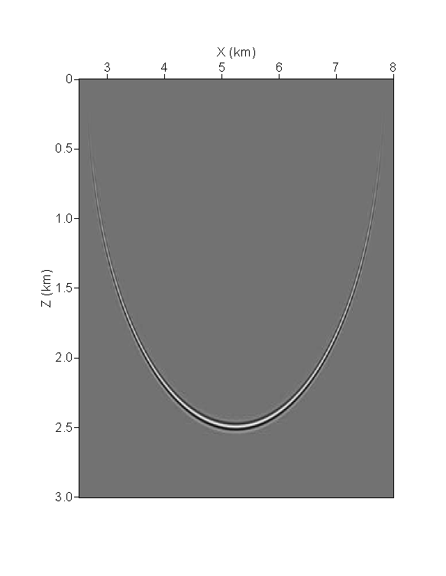
Candidate curve for one source, one receiver
(4.5km, 0km)
(6.0km, 0km)
Homogeneous ellipse
(Biondi,2006)
Notes:
tD here is

Slide 13
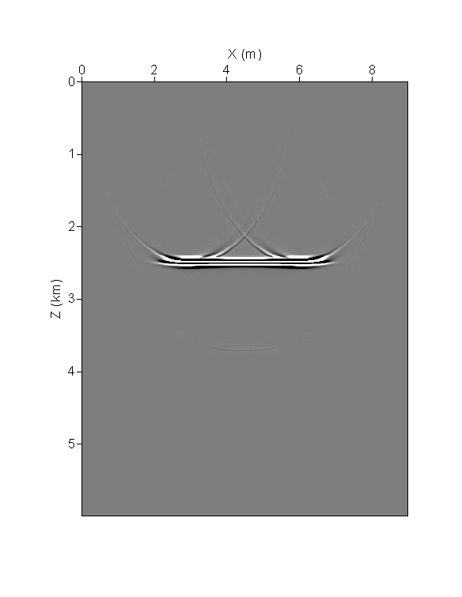
Aperture limitation
Backward propagating the signals of all receivers can highlight the reflector.
Receivers interval=10m
RTM result
Notes:
If all the candidate arrival happens at some points, it must be the reflector. The linear summation of all the candidate curve of all receivers emphasize the scatter points, but cancel un-scattered point. Well, under the limitation of finite length of receiver line, the aperture artifacts still exist. That is also why the result here and result from Dr. Herrara both suffer from this kind of artifacts.

Slide 14
Sub-salt model test

Slide 15
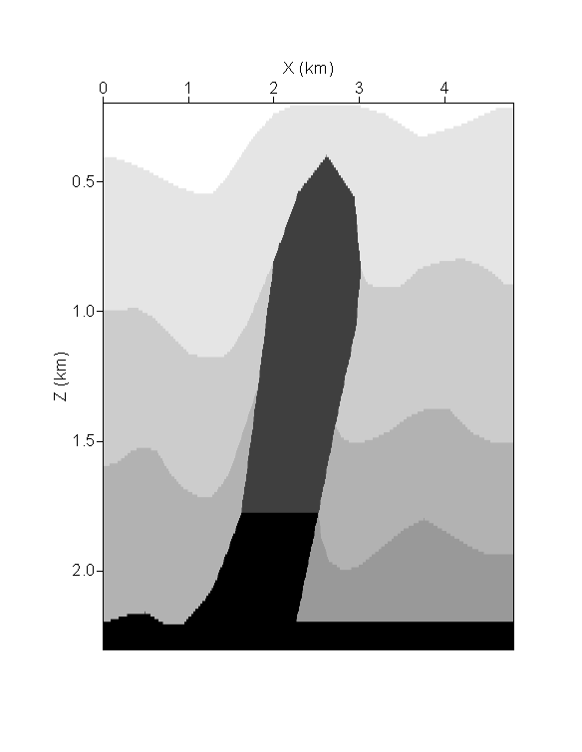
Sub-salt Model
Model size:
2410m*4810m;
Eight shots;
Velocities range from 2500m/s to 6500m/s;
Acoustic;
Dominant frequency:
10Hz;
Absorbing boundaries.
Sub-salt Model
(Courtesy of AGL)

Slide 16
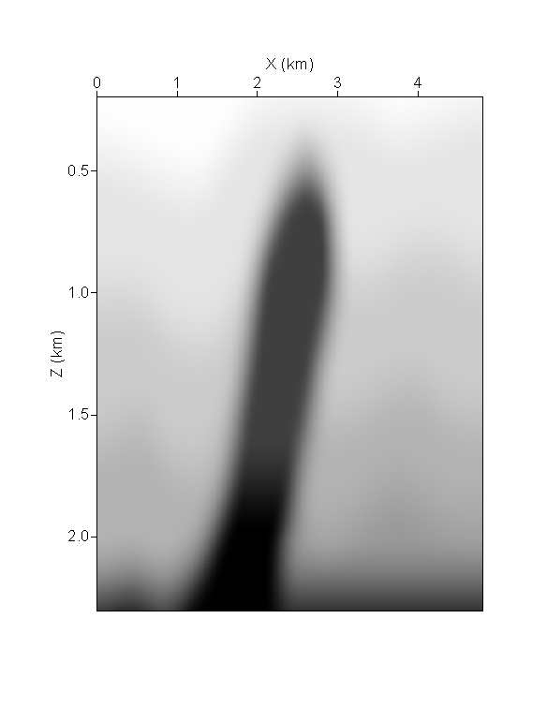
Smoothed Sub-salt Model
Actual Velocity Model
Smooth Migration Velocity:
Gaussian Smoothed by 1.5*wavelength

Slide 17
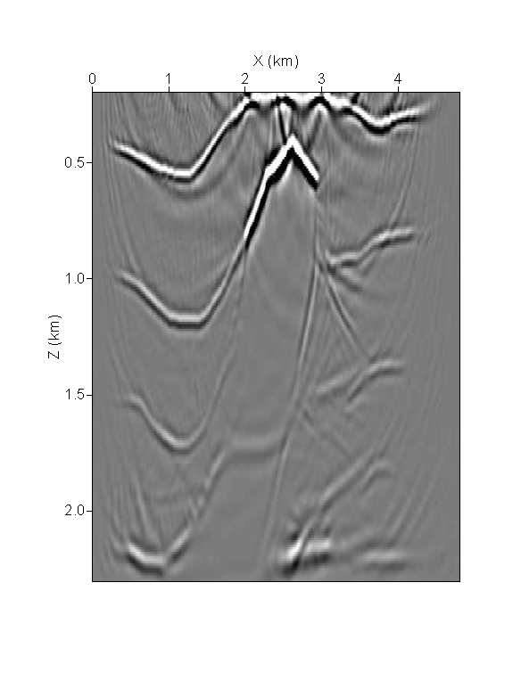
Original RTM Result
Actual Velocity Model
Original RTM Result

Slide 18
Original RTM Result
For this salt flank model, the structure under the high velocity salt-body which cannot be touched by primaries has a “shadow zone”.
The connection point and edge of the salt-body cannot be detected from the original RTM concept result.
There are artifacts in the deep depth image.
Original RTM Result

Slide 19
Conclusions

Slide 20
Conclusions
The initial test of the asymptotic reverse-time migration produced an encouraging result. Shadow zone and other issues will be examined in both different asymptotic RTM and wave-theory RTM methods.
Notes:
Multiples in data can gives the more complicated location issues, which cannot be assume to

Slide 21
Acknowledge

Slide 22
References
Baysal, E., D. D. Kosloff, and J.W. C. Sherwood, 1983, Reverse timemigration: Geophysics, 48, 1514–1524.
Chattopadhyay S. and McMechan G., 2008, Imaging conditions for pre-stack reverse-time: Geophysics, 73, S81-S89.
Biondi, B., and G. Shan, 2002, Prestack imaging of overturned reflections by reverse time migration: 72nd Annual International Meeting, SEG, Expanded Abstracts, 1284–1287.
Claerbout, J. F., 1971, Toward a unified theory of reflector mapping: Geophysics, 36, 467–481.
Kaelin, B., and A. Guitton, 2006, Imaging condition for reverse time migration: 76th Annual International Meeting and Exposition, SEG, Expanded Abstracts, 2594–2598.
Whitmore, N. D., 1983, Iterative depth migration by backward time propagation: 53rd Annual International Meeting, SEG, Expanded Abstracts, 382–385.
McMechan, G. A., 1983, Migration by extrapolation of time-dependent boundary values: Geophysical Prospecting, 31, 413–420.
Bionto L. Biondi, 2006, 3D seismic imaging, Investigations in geophysics No.14.

