Slide 1


Tutorial: ISS and ISS multiple removal
Arthur B. Weglein
May 27-30, 2014
Austin, TX
Notes:
1
1

Slide 2
Seismic E&P challenges
Methods make assumptions; when they are satisfied the methods are effective and when they are not satisfied the methods have difficulty and/or fail – challenges arise from that breakdown or failure.

Slide 3
Seismic E&P challenges
Among assumptions:
acquisition
compute power
innate algorithmic
assumptions/requirements

Slide 4
Innate algorithmic assumptions
Many processing methods require subsurface information
In complex and ill-defined areas that requirement can be difficult or impossible to satisfy
The inability to satisfy that requirement can lead to algorithmic failure and dry hole drilling

Slide 5
Innate algorithmic assumptions
The inverse scattering series states that all processing objectives can be achieved directly and without any subsurface information
Among processing objectives
  1. Free surface multiple removal
  2. Internal multiple removal
  3. Depth imaging
  4. Non-linear AVO
  5. Q compensation
All without subsurface information.

Slide 6

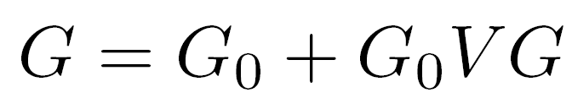

Inverse Scattering Series
Scattering theory = perturbation theory
(1)
Eq.(1) can be expanded in a forward scattering series,

Slide 7
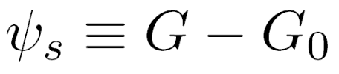



The scattered field can be defined as
(2)
Where is the portion of that is order in .
The measured values of are the data
D, where

Slide 8



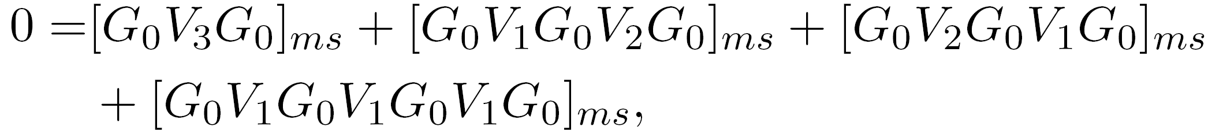
The inverse relation to (2), expands
(3)
as powers (orders) in the measured values of Ψs.
Substituting (3) into (2) and evaluating (2) on the
measurement surface results in
( )m
……

Slide 9
Therefore, the ISS is not only the only direct inversion method for a multidimensional acoustic, elastic, anelastic earth, but it further communicates that all inversion tasks/processing goals are able to be achieved directly and without subsurface information.
Direct and without subsurface information are two distinct and independent properties.

Slide 10
The combination represents a powerful and unique capability and unconventional thinking with stand-alone potential for addressing challenges that are caused by methods that are either indirect (and are necessary conditions, but not sufficient – and therefore are not equivalent to direct methods) and/or are dependent on a-priori information or other assumptions that cannot be adequately provided. The latter is especially significant as our exploration portfolios increasingly move to complex marine and on-shore plays.

Slide 11
That unique promise and potential is what the ISS, combined with the concept of isolated task subseries, offers.

Slide 12
Non-linearity (2 types)
Innate or intrinsic non-linearity
e.g., R.C. and material property changes.
Circumstantial non-linearity
- Removing multiples or depth imaging
primaries.

Slide 13
The inverse scattering series is (once again) unique
in its ability to directly address either alone, let
alone these two in combination.

Slide 14
The first term in a task specific subseries that addresses a potential circumstantial non-linearity first decides if its assistance and contribution is required in your data…
And only if decides that it is, then it starts to compute … if there is no nonlinear circumstantial issue to address, it computes an integrand which is zero.

Slide 15
The latter is a very sophisticated and impressive (and surprising) quality of task specific subseries
We call that property purposeful perturbation theory….
It decides if its assistance is needed before it acts!

Slide 16
Free-surface multiple removal
16
Notes:
16

Slide 17

The 1D FS multiple removal algorithm
Data without a free surface
1
Data with a free surface
contains
free-surface multiples.
1

Slide 18
Free surface demultiple algorithm
= primaries and
internal multiples
= primaries, free
surface multiples
and internal
multiples
1
Total upfield
and,

Slide 19
Free surface demultiple example
t₁
t₂
t₁ + t₂
2t₁
2t₂

Slide 20
t₁ + t₂
2t₁
2t₂
So precisely eliminates all free surface
multiples that have experienced one downward
reflection at the free surface.
The absence of low frequency (and in fact all other
frequency) plays absolutely no role in this prediction.

Slide 21
Free Surface Multiple Elimination Example Recovering an Invisible Primary
Consider a free surface example with the following data:
(1)
R₁δ(t-t₁) -R₁²δ(t-2t₁) R₂'δ(t-t₂)
FS
t₁
2t₁
t₂
R₁
R₂
Notes:
21

Slide 22
Invisible primary example
Now assume
for some special case, then from (1)
(2)
The second primary and the free surface multiple cancel, and
Notes:
22

Slide 23
Invisible primary example
and you have the two primaries, recovering the invisible primary which was not ‘seen’ in the original data.
How does that happen?
Notes:
23

Slide 24
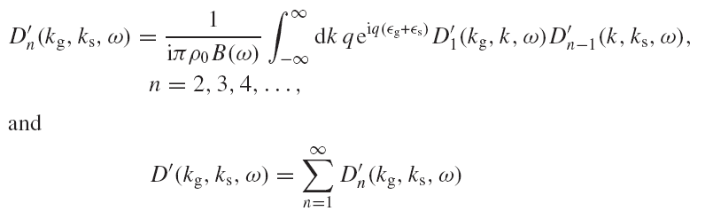
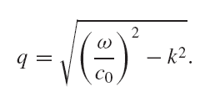
2D free surface multiple algorithm
The obliquity factor is defined as,

Slide 25
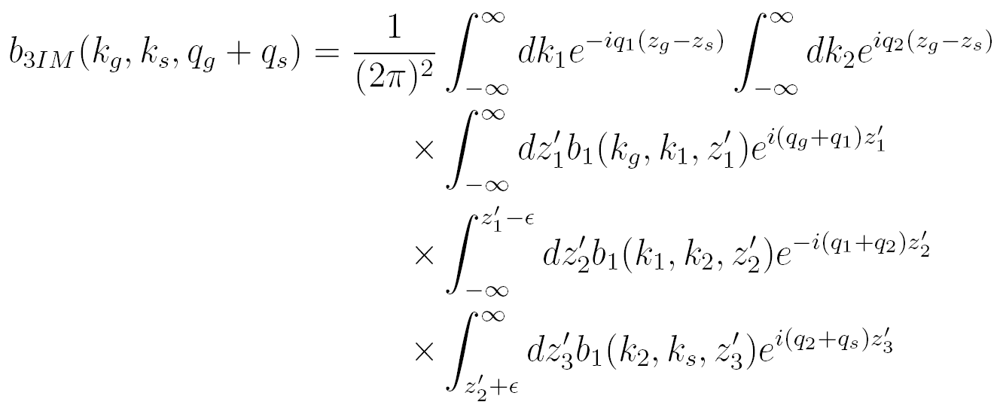
2D internal multiple attenuation algorithm
(Araujo 1994; Weglein et al. 1997)

Slide 26

Internal Multiple Removal in Offshore Brazil Seismic Data Using the Inverse Scattering Series
Master Thesis
Andre S. Ferreira
Advisor: Dr. Arthur B. Weglein
November 15, 2011

Slide 27
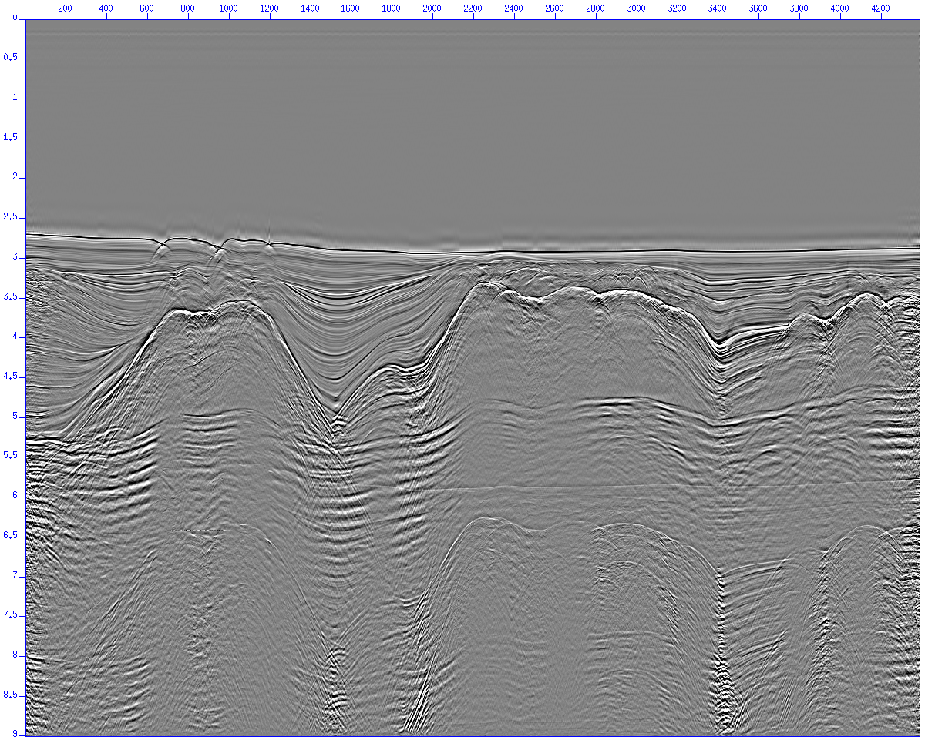
Multiple attenuation
Free surface multiple attenuation
  Stack before free surface multiple removal
Notes:
27

Slide 28
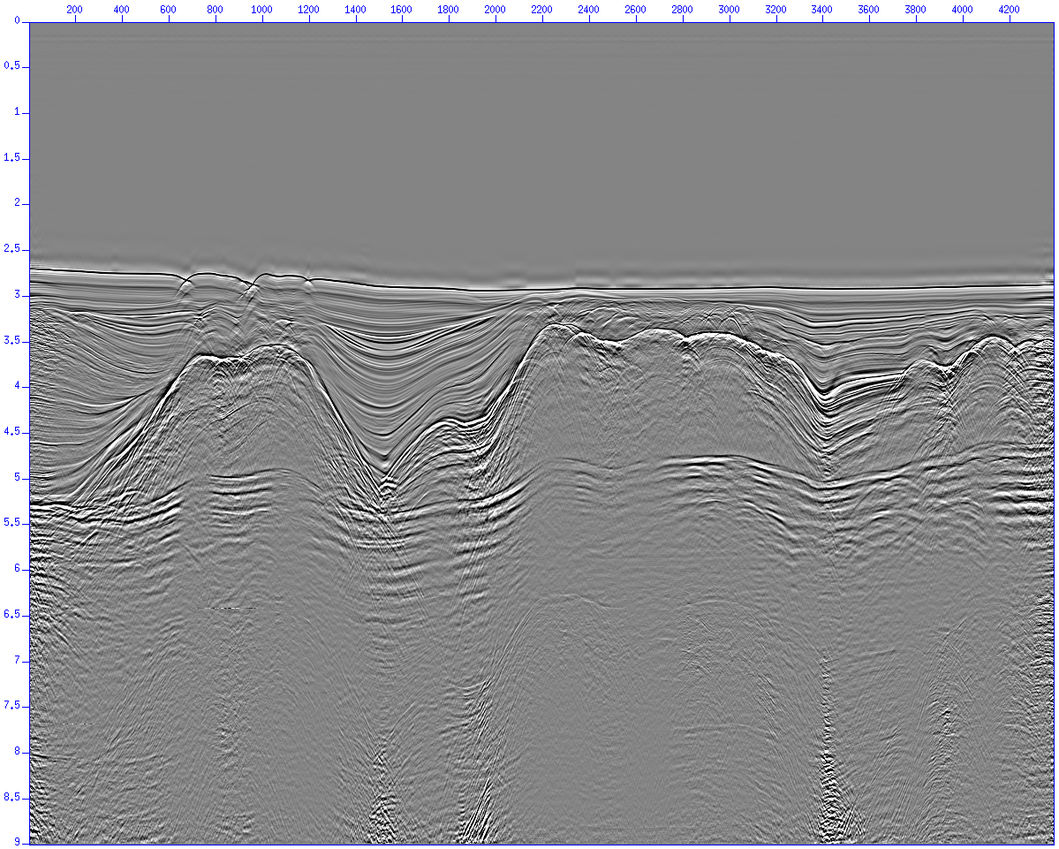
Multiple attenuation
Free surface multiple attenuation
  Stack after free surface multiple removal
Notes:
28

Slide 29
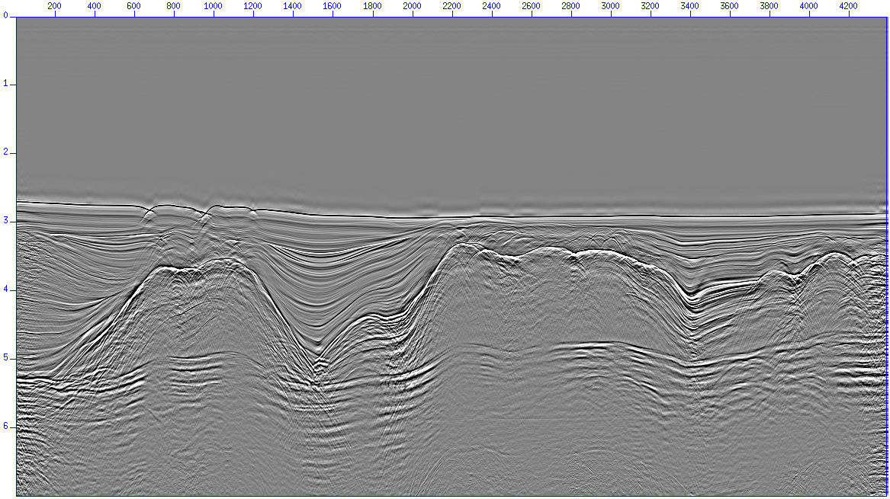
Multiple attenuation
Internal multiple attenuation results (stacked sections)

Slide 30
Multiple attenuation
Internal multiple attenuation results (stacked sections)

Slide 31

Multiple attenuation
Internal multiple attenuation results (stacked sections)

Slide 32
Conclusions
Multiple removal/attenuation is a major problem in seismic exploration
Free surface multiple removal results
  Multiple prediction is excellent
    Improved when source wavelet information was provided
  Anti-alias filter application is important
  Multiples from 3D structures are attenuated but not removed
  Adaptive subtraction required
Internal multiple attenuation results
  Multiple prediction is excellent
  Very high computer cost (both CPU time and memory)
  Adaptive subtraction required

Slide 33
Conclusions
ISS methods were able to attenuate both free surface and internal multiples in a very complex situation
  No a priori information about the dataset is necessary
  No other tested method was able to attenuate the sequence of internal multiples below the salt layers
  High computer cost (internal multiples)
  Adaptive subtraction requirement

Slide 34
Land application of ISS internal multiple
“Their (ISS internal multiple algorithm) performance was demonstrated with complex synthetic and challenging land field datasets with encouraging results, where other internal multiple suppression methods were unable to demonstrate similar effectiveness.”
- Yi Luo, Panos G. Kelamis, Qiang Fu, Shoudong Huo, and Ghada Sindi, Saudi Aramco; Shih-Ying Hsu and Arthur B. Weglein, U. of Houston, “The inverse scattering series approach toward the elimination of land internal multiples.” Aug 2011, TLE

Slide 35
Status
Distinct algorithms/methods have been developed that:
(1) can eliminate free surface multiples of all orders;
(2) can attenuate internal multiples of all orders.
Attenuate means it reduces the amplitude but does not remove (eliminate) the multiples.
— and these algorithms do not require (1) any subsurface information or (2) selecting a “phantom layer,” where the generators of the internal multiples are assumed to reside, and (3) are independent of earth model type.

Slide 36
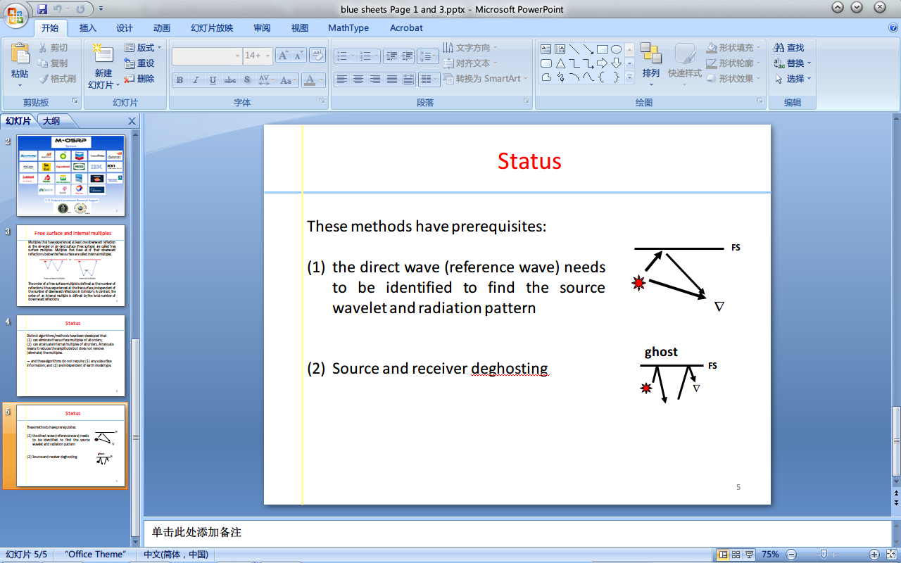
Status
These methods do require (they have prerequisites) :
the direct wave (reference wave) needs to be identified to find the source wavelet and radiation pattern
Source and receiver deghosting

Slide 37

For the free surface and internal multiple algorithms to reach their potential/deliver their promise, these prerequisites need to be satisfied
Energy minimization adaptive subtraction is often called upon to recognize/accommodate all differences between the prediction algorithm and its prerequisites, and all the other factors (beyond the assumed physics) that need to be accommodated to eliminate the multiple.

Slide 38
Major issues in the last 20-25 years:
Industry trend to deep water, and
Exploration plays in ever more complex and ill-defined circumstances.

Slide 39
The current challenge
In this talk we will:
Recognize that the nature of current on-shore and complex off-shore plays increasingly represent challenges with removing multiples that go well beyond our entire collective industry’s capability to effectively respond to/ address;

Slide 40
These plays can often have proximal or interfering primary and multiple events, and multiples of different orders interfering
That raises the bar on multiple removal effectiveness: to predict the amplitude and phase of all orders of free surface and internal multiples

Slide 41
That reality has returned multiple elimination to center stage within M-OSRP
In principle, the ISS has subseries that can eliminate (amplitude and phase predict) all free surface and internal multiples—locate that capability, directly and without subsurface information. The ISS is the only method with that promise and potential.

Slide 42
A proposed response
In this talk we will:
Propose a three pronged technical strategy with the potential to address this current gap between challenge and capability.

Slide 43
All ISS subseries share a common set of prerequisites
  Reference wave removal
  Deghosting
  Source signature and radiation pattern identified and utilized (accommodated) in the algorithms
Green’s theorem provides methods to achieve these prerequisites that are consistent with the ISS methods they are meant to serve.

Slide 44
A three pronged multiple attenuation strategy
Provide the prerequisites, e.g., the removal of the reference wavefield, the wavelet, and deghosted data required by ISS methods
Provide methods from the Inverse Scattering Series (ISS) that predict the phase and amplitude of all orders of free surface and internal multiples at all offsets
Develop a replacement to the energy minimization criteria behind adaptive subtraction methods with a property that always is satisfied by (aligns with) the free surface and internal multiple algorithms

Slide 45
Identify the limitations in the lowest order ISS internal multiple attenuator
Attenuate
Spurious events
Extend that algorithm to remove those limitations.

Slide 46
AGENDA
Wednesday, May 28, 2014
8:30 AM Welcome, program goals, objectives and overall strategy: Tutorial on the inverse scattering series and Green’s theorem for preprocessing, one-way wave equation migration and for RTM
Arthur B. Weglein*
Multiples: part I
10:00 AM Multiple attenuation: recent progress, and a plan to address open, prioritized and pressing issues and challenges
Arthur B. Weglein*
10:45 AM Multiple removal and prerequisite satisfaction: Current status and future plans
James D. Mayhan* and Arthur B. Weglein
12:00 PM Lunch: Hill Country Dining
1:00 PM Predicting reference medium properties from invariances in Green’s theorem reference wave prediction: towards an on-shore near surface medium and reference wave prediction
Lin Tang* and Arthur B. Weglein

Slide 47
AGENDA
2:15 PM Elastic Green’s theorem preprocessing for on-shore internal multiple attenuation: theory and initial synthetic data tests
Jing Wu* and Arthur B. Weglein
3:00 PM Incorporating the source wavelet and radiation pattern into the ISS internal multiple attenuation algorithm
Jinlong Yang* and Arthur B. Weglein
3:45 PM Internal multiple attenuation on Encana Data
Qiang Fu* and Arthur B. Weglein
Thursday, May 29, 2014
Multiples: part II: ISS for internal multiple elimination in elastic and inelastic media, directly and without subsurface (elastic or inelastic) information
8:30 AM Including higher order terms to address a serious shortcoming/problem of the internal multiple attenuator: examining the problem and its resolution
Chao Ma* and Arthur B. Weglein

Slide 48
AGENDA
9:15 AM The internal multiple elimination algorithm for all reflectors in a 1D earth: part 1, strengths and limitations
Yanglei Zou* and Arthur B. Weglein
The internal multiple elimination algorithm for all reflectors in a 1D earth: part 2, addressing the limitations
Yanglei Zou* and Arthur B. Weglein
10:35 AM ISS internal multiple attenuation algorithm for a 3D source and one dimensional subsurface
Xinglu Lin* and Arthur B. Weglein
11:20 AM The first test and evaluation of the inverse scattering series internal multiple attenuation algorithm for an attenuating medium
Jing Wu* and Arthur B. Weglein
12:05 PM Lunch: Hill Country Dining
1:20 PM Invited Guest Presentation: The Leadership Computing Alliance: addressing the HPC challenges of M-OSRP algorithms
Michael Perrone*, IBM

Slide 49
AGENDA
ISS direct depth imaging without a velocity model
2:15 PM ISS direct depth imaging without a velocity model; update and Marmousi model tests
Fang Liu* and Arthur B. Weglein
Wave equation RTM (with a velocity model)
2:45 PM The first wave equation migration RTM with data consisting of primaries and internal multiples: theory and 1D examples
Fang Liu* and Arthur B. Weglein
Asymptotic (Kirchhoff) migration and Wave equation migration
3:15 PM Asymptotic (Kirchhoff) migration and Wave Equation Migration for one-way waves: comparison of the migrated images amplitude as a function of angle: implications for asymptotic and WEM RTM
Qiang Fu*, Yanglei Zou, Arthur B. Weglein and Robert H. Stolt

Slide 50
AGENDA
4:00 PM Initial analysis and comparison of the wave equation and asymptotic prediction of a receiver experiment at depth for one-way propagating waves
Chao Ma*, Jing Wu and Arthur B. Weglein
4:45 PM Meeting overview and plans going forward
Arthur B. Weglein*

Slide 51
AGENDA
Wednesday, May 28, 2014
8:30 AM Welcome, program goals, objectives and overall strategy: Tutorial on the inverse scattering series and Green’s theorem for preprocessing, one-way wave equation migration and for RTM
Arthur B. Weglein*
Multiples: part I
10:00 AM Multiple attenuation: recent progress, and a plan to address open, prioritized and pressing issues and challenges
Arthur B. Weglein*
10:45 AM Multiple removal and prerequisite satisfaction: Current status and future plans
James D. Mayhan* and Arthur B. Weglein
12:00 PM Lunch: Hill Country Dining
1:00 PM Predicting reference medium properties from invariances in Green’s theorem reference wave prediction: towards an on-shore near surface medium and reference wave prediction
Lin Tang* and Arthur B. Weglein

Slide 52
AGENDA
Wednesday, May 28, 2014
8:30 AM Welcome, program goals, objectives and overall strategy: Tutorial on the inverse scattering series and Green’s theorem for preprocessing, one-way wave equation migration and for RTM
Arthur B. Weglein*
Multiples: part I
10:00 AM Multiple attenuation: recent progress, and a plan to address open, prioritized and pressing issues and challenges
Arthur B. Weglein*
10:45 AM Multiple removal and prerequisite satisfaction: Current status and future plans
James D. Mayhan* and Arthur B. Weglein
12:00 PM Lunch: Hill Country Dining
1:00 PM Predicting reference medium properties from invariances in Green’s theorem reference wave prediction: towards an on-shore near surface medium and reference wave prediction
Lin Tang* and Arthur B. Weglein

Slide 53
AGENDA
Wednesday, May 28, 2014
8:30 AM Welcome, program goals, objectives and overall strategy: Tutorial on the inverse scattering series and Green’s theorem for preprocessing, one-way wave equation migration and for RTM
Arthur B. Weglein*
Multiples: part I
10:00 AM Multiple attenuation: recent progress, and a plan to address open, prioritized and pressing issues and challenges
Arthur B. Weglein*
10:45 AM Multiple removal and prerequisite satisfaction: Current status and future plans
James D. Mayhan* and Arthur B. Weglein
12:00 PM Lunch: Hill Country Dining
1:00 PM Predicting reference medium properties from invariances in Green’s theorem reference wave prediction: towards an on-shore near surface medium and reference wave prediction
Lin Tang* and Arthur B. Weglein

Slide 54
AGENDA
Wednesday, May 28, 2014
8:30 AM Welcome, program goals, objectives and overall strategy: Tutorial on the inverse scattering series and Green’s theorem for preprocessing, one-way wave equation migration and for RTM
Arthur B. Weglein*
Multiples: part I
10:00 AM Multiple attenuation: recent progress, and a plan to address open, prioritized and pressing issues and challenges
Arthur B. Weglein*
10:45 AM Multiple removal and prerequisite satisfaction: Current status and future plans
James D. Mayhan* and Arthur B. Weglein
12:00 PM Lunch: Hill Country Dining
1:00 PM Predicting reference medium properties from invariances in Green’s theorem reference wave prediction: towards an on-shore near surface medium and reference wave prediction
Lin Tang* and Arthur B. Weglein

Slide 55
AGENDA
2:15 PM Elastic Green’s theorem preprocessing for on-shore internal multiple attenuation: theory and initial synthetic data tests
Jing Wu* and Arthur B. Weglein
3:00 PM Incorporating the source wavelet and radiation pattern into the ISS internal multiple attenuation algorithm
Jinlong Yang* and Arthur B. Weglein
3:45 PM Internal multiple attenuation on Encana Data
Qiang Fu* and Arthur B. Weglein
Thursday, May 29, 2014
Multiples: part II: ISS for internal multiple elimination in elastic and inelastic media, directly and without subsurface (elastic or inelastic) information
8:30 AM Including higher order terms to address a serious shortcoming/problem of the internal multiple attenuator: examining the problem and its resolution
Chao Ma* and Arthur B. Weglein

Slide 56
AGENDA
2:15 PM Elastic Green’s theorem preprocessing for on-shore internal multiple attenuation: theory and initial synthetic data tests
Jing Wu* and Arthur B. Weglein
3:00 PM Incorporating the source wavelet and radiation pattern into the ISS internal multiple attenuation algorithm
Jinlong Yang* and Arthur B. Weglein
3:45 PM Internal multiple attenuation on Encana Data
Qiang Fu* and Arthur B. Weglein
Thursday, May 29, 2014
Multiples: part II: ISS for internal multiple elimination in elastic and inelastic media, directly and without subsurface (elastic or inelastic) information
8:30 AM Including higher order terms to address a serious shortcoming/problem of the internal multiple attenuator: examining the problem and its resolution
Chao Ma* and Arthur B. Weglein

Slide 57
AGENDA
2:15 PM Elastic Green’s theorem preprocessing for on-shore internal multiple attenuation: theory and initial synthetic data tests
Jing Wu* and Arthur B. Weglein
3:00 PM Incorporating the source wavelet and radiation pattern into the ISS internal multiple attenuation algorithm
Jinlong Yang* and Arthur B. Weglein
3:45 PM Internal multiple attenuation on Encana Data
Qiang Fu* and Arthur B. Weglein
Thursday, May 29, 2014
Multiples: part II: ISS for internal multiple elimination in elastic and inelastic media, directly and without subsurface (elastic or inelastic) information
8:30 AM Including higher order terms to address a serious shortcoming/problem of the internal multiple attenuator: examining the problem and its resolution
Chao Ma* and Arthur B. Weglein

Slide 58
AGENDA
2:15 PM Elastic Green’s theorem preprocessing for on-shore internal multiple attenuation: theory and initial synthetic data tests
Jing Wu* and Arthur B. Weglein
3:00 PM Incorporating the source wavelet and radiation pattern into the ISS internal multiple attenuation algorithm
Jinlong Yang* and Arthur B. Weglein
3:45 PM Internal multiple attenuation on Encana Data
Qiang Fu* and Arthur B. Weglein
Thursday, May 29, 2014
Multiples: part II: ISS for internal multiple elimination in elastic and inelastic media, directly and without subsurface (elastic or inelastic) information
8:30 AM Including higher order terms to address a serious shortcoming/problem of the internal multiple attenuator: examining the problem and its resolution
Chao Ma* and Arthur B. Weglein

Slide 59
AGENDA
9:15 AM The internal multiple elimination algorithm for all reflectors in a 1D earth: part 1, strengths and limitations
Yanglei Zou* and Arthur B. Weglein
The internal multiple elimination algorithm for all reflectors in a 1D earth: part 2, addressing the limitations
Yanglei Zou* and Arthur B. Weglein
10:35 AM ISS internal multiple attenuation algorithm for a 3D source and one dimensional subsurface
Xinglu Lin* and Arthur B. Weglein
11:20 AM The first test and evaluation of the inverse scattering series internal multiple attenuation algorithm for an attenuating medium
Jing Wu* and Arthur B. Weglein
12:05 PM Lunch: Hill Country Dining
1:20 PM Invited Guest Presentation: The Leadership Computing Alliance: addressing the HPC challenges of M-OSRP algorithms
Michael Perrone*, IBM

Slide 60
AGENDA
9:15 AM The internal multiple elimination algorithm for all reflectors in a 1D earth: part 1, strengths and limitations
Yanglei Zou* and Arthur B. Weglein
The internal multiple elimination algorithm for all reflectors in a 1D earth: part 2, addressing the limitations
Yanglei Zou* and Arthur B. Weglein
10:35 AM ISS internal multiple attenuation algorithm for a 3D source and one dimensional subsurface
Xinglu Lin* and Arthur B. Weglein
11:20 AM The first test and evaluation of the inverse scattering series internal multiple attenuation algorithm for an attenuating medium
Jing Wu* and Arthur B. Weglein
12:05 PM Lunch: Hill Country Dining
1:20 PM Invited Guest Presentation: The Leadership Computing Alliance: addressing the HPC challenges of M-OSRP algorithms
Michael Perrone*, IBM

Slide 61
AGENDA
9:15 AM The internal multiple elimination algorithm for all reflectors in a 1D earth: part 1, strengths and limitations
Yanglei Zou* and Arthur B. Weglein
The internal multiple elimination algorithm for all reflectors in a 1D earth: part 2, addressing the limitations
Yanglei Zou* and Arthur B. Weglein
10:35 AM ISS internal multiple attenuation algorithm for a 3D source and one dimensional subsurface
Xinglu Lin* and Arthur B. Weglein
11:20 AM The first test and evaluation of the inverse scattering series internal multiple attenuation algorithm for an attenuating medium
Jing Wu* and Arthur B. Weglein
12:05 PM Lunch: Hill Country Dining
1:20 PM Invited Guest Presentation: The Leadership Computing Alliance: addressing the HPC challenges of M-OSRP algorithms
Michael Perrone*, IBM

Slide 62
AGENDA
9:15 AM The internal multiple elimination algorithm for all reflectors in a 1D earth: part 1, strengths and limitations
Yanglei Zou* and Arthur B. Weglein
The internal multiple elimination algorithm for all reflectors in a 1D earth: part 2, addressing the limitations
Yanglei Zou* and Arthur B. Weglein
10:35 AM ISS internal multiple attenuation algorithm for a 3D source and one dimensional subsurface
Xinglu Lin* and Arthur B. Weglein
11:20 AM The first test and evaluation of the inverse scattering series internal multiple attenuation algorithm for an attenuating medium
Jing Wu* and Arthur B. Weglein
12:05 PM Lunch: Hill Country Dining
1:20 PM Invited Guest Presentation: The Leadership Computing Alliance: addressing the HPC challenges of M-OSRP algorithms
Michael Perrone*, IBM

Slide 63
AGENDA
ISS direct depth imaging without a velocity model
2:15 PM ISS direct depth imaging without a velocity model; update and Marmousi model tests
Fang Liu* and Arthur B. Weglein
Wave equation RTM (with a velocity model)
2:45 PM The first wave equation migration RTM with data consisting of primaries and internal multiples: theory and 1D examples
Fang Liu* and Arthur B. Weglein
Asymptotic (Kirchhoff) migration and Wave equation migration
3:15 PM Asymptotic (Kirchhoff) migration and Wave Equation Migration for one-way waves: comparison of the migrated images amplitude as a function of angle: implications for asymptotic and WEM RTM
Qiang Fu*, Yanglei Zou, Arthur B. Weglein and Robert H. Stolt

Slide 64
AGENDA
ISS direct depth imaging without a velocity model
2:15 PM ISS direct depth imaging without a velocity model; update and Marmousi model tests
Fang Liu* and Arthur B. Weglein
Wave equation RTM (with a velocity model)
2:45 PM The first wave equation migration RTM with data consisting of primaries and internal multiples: theory and 1D examples
Fang Liu* and Arthur B. Weglein
Asymptotic (Kirchhoff) migration and Wave equation migration
3:15 PM Asymptotic (Kirchhoff) migration and Wave Equation Migration for one-way waves: comparison of the migrated images amplitude as a function of angle: implications for asymptotic and WEM RTM
Qiang Fu*, Yanglei Zou, Arthur B. Weglein and Robert H. Stolt

Slide 65
AGENDA
ISS direct depth imaging without a velocity model
2:15 PM ISS direct depth imaging without a velocity model; update and Marmousi model tests
Fang Liu* and Arthur B. Weglein
Wave equation RTM (with a velocity model)
2:45 PM The first wave equation migration RTM with data consisting of primaries and internal multiples: theory and 1D examples
Fang Liu* and Arthur B. Weglein
Asymptotic (Kirchhoff) migration and Wave equation migration
3:15 PM Asymptotic (Kirchhoff) migration and Wave Equation Migration for one-way waves: comparison of the migrated images amplitude as a function of angle: implications for asymptotic and WEM RTM
Qiang Fu*, Yanglei Zou, Arthur B. Weglein and Robert H. Stolt

Slide 66
AGENDA
4:00 PM Initial analysis and comparison of the wave equation and asymptotic prediction of a receiver experiment at depth for one-way propagating waves
Chao Ma*, Jing Wu and Arthur B. Weglein
4:45 PM Meeting overview and plans going forward
Arthur B. Weglein*

Slide 67
AGENDA
4:00 PM Initial analysis and comparison of the wave equation and asymptotic prediction of a receiver experiment at depth for one-way propagating waves
Chao Ma*, Jing Wu and Arthur B. Weglein
4:45 PM Meeting overview and plans going forward
Arthur B. Weglein*

