Slide 1
Predicting reference medium properties
from invariances in Green’s theorem reference
wave prediction: towards an on-shore
near surface medium and reference wave prediction
Lin Tang* and Arthur B. Weglein
May 28th, 2014
Austin, TX
Notes:
1
1

Slide 2
Key points
This talk will study the challenges in determining the complex near surface medium property. We discuss the criteria for finding the correct reference velocity.
Using marine environment as a starting point, we are showing that for data from a point source, the invariance of the estimated source signature for different output points below the cable could be a criterion for finding the correct reference velocity.
For the case of a source array and radiation pattern, the invariance of the source wavelet in one radiation angle could be the criterion for having the right reference velocity.

Slide 3
Outline
Motivation
Method – Green’s theorem
An analytic example
Test result
Data from a point source
Data from a source array
Conclusions

Slide 4
Outline
Motivation
Method – Green’s theorem
An analytic example
Test result
Data from a point source
Data from a source array
Conclusions

Slide 5
Motivation
As seismic exploration moves to more complex and difficult on-shore and off-shore plays, there are more fundamental issues and challenges need to be resolved.
Inverse Scattering Series (ISS) offers a direct way of removing multiples without requiring any subsurface information.
When the prerequisites are satisfied, ISS methods can deliver more effective prediction of multiples (Dr. Mayhan’s presentation).

Slide 6
Motivation
The three pronged strategy to address the current challenges of ISS internal multiple attenuator :
Preprocessing for on-shore applications
Beyond ISS internal multiple attenuation
elimination
spurious
New adaptive subtraction criteria
Notes:
As Weglein mentioned.

Slide 7
Motivation
Among these prerequisites, the removal of reference wave is the first step.
In Inverse Scattering Series, the data D on the measurement surface is,
The very first step in any ISS methods (free surface multiple removal, internal multiple removal, depth imaging) is to remove G0. In order to know G0, we need to know the reference medium.
$$G_{0}$$

Slide 8
Motivation
ISS methods require that the reference medium agrees with the actual medium at and above the measurement surface.
For on-shore seismic application, the property of the medium near surface is often complicated and not easy to acquire. Strong ground roll could be generated and that can obscure the reflected seismic data.
For on-shore problems, understanding of the near surface property could enable us to predict and remove ground roll/reference wave on land (Jing Wu’s presentation), and finally enhance the capability of following multiple removal processing steps.

Slide 9
Outline
Motivation
Method—Green’s theorem
An analytic example
Test result
Data from a point source
data from a source array
Conclusions

Slide 10
Green’s theorem
air
water
Measurement surface
V
Earth
S
Notes:
Point r can be under water or in earth, as long as it is under the m.s.

Slide 11
Green’s theorem
air
water
Measurement surface
V
Earth
S
Notes:
From the above equations, we can see that given the wavefield P and its normal derivative Pn on the measurement surface, we
can easily calculate the reference wave P0 and the scattered wave Ps, depending on the observation point we choose. In
other words, the reference wave and the scattered wave are separated by using Green’s theorem.

Slide 12
Green’s theorem
Last year, we have shown that when using Green’s theorem to separate the reference wave and the reflected data, several practical issues may affect the prediction result;
The depth difference between the cable and the predicted point, Δz, is required to be larger than ½ Δx (receiver sampling).
Prediction point
for P_{s}
Δz
cable
Δx=12.5m

Slide 13
Green’s theorem
Last year, we have shown that when using Green’s theorem to separate the reference wave and the reflected data, several practical issues may affect the prediction result;
The depth difference between the cable and the predicted point, Δz, is required to be larger than ½ Δx (receiver sampling).
Prediction point
for P_{s}
Δz
cable
Δx=12.5m

Slide 14
Green’s theorem
Last year, we have shown that when using Green’s theorem to separate the reference wave and the reflected data, several practical issues may affect the prediction result;
The depth difference between the cable and the predicted point, Δz, is required to be larger than ½ Δx (receiver sampling).
cable
Δz
Prediction point
for P₀
Δx=12.5m

Slide 15
Green’s theorem
Last year, we have shown that when using Green’s theorem to separate the reference wave and the reflected data, several practical issues may affect the prediction result;
The depth difference between the cable and the predicted point, Δz, is required to be larger than ½ Δx (receiver sampling).
cable
Δz
Prediction point
for P₀
Δx=12.5m

Slide 16
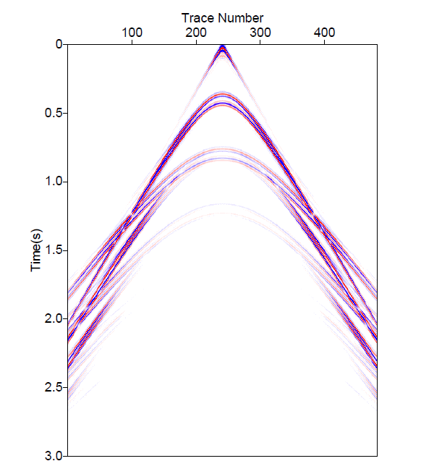
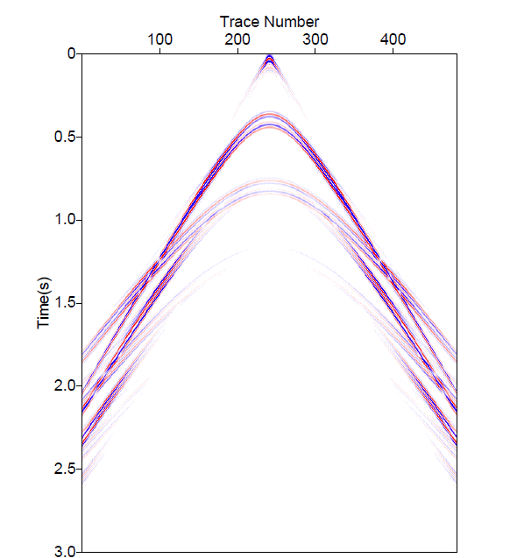
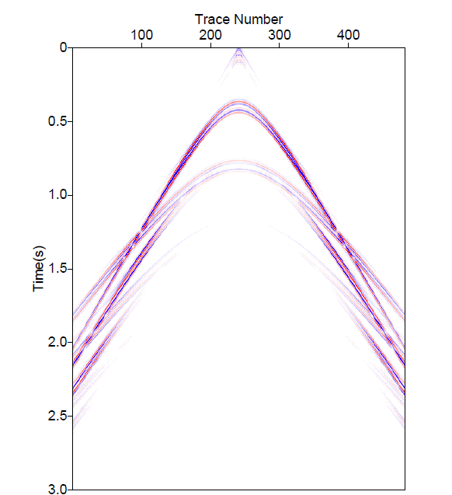
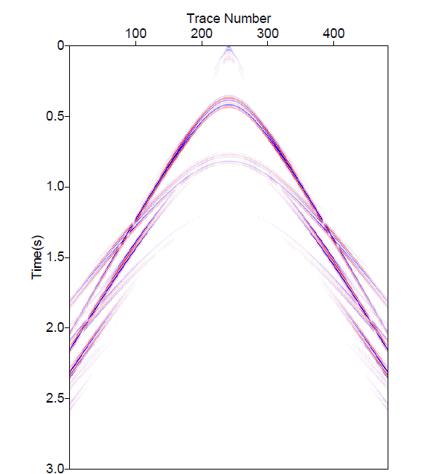
Prediction of P_{s} at different Δz (Δz = depth difference between the cable and the predicted point)
P_{s} at 48.4m
(Δz =1/8Δx)
P_{s} at 46.9m
(Δz =1/4Δx)
P_{s} at 43.8m
(Δz =1/2Δx)
P_{s} at 37.5m
(Δz =Δx)

Slide 17
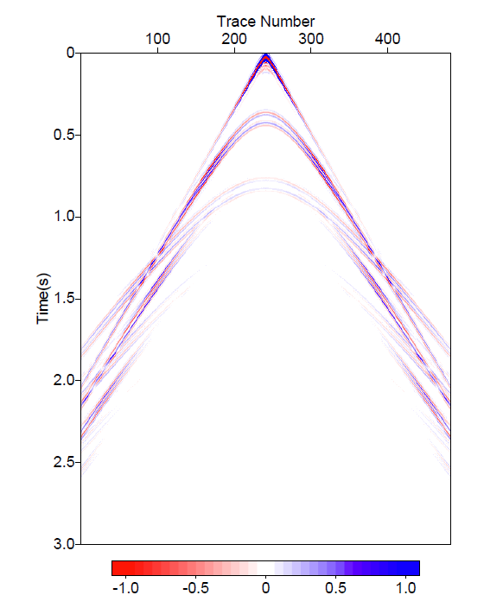
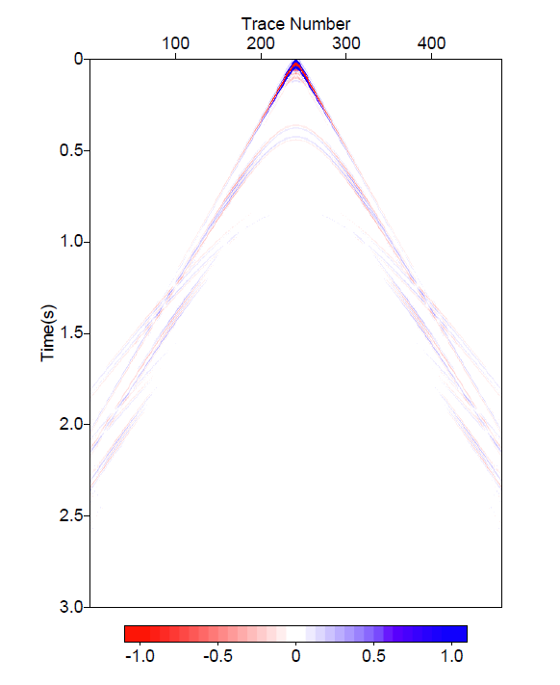
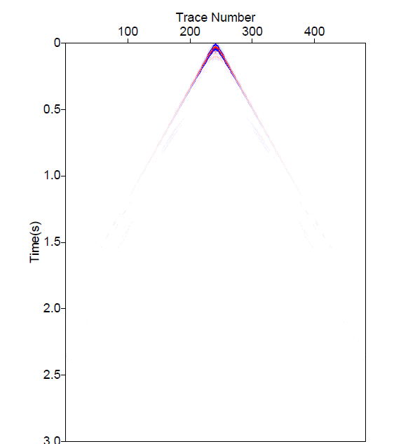
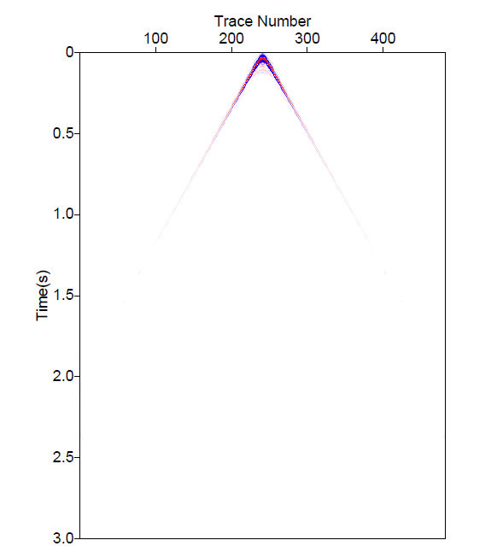
Prediction of P₀ at different Δz (Δz = depth difference between the cable and the predicted point)
P₀ at 51.6m
(Δz =1/8Δx)
P₀ at 53.1m
(Δz =1/4Δx)
P₀ at 56.3m
(Δz =1/2Δx)
P₀ at 62.5m
(Δz =Δx)

Slide 18
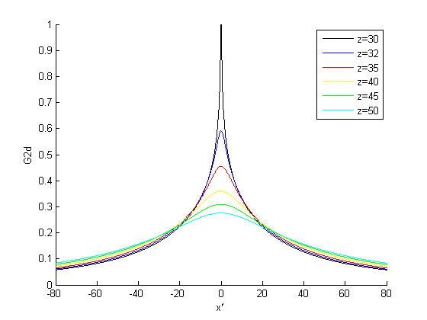
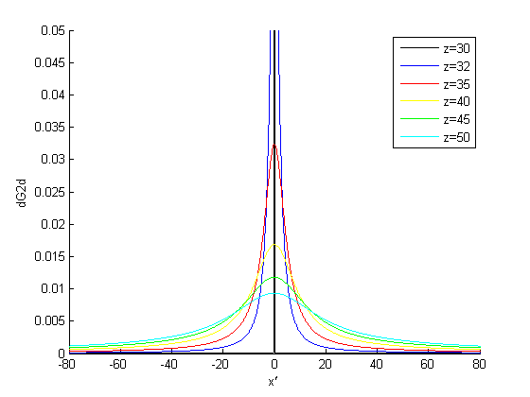
Examining Green’s function in
X’
X’
When the depth between the measurement surface and the prediction point gets closer, dG₀/dz becomes more concentrated at a local point. Unless having a very small sampling interval △x, the value of dG₀/dz cannot be picked up.
Notes:
Here I am plotting the Green’s function and its normal derivatives with respective of x’. Different color corresponds to different distances between the measurement surface and the predicted wave, which is defined as delta z. Notice that the black line means the predicting wave closest to the cable, and cyan one means a larger delta z.

Slide 19
Green’s theorem
In (x, ω) domain, it is not possible to predict P₀ or P_{s} on the cable. On the other hand, in (x, ω) domain, it can accommodate non-flat measurement surface, e.g., ocean bottom.
Calculation in the (k,ω) domain enables us to predict and remove P₀ or P_{s} on the cable, which means, it can isolate P₀ or P_{s} in the data. But it requires the measurement surface to be flat.
For the on-shore problem, it is important to predict and remove the reference wave/ground roll from the data. The very first step is to determine the property of near surface.

Slide 20
Reference medium problem
In this talk, we are seeking criteria which can determine whether we have the correct reference medium information or not.
The criteria could be the presence of some invariance that only the correct reference velocity would satisfy.
We use a marine seismic application as a starting point to pursue this idea:
Data from a point source;
Data with radiation pattern.

Slide 21
Outline
Motivation
Method – Green’s theorem
An analytic example
Test result
Data from a point source
data from a source array
Conclusions

Slide 22
Green’s theorem
It is valid for any below the measurement surface. Both the numerator and the denominator are functions of the prediction point . However, their quotient A(ω) is independent of .
Using this property, we can determine the reference medium of Green’s theorem using the algorithm itself.
Notes:
Variables explanation. r’ measurement surface. r chosen below the ms. equation valid for any points below the cable.
Function of r and rs and omega. Function of r, rs, omega. Quotient is function of omega only. not function of r. use this property. what if we pick the wrong velocity. will break that property. the quotient will be a function of r. right velocity, not function of r. wrong velocity, function of r.
velocity is velocity right at the cable. reference velocity. not the subsurface velocity. variable water velocity does not matter. all you need is the reference velocity right at the cable. Bill Dragset.
for land it’s not simple.

Slide 23
Green’s theorem
0
We show a 1D analytic example illustrating how the invariances can back out the reference medium.
free surface
zs
a
cable
z
Notes:
Variables explanation. r’ measurement surface. r chosen below the ms. equation valid for any points below the cable.
Function of r and rs and omega. Function of r, rs, omega. Quotient is function of omega only. not function of r. use this property. what if we pick the wrong velocity. will break that property. the quotient will be a function of r. right velocity, not function of r. wrong velocity, function of r.
velocity is velocity right at the cable. reference velocity. not the subsurface velocity. variable water velocity does not matter. all you need is the reference velocity right at the cable. Bill Dragset.
for land it’s not simple.

Slide 24
An analytical example
using correct velocity

Slide 25
An analytical example
using wrong velocity

Slide 26
Outline
Motivation
Method
An analytic example
Test result
Data from a point source
Data from a source array
Conclusions

Slide 27
Point source data
For point source data, the source wavelet is independent of the prediction point .
Only when using the correct reference velocity, the estimation of the source wavelet displays invariance at different points below the measurement surface.
Therefore, the invariance of the estimated wavelet can be a criterion for having the correct reference velocity.

Slide 28
Point source data-- steps
Use Cagniard-de Hoop method to model over/under cable data generated from an isotropic source.
Use Green’s theorem to predict the source wavelet at different points below the cable, using different reference velocities in Green’s function:
correct reference velocity c₀ = 1500m/s;
wrong reference velocity c₀ = 1490m/s;
further wrong reference velocity c₀ = 1450m/s.
Codes for both Cagniard-de Hoop modeling method and Green’s theorem preprocessing are available from M-OSRP. The latter code can be used to back out the reference medium.

Slide 29
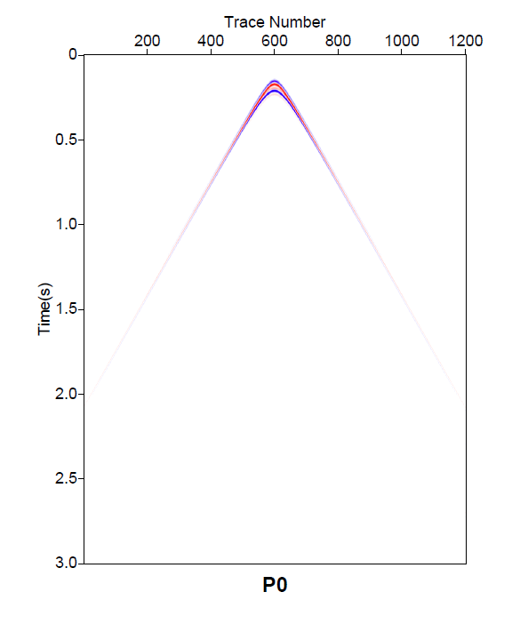
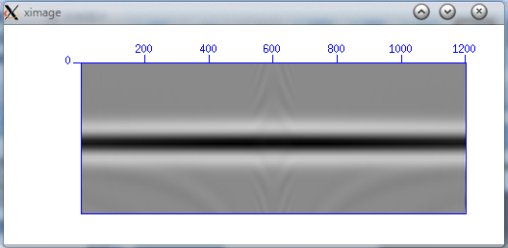
Point source data, correct reference velocity
c₀=1500 (correct)
P₀
t
A(t)
Notes:
Cdh_p0_z162.su

Slide 30
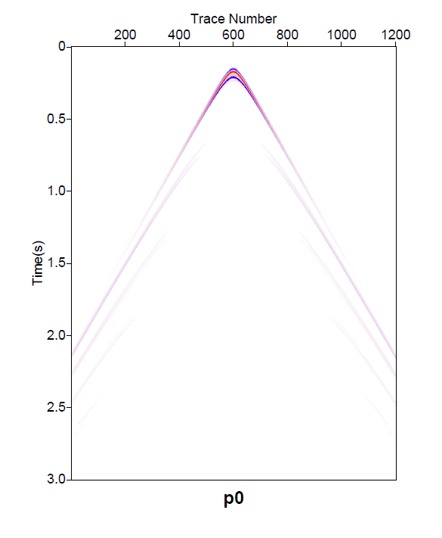
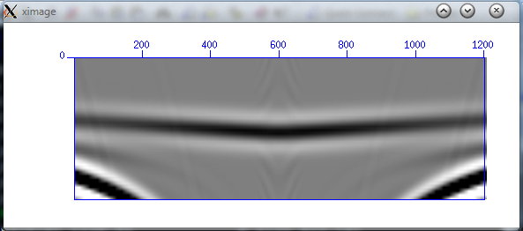
Point source data, wrong reference velocity
c₀=1490 (wrong)
P₀
t
A(t)
Notes:
Cdh_p0_z162.su

Slide 31
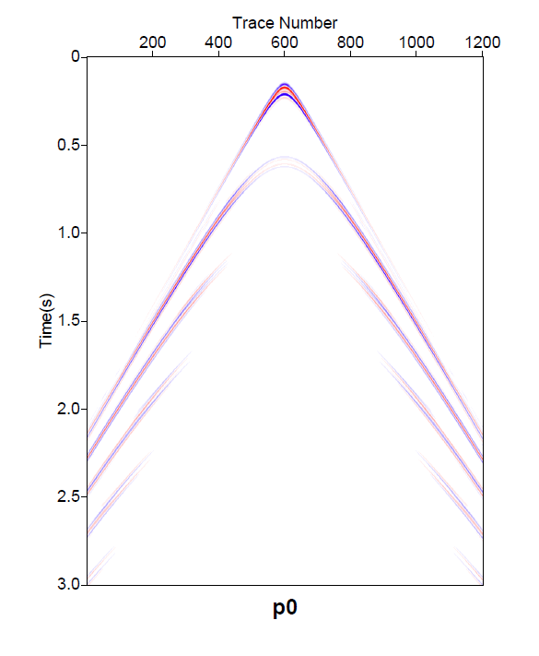
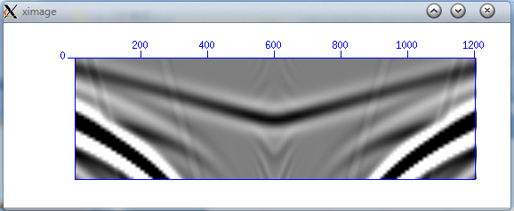
Point source data, wrong reference velocity
c₀=1450 (wrong)
P₀
t
A(t)
Notes:
Cdh_p0_z162.su

Slide 32
Wavelet estimation results using different reference velocities
Angle invariance →
t
A(t)
1450
1490
1500
c0
t
t
A(t)
A(t)
Notes:
The estimated source wavelet results show that when using the correct reference velocity, the wavelet
displays invariance at different offset, while wrong velocities give different wavelet prediction at different output points.
Therefore, only the correct reference velocity can result in the invariance of estimated wavelet. When the velocities are further
from the reference velocity, the errors of wavelet invariance also becomes larger. This conclusion will also help us in
finding the correct reference velocity.

Slide 33
Outline
Motivation
Method
An analytic example
Test result
Data from a point source
Data from a source array
Conclusions

Slide 34
General source
Wavefield at $\overset{⃑}{r}$can be calculated from
Using a far field approximation, $|\overset{⃑}{r}$|≫|$\overset{⃑}{r}$’|, we can simplify the wavefieldas,
If divided by a point source Green’s function, the estimated wavelet results are invariant in the same radiation angle.
0
θ
r’
x
y
r
z

Slide 35
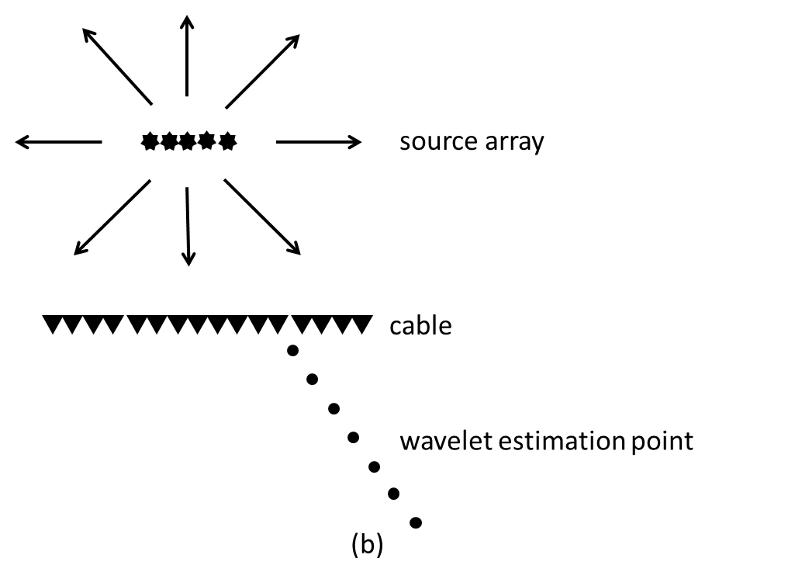
Method – source array data
Notes:
Furthermore, instead of a single point source, in practice, source arrays which have angle radiation pattern are widely used in
industry (Loveridge et al. (1984)). Then the invariance of the estimated wavelet will happen when estimating the wavelet at
different points along one radiation angle. Similarly, only the correct reference velocity can lead to the invariance. Thus, the
invariances of the source wavelet indicate that we have found the correct reference velocity.

Slide 36
Source array -- Steps
Use Cagniard-de Hoop method to model over/under cable data generated from a source array.
Estimate wavelet along different angles, to examine the radiation pattern;
Estimate wavelet along one radiation angle using correct reference velocity 1500 m/s to examine the invariance;
Repeat step II using wrong reference velocity 1450m/s.
18m
3m
Notes:
picture

Slide 37
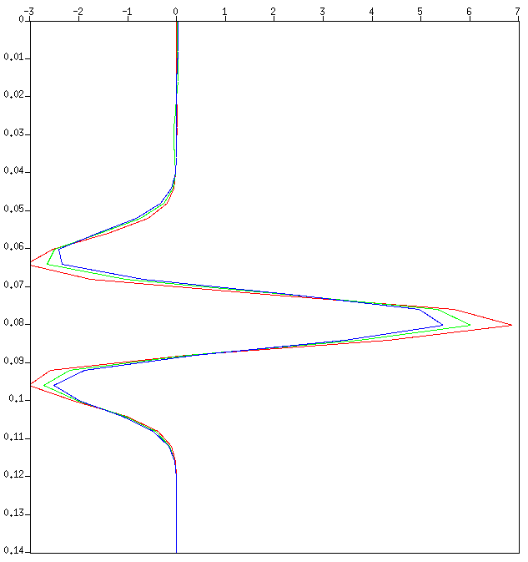
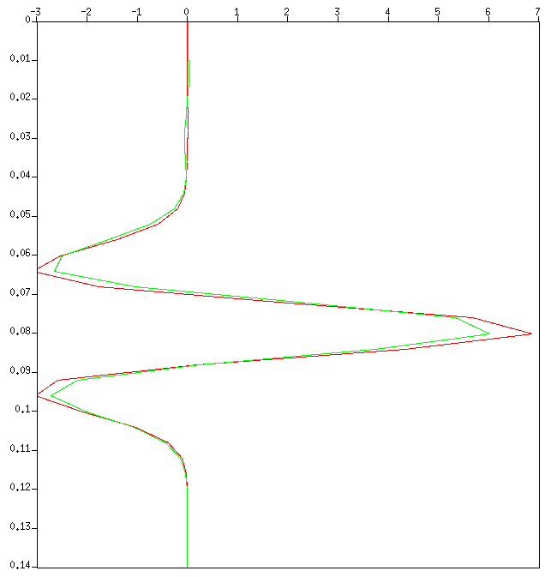
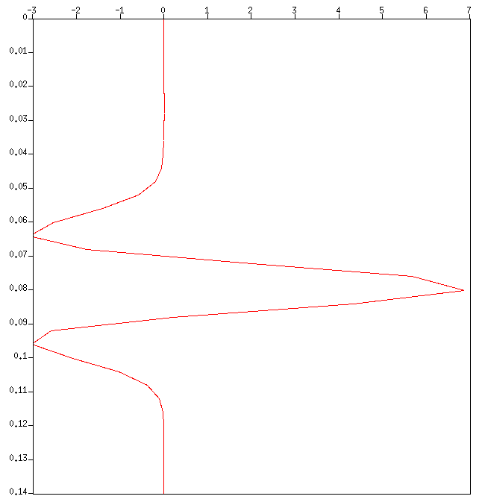
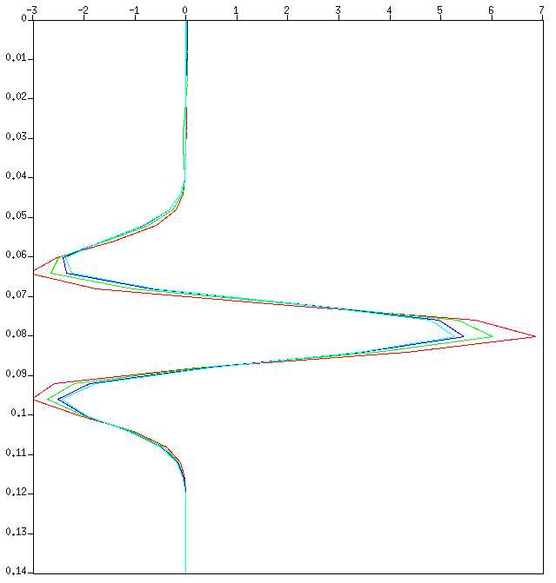
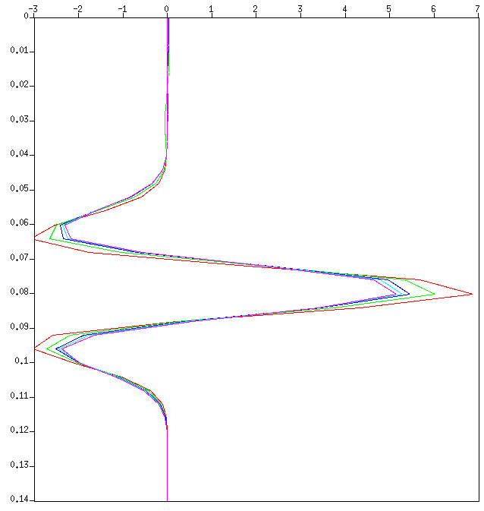
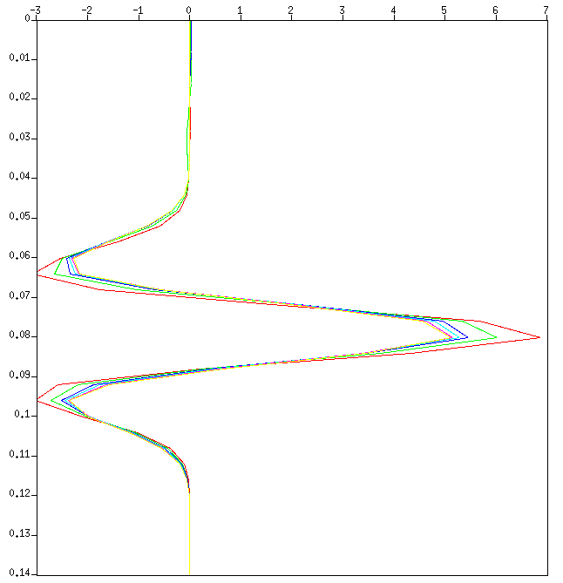
Source array, correct reference velocity
Estimate wavelet along different angles, to examine the radiation pattern;
FS
z_{s}=6m
time(s)
z=56m
0⁰~85 ⁰
A(t)
Wavelet estimated from offset 0m ~ 606m at depth 56m.

Slide 38
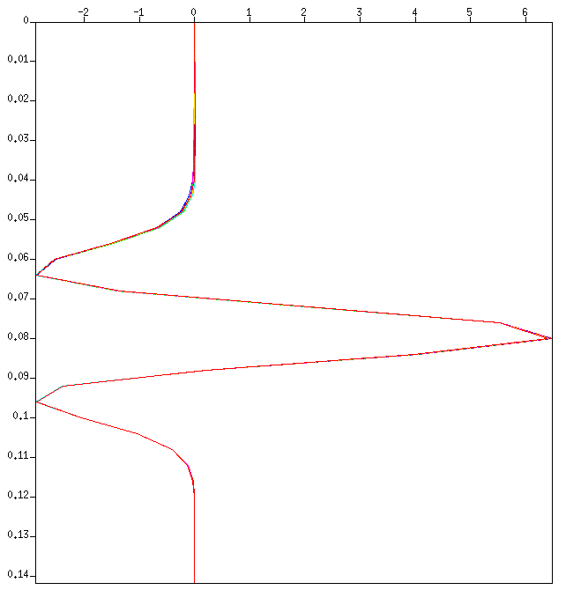
Source array, correct reference velocity
II. Estimate wavelet along one radiation angle, using correct reference velocity 1500m/s;
FS
zs=6m
time(s)
5.8 ⁰
Invariance when using the correct reference velocity
A(t)
Wavelet estimated at depth 36m, 56m, 76m, 96m, 116m, 136m, 156m in the same radiation angle.

Slide 39
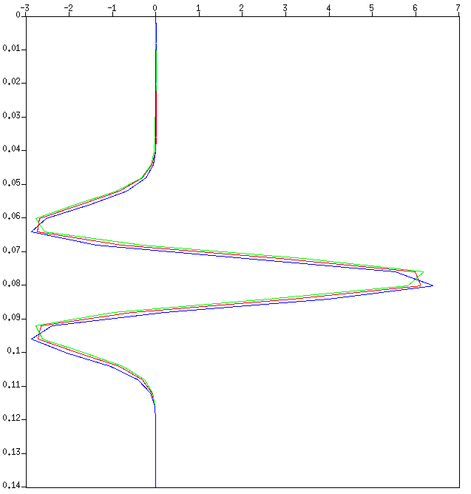
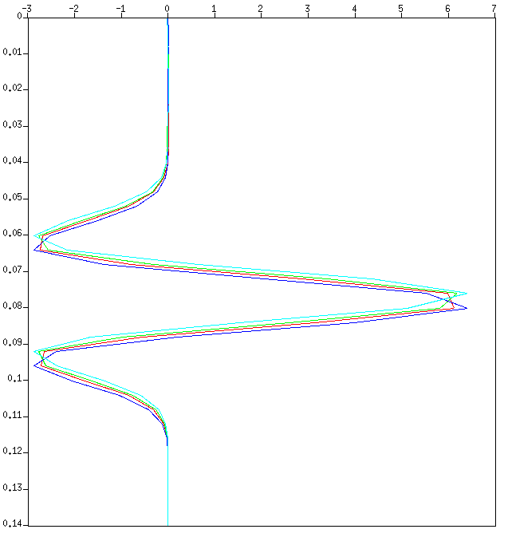
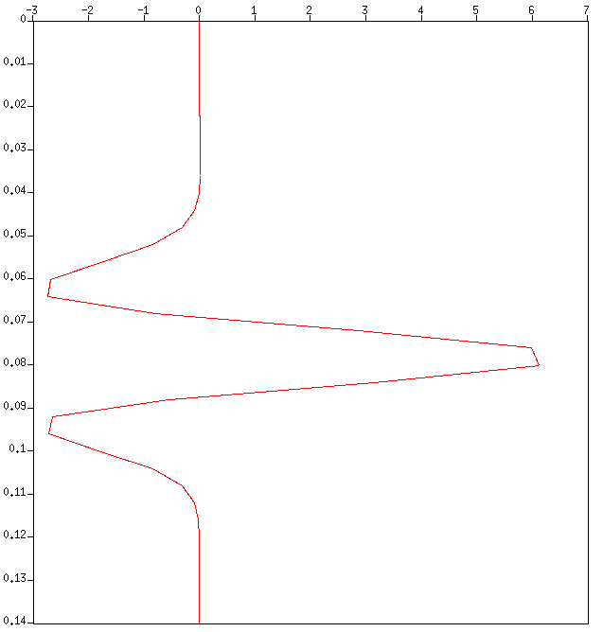
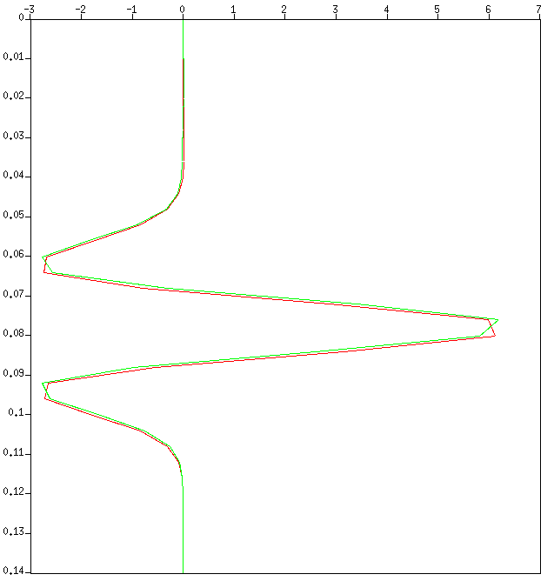
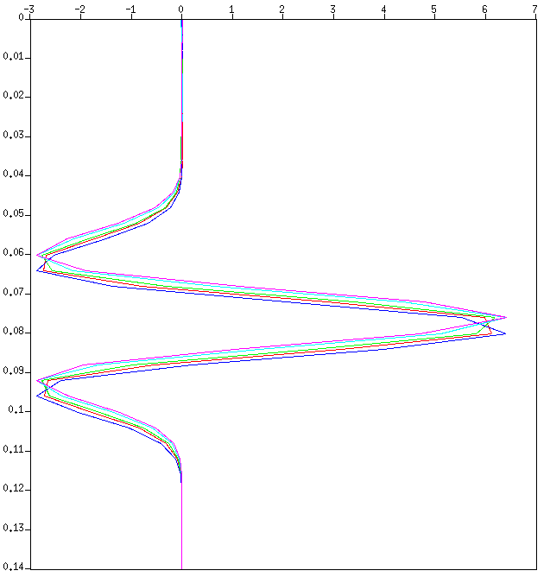
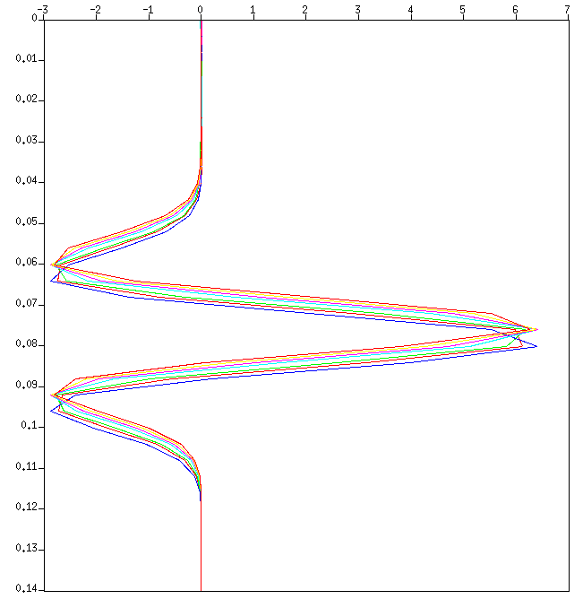
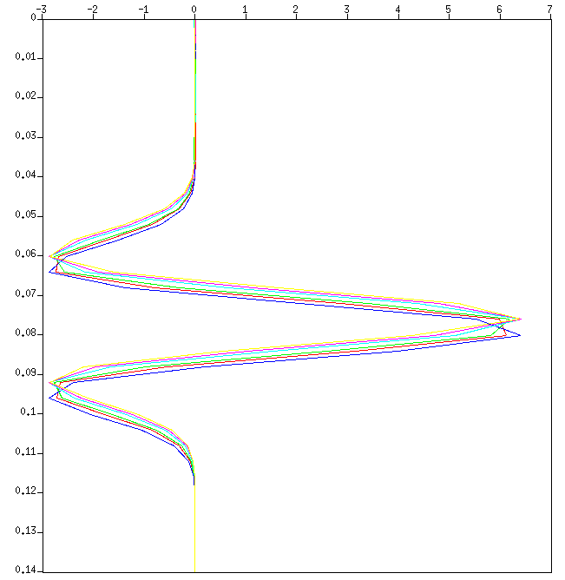
Source array, wrong reference velocity
III. Estimate wavelet along one radiation angle, using wrong reference velocity 1450m/s;
FS
zs=6m
time(s)
5.8 ⁰
Loss of invariance when using the wrong reference velocity
A(t)
Wavelet estimated at depth 36m, 56m, 76m, 96m, 116m, 136m, 156m in the same radiation angle.

Slide 40
Outline
Motivation
Method – Green’s theorem
An analytic example
Test result
Data from a point source
Data from a source array
Conclusions

Slide 41
Conclusions
Can we find criteria satisfied by the correct reference velocity?
For the point source data, the invariance of the estimated wavelet is at every output point below the measurement surface;
For data with a radiation pattern, the invariance of the wavelet is along one radiation angle.
Future study: Using a similar thinking to study complex on-shore or ocean bottom near surface property problems.

