Slide 1
ISS internal multiple attenuation on Encana data set
Qiang Fu* and Arthur B. Weglein
May 27, 2014
Austin, Texas
Notes:
1
1

Slide 2
The key points
We tested ISS internal multiple attenuation algorithm on Encana data set.
Besides the prerequisites, the ISS algorithm for the surface and internal multiple attenuation requires reasonable data collection in terms of sampling and offset as well
Higher order internal multiple attenuator may be required to better remove higher order internal multiple energy

Slide 3
Outline
Background
The Encana dataset
The algorithm we choose
Results and discussion
Conclusion

Slide 4
Outline
Background
The Encana dataset
The algorithm we choose
Results and discussion
Conclusion

Slide 5
Seismic processing chain
Seismic data processing tasks
Preprocessing
De-multiple
Depth Imaging
Inversion

Slide 6
Seismic processing chain
Seismic data processing tasks
Preprocessing
De-multiple
Depth Imaging
Inversion
Surface multiple
Internal multiple

Slide 7
Seismic processing chain
Seismic data processing tasks
Preprocessing
De-multiple
Depth Imaging
Inversion
Surface multiple
Internal multiple

Slide 8
Seismic processing chain
Seismic data processing tasks
Preprocessing
De-multiple
Depth Imaging
Inversion
Surface multiple
Internal multiple
ISS internal multiple attenuation / elimination

Slide 9
The ISS internal-multiple attenuation
Advantages of ISS internal-multiple attenuation
Not requirement for subsurface information
Can predict exact time and approximate amplitude
Can predict internal multiples at all depths at once

Slide 10
The ISS internal-multiple attenuation
Prerequisites for the ISS algorithm to be effective
Reference wave removal
Source wavelet removal
Source and receiver de-ghosting
Free surface multiple removal

Slide 11
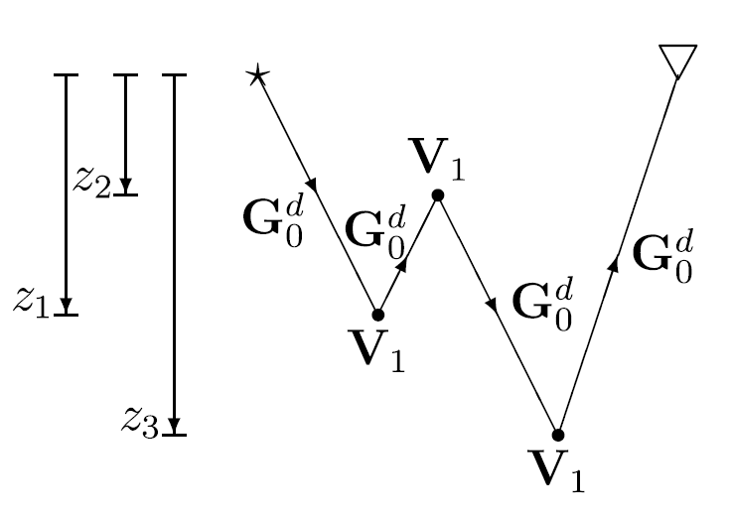
ISS internal multiple attenuation
An intuitive explanation of ISS internal multiple attenuation

Slide 12
The ISS first-order attenuation
The 2D first-order ISS internal multiple attenuation

Slide 13
Previous efforts to apply ISS multiple attenuation on field data
Mason et al. 1999 were the first to apply the ISS internal-multiple attenuation on streamer marine data
Matson (1997) and Weglein et al. (1997) extended the ISS method to free-surface and internal multiple on ocean-bottom and land data
Fu et al. (2010) applied ISS internal-multiple attenuation on Arabian Peninsula land field data.
Terenghi (2011) showed ISS internal-multiple attenuation on land data

Slide 14
Outline
Background
The Encana dataset
The algorithm we choose
Results and discussion
Conclusion

Slide 15
The Encana data set – stack section

Slide 16
Geological background
I am not a geologist, so I can not tell you the whole geological background…
There is a coal layer in vicinity of 1 second.
There should be reefs in this area below the coal layer (by well-log of this area)
The reefs is invisible on the data, the reason should be the strong internal-multiple interference caused by the coal layer.
Our goal is to make the reefs to be visible clearly by remove the internal-multiple interference.

Slide 17
Acquisition parameters
The data set is acquired in mid of 1990s
It is a 2D CMP survey line which consists of 146 CMP stations.
The data set include traces of 4 different azimuths.
The offset interval is 62.5m, and each CMP gather has 32 traces (for single azimuth).
The time sample interval is 0.002s, and there are 1001 time samples per trace.

Slide 18
The acquisition geometry
Source
Receiver

Slide 19
One CMP gather - one azimuth
Source
Receiver

Slide 20
One CMP gather - one azimuth
Source
32 receivers
Receiver
CMP point
32 sources

Slide 21
One CMP gather - one azimuth
CMP point
receivers
sources
……
……

Slide 22
One CMP gather - one azimuth
Source
Receiver

Slide 23
Four CMP gathers for one CMP station - four azimuths
Source
Receiver

Slide 24
The acquisition geometry
Source
Receiver

Slide 25
Outline
Background
The Encana dataset
The algorithm we choose
Results and discussion
Conclusion

Slide 26
Decision to make: 2D vs. 1.5D
The data is a 2D survey line (although there are 4 different azimuths)
However it is only 32 traces per CMP gathers
If we would like to perform 2D ISS internal-multiple attenuation, we would need a large amount of extrapolations to obtain full 2D data coverage from low-fold data that we have.
In addition, we found the subsurface geological structures here is fairly flat.
Thus we choose 1.5D ISS internal-multiple attenuation algorithm.

Slide 27
The 2D ISS first-order internal multiple attenuation
The 2D first-order ISS internal multiple attenuation

Slide 28
The 1.5D ISS first-order internal multiple attenuation
1.5D = a 2D source and a 1D earth
The medium consists of horizontal flat-layer reflectors
Under this assumption, and from the symmetry
After the integral over k₁ and k₂ , we get The 1.5D first-order ISS internal multiple attenuator
My colleague Xinlu Lin will explain more about this topic in her tomorrow presentation

Slide 29
The 1.5D ISS first-order attenuation
The 1.5D first-order ISS internal multiple attenuation

Slide 30
The code I used
I used a revised version of ISS internal multiple attenuation code based on Paolo Terenghi’s 1.5D ISS internal prediction code
The Paolo Terenghi’s 1.5D ISS internal prediction code (released in 2012) can be found on M-OSRP website

Slide 31
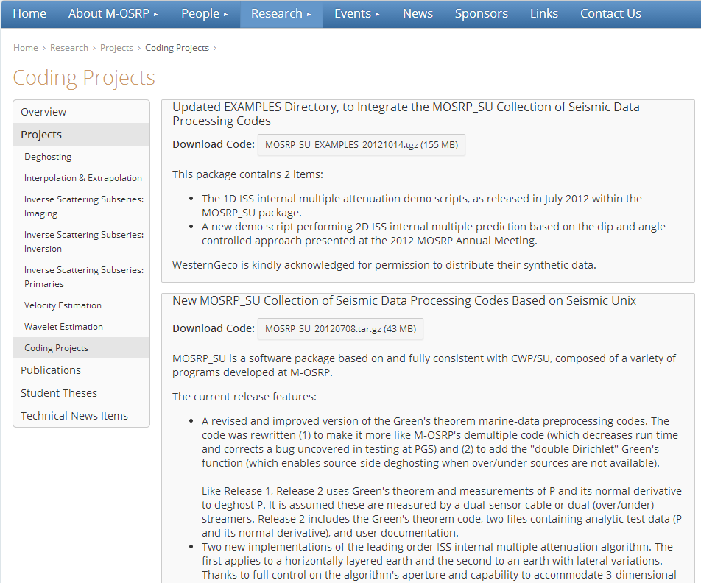

Slide 32
Outline
Background
The Encana dataset
The algorithm we choose
Results and discussion
Conclusion

Slide 33
Stack section of input data

Slide 34
Stack section of output

Slide 35
The difference

Slide 36
Three gathers of input data

Slide 37
Predicted internal multiple

Slide 38
Reasons for the not entirely effective
The data set has limited fold per gather (32 trace per DMP gather)
The amplitude in near offset traces is low
There are ambient noise, bad traces (common issues for land data)
There may be a lot of higher order internal multiple energy, the first-order internal multiple attenuator we used may be not sufficient

Slide 39
Reasons for the not entirely effective

Slide 40
Conclusions
The earlier Saudi Aramco on-shore ISS internal multiple test (Fu et al 2010) had reasonable multiple offset aperture and produced a successful result. The Encana data set tested in this paper was of an earlier vintage, and had a much smaller maximum offset, and produced a less successful result. Current typical acquisition for marine and on-shore exploration is adequate for ISS internal multiple attenuation effectiveness.
The ISS algorithm for the surface and internal multiple attenuation require reasonable data collection in terms of sampling and offset
Higher order internal multiple attenuator may be required to better remove higher order internal multiple energy

Slide 41
Acknowledgment
David Mackidd, David Bonar and Encana
Paolo Terenghi
Bill Goodway
All M-OSRP sponsors

Slide 42
M-OSRP Sponsors

Slide 43
Thank you

