Slide 1

Multiples can be useful (at times) to enhance imaging, by providing an approximate image of an unrecorded primary, but its always primaries that are migrated or imaged
Arthur B. Weglein
M-OSRP, University of Houston
Oct 20th, 2015

Slide 2
Migration
was originally (and remains today) only meaningful for primaries

Slide 3
The original purpose of migration was to map an event on a time section in (x,t) to a point on a structure map.That is, to a point on a reflector in x,z
That concept only has meaning for primaries.
We will show that that remains the meaning of migration today.

Slide 4
Wave theory methods used to migrate seismic data have two components
  A wave propagation component
  An imaging condition

Slide 5
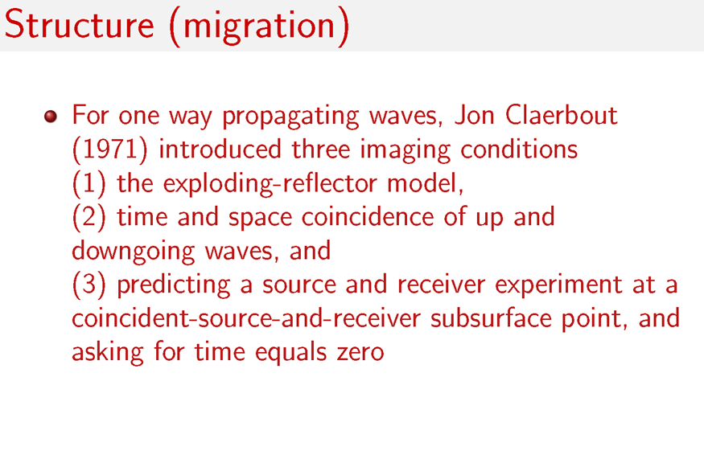

Slide 6
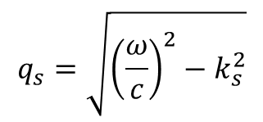
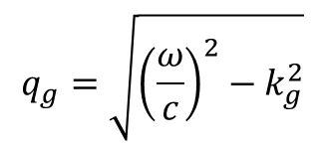
2D Claerbout III (Stolt migration)
Data on measurement surface
Fourier transform
Data at depth
$$D\left(k_{g},z,k_{s},z,ω\right)=D\left(k_{g},z_{g}=0,k_{s},z_{s}=0,ω\right)×e^{−i\left(q_{g}+q_{s}\right)z}$$
$$q_{g}=\sqrt{{\left(\frac{ω}{c}\right)}^{2}−k_{g}^{2}}$$
$$q_{s}=\sqrt{{\left(\frac{ω}{c}\right)}^{2}−k_{s}^{2}}$$
Data at depth at t=0

Slide 7
2D Claerbout III (Stolt migration)
Change of variables
Inverse Fourier transform
Set x_{g}=x_{s}=x (x_{m}=x; x_{h}=0 ) original Stolt migration (Claerbout III)
angle average plane wave reflection coefficient by summing over k_{h}

Slide 8
Stolt extended (Claerbout III) migration retains k_{h} information at depth z, D(km,kh,kz) and that provides the plane wave reflection coefficient at a specular reflector
Stolt and collaborators further extended Claerbout III to provide a point reflectivity model that automatically images specular and non-specular reflections.
The latter is only possible for extensions/generalizations of Claerbout III(not for Claerbout II)

Slide 9
Claerbout imaging II
Claerbout imaging III

Slide 10
Let’s examine Claerbout II and III where only the imaging condition is the issue

Slide 11
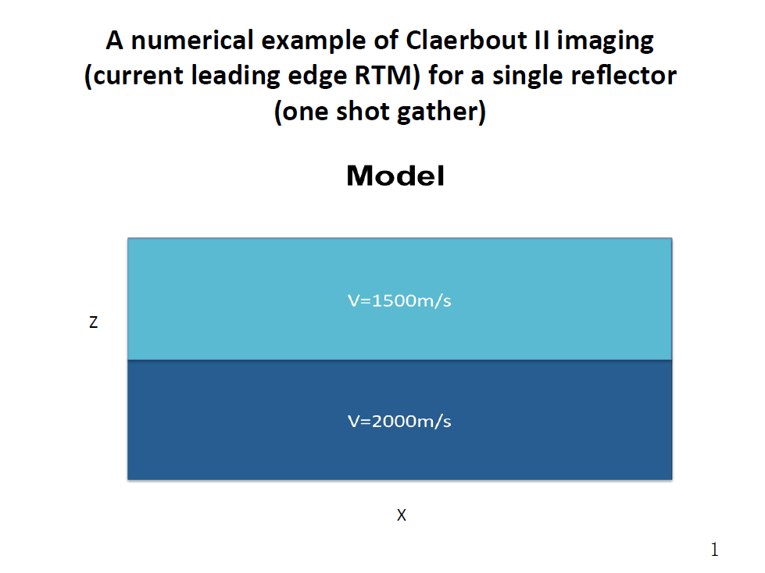
Zou and Weglein, 2014

Slide 12
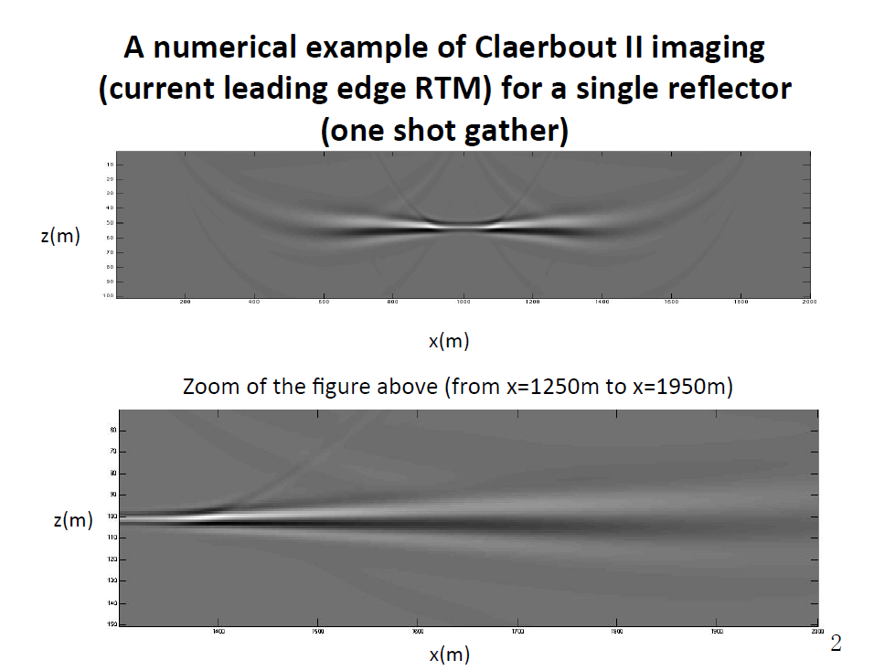

Slide 13
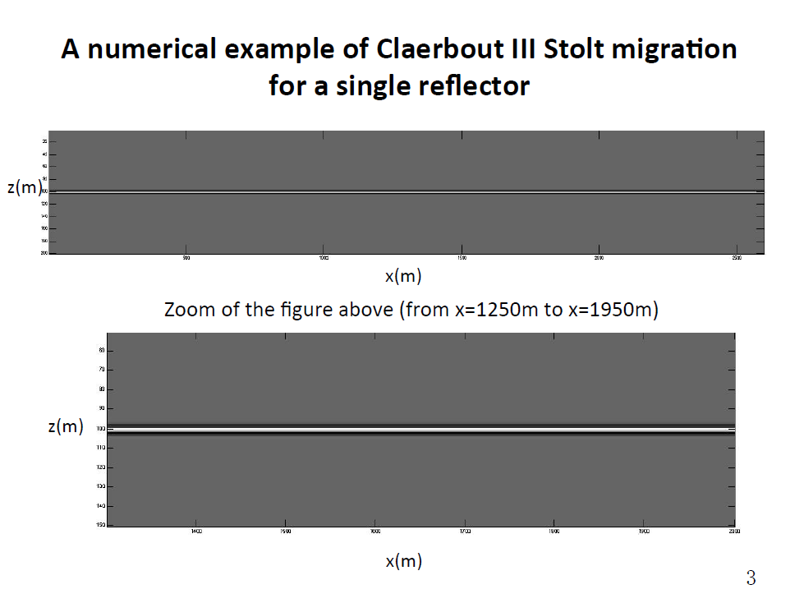

Slide 14
The Claerbout II imaging principle provides an image for one shot record. However, the resulting inconsistency in the image is mitigated by summing over shots. Claerbout II has a somewhat ad hoc origin and an ad hoc ‘fix’.

Slide 15
In Claerbout III one shot record predicts the receiver at depth (not an image). The Green’s theorem weighted sum over shots then predicts the source at depth, leading to an image.
There is nothing that’s inconsistent or being fixed with the sum over sources in Claerbout III.

Slide 16
How do you know if a migration method has made a high frequency approximation?

Slide 17
(1) If there is a travel time curve of candidate images within the method, it is a high frequency ‘ray theory’ approximation/ assumption.
where,

Slide 18
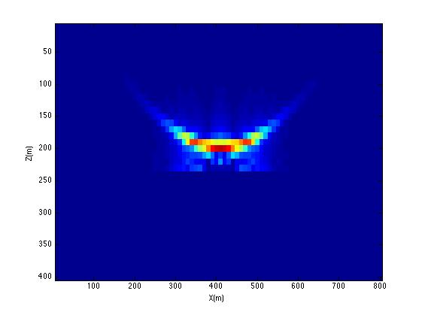
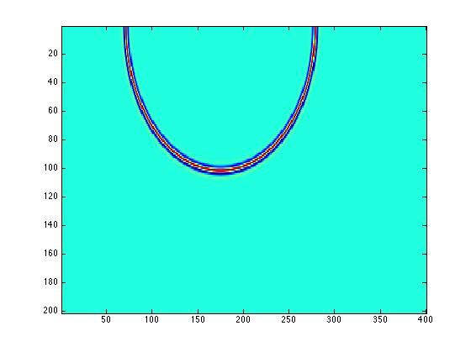
Imaging Conditions and High Frequency Assumptions
Claerbout III
Claerbout II
Stolt migration: one source one receiver
RTM(2D)
z
x
Zou, 2015
No high frequency assumption
High frequency assumption

Slide 19
How do you know if a migration method has made a high frequency approximation?
(2) A stationary phase of other high frequency approximation is employed within the method.
(3) a propagation model that assumes one way wave propagation (for anything other than a homogeneous subsurface) is a high frequency approximation
  high frequency approximation can enter migration methods through (1) the imaging condition (all Claerbout II) or (2) through the propagation component (or both), that is, for example, assuming a one way propagation for a slowly varying velocity in Claerbout III

Slide 20
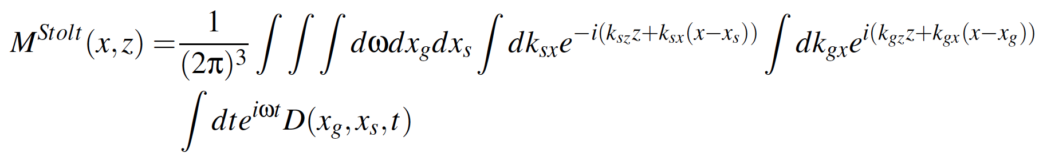
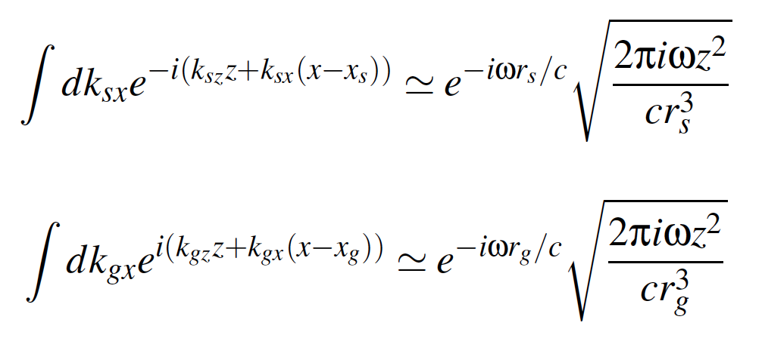
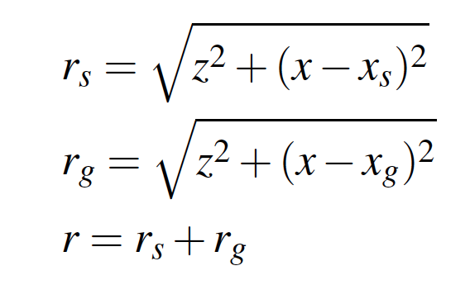
2D Stolt migration
An asymptotic approximation can be made with
the stationary phase approximation

Slide 21
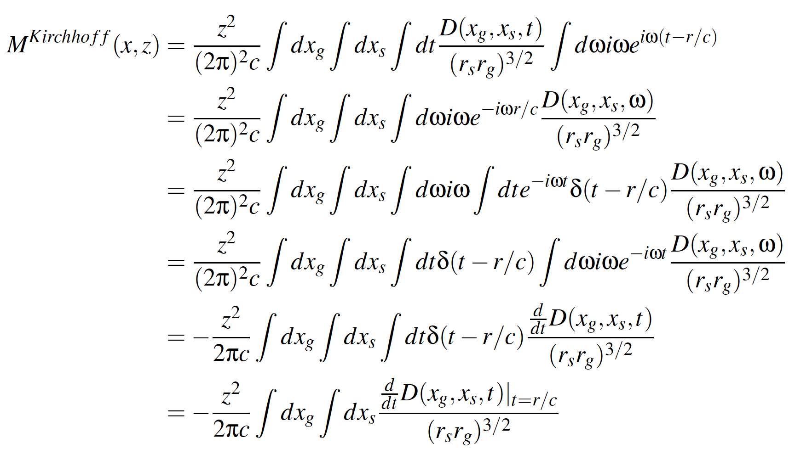
The Kirchhoff migration is an asymptotic approximation
of Stolt migration

Slide 22
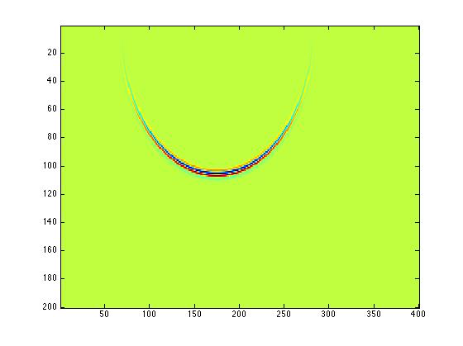
Kirchhoff migration for a single source and receiver
Kirchhoff migration (2D)
z
x
Zou et al, 2015
High Frequency approximation from a stationary phase approximation
Notes:
----- Meeting Notes (5/28/15 03:35) -----
Kirchhoff migration shares some kind of behavior with RTM (Claerbout II), including producing candidate and depending on the coherent summing over candidate.

Slide 23
Claerbout II and III have been extended and generalized
For Claerbout II
  e.g., Yu Zhang, Sheng Xu and Norman Bleistein
    ----- introduce a geometric optics reflection coefficient model relating the reflection data and the incident source wavefield.
For Claerbout III
Stolt and collaborators
----- non-zero offset at t=0 provides amplitude information
----- outputs plane wave reflection coefficient or point scatterer reflectivity for specular and non-specular reflection

Slide 24
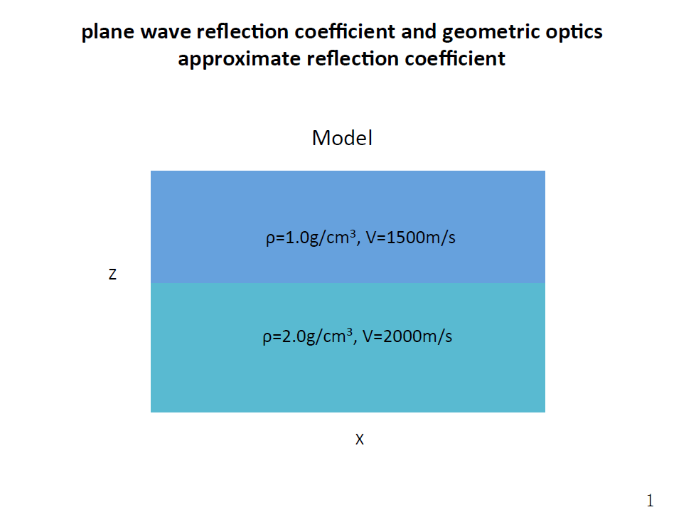

Slide 25
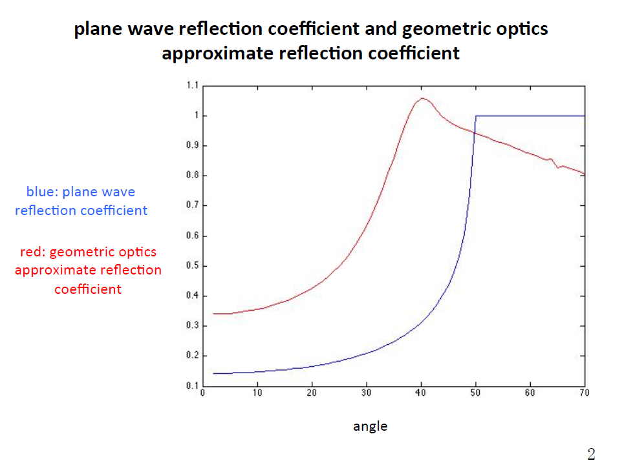
Zou and Weglein, 2015

Slide 26
Benefits of Claerbout III imaging (extended by Stolt and colleagues) for specular and non-specular imaging
1
2
3
specular
non-specular
non-specular
1. Specular
outputs actual plane wave reflection coefficient data for
specular reflection (unique to Claerbout III )
2. Non-Specular reflection
a point scatterer model for structure and inversion of non-specular reflections (unique to Claerbout III )

Slide 27
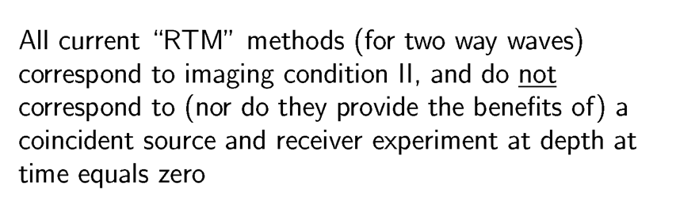

Slide 28
M-OSRP has recently pioneered and developed a new migration method that has Stolt’s extension of Claerbout III imaging inside a medium with two way waves
The new migration method provides four benefits

Slide 29
Recent new imaging development from M-OSRP (Weglein, A.B., Stolt, R. H., Mayhan, J. D., “Reverse-time migration and Green’s theorem: Part I — The evolution of concepts, and setting the stage for the new {RTM} method” Journal ofSeismic Exploration, 20, 73–90. February 2011; Weglein, A.B., Stolt, R. H., Mayhan, J. D., “Reverse time migration and Green’s theorem: Part II — A new and consistent theory that progresses and corrects current RTM concepts and methods” Journal ofSeismic Exploration, 20, 135–159. May 2011; THE FIRST WAVE EQUATION MIGRATION RTM WITH DATA CONSISTING OF PRIMARIES AND INTERNAL MULTIPLES: THEORY AND 1D EXAMPLES FANG LIU and ARTHUR B. WEGLEIN JOURNAL OF SEISMIC EXPLORATION 23, 357-366 (2014) 357) provides the predicted source and receiver experiment at depth beneath an overburden that has two way wave propagation
  A tool to analyze the role of primaries and multiples in imaging
  A more effective and interpretable RTM by realizing Stolt extended Claerbout III providing a more complete realistic model for imaging and inverting specular and non-specular reflectors
  Provides the first migration method that is equally effective at every frequency component of recorded data (avoids asymptotic high frequency approximations) in both the imaging condition and in how the imaging condition is implemented.
  Imaging and inverting from above (and from below) a reflector without backscatter.

Slide 30
Use the new imaging method with two way propagating waves to examine the role of primaries and multiples in imaging and inversion
That provides a definitive response to the question of whether multiples are migrated

Slide 31
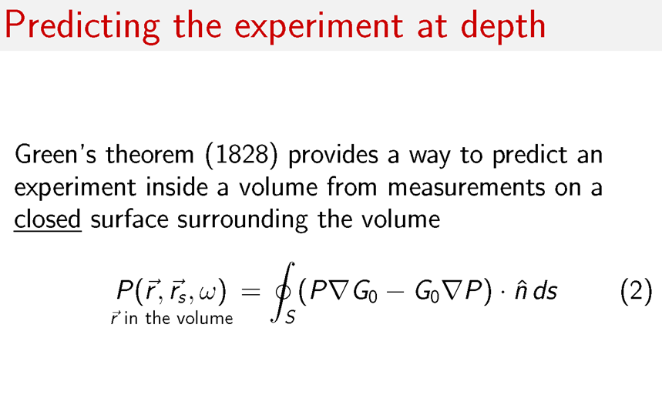

Slide 32
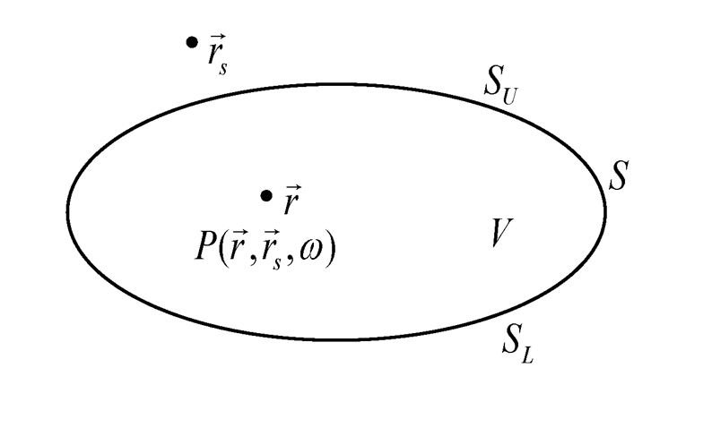

Slide 33
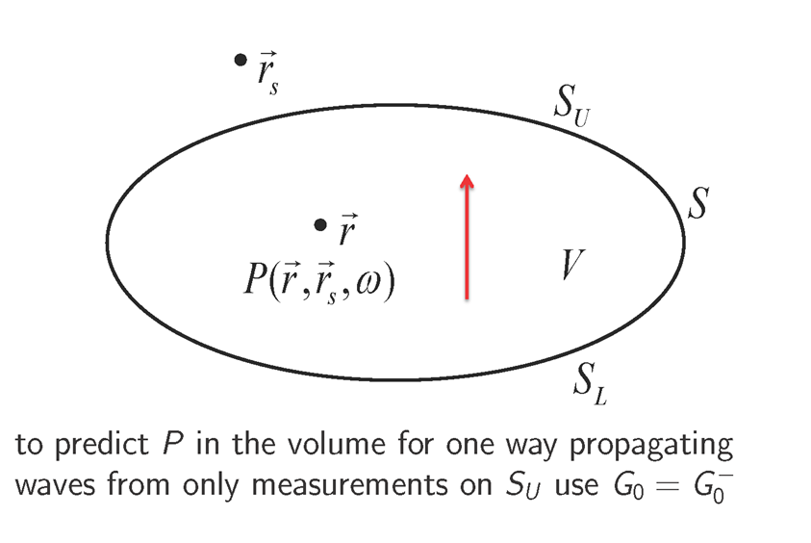

Slide 34
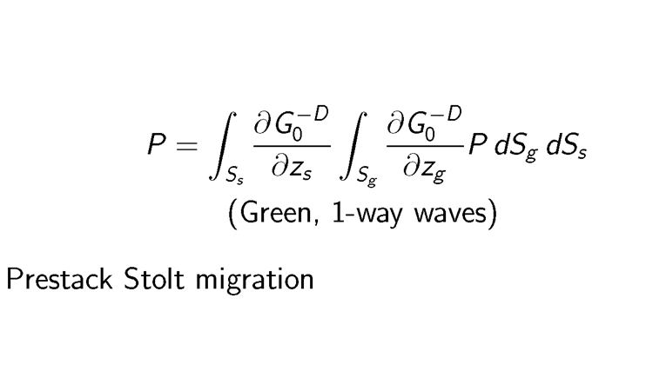

Slide 36
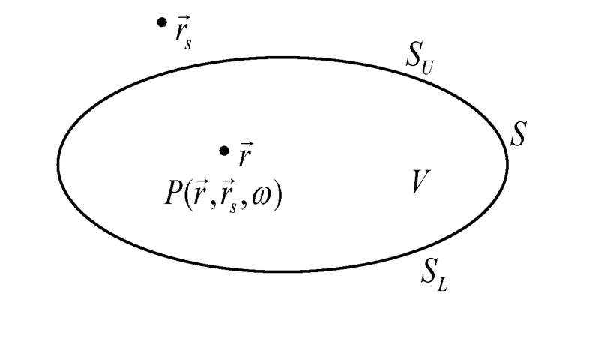

Slide 37
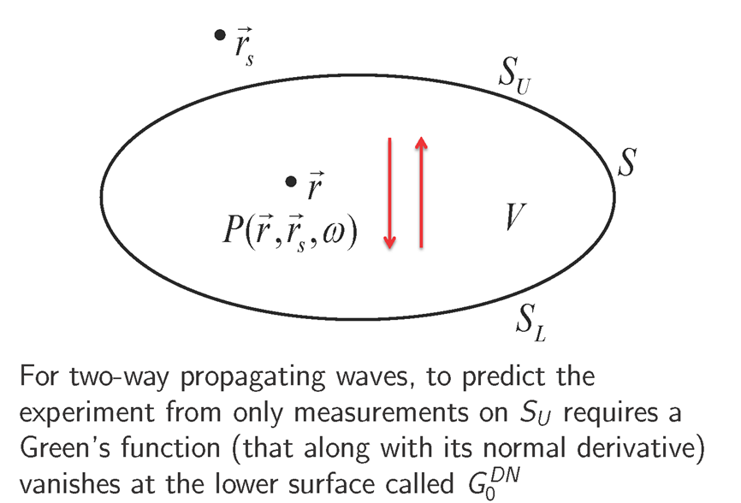

Slide 38
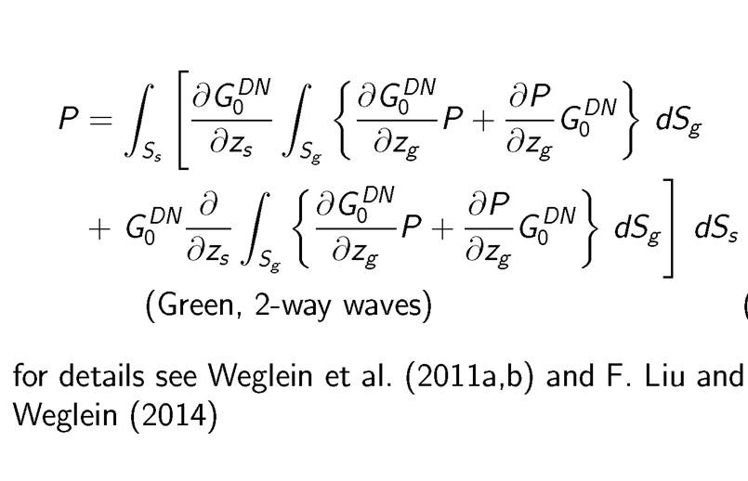

Slide 41
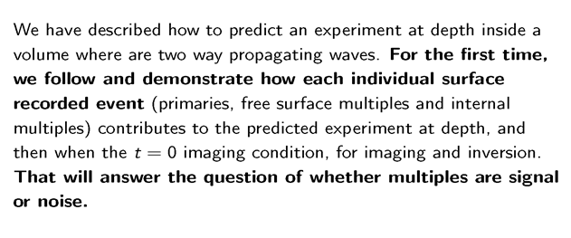
Migrating multiples?

Slide 42
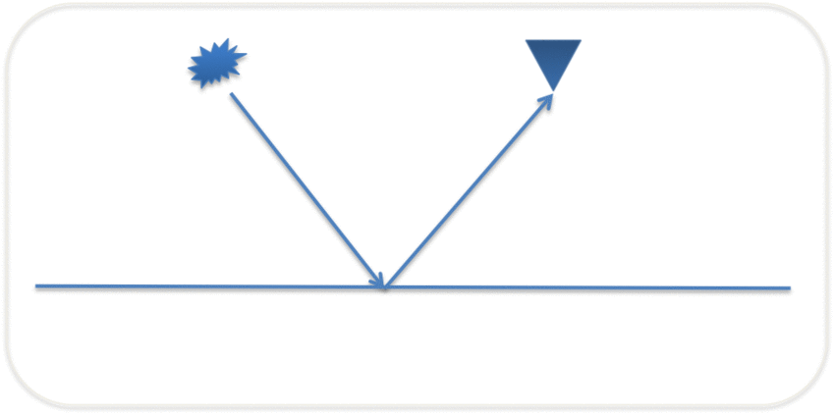
Case 1: a primary
42
Notes:
42

Slide 43
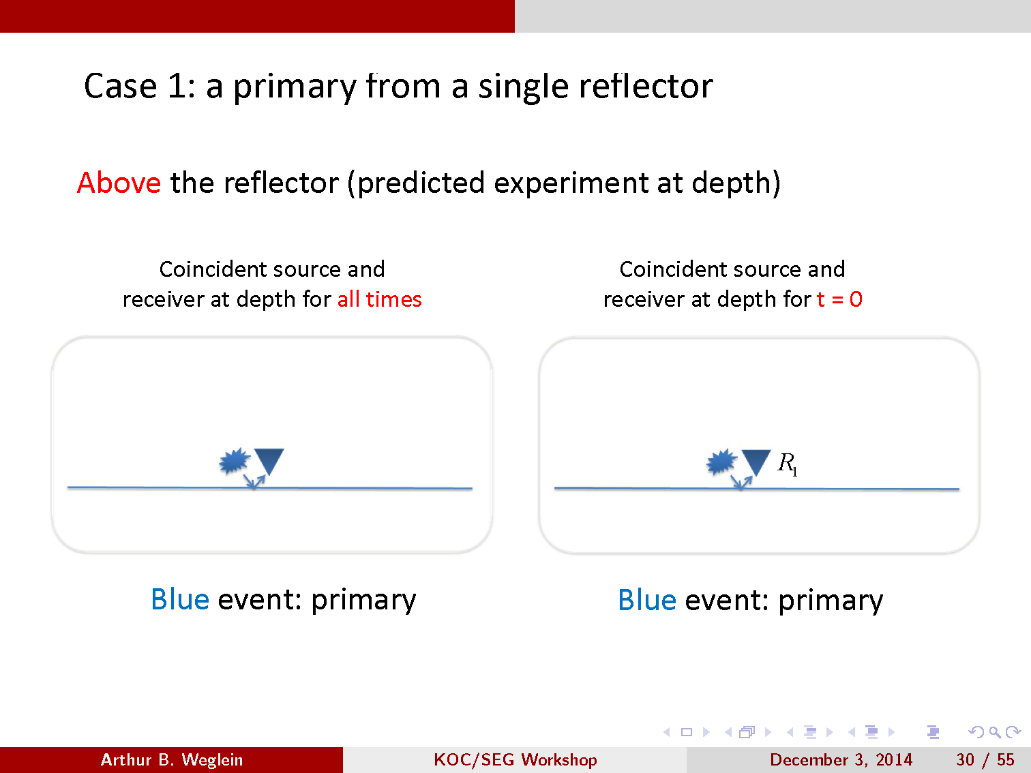

Slide 44
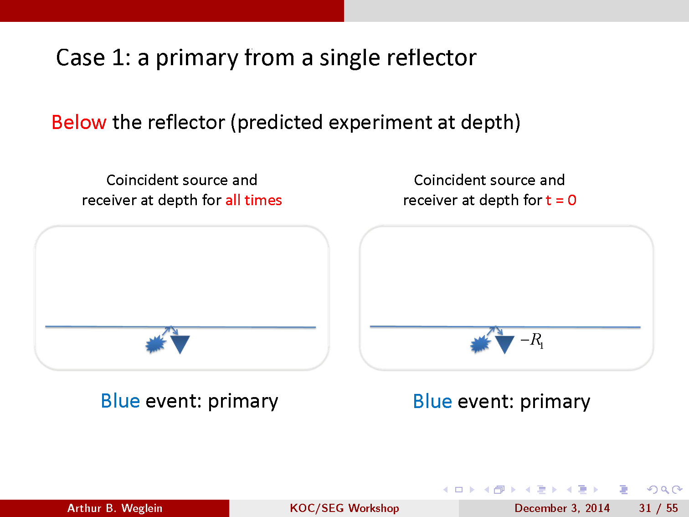

Slide 45
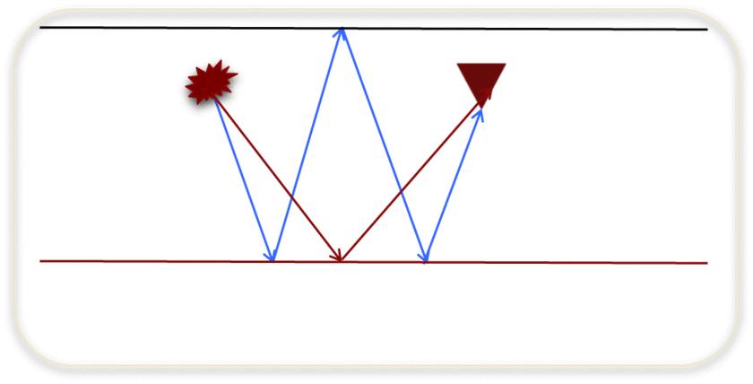
Case 2: a primary and free surface multiple
45
Notes:
45

Slide 46
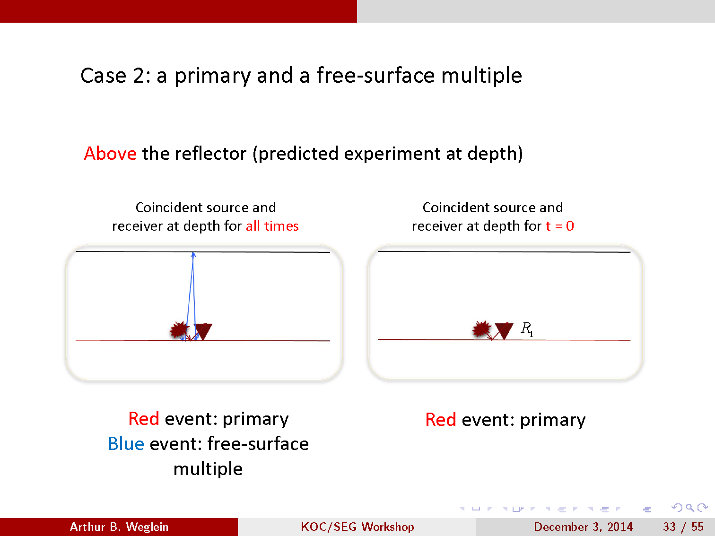

Slide 47
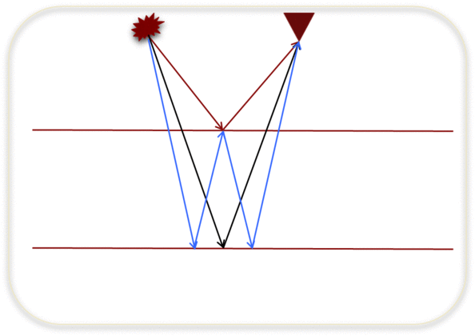
Case 3: two primaries and an internal multiples
47
Notes:
47

Slide 48
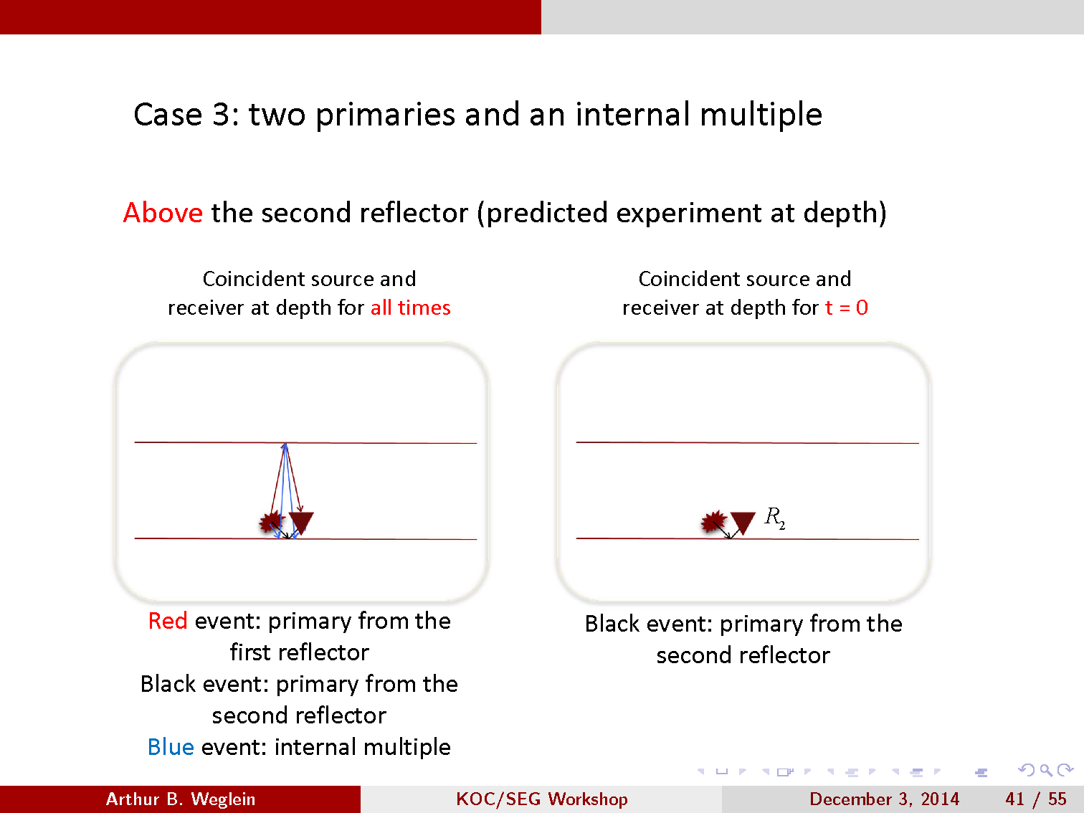

Slide 49
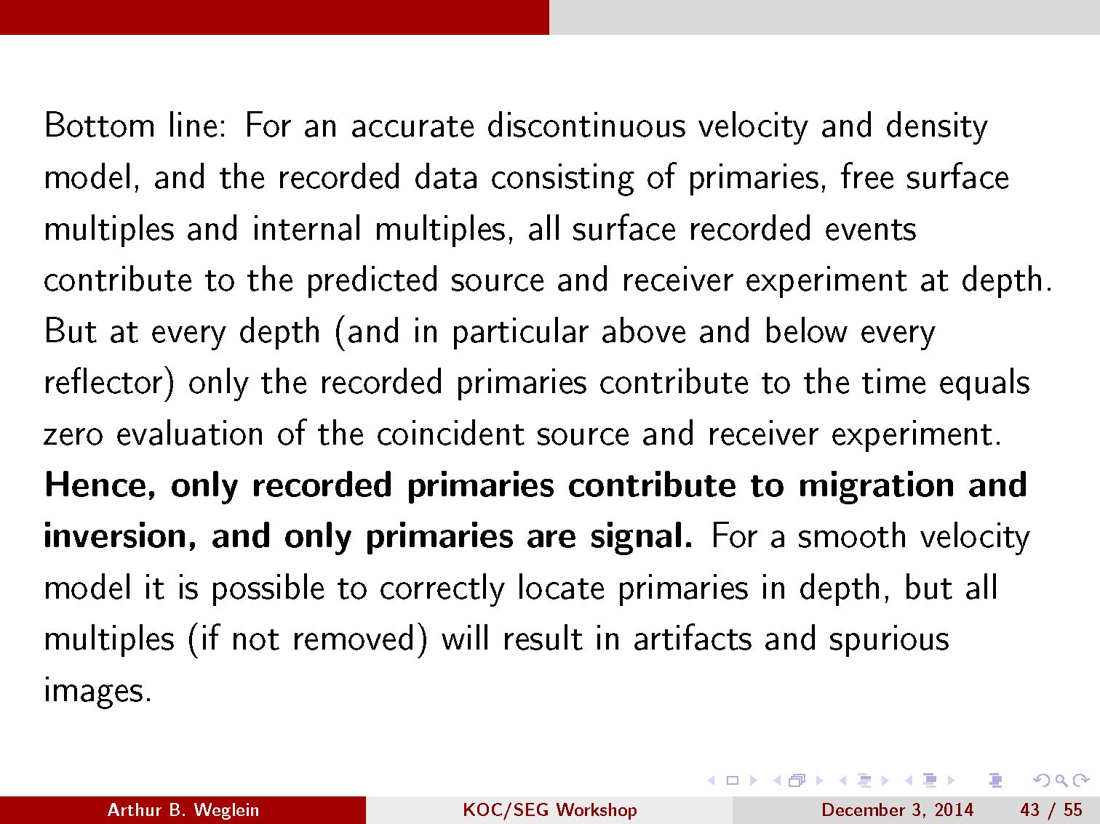
Hence, only recorded primaries contribute to migration and inversion, and only primaries are signal. For a smooth velocity model it is possible to correctly locate primaries in depth, but all multiples (if not removed) will result in artifacts and spurious images.

Slide 50
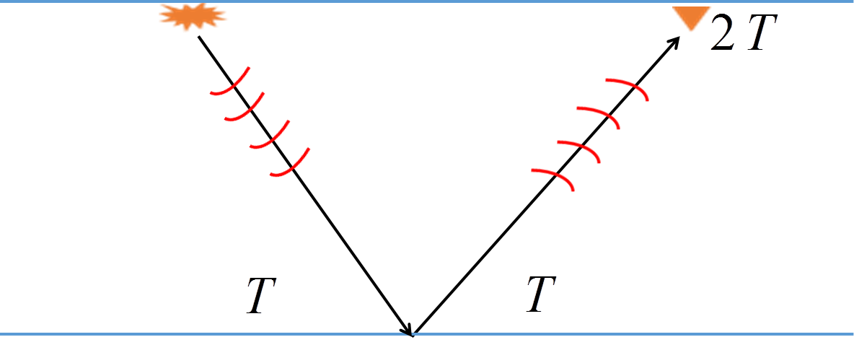
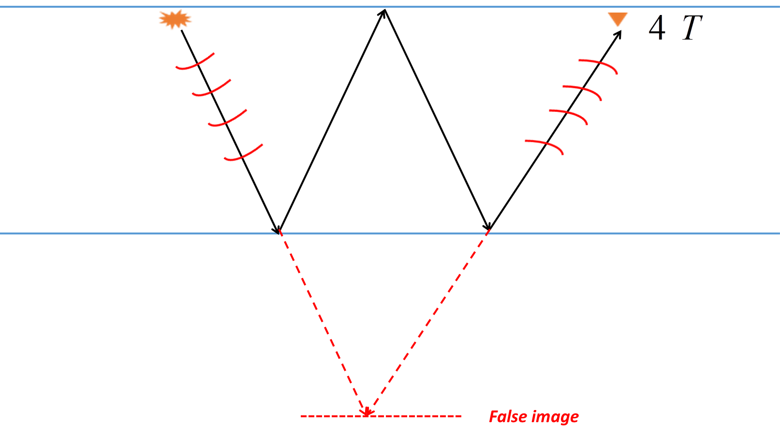


What happens to multiples with methods that image recorded primaries
Claerbout II
$$R_{1}$$
$${−R}_{1}^{2}$$
Multiples cause false images when migrating primaries

Slide 51
For smooth velocities, multiples produce false images and must be removed in any migration of primary and multiples, the same is true for Claerbout III

Slide 52
What if the recorded primaries are insufficient/less than adequate?
Given the velocity model of the unrecorded primary, a recorded multiple can be used to find an approximate image of an unrecorded primary

Slide 53
Claerbout Imaging condition II
Space and time coincidence of upgoing and downgoing wavefield
(e.g., Claerbout, 1971; Whitmore, 1983)

Slide 54
Use of primaries for imaging with II
Down-going plane wave that starts at z = at t = t₀ = 0
Downgoing
Upgoing

Slide 55
Use of primaries for imaging with II
Applying the imaging condition

Slide 56
Using multiples to enhance imaging
Downgoing
Upgoing

Slide 57
Using multiples to enhance imaging
Effective up & down wavefield separation
Downgoing
Upgoing

Slide 58
Using multiples to enhance imaging
Applying the imaging condition

Slide 59
Amplitude of the image of unrecorded primary is R₁. The image found by using a multiple is R₁³

Slide 61
These two figures have the same exact process in obtaining an approximate image of primary HIJ. To call that process migrating ABC…GIJ makes no sense. How can the migration of an event not care about the history of the event?

Slide 62
Imaging primaries
Imaging recorded primaries
Finding the approximate image of an unrecorded primary

Slide 63
Imaging recorded primaries

Slide 64
What happens to multiples with methods that image recorded primaries
Claerbout II
$$R_{1}$$
$${−R}_{1}^{2}$$
Multiples cause false images when migrating primaries

Slide 65
For smooth velocities, multiples produce false images and must be removed in any migration of primary and multiples, the same is true for Claerbout III

Slide 66
To image recorded primaries, using any imaging method, requires first effectively removing multiples without damaging primaries
While tremendous progress has occurred in the last 20 years (from ISS methods for FS and internal multiples), significant high priority challenges remain
Responding to those challenges is a strategic priority for the petroleum industry – if not, the information and value of recorded primaries will remain only partially accessible and delivered. Only recorded primaries can deliver Stolt extended Claerbout III imaging and inversion benefits.

Slide 67
Finding the approximate image of an unrecorded primary

Slide 68
Using a multiple to find an approximate image of an unrecorded primary
Outputs a amplitude challenged Claerbout II image of the unrecorded primary (that’s a very low bar for the claim of a new vision of seismic data)
Hence, to seek images of recorded primaries plus an approximate image of unrecorded primaries, requires, as a critical step, a very effective multiple removal for the first, and predicting multiples for the second.

Slide 69
The approximate image of unrecorded primaries cause cross-talk – since the method cannot predict a multiple unless all of its subevents are recorded – if all of its subevents are recorded the multiple is useless in providing an image of an unrecorded primary, since there are none – that circular reasoning leads to using the entire data set (that contain multiples) and the non-multiple events in the data are one of the causes of cross-talk.
This 'use of multiples' is an ad-hoc method, that doesn't derive from a comprehensive framework, where problems and shortcomings can be addressed in a systematic fashion, by returning to the theory without the issues. There is no theory that ‘uses’ multiples, without causing false events due to cross talk.

Slide 70
The effective removal of multiples remains a priority for those serious about imaging and inversion objectives ---- the improvement in structure from using multiples to obtain an approximate image of an unrecorded shallow primary can be useful ---- but doesn't represent a new and superceding view of primaries and multiples and their roles in migrating and inverting data.

