Slide 1

A direct inverse solution for AVO/FWI parameter estimation objectives
Arthur B. Weglein
M-OSRP, University of Houston
Oct 20th, 2015

Slide 2
Modeling
Inversion
Indirect
Direct

Slide 3
Direct
Indirect
Search for x such that
is a minimum

Slide 4
Indicators of “indirect”
model matching
objective/cost functions
search algorithm
iterative linear “inversion”
necessary and not sufficient conditions, e.g., CIG flatness
Solving a forward problem in an inverse sense

Slide 5
There’s a role for direct and indirect methods in practical real world applications.

Slide 6
For a normal incidence plane wave on a 1D earth, a closed-form direct inverse solution exists (e.g., Ware and Aki, (1968) JASA)

Slide 7
Direct Inverse for a multi-dimensional subsurface
Relationship
(1)
An operator identity that follows from
Modeling

Slide 8
Relationship
(1)
Modeling
(2)
From
With

Slide 9
Direct Forward and Direct Inverse
Solve for r

Slide 10
Each term in the inverse series that inverts
for
is computed directly in terms of S and a.

Slide 11
When we consider the generalized Geometric Series
the inverse Geometric Series for
where each term is computed directly in terms of a (‘G₀’) and S (‘ ’ the recorded data).

Slide 12
The r₁, r₂, … equations generalize

Slide 13
Hence, the inverse scattering series is not only the only direct multidimensional inverse seismic solution, in addition, every term in the solution is directly computed in terms of a single unchanged reference and the recorded reflection data.

Slide 14
Direct Forward and Direct Inverse
Forward S in terms of V, inverse V in terms of S
(3)
where V_{n} is the portion of V, n-th order in the data
(2) is the forward series;
(3) is the inverse series.

Slide 15
The relationship (2) provides a Geometric forward series rather than a Taylor series.
In general, a Taylor series doesn’t have an inverse series; however, a Geometric series has an inverse series.
All conventional current mainstream inversion, including iterative linear inversion and FWI, are based on a Taylor series concept.
Solving a forward problem in an inverse sense is not the same as solving an inverse problem directly.

Slide 16
If (a linear exact relationship)
Then is solving the inverse problem directly and the forward problem in an inverse sense

Slide 17
But if the relationship is non-linear
n roots,
As , number of roots
However, from , we found the direct inverse
(one real root)

Slide 18
This provides a vivid illustration of how solving a forward problem in an inverse sense is not the same as solving the inverse problem directly.

Slide 19
In all current indirect ‘inversion’ methods

Slide 20
The terms in the inverse scattering series

Slide 21
Isolated Task Subseries of the ISS
If we imagine that the inverse machine that inputs reflection data and outputs earth properties needs to achieve certain tasks, then we can seek to locate terms within the general ISS that achieve those specific objectives.
Those tasks are:
  Free surface multiple removal
  Internal multiple removal
  Depth imaging
  Parameter estimation
  Q compensation without knowing or needing Q

Slide 22
Each of these tasks has a subseries that doesn't require subsurface information.
In addition, several of these tasks (and corresponding subseries) are model type independent. That is, there is one unchanged algorithm to achieve that task independent of whether you assume the earth is acoustic, elastic, anisotropic or inelastic.
To see how different the ISS direct inverse is from linear updating and model matching: It is not conceivable to perform model type independent model matching and updating, e.g., for multiple removal.
And the ISS free-surface multiple elimination method works one temporal frequency at a time. You cannot model match (and update models) to subtract multiples one frequency at a time.

Slide 23
Non-linearity (2 types)
Innate or intrinsic non-linearity
e.g., R.C. and material property changes.
Circumstantial non-linearity
- Removing multiples or depth imaging
primaries.

Slide 24
The inverse scattering series is (once again) unique
in its ability to directly address either alone, let
alone these two in combination.

Slide 25
The first term in a task specific subseries that addresses a potential circumstantial non-linearity first decides if its assistance and contribution is required in your data…
And only if decides that it is, then it starts to compute … if there is no nonlinear circumstantial issue to address, it computes an integrand which is zero.

Slide 26
The latter is a very sophisticated and impressive (and surprising) quality of task specific subseries
We call that property purposeful perturbation theory….
It decides if its assistance is needed before it acts!

Slide 27
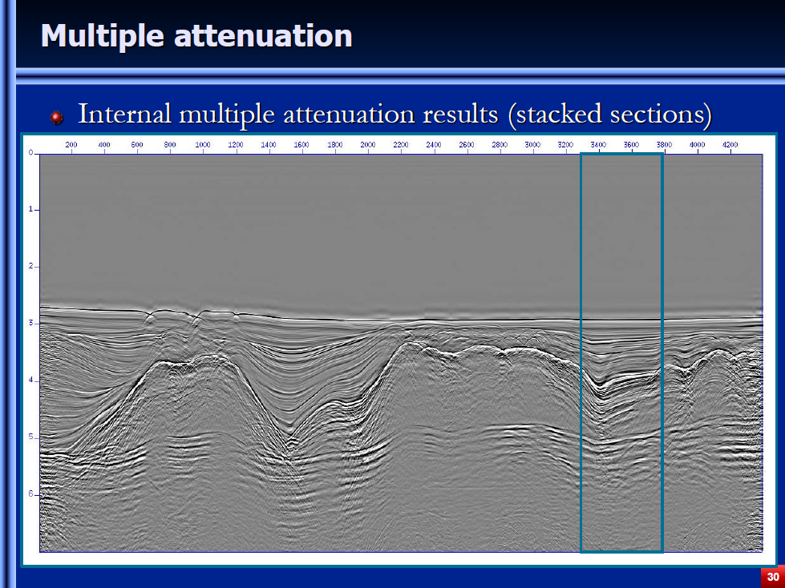
Offshore Brazil data example
(A. Ferreira and A. Weglein, 2011; A. Ferreira et al., 2013, Petrobras)

Slide 28
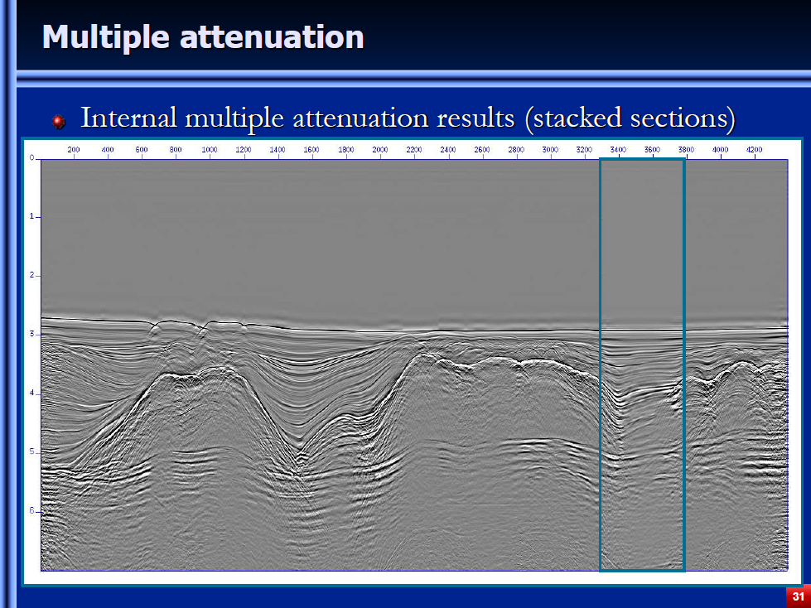
Offshore Brazil data example
(A. Ferreira and A. Weglein, 2011; A. Ferreira et al., 2013, Petrobras)
Notes:
These two samples show you the uniqueness and significance of the ISS internal multiple attenuator.

Slide 29
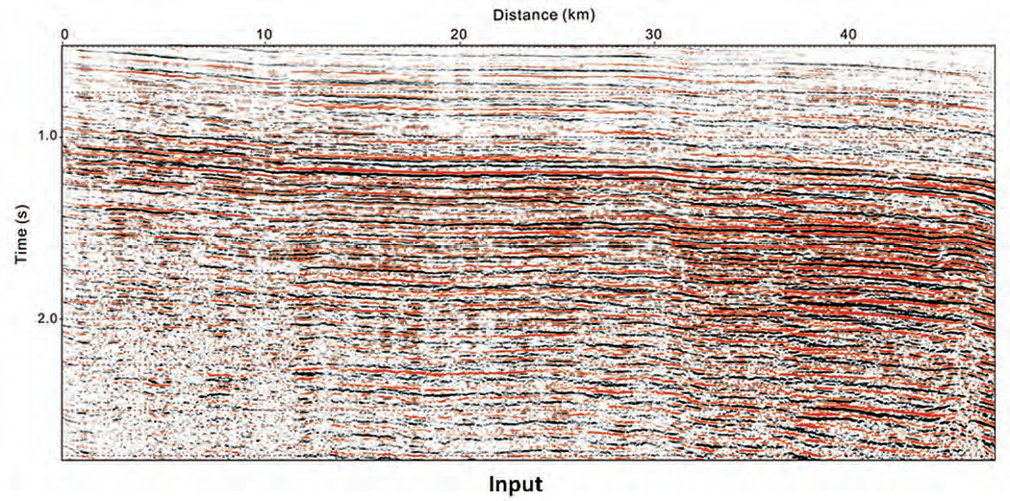
Onshore Saudi Aramco example:
Yi Luo et al., 2011, TLE
“Elimination of land internal multiples based on the inverse scattering series”

Slide 30
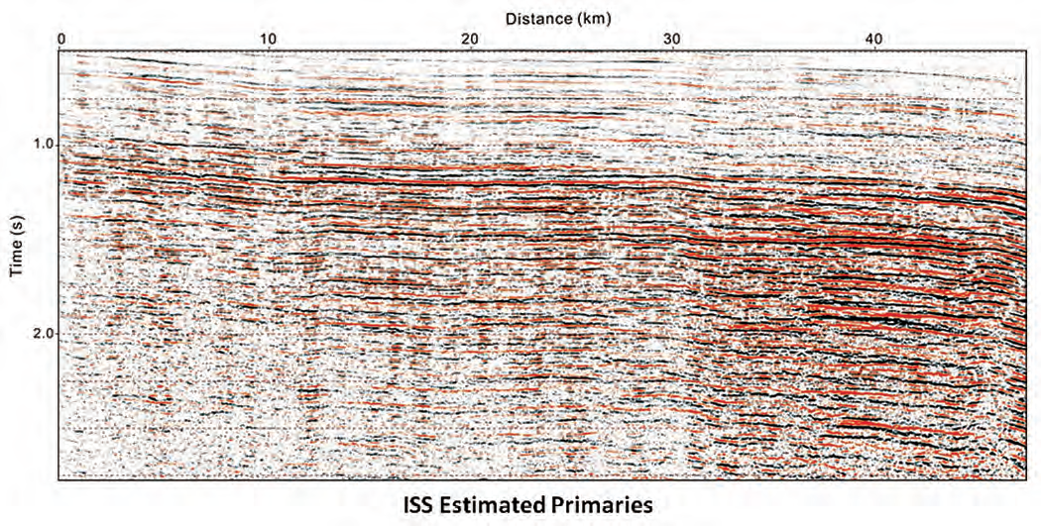
Onshore Saudi Aramco example:
Yi Luo et al., 2011, TLE
“Elimination of land internal multiples based on the inverse scattering series”

Slide 31
For the purposes of this talk we focus on the parameter estimation, target identification or inversion task within the inverse scattering series.

Slide 32
（2D） Elastic (isotropic)
where

Slide 33
（2D） Elastic (isotropic)
where

Slide 34
The forward problem
(4)

Slide 35
The inverse problem
(solving for r in terms of S)
(5)

Slide 37
(6)
Hence, for any one of the four matrix elements of V requires

Slide 38
can be determined independently in terms of
but or requires
That’s what the general relationship requires
A direct non-linear solution order by order in the data matrix

Slide 39
ISS is not iterative linear inversion.
Iterative linear starts with
solves for V₁, changes the reference medium, finds a new L₀ and G₀ (and require generalized inversions of noisy band limited data dependent operators).
To find ,
(7)

Slide 40
The problem is much more serious than a different approach to solve (7) for .
If (7) is our entire basic theory, you can mistakenly think that
is sufficient to update
That step loses contact with and violates
for the elastic wave equation.

Slide 41
That is, it violates the basic relationship between changes in a medium, V and changes in the wavefield, G-G₀ for the simplest elastic model.
This direct inverse method gives you a platform for FWI and communicates when a “FWI” method should work in principle.
Iteratively inverting multi-component data has the correct data but doesn’t corresponds to a direct inverse algorithm.
To honor G=G₀+G₀VG, you need both the data and the algorithm that direct inverse prescribes.
A.B. Weglein and Jinlong Yang
  A first comparison of the inverse scattering series and iterative linear inverse for parameter estimation, M-OSRP (2015), SEG Abstract (2015).

Slide 42
There’s a role for direct and indirect methods in practical real world application.

Slide 43
4D Application

Slide 44

Discrimination between pressure and fluid saturation using direct non-linear inversion method: an application to time-lapse seismic data
Haiyan Zhang, Arthur B. Weglein, Robert Keys, Douglas Foster and Simon Shaw
M-OSRP Annual Meeting
University of Houston
May 10 –12, 2006

Slide 45
Statement of the problem
Distinguishing pressure changes from reservoir fluid changes is difficult with conventional seismic time-lapse attributes.
Pressure changes or fluid changes?
  shear modulus sensitive to pressure changes
  Vp/Vs sensitive to fluid changes
A direct non-linear inversion method may be useful for accomplishing this goal.

Slide 46
Introduction of the method
Inverse scattering series
Time-lapse seismic monitoring
Reference medium L₀ | Initial reservoir condition
Actual medium L | Current reservoir condition
Earth property changes in space V=L₀-L | Reservoir property changes in time
Reference wave field G₀ | Baseline survey
Actual wave field G | Monitor survey
Scattered wave field D=G-G₀ | Monitor-Baseline

Slide 47
Conclusion
Comparing the first and second order algorithms in estimating shear modulus and Vp/Vs contrasts.
  Second order direct inverse was able to distinguish pressure changes from fluid changes.

Slide 48
Summary
The role of direct and indirect methods
Direct methods for the part of the world that your physics is describing and accommodating.
Indirect methods provide a channel to accommodate the part of the world that is outside and beyond the assumed physics model.
Strive to have a consistency and alignment between the direct and indirect methods.

Slide 50
Reference
Weglein, A.B., F. V. Araújo, P. M. Carvalho, R. H. Stolt, K. H. Matson, R. T. Coates, D. Corrigan, D. J. Foster, S. A. Shaw, and H. Zhang. “Inverse Scattering Series and Seismic Exploration.” Inverse Problems (2003): R27–R83.
Weglein, A.B., H. Zhang, A.C. Ramírez, F. Liu, and J. Lira. “Clarifying the underlying and fundamental meaning of the approximate linear inversion of seismic data”. Geophysics, 2009, 74(6): WCD1-WCD13.
Weglein, A.B. “A timely and necessary antidote to indirect methods and so-called P-wave FWI”. The Leading Edge, 32(10):1192-1204, October 2013.
Zhang, H. Direct non-linear acoustic and elastic inversion: Towards fundamentally new comprehensive and realistic target identification. PhD thesis, University of Houston, 2006.
Li, X. I.- Multi-component direct nonlinear inversion for elastic earth properties using the inverse scattering series; II.- Multi-parameter depth imaging using the inverse scattering series. PhD thesis, University of Houston, 2011.
Liang, H., Addressing several key oustanding issues and extending the capability of the inverse scattering subseries for internal multiple attenuation, depth imaging, and parameter estimation. PhD thesis, University of Houston, 2013.

