Slide 1

Inverse scattering subseries that provide seismic processing algorithms that are: (1) direct (2) do not require subsurface information, and (3) are earth model type independent, with the same unchanged algorithm and code for an acoustic, elastic, anisotropic or an inelastic earth
Arthur B. Weglein
M-OSRP, University of Houston
Oct 22nd, 2015

Slide 2
Modeling
Inversion
Indirect
Direct

Slide 3
Direct
Indirect
Search for x such that
is a minimum

Slide 4
Indicators of “indirect”
model matching
objective/cost functions
search algorithm
iterative linear “inversion”
necessary and not sufficient conditions, e.g., CIG flatness

Slide 5
There’s a role for direct and indirect methods in practical real world application.

Slide 6
For a normal incidence plane wave on a 1D earth, a closed-form direct inverse solution exists (e.g., Ware and Aki, (1968) JASA)

Slide 7
Direct Forward and Direct Inverse for a multi-dimensional subsurface
Relationship
(1)
An operator identity that follows from
Modeling

Slide 8
Direct Forward and Direct Inverse
Relationship
(1)
Modeling
(2)
Form
with

Slide 9
Direct Forward and Direct Inverse
Solve for r

Slide 10
Each term in the inverse series that inverts
for r, is computed directly in terms of S and a.

Slide 11
When we consider the generalized Geometric Series
the inverse Geometric Series for
where each term is computed directly in terms of a (‘G₀’) and S (‘ ’ the recorded data).

Slide 12
Hence, the inverse scattering series is not only the only direct multidimensional inverse seismic solution, in addition, every term in the solution is directly computed in terms of a single unchanged reference and the recorded reflection data.

Slide 13
Isolated Task Subseries of the ISS
If we imagine that the inverse machine that inputs reflection data and outputs earth properties needs to achieve certain tasks, then we can seek to locate terms within the general ISS that achieve those specific objectives.
Those tasks are:
  (1) Free surface multiple removal
  (2) Internal multiple removal
  (3) Depth imaging
  (4) Parameter estimation
  (5) Q compensation without knowing or needing Q

Slide 14
Each of these tasks has a subseries that doesn't require subsurface information
In addition, several of these tasks(and corresponding subseries) are model type independent. That is. there is one unchanged algorithm to achieve that task independent of whether you assume the earth is acoustic, elastic, anisotropic or inelastic.
If anyone needed a way to see how different the ISS direct inverse is different from linear updating and model matching. It isn't conceivable to perform model type independent model matching and updating, e.g., for multiple removal.

Slide 15
Direct Forward and Direct Inverse
Forward S in terms of V, inverse V in terms of S
(3)
where V_{n} is the portion of V, n-th order in the data
(2) is the forward series;
(3) is the inverse series.

Slide 16
The relationship (2) provides a Geometric forward series rather than a Taylor series.
In general, a Taylor series doesn’t have an inverse series; however, a Geometric series has an inverse series.
All conventional current mainstream inversion, including iterative linear inversion and FWI, are based on a Taylor series concept.
Solving a forward problem in an inverse sense is not the same as solving an inverse problem directly.

Slide 17
If (a linear exact relationship)
Then is solving the inverse problem directly and the forward problem in an inverse sense

Slide 18
But if the relationship is non-linear
n roots,
As , number of roots
However, from , we found the direct inverse
(one real root)

Slide 19
This provides a vivid illustration of how solving a forward problem in an inverse sense is not the same as solving the inverse problem directly.

Slide 20

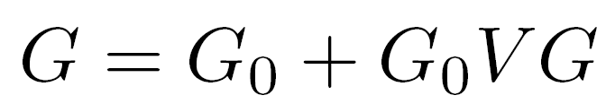

Inverse Scattering Series
Scattering theory = perturbation theory
(1)
Eq.(1) can be expanded in a forward scattering series,

Slide 21
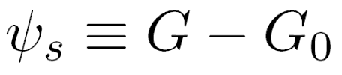



The scattered field can be defined as
(2)
Where is the portion of that is order in .
The measured values of are the data
D, where

Slide 22



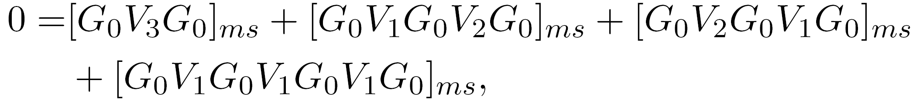
The inverse relation to (2), expands
(3)
as powers (orders) in the measured values of Ψs.
Substituting (3) into (2) and evaluating (2) on the
measurement surface results in
( )m
……

Slide 23
Therefore, the ISS is not only the only direct inversion method for a multidimensional acoustic, elastic, anelastic earth, but it further communicates that all inversion tasks/processing goals are able to be achieved directly and without subsurface information.
Direct and without subsurface information are two distinct and independent properties.

Slide 24
The combination represents a powerful and unique capability and unconventional thinking with stand-alone potential for addressing challenges that are caused by methods that are either indirect (and are necessary conditions, but not sufficient – and therefore are not equivalent to direct methods) and/or are dependent on a-priori information or other assumptions that cannot be adequately provided. The latter is especially significant as our exploration portfolios increasingly move to complex marine and on-shore plays.

Slide 25
That unique promise and potential is what the ISS, combined with the concept of isolated task subseries, offers.

Slide 26
Non-linearity (2 types)
Innate or intrinsic non-linearity
e.g., R.C. and material property changes.
Circumstantial non-linearity
- Removing multiples or depth imaging
primaries.

Slide 27
The inverse scattering series is (once again) unique
in its ability to directly address either alone, let
alone these two in combination.

Slide 28
The first term in a task specific subseries that addresses a potential circumstantial non-linearity first decides if its assistance and contribution is required in your data…
And only if decides that it is, then it starts to compute … if there is no nonlinear circumstantial issue to address, it computes an integrand which is zero.

Slide 29
The latter is a very sophisticated and impressive (and surprising) quality of task specific subseries
We call that property purposeful perturbation theory….
It decides if its assistance is needed before it acts!

Slide 30
Free-surface multiple removal
Notes:
30

Slide 31

The 1D FS multiple removal algorithm
Data without a free surface
1
Data with a free surface
contains
free-surface multiples.
1

Slide 32
Free surface demultiple algorithm
= primaries and
internal multiples
= primaries, free
surface multiples
and internal
multiples
1
Total upfield
and,

Slide 33
Free Surface Multiple Elimination Example Recovering an Invisible Primary
Consider a free surface example with the following data:
(1)
R₁δ(t-t₁) -R₁²δ(t-2t₁) R₂'δ(t-t₂)
FS
t₁
2t₁
t₂
R₁
R₂
Notes:
33

Slide 34
Invisible primary example
Now assume
for some special case, then from (1)
(2)
The second primary and the free surface multiple cancel, and
Notes:
34

Slide 35
Invisible primary example
and you have the two primaries, recovering the invisible primary which was not ‘seen’ in the original data.
How does that happen?
Notes:
35

Slide 36
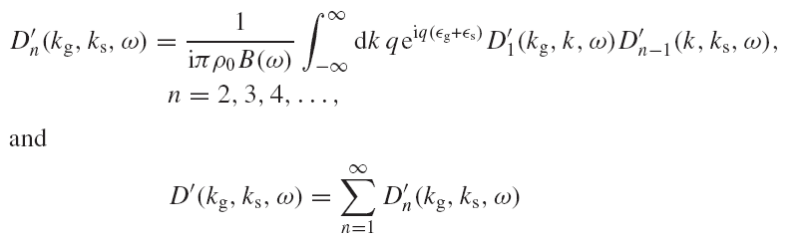
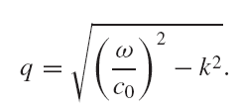
2D free surface multiple algorithm
The obliquity factor is defined as,

Slide 37
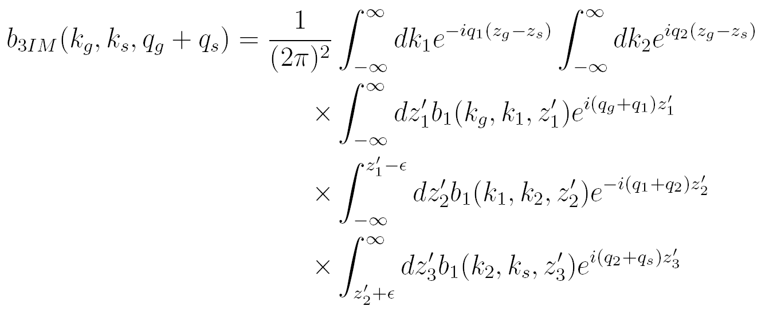
2D internal multiple attenuation algorithm
(Araujo 1994; Weglein et al. 1997)

Slide 38
ISS for multiple reduction
Free surface multiple elimination
Internal multiple attenuation

Slide 39
Internal multiple elimination in an elastic earth
Model
-2500m
12.5m
0
2500m
Z1=0m
Layer 1: ρ=1.0g/cm³, vp=1500m/s, vs=400m/s
Z2=300m
Layer 2: ρ=3.0g/cm³, vp=2000m/s, vs=1200m/s
Z3=800m
Layer 3: ρ=2.1g/cm³, vp=1500m/s, vs=900m/s
Z4=1900m
Layer 4: ρ=1.5g/cm³, vp=1500m/s, vs=1500m/s
Z5=2100m
Layer 5: ρ=1.8g/cm³, vp=2500m/s, vs=1500m/s
Z6=2400m
Yanglei Zou et al. (2014)
Courtesy of Schlumberger De-multiples Team

Slide 40
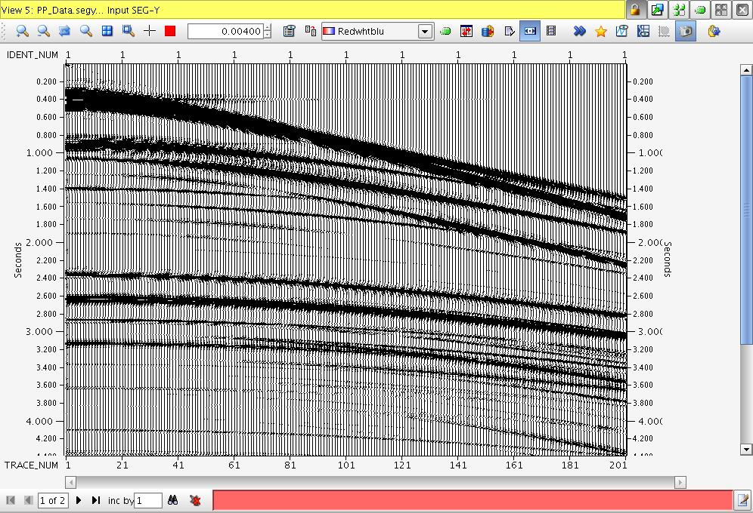
Data
Yanglei Zou et al. (2014)

Slide 41
Data
(with arrows pointed to P primaries)
P primaries
Yanglei Zou et al. (2014)

Slide 42
Data
(with arrows pointed to converted primaries)
Converted primaries
Yanglei Zou et al. (2014)

Slide 43
Data
(with arrows pointed to P multiples)
P multiples
Yanglei Zou et al. (2014)

Slide 44
Data
Yanglei Zou et al. (2014)

Slide 45
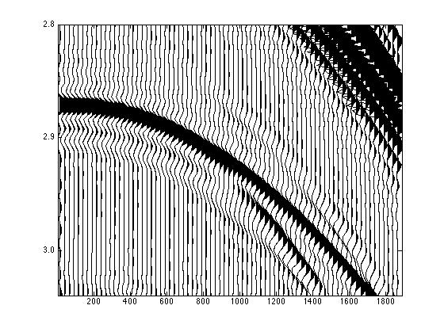
A section of the synthetic data where a primary interferes with two internal multiples

Slide 46
A section of the synthetic data where a primary interferes with two internal multiples
arrow point to a internal multiple
internal multiple

Slide 47
A section of the synthetic data where a primary interferes with two internal multiples
arrow point to another internal multiple
internal multiple

Slide 48
A section of the synthetic data where a primary interferes with two internal multiples
arrow point to a primary
converted wave
primary

Slide 49
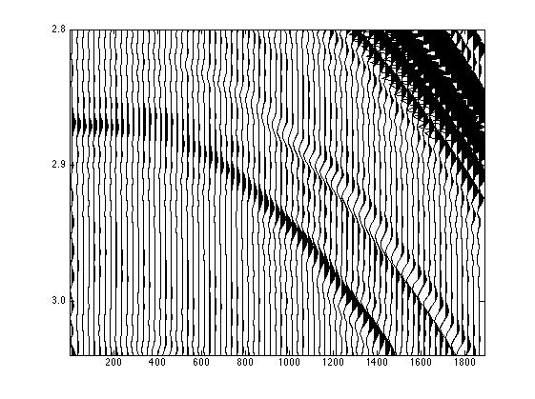
A section of the synthetic data after
internal multiple elimination
converted wave
primary

Slide 50
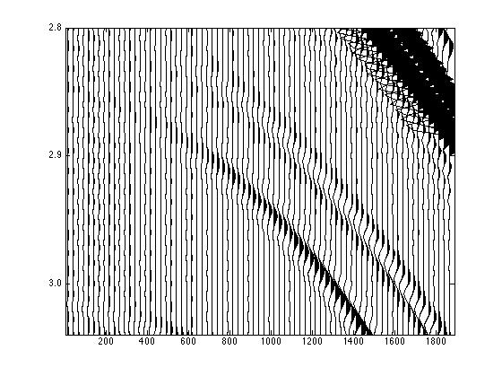
A section of the synthetic data
with only primaries
converted wave
primary

Slide 51
Testing, evaluating and analyzing the inverse scattering series internal multiple attenuation algorithm for an inelastic earth without knowing or needing the elastic or inelastic subsurface properties
Jing Wu* and Arthur B. Weglein
M-OSRP, University of Houston
Oct 23rd, 2015
Notes:
Good afternoon, this talk tests the ISS internal multiple attenuation algorithm, given the earth to be anelastic. We will see later this method doesn’t need any elastic/inelastic information about the earth property.

Slide 52
EXAMINATION OF ISS ATTENUATION ALGORITHM using numerical data with q
1D normal incidence plane wave
1D earth pre-stack data

Slide 53
1D normal incidence plane wave
Layer No. | Depth (m) | Velocity (m/s) | Density (kg/m³) | Q
1 | 375 | 1500 | 1000 | 60
2 | 1250 | 2500 | 1000 | 40
3 |  | 6000 | 1000 | 60
A two-reflector model

Slide 54
Data (B1) vS predicted IM

Slide 55
Actual IM vS predicted IM

Slide 56
1D earth pre-stack data
Layer No. | Depth (m) | Velocity (m/s) | Density (kg/m³) | Q
1 | 400 | 1500 | 1000 | 100
2 | 850 | 2000 | 1200 | 40
3 | 1200 | 2500 | 1500 | 80
4 | 3200 | 6500 | 3000 | 80
5 |  | 4000 | 3500 | 100
A four-reflector model
This test was performed at Schlumberger (2014).

Slide 57
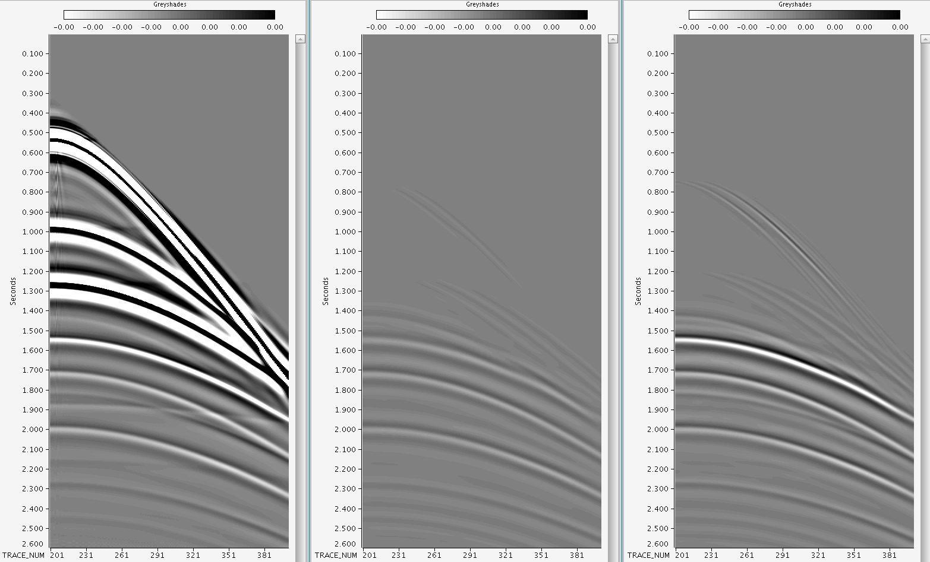
Data, with absorption
IM prediction
P1
P2
seconds
seconds
P3
P4
courtesy of
Schlumberger
IM
IM
Trace Number
Trace Number

Slide 58
Data, with absorption
IM prediction
P1
P2
seconds
seconds
P3
P4
courtesy of
Schlumberger
IM
IM
Trace Number
Trace Number

Slide 59
Single trace comparison: data
Offset 0m
Offset 1250m

Slide 60
Single trace comparison: data vs predicted internal multiple
Offset 0m
Offset 1250m

Slide 61
summary
  The ISS internal multiple attenuator is model-type independent
  For anelastic media, the ISS attenuator can predict internal multiple with
    Perfect time and approximate amplitude
    No subsurface absorptive or dispersive information

Slide 62
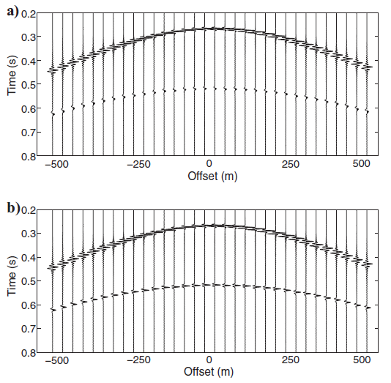
ISS Q compensation without Q
Before
After
( Innanen & Lira 2010 )

Slide 63
Kristin Field data with ISS depth imaging without velocity model
JOURNAL OF SEISMIC EXPLORATION 21, 1~28 (2012)
INVERSE SCATTERING SERIES DIRECT DEPTH IMAGING WITHOUT THE VELOCITY MODEL: FIRST FIELD DATA EXAMPLES
ARTHUR B. WEGLEIN¹, FANG LIU¹, XU LI¹, PAOLO TERENGHI¹, ED KRAGH², JAMES D, MAYHAN¹, ZHIQIANG WANG¹, JOACHIM MISPEL³, LASSE AMUNDSEN³, HONG LIANG¹, LINTANG² AND SHIH-YING HSU¹
¹M-OSRP, University of Houston, 617 Science & Research Bldg. 1, Houston, TX 77004, U.S.A.
²SCR/Schlumberger, Schlumberger Cambridge Research Center high Cross, Madingley Road, Cambridge CB3 OEL, U.K.
³Statoil ASA, Statoil Forskningssenier, Arkitekt Ebbells veg 10, 7053 Ranheim, Norway.
(Received September 3, 2011; revised version accepted November 24, 2011)

Slide 64


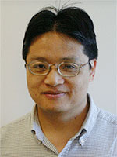
ISS direct depth imaging without a velocity model: update and Marmousi model tests
Fang Liu
February 20th, 2015
Houston, TX
Notes:
64
64

Slide 65
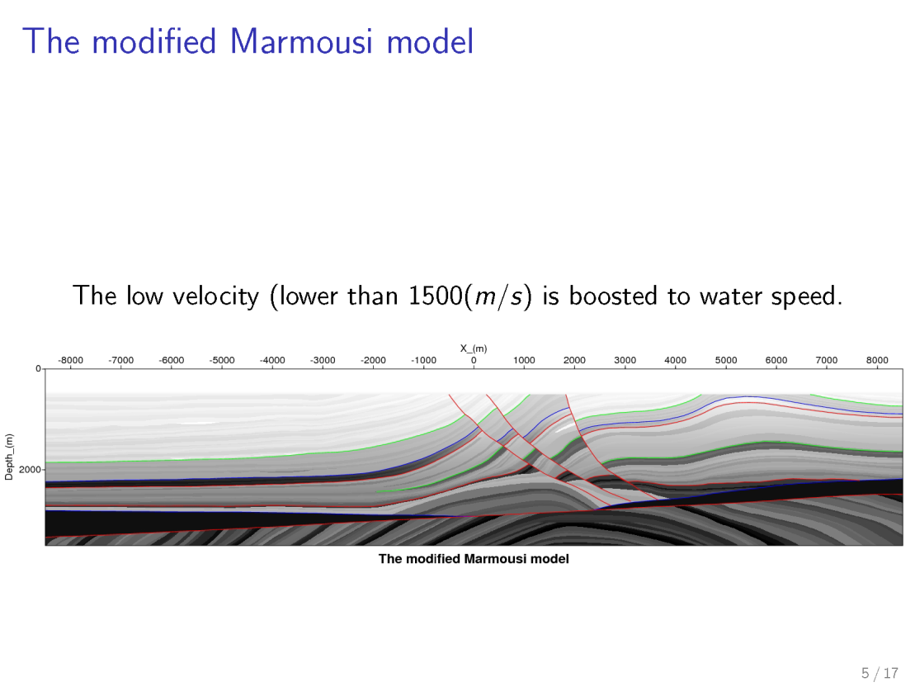

Slide 66


Slide 67
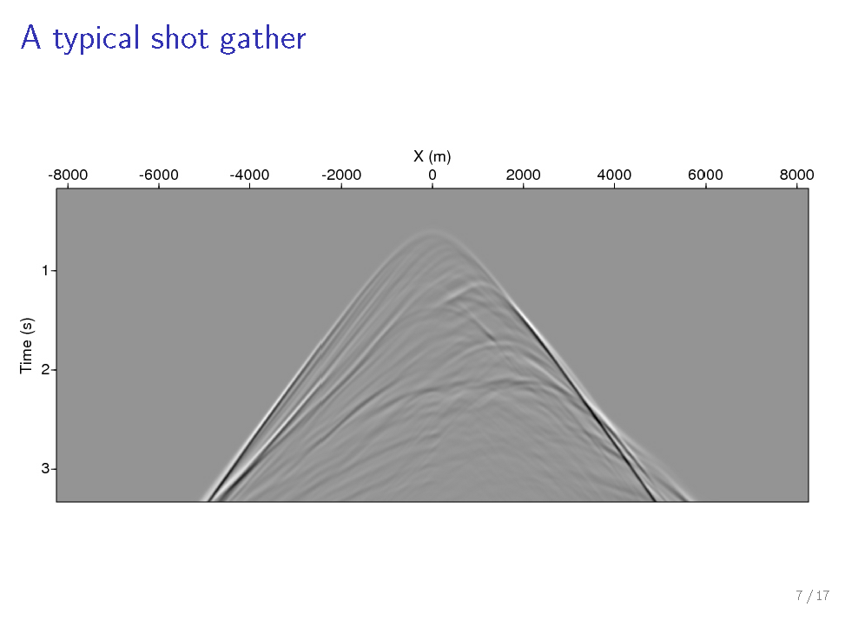
Shot position at X=0 m

Slide 68
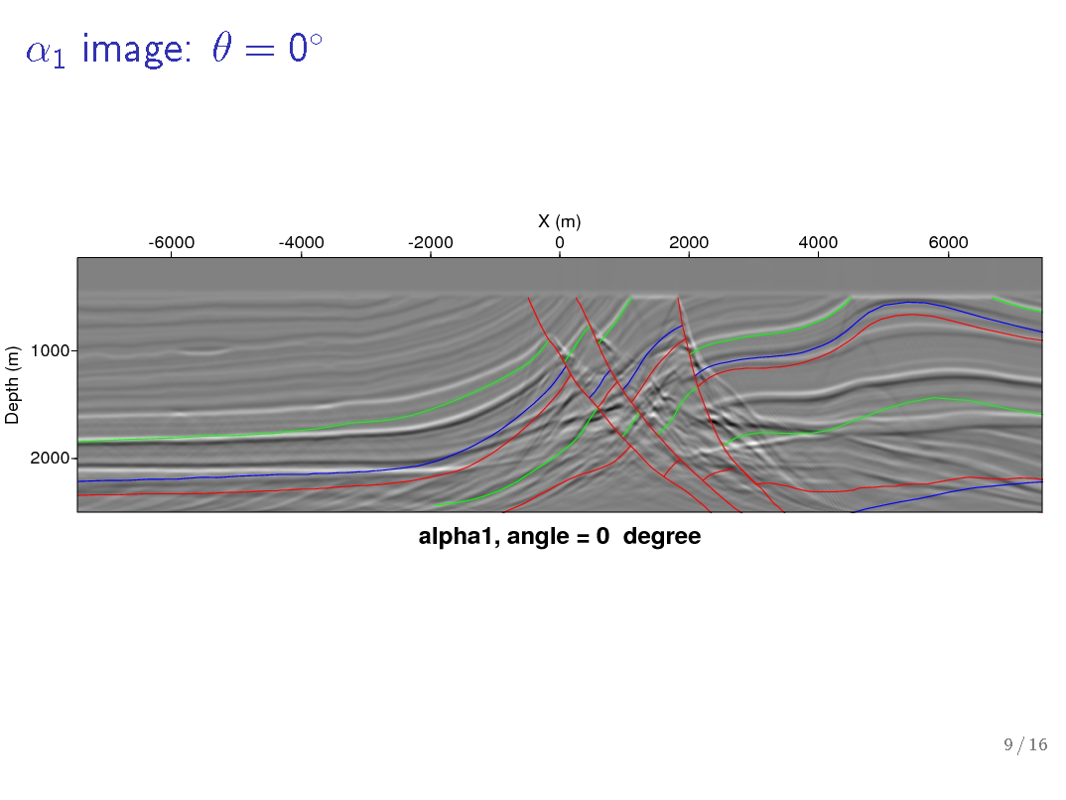
Prestack FK water-speed image,

Slide 69
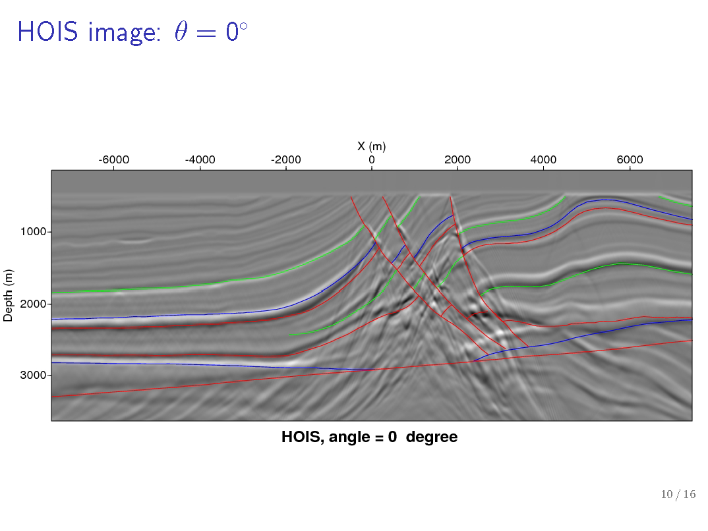

Slide 70
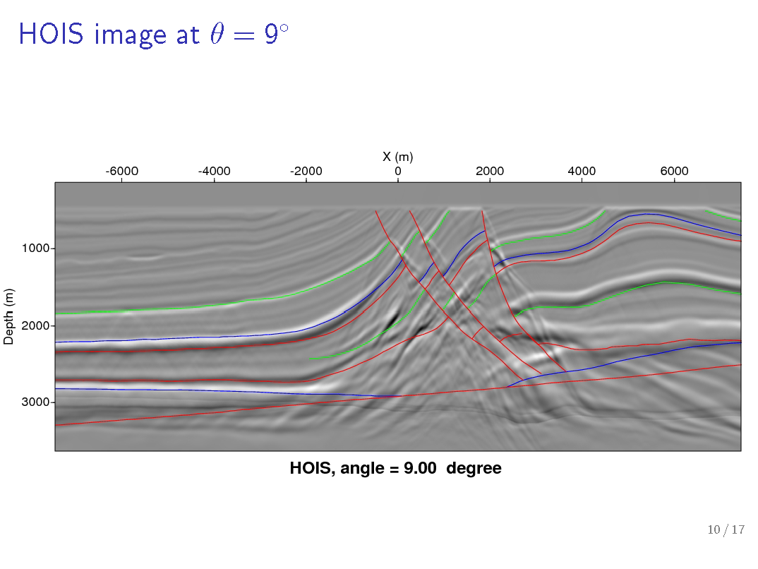

Slide 71
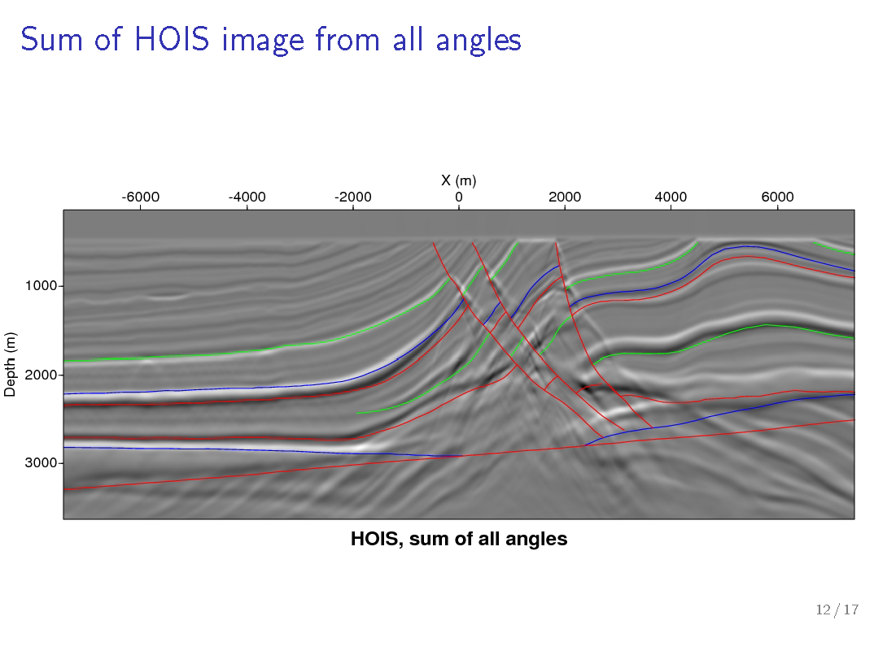

Slide 72
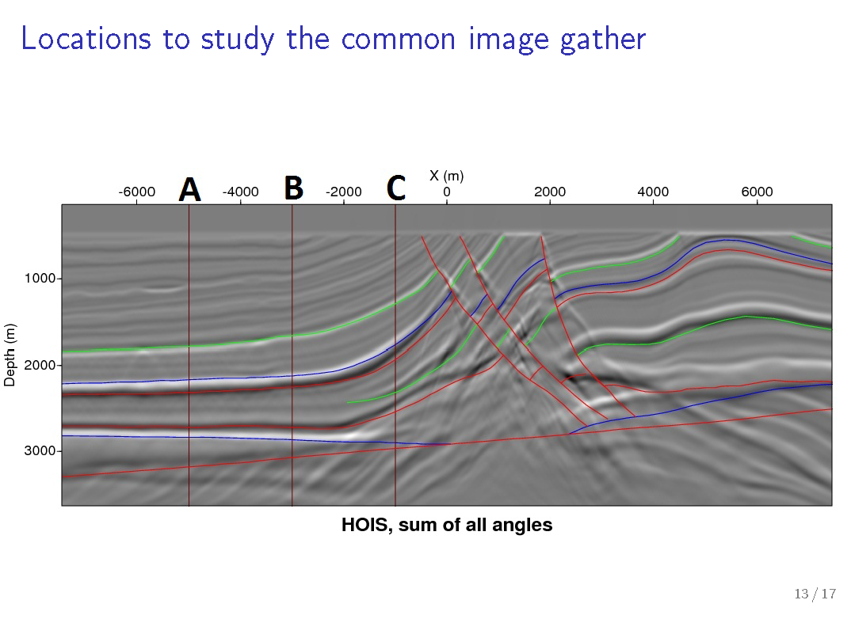

Slide 73
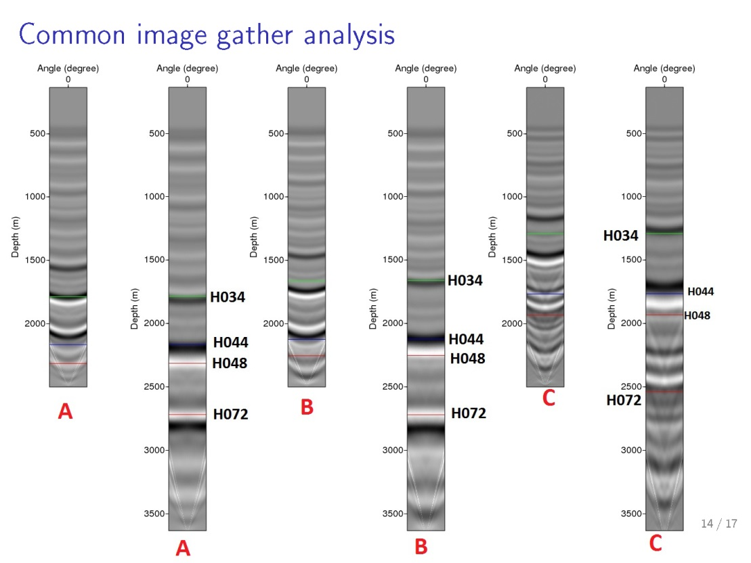
(Prestack FK migration)
(Prestack FK migration)
(Prestack FK migration)
(HOIS)
(HOIS)
(HOIS)

Slide 74
Iss delivery / promise
Model type independent algorithms
  for free surface and internal multiples
A framework and method for direct amplitude algorithms (for AVO and FWI)
Direct depth imaging without a velocity model
-feasibility demonstrated of Kristin field data

