Slide 1

Processing for subsalt imaging: A new and first two way migration method that avoids all high frequency asymptotic assumptions and is equally effective for all frequency components of broadband data
Arthur B. Weglein
M-OSRP, University of Houston
Oct 23rd, 2015

Slide 2
Migration
was originally (and remains today) only meaningful for primaries

Slide 3
The original purpose of migration was to map an event on a time section in (x,t) to a point on a structure map.That is, to a point on a reflector in x,z
That concept only has meaning for primaries.
We will show that that remains the meaning of migration today.

Slide 4
Wave theory methods used to migrate seismic data have two components
  A wave propagation component
  An imaging condition

Slide 5
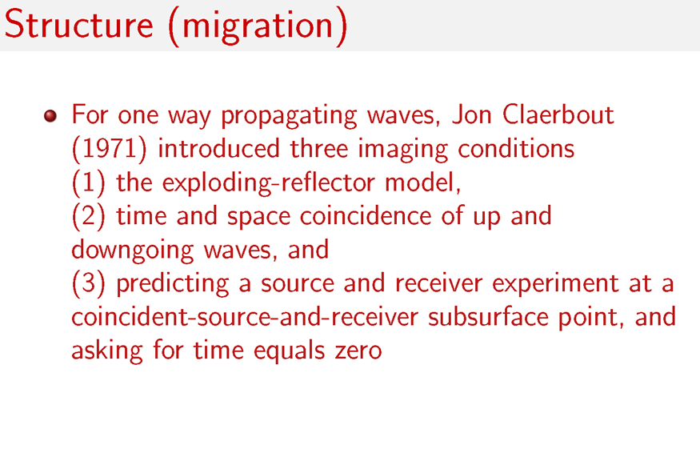

Slide 6
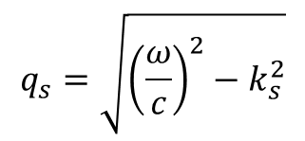
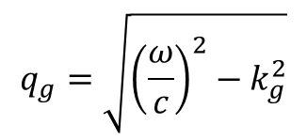
2D Claerbout III (Stolt migration)
Data on measurement surface
Fourier transform
Data at depth
$$D\left(k_{g},z,k_{s},z,ω\right)=D\left(k_{g},z_{g}=0,k_{s},z_{s}=0,ω\right)×e^{−i\left(q_{g}+q_{s}\right)z}$$
$$q_{g}=\sqrt{{\left(\frac{ω}{c}\right)}^{2}−k_{g}^{2}}$$
$$q_{s}=\sqrt{{\left(\frac{ω}{c}\right)}^{2}−k_{s}^{2}}$$
Data at depth at t=0

Slide 7
2D Claerbout III (Stolt migration)
Change of variables
Inverse Fourier transform
Set x_{g}=x_{s}=x (x_{m}=x; x_{h}=0 ) original Stolt migration (Claerbout III)
angle average plane wave reflection coefficient by summing over k_{h}

Slide 8
Stolt extended (Claerbout III) migration retains k_{h} information at depth z, D(km,kh,kz) and that provides the plane wave reflection coefficient at a specular reflector
Stolt and collaborators further extended Claerbout III to provide a point reflectivity model that automatically images specular and non-specular reflections.
The latter is only possible for extensions/generalizations of Claerbout III(not for Claerbout II)

Slide 9
Claerbout imaging II
Claerbout imaging III

Slide 10
Let’s examine Claerbout II and III where only the imaging condition is the issue

Slide 11
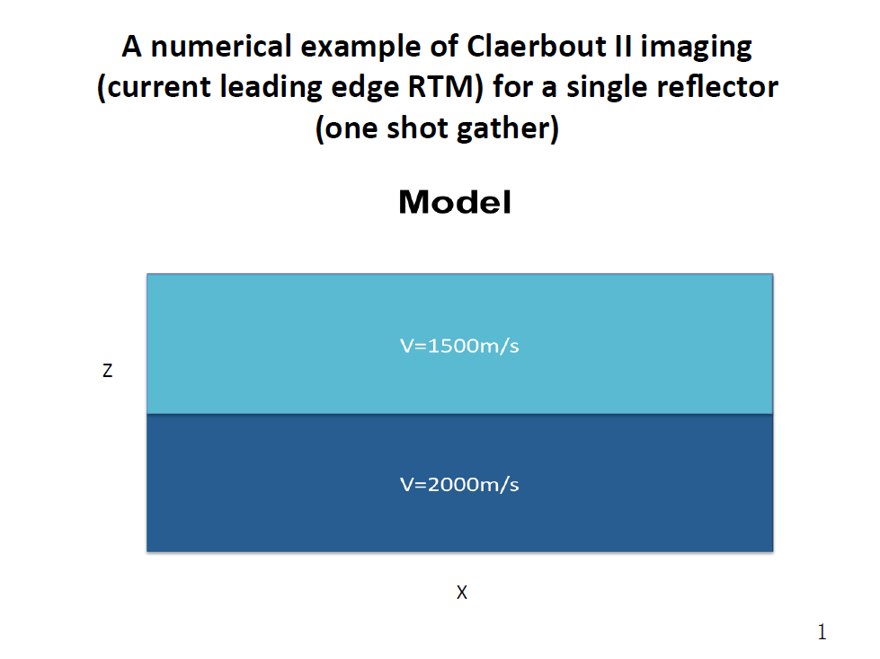
Zou and Weglein, 2014

Slide 12
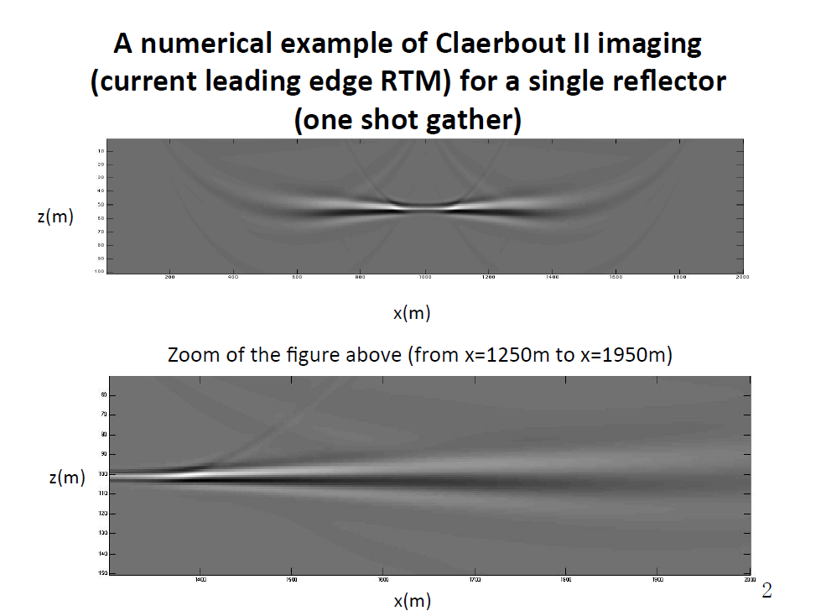

Slide 13
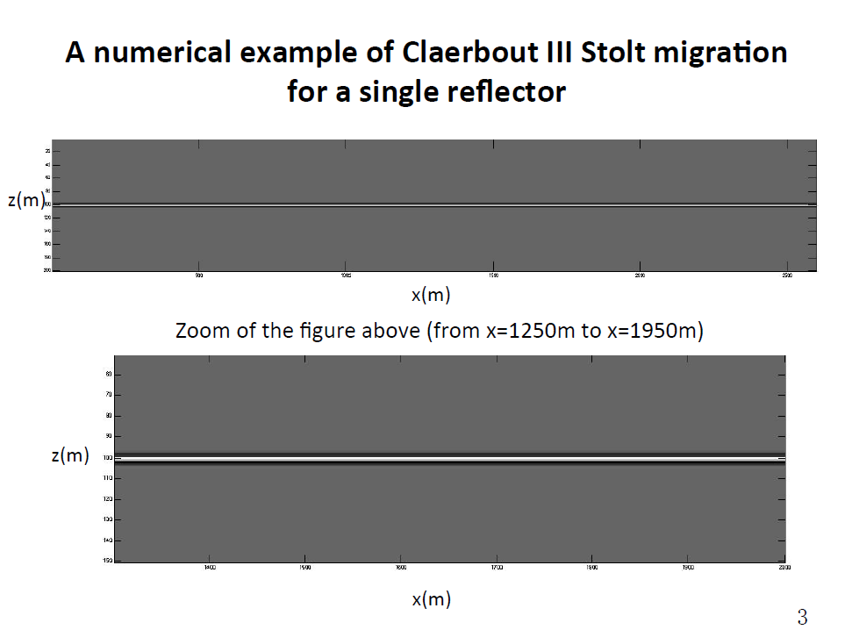

Slide 14
The Claerbout II imaging principle provides an image for one shot record. However, the resulting inconsistency in the image is mitigated by summing over shots. Claerbout II has a somewhat ad hoc origin and an ad hoc ‘fix’.

Slide 15
In Claerbout III one shot record predicts the receiver at depth (not an image). The Green’s theorem weighted sum over shots then predicts the source at depth, leading to an image.
There is nothing that’s inconsistent or being fixed with the sum over sources in Claerbout III.

Slide 16
How do you know if a migration method has made a high frequency approximation?

Slide 17
(1) If there is a travel time curve of candidate images within the method, it is a high frequency ‘ray theory’ approximation/ assumption.
where,

Slide 18
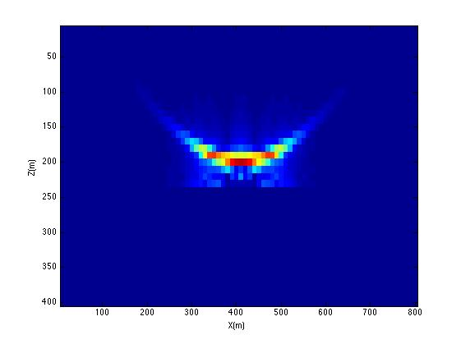
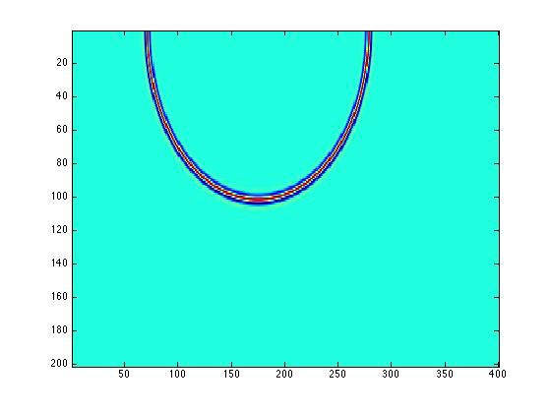
Imaging Conditions and High Frequency Assumptions
Claerbout III
Claerbout II
Stolt migration: one source one receiver
RTM(2D)
z
x
Zou, 2015
No high frequency assumption
High frequency assumption

Slide 19
How do you know if a migration method has made a high frequency approximation?
(2) A stationary phase of other high frequency approximation is employed within the method.
(3) a propagation model that assumes one way wave propagation (for anything other than a homogeneous subsurface) is a high frequency approximation
  high frequency approximation can enter migration methods through (1) the imaging condition (all Claerbout II) or (2) through the propagation component (or both), that is, for example, assuming a one way propagation for a slowly varying velocity in Claerbout III

Slide 20
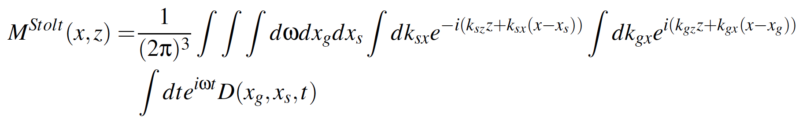
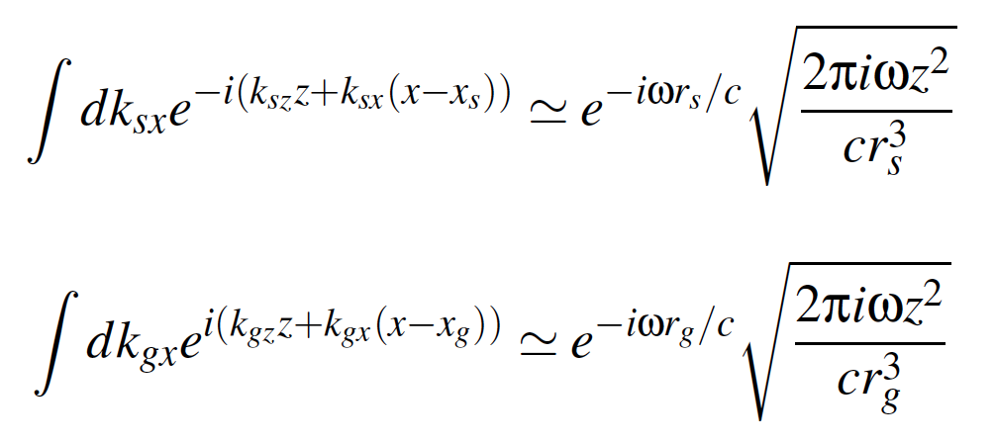
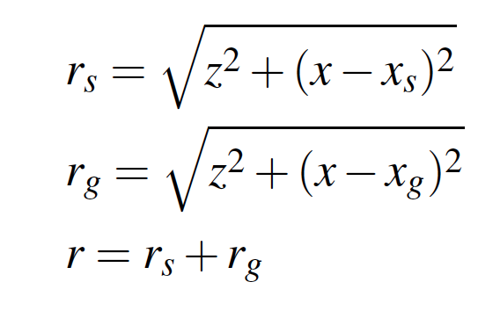
2D Stolt migration
An asymptotic approximation can be made with
the stationary phase approximation

Slide 21
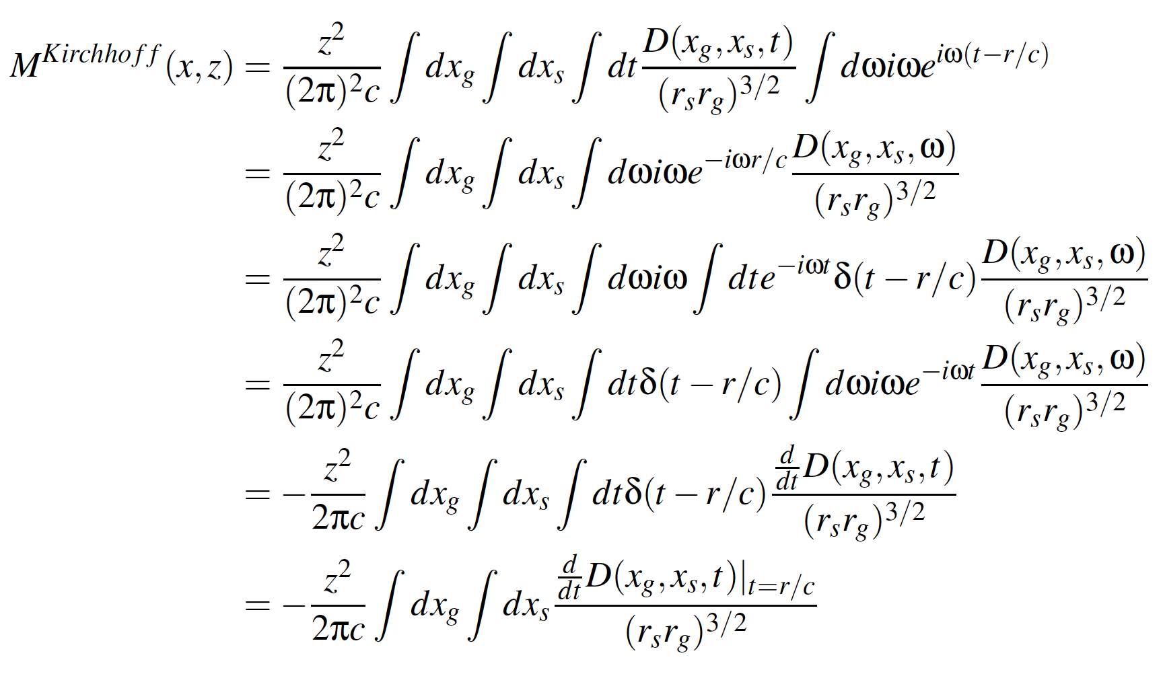
The Kirchhoff migration is an asymptotic approximation
of Stolt migration

Slide 22
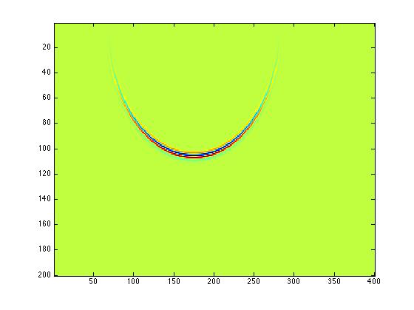
Kirchhoff migration for a single source and receiver
Kirchhoff migration (2D)
z
x
Zou et al, 2015
High Frequency approximation from a stationary phase approximation
Notes:
----- Meeting Notes (5/28/15 03:35) -----
Kirchhoff migration shares some kind of behavior with RTM (Claerbout II), including producing candidate and depending on the coherent summing over candidate.

Slide 23
Claerbout II and III have been extended and generalized
For Claerbout II
  e.g., Yu Zhang, Sheng Xu and Norman Bleistein
    ----- introduce a geometric optics reflection coefficient model relating the reflection data and the incident source wavefield.
For Claerbout III
Stolt and collaborators
----- non-zero offset at t=0 provides amplitude information
----- outputs plane wave reflection coefficient or point scatterer reflectivity for specular and non-specular reflection

Slide 24
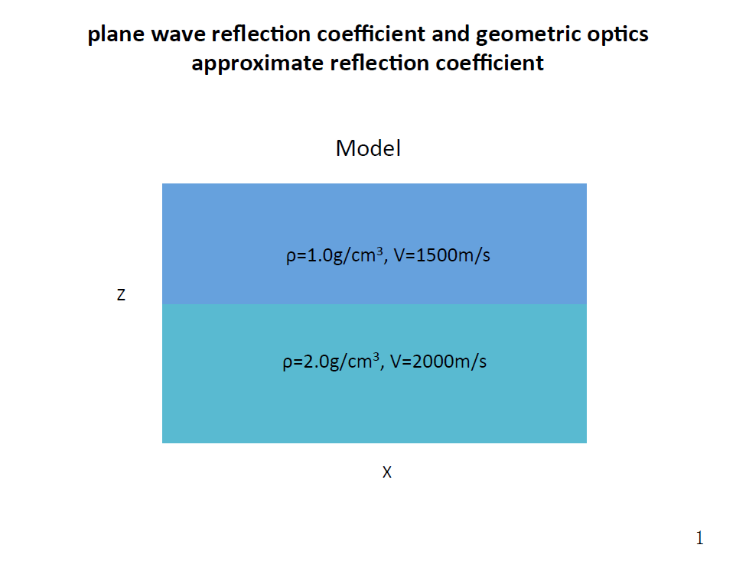

Slide 25
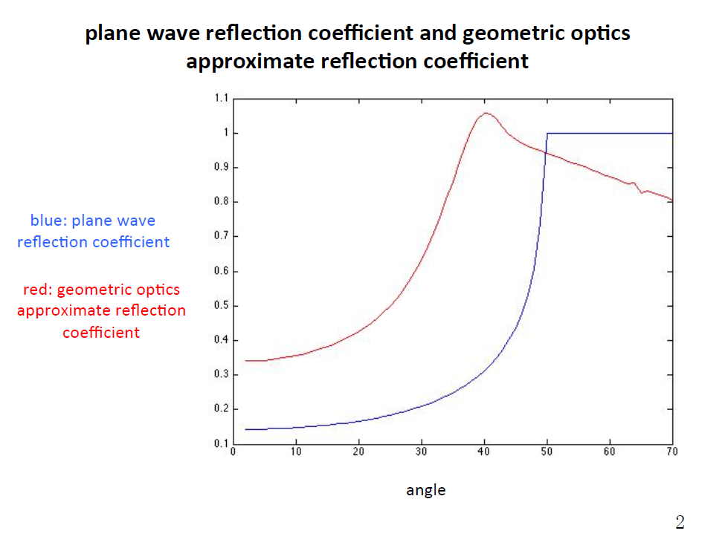
Zou and Weglein, 2015

Slide 26
Benefits of Claerbout III imaging (extended by Stolt and colleagues) for specular and non-specular imaging
1
2
3
specular
non-specular
non-specular
1. Specular
outputs actual plane wave reflection coefficient data for
specular reflection (unique to Claerbout III )
2. Non-Specular reflection
a point scatterer model for structure and inversion of non-specular reflections (unique to Claerbout III )

Slide 27
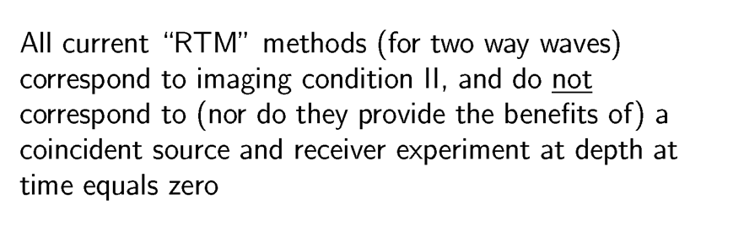

Slide 28
M-OSRP has recently pioneered and developed a new migration method that has Stolt’s extension of Claerbout III imaging inside a medium with two way waves
The new migration method provides four benefits

Slide 29
Recent new imaging development from M-OSRP (Weglein, A.B., Stolt, R. H., Mayhan, J. D., “Reverse-time migration and Green’s theorem: Part I — The evolution of concepts, and setting the stage for the new {RTM} method” Journal ofSeismic Exploration, 20, 73–90. February 2011; Weglein, A.B., Stolt, R. H., Mayhan, J. D., “Reverse time migration and Green’s theorem: Part II — A new and consistent theory that progresses and corrects current RTM concepts and methods” Journal ofSeismic Exploration, 20, 135–159. May 2011; THE FIRST WAVE EQUATION MIGRATION RTM WITH DATA CONSISTING OF PRIMARIES AND INTERNAL MULTIPLES: THEORY AND 1D EXAMPLES FANG LIU and ARTHUR B. WEGLEIN JOURNAL OF SEISMIC EXPLORATION 23, 357-366 (2014) 357) provides the predicted source and receiver experiment at depth beneath an overburden that has two way wave propagation
  A tool to analyze the role of primaries and multiples in imaging
  A more effective and interpretable RTM by realizing Stolt extended Claerbout III providing a more complete realistic model for imaging and inverting specular and non-specular reflectors
  Provides the first migration method for a smooth or discontinuous velocity that is equally effective at every frequency component of recorded data (avoids asymptotic high frequency approximations) in both the imaging condition and in how the imaging condition is implemented.
  Imaging and inverting Claerbout III from above (and from below) a reflector without Claerbout II issues that the de-primary activity seeks to address (e.g., backscatter and other false images).

Slide 30
Use the new imaging method with two way propagating waves to examine the role of primaries and multiples in imaging and inversion
That provides a definitive response to the question of whether multiples are migrated

Slide 31
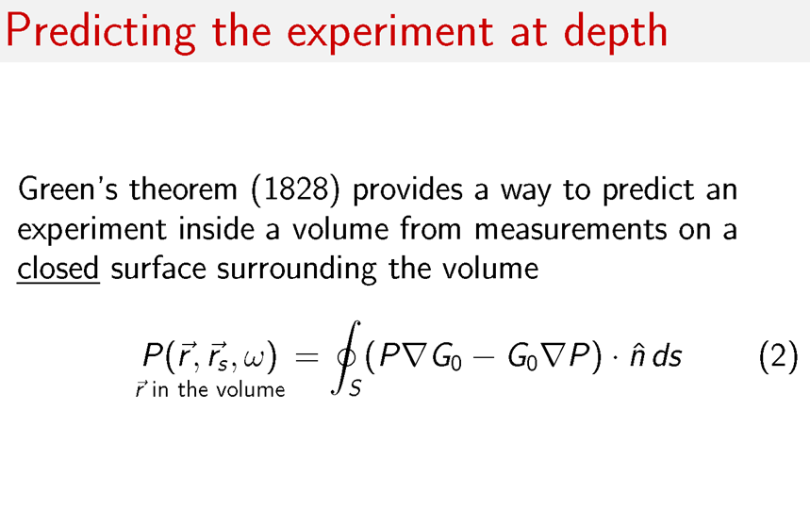

Slide 32
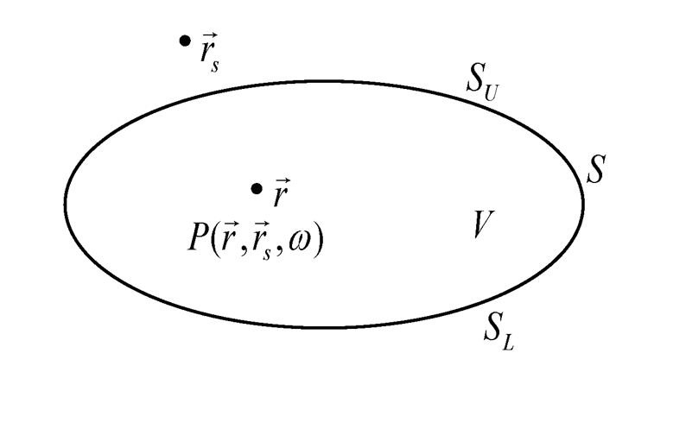

Slide 33
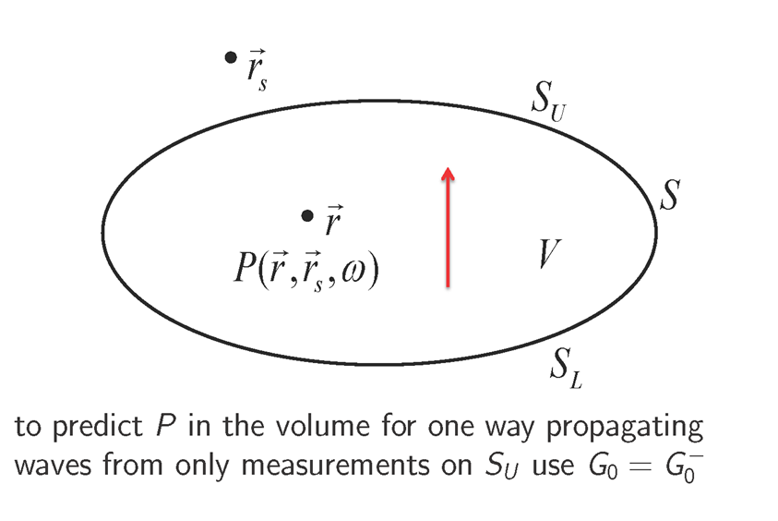

Slide 34
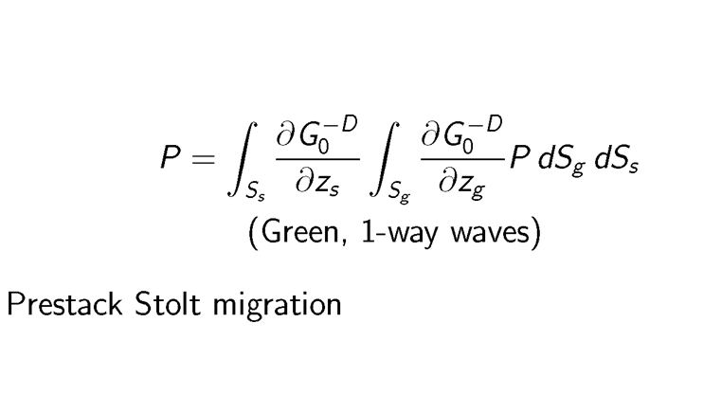

Slide 36
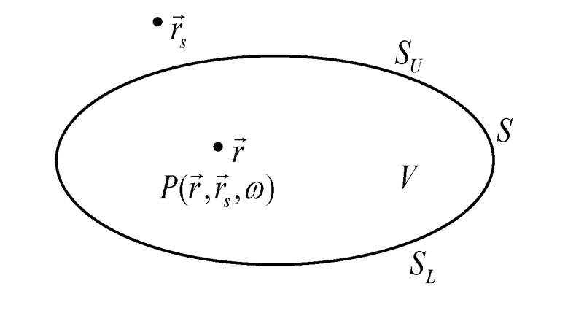

Slide 37
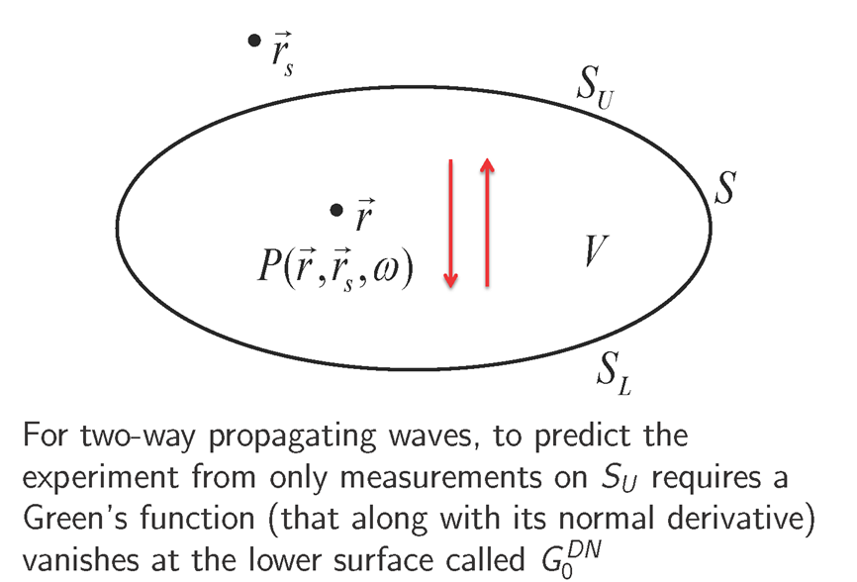

Slide 38
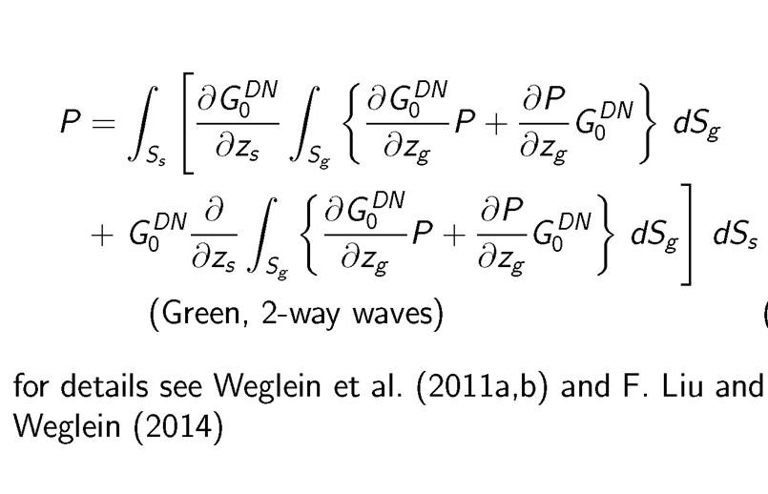

Slide 41
A Two-reflector model
c₁
a₁
R₁
c₂
a₂
R₂
c₃

Slide 42
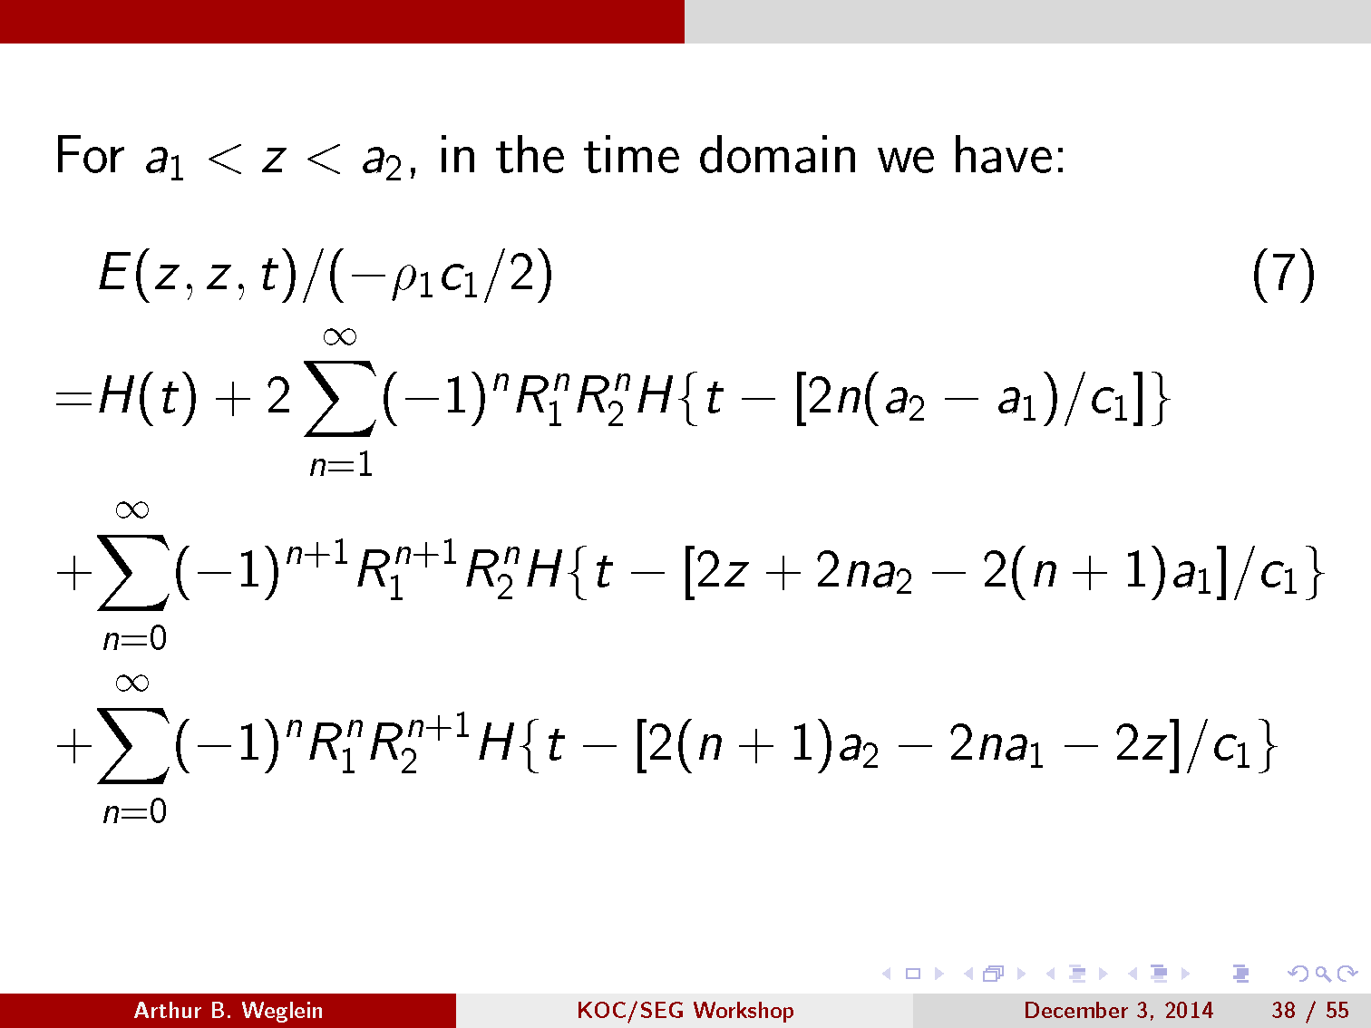

Slide 43
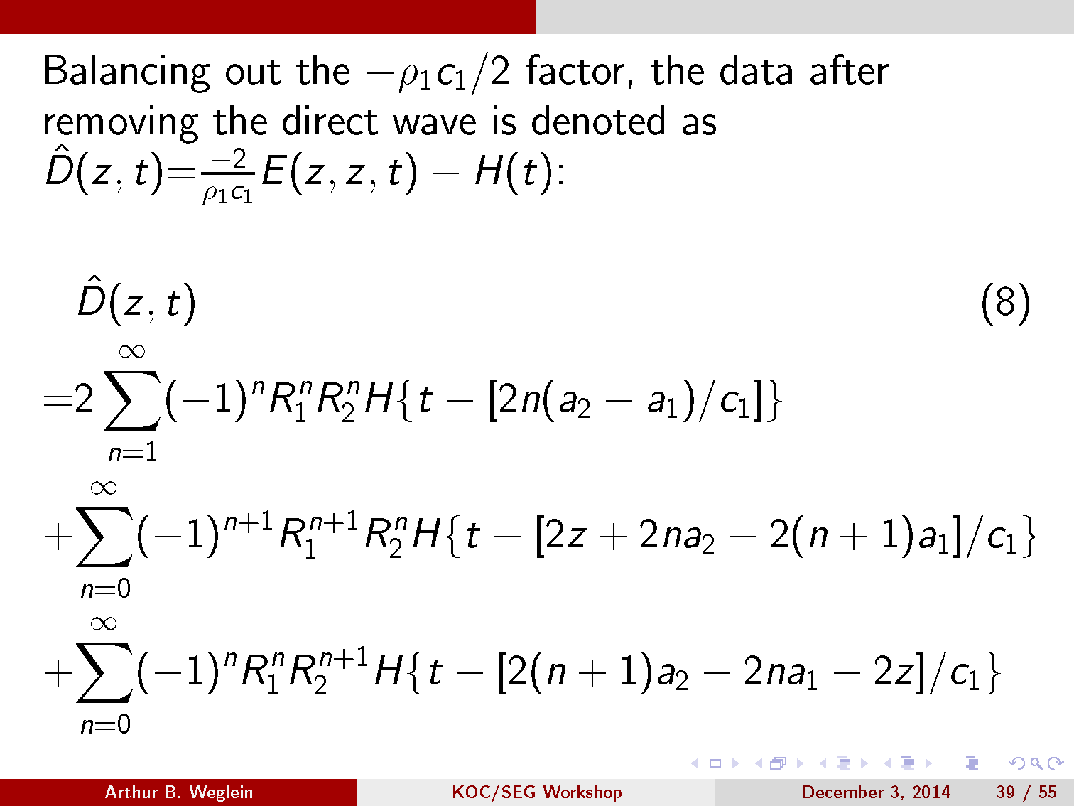
Data at depth

Slide 44
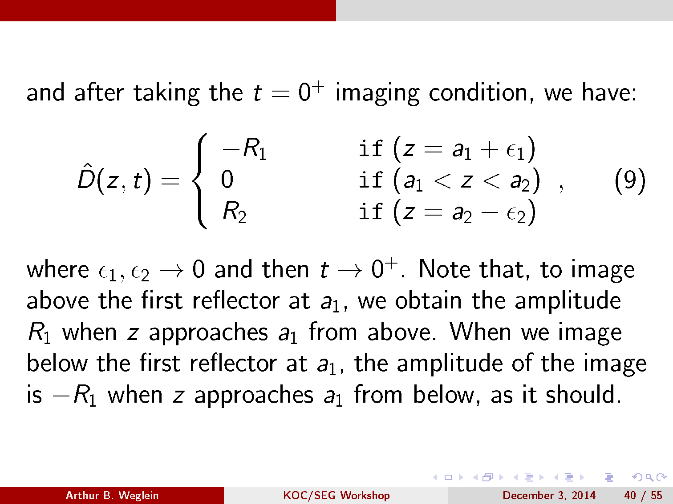

Slide 45
Summary
We present the first migration method for imaging that is equally effective at all frequencies.

