Slide 1


2016 M-OSRP SEG Executive Summary: Strategy, plans, deliverables and impact
Arthur B. Weglein
Sept 23, 2016

Slide 2
This presentation
A broad and general perspective on our strategy for identifying and addressing seismic exploration challenges
Illustrating how we execute that strategy by providing an overview of our projects, recent progress, plans, and deliverables.

Slide 3
Seismic E&P challenges
Methods make assumptions; when they are satisfied the methods are effective and when they are not satisfied the methods have difficulty and/or fail – challenges arise from that breakdown or failure.

Slide 4
Seismic E&P challenges
Among assumptions:
acquisition
compute power
innate algorithmic
assumptions/requirements

Slide 5
Seismic research goals and objectives
to develop and deliver more capable methods
where progress and advancement are measured by the increase in effective drilling (exploration, appraisal and development) decisions and avoiding dry holes and sub optimal development wells

Slide 6
Modeling
Inversion
Indirect
Direct

Slide 7
Direct
Indirect
Search for x such that
is a minimum

Slide 8
Indicators of “indirect”
model matching
objective/cost functions
search algorithm
iterative linear “inversion”
necessary and not sufficient conditions, e.g., CIG flatness
Solving a forward problem in an inverse sense

Slide 9
There’s a role for direct and indirect methods in practical real world applications.

Slide 10
Migration
  Post-stack time
  Post-stack depth
  Pre-stack time
  Pre-stack depth
  RTM
As migration became more capable there was a commensurate increase in the need for an accurate velocity model

Slide 11
Multiple removal
  Predictive deconvolution
  Stacking
  FK filter
  Radon
  Model and Subtraction
  SRME + Feed back loop (Delphi)
As multiple removal became more capable there was a commensurate increase in the need for accurate subsurface information

Slide 12
As the industry trend moved to deep water and complex and complicated on-shore and off-shore plays, these methods bumped up against their assumptions – and they became less than effective or would fail.

Slide 13
To begin:
What are the current outstanding and prioritized challenges in seismic E&P
  On shore preprocessing
  Internal multiple elimination
  Determine an accurate velocity model for depth migration
  Produce an accurate and resolved structural map for complex curved and diffractive reflectors
  Determine all the relevant subsurface properties required to perform migration-inversion

Slide 14
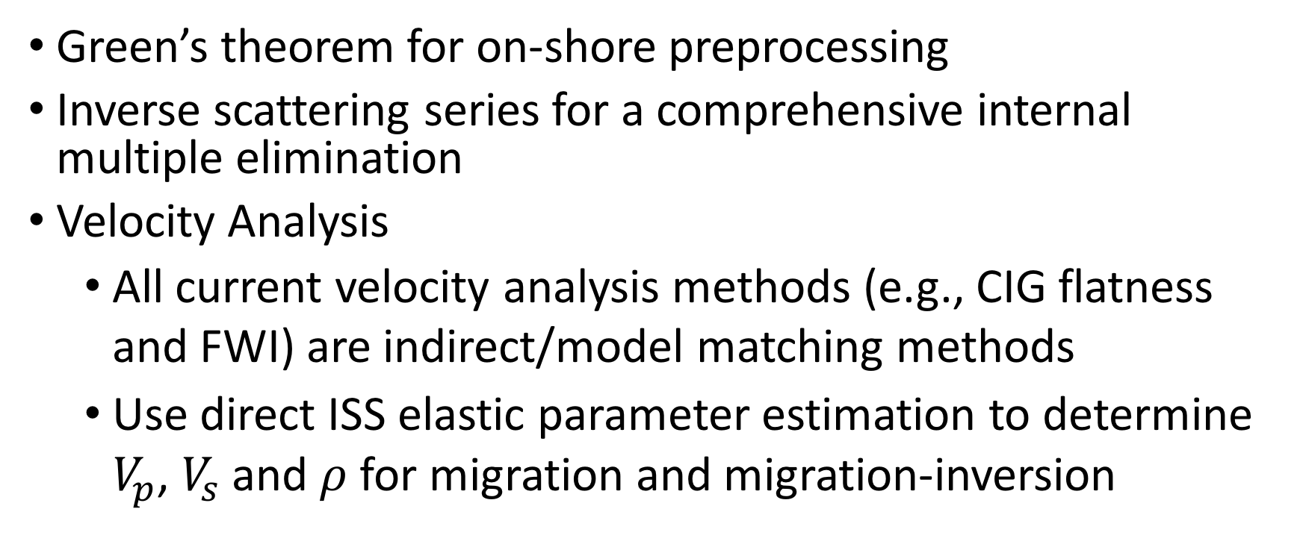
Response
  Green’s theorem for on-shore preprocessing
  Inverse scattering series for a comprehensive internal multiple elimination
  Velocity Analysis
  All current velocity analysis methods (e.g., CIG flatness and FWI) are indirect/model matching methods
  Use direct ISS elastic parameter estimation to determine $V_{p}$, $V_{s}$ and $ρ$ for migration and migration-inversion

Slide 15
Response
Imaging/migration
  Stolt extended CIII for heterogeneous media (requires a velocity model)

Slide 16
A Game Changing response to velocity analysis and direct depth imaging
ISS depth imaging
  Direct depth imaging without a velocity model

Slide 17
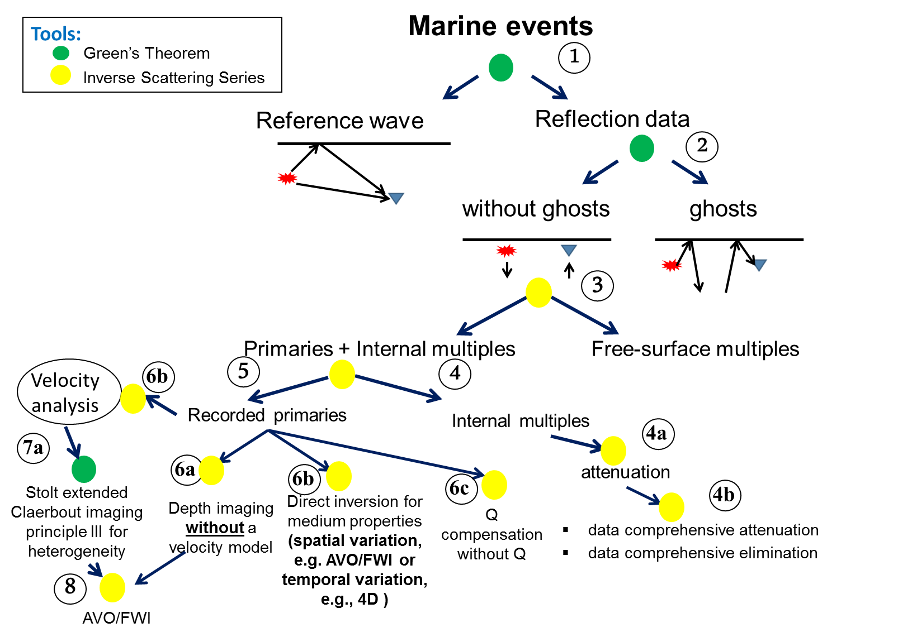

Slide 18
Two basic types/categories of TOOLS are developed and delivered to address pressing and prioritized seismic challenges
Green’s theorem for
  Wavefield separation without subsurface information
  Wavefield prediction with subsurface information (for Stolt extended Claerbout III migration)
Inverse Scattering Subseries, without subsurface information for
  Free surface multiple removal
  Internal multiple attenuation and elimination
  Depth imaging
  Non liner direct amplitude analysis
  Q compensation without Q

Slide 19

Green’s theorem tutorial part I:
Wave field separation
Arthur B. Weglein
June 8, 2016
Houston, Texas
Notes:
19
19

Slide 20
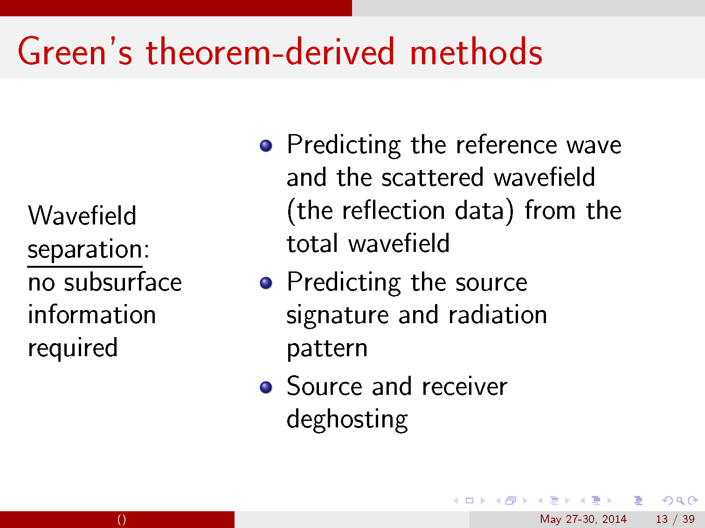

Slide 21

Onshore preprocessing: (1) reference wave removal including ground roll and deghosting, and (2) achieving that objective with a reduced data requirement
Jing Wu* and Arthur B. Weglein
M-OSRP, University of Houston

Slide 22
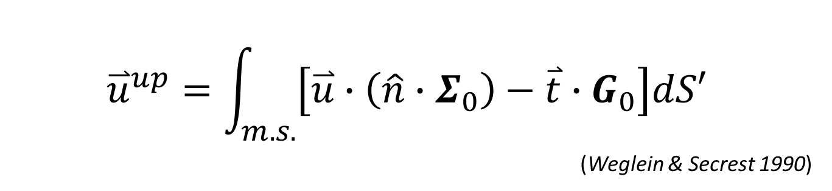
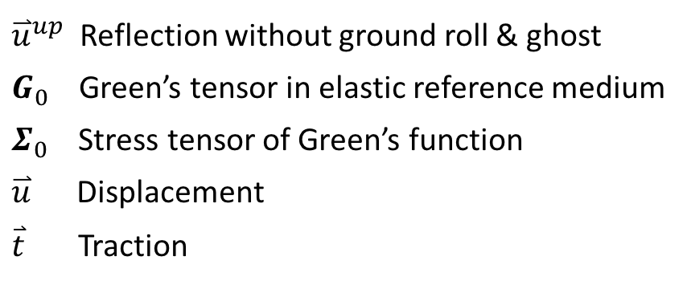
Onshore – wave separation algorithm
$${\overset{⃑}{u}}^{up}=\int_{m.s.}{\left[\overset{⃑}{u}∙\left(\hat{n}∙Σ_{0}\right)−\overset{⃑}{t}∙G_{0}\right]dS′ }$$
(Weglein & Secrest 1990)
${\overset{⃑}{u}}^{up}$ Reflection without ground roll & ghost
$G_{0}$ Green’s tensor in elastic reference medium
$Σ_{0}$ Stress tensor of Green’s function
$\overset{⃑}{u}$ Displacement
$\overset{⃑}{t}$ Traction

Slide 23
The data requirement is satisfied
Measure both multicomponent displacement and multicomponent traction
Effectively separate ground roll and ghosts out and without damaging reflection data

Slide 24
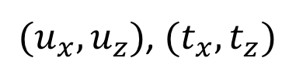

Model (Generate data from air/earth)
Air
A/E boundary
$$\overset{⃑}{r}$$
M.S. 100m
${(u}_{x},u_{z})$, ${(t}_{x},t_{z})$
Earth
400m
Layer | P Velocity (m/s) | S Velocity (m/s) | Density (kg/m³)
1(Air) | 340 | 0 | 3
2(Top earth) | 1800 | 1200 | 1500
3(Bottom earth) | 4000 | 2500 | 1800

Slide 25

Total $u_{x}$ input to the separation algorithm
(J. Wu and A. B. Weglein, 15)
Direct
Rayleigh
Primary
Ghost
receiver at 100 m

Slide 26

Predicted up $u_{x}$ from the separation algorithm
(J. Wu and A. B. Weglein, 15)
Primary
receiver at 100 m

Slide 27
Reduce requirement of traction

Slide 28
2D onshore experiment
$${(F}_{x},F_{z})$$
Air
A/E boundary
$${(u}_{x},u_{z})$$
Earth

Slide 29
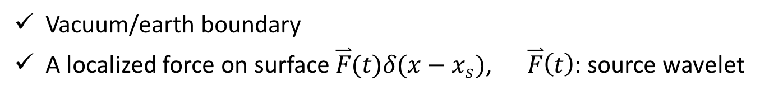


2D onshore experiment -- approximation
Vacuum/earth boundary
A localized force on surface $\overset{⃑}{F}(t)δ(x−x_{s})$, $\overset{⃑}{F}\left(t\right)$: source wavelet
$${(F}_{x},F_{z})$$
Vacuum
V/E boundary
$${(u}_{x},u_{z})$$
Earth

Slide 30
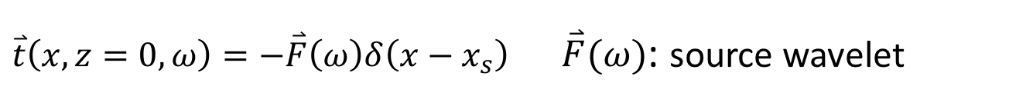
Boundary condition
$\overset{⃑}{t}\left(x,z=0,ω\right)=−\overset{⃑}{F}\left(ω\right)δ\left(x−x_{s}\right)$ $\overset{⃑}{F}(ω)$: source wavelet
$${(F}_{x},F_{z})$$
Vacuum
V/E boundary
$${(u}_{x},u_{z})$$
Earth

Slide 31
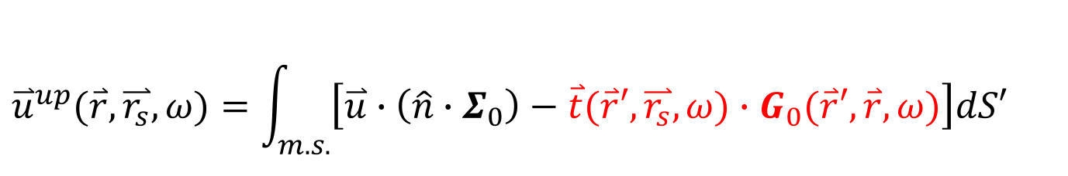
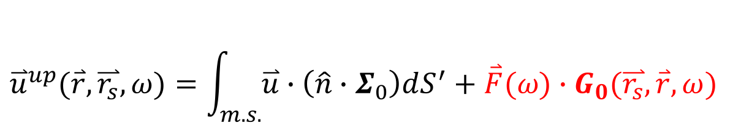
Formula simplification
$\overset{⃑}{t}\left(x,z=0,ω\right)=−\overset{⃑}{F}\left(ω\right)δ\left(x−x_{s}\right)$ $\overset{⃑}{F}(ω)$: source wavelet
Original
$${\overset{⃑}{u}}^{up}(\overset{⃑}{r},\overset{⃑}{r_{s}},ω)=\int_{m.s.}{\left[\overset{⃑}{u}∙\left(\hat{n}∙Σ_{0}\right)−\overset{⃑}{t}(\overset{⃑}{r}′,\overset{⃑}{r_{s}},ω)∙G_{0}(\overset{⃑}{r}′,\overset{⃑}{r},ω)\right]dS′}$$
Require traction everywhere along acquisition surface
Simplified
$${\overset{⃑}{u}}^{up}(\overset{⃑}{r},\overset{⃑}{r_{s}},ω)=\int_{m.s.}{\overset{⃑}{u}∙\left(\hat{n}∙Σ_{0}\right)dS^{′}}+\overset{⃑}{F}(ω)∙G_{0}(\overset{⃑}{r_{s}},\overset{⃑}{r},ω)$$
Require source wavelet

Slide 32
The data requirement is satisfied
Measure both multicomponent displacement and multicomponent traction
Effectively separate ground roll and ghosts out and without damaging reflection data

Slide 33
The data requirement is satisfied
Measure both multicomponent displacement and multicomponent traction
Effectively separate ground roll and ghosts out and without damaging reflection data
The data requirement is not satisfied
Measure only multicomponent displacement, but no multicomponent traction
Effectively separate ground roll and ghosts out and without damaging reflection data

Slide 34

Total $u_{z}$ input to simplified wave separation algorithm

Slide 35
Total $u_{z}$ input to simplified wave separation algorithm
Rayleigh

Slide 36



Total $u_{z}$ input to simplified wave separation algorithm
$\grave{P}\acute{P}$ + Ghost
$\grave{P}\acute{S}$/$\grave{S}\acute{P}$ + Ghost
$\grave{S}\acute{S}$ + Ghost

Slide 37
Predicted primary from simplified wave separation algorithm

Slide 38
Total $u_{z}$ input to simplified wave separation algorithm
Rayleigh

Slide 39
Predicted primary from simplified wave separation algorithm
Rayleigh

Slide 40
Total $u_{z}$ input to simplified wave separation algorithm
$\grave{P}\acute{P}$ + Ghost
$\grave{P}\acute{S}$/$\grave{S}\acute{P}$ + Ghost
$\grave{S}\acute{S}$ + Ghost

Slide 41



Predicted primary from simplified wave separation algorithm
$\grave{P}\acute{P}$ + Ghost
$\grave{P}\acute{S}$/$\grave{S}\acute{P}$ + Ghost
$\grave{S}\acute{S}$ + Ghost

Slide 42
Simulated primary with analytical form
$\grave{P}\acute{P}$ + Ghost
$\grave{P}\acute{S}$/$\grave{S}\acute{P}$ + Ghost
$\grave{S}\acute{S}$ + Ghost

Slide 43
Formula simplification
$\overset{⃑}{t}\left(x,z=0,ω\right)=−\overset{⃑}{F}\left(ω\right)δ\left(x−x_{s}\right)$ $\overset{⃑}{F}(ω)$: source wavelet
Original
$${\overset{⃑}{u}}^{up}(\overset{⃑}{r},\overset{⃑}{r_{s}},ω)=\int_{m.s.}{\left[\overset{⃑}{u}∙\left(\hat{n}∙Σ_{0}\right)−\overset{⃑}{t}(\overset{⃑}{r}′,\overset{⃑}{r_{s}},ω)∙G_{0}(\overset{⃑}{r}′,\overset{⃑}{r},ω)\right]dS′}$$
Require traction everywhere along acquisition surface
Simplified
$${\overset{⃑}{u}}^{up}(\overset{⃑}{r},\overset{⃑}{r_{s}},ω)=\int_{m.s.}{\overset{⃑}{u}∙\left(\hat{n}∙Σ_{0}\right)dS^{′}}+\overset{⃑}{F}(ω)∙G_{0}(\overset{⃑}{r_{s}},\overset{⃑}{r},ω)$$
Require source wavelet

Slide 44

2D Green’s theorem receiver deghosting in the
(x-ω) domain using a depth-variable cable
-- towards on-shore and ocean-bottom application with
variable topography
Zhen Zhang* and Arthur B. Weglein
Oct 19, 2016
Dallas, TX

Slide 45
Outline
Motivation
Developments of Green’s theorem deghosting
Green’s theorem deghosting method
Numerical example
  Initial test using a parabolic cable
  Robustness test using a periodically semicircular cable
Conclusions

Slide 46

Numerical example (2D source, 1D earth) of Green’s theorem receiver deghosting
2. Periodically semicircular cable
(0,0)
x
z
z

Slide 47
Numerical example (2D source, 1D earth) of Green’s theorem receiver deghosting
2. Periodically semicircular cable
(0,0)
x
(0,50)
95m
400m
z
z

Slide 48
Numerical example (2D source, 1D earth) of Green’s theorem receiver deghosting
2. Periodically semicircular cable
direct wave
reflection from air-water boundary
primary reflected from water bottom
source ghost of the primary
receiver ghost of the primary
source-receiver ghost of the primary
1st order free surface multiples
Total wave generated by the Cagniard-de Hoop method on the cable

Slide 49

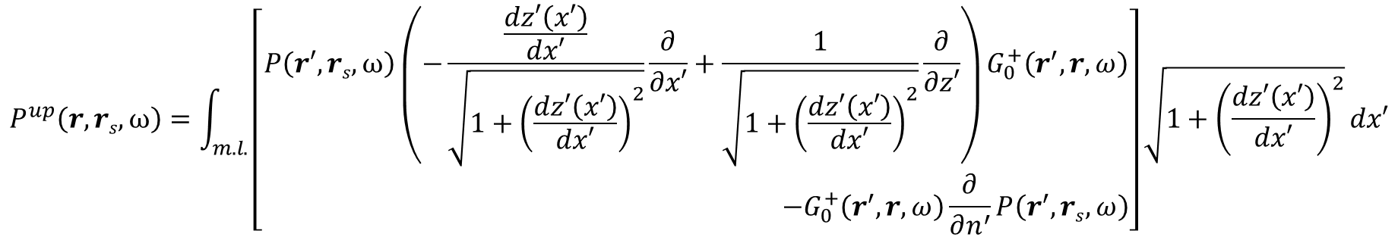
Numerical example (2D source, 1D earth) of Green’s theorem receiver deghosting
2. Periodically semicircular cable
Actual measurement surface
Assumed measurement surface
(same as actual) in deghosting
Receiver deghosted data predicted above the cable
(at z=95m) using formula below
$$P^{up}\left(r,rs,ω\right)=\int_{m.l.}{\left[\begin{aligned}P\left(r′,rs,ω\right){\left(−\frac{\frac{dz′\left(x′\right)}{dx′}}{\sqrt{1+{\left(\frac{dz′\left(x′\right)}{dx′}\right)}^{2}}}\frac{∂}{∂x′}+\frac{1}{\sqrt{1+{\left(\frac{dz′\left(x′\right)}{dx′}\right)}^{2}}}\frac{∂}{∂z′}\right)G}_{0}^{+}\left(r^{′},r,ω\right) \\ −G_{0}^{+}\left(r^{′},r,ω\right)\frac{∂}{∂n^{′}}P\left(r^{′},rs,ω\right)\end{aligned}\right]\sqrt{1+{\left(\frac{dz′\left(x′\right)}{dx′}\right)}^{2}}dx′}$$

Slide 50
Numerical example (2D source, 1D earth) of Green’s theorem receiver deghosting
2. Periodically semicircular cable
Actual upgoing wave (primary, its source ghost and their free surface multiples) generated above the cable (at z=95m) by the Cagniard-de Hoop method, for comparison

Slide 51
Numerical example (2D source, 1D earth) of Green’s theorem receiver deghosting
Actual measurement surface
Assumed measurement surface (z=100m) in deghosting
2. Periodically semicircular cable
Receiver deghosted data predicted above the cable
(at z=95m) assuming flat cable, using formula below
$$P^{up}\left(r,rs,ω\right)=\int_{m.l.}{\left[P\left(r′,rs,ω\right)\frac{∂}{∂z′}G_{0}^{+}P^{up}\left(r′,r,ω\right)−G_{0}^{+}\left(r′,r,ω\right){\frac{∂}{∂z′}P}^{up}\left(r′,rs,ω\right)\right]dx′}$$

Slide 53
Green’s theorem tutorial part II:
Wave field prediction
Arthur B. Weglein
June 8, 2016
Houston, Texas
Notes:
53
53

Slide 54
The first migration method that's equally effective for all acquired frequencies for imaging and inverting at the target and reservoir
Arthur B. Weglein
Houston, Texas
July 13, 2016

Slide 55
Migration
was originally (and remains today) only meaningful for primaries

Slide 56
The original purpose of migration was to map an event on a time section in (x,t) to a point on a structure map. That is, to a point on a reflector in x,z
That concept only has meaning for primaries.
We will show that that remains the meaning of migration today.

Slide 57
Wave theory methods used to migrate seismic data have two components
  A wave propagation component
  An imaging condition

Slide 58
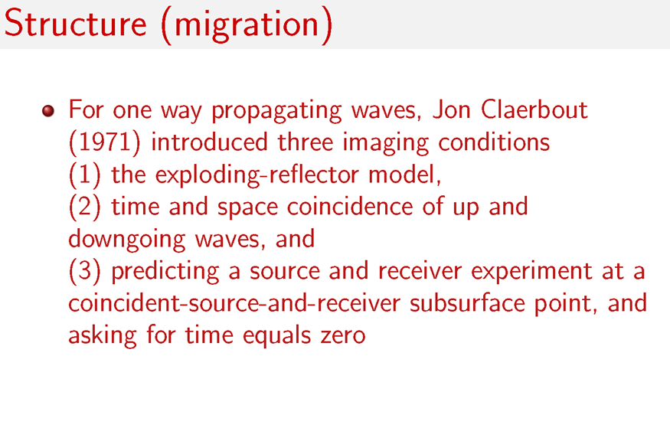

Slide 59
2D Claerbout III in the Fourier domain (Stolt migration)
6) Inverse Fourier transform
Set x_{g}=x_{s}=x (x_{m}=x; x_{h}=0 ) original Stolt migration (Claerbout III)
angle average plane wave reflection coefficient by summing over k_{h}

Slide 60
Stolt extended (Claerbout III) migration retains k_{h} information at depth z, D(km,kh,kz) and that provides the plane wave reflection coefficient at a specular reflector

Slide 61
Stolt extended (Claerbout III) migration retains k_{h} information at depth z, D(km,kh,kz) and that provides the plane wave reflection coefficient at a specular reflector
Stolt and collaborators further extended Claerbout III to provide a point reflectivity model that automatically images specular and non-specular reflections.
R. H. Stolt and A. B. Weglein, ‘Seismic Imaging and Inversion: Application of Linear Inverse Theory’, Chapter 8, (2012), Cambridge University Press (volume 1)

Slide 62
Stolt extended (Claerbout III) migration retains k_{h} information at depth z, D(km,kh,kz) and that provides the plane wave reflection coefficient at a specular reflector
Stolt and collaborators further extended Claerbout III to provide a point reflectivity model that automatically images specular and non-specular reflections.
The latter is only possible for extensions/generalizations of Claerbout III(not for Claerbout II)

Slide 63
Claerbout II imaging (A typical form)
Where R is the reflection data (for a shot record), run backwards, and S is the source wavefield.

Slide 64
Claerbout II imaging
Claerbout III imaging

Slide 65
Let’s examine Claerbout II and III where only the imaging condition is the issue

Slide 66
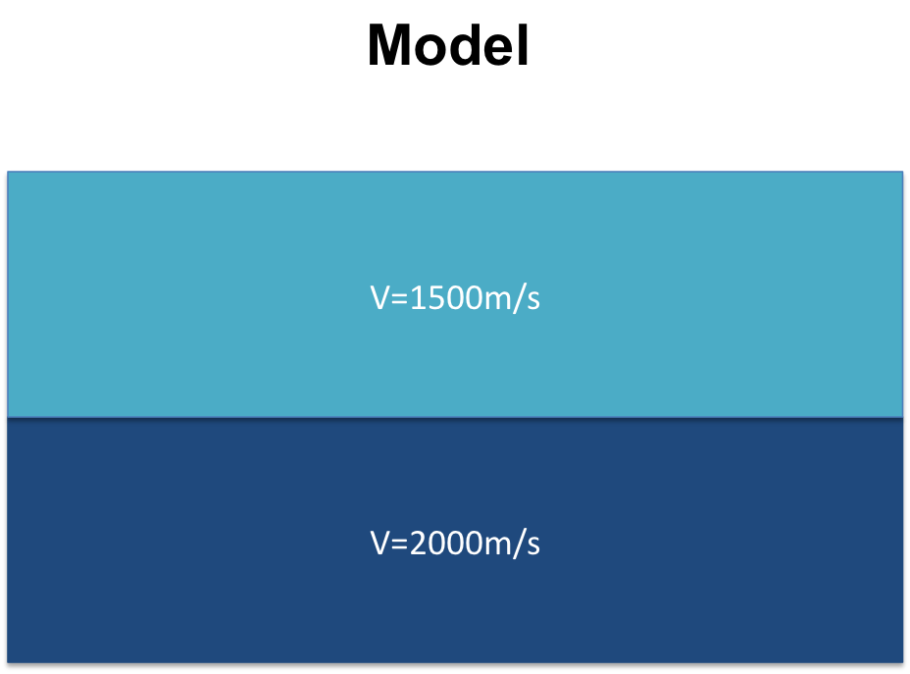
A numerical example of Claerbout II imaging
(current leading edge RTM) for a single reflector with a homogeneous velocity model
(one shot gather)
Z
X
Yanglei Zou and Weglein, 2014
Notes:
repeat

Slide 67
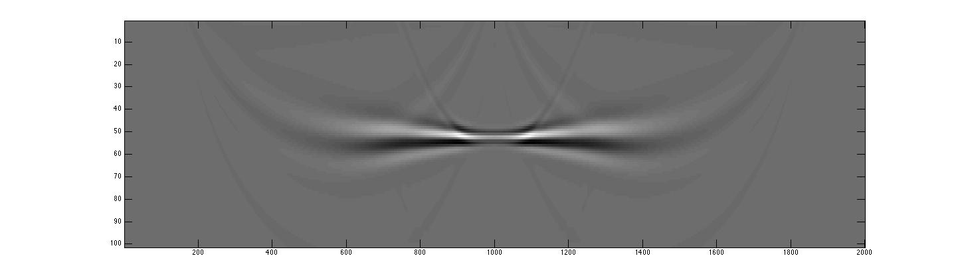
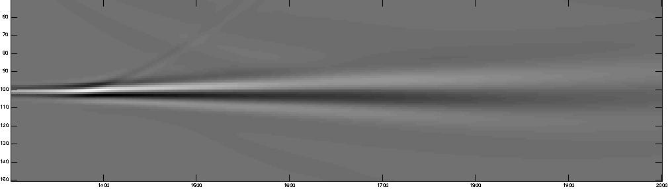
A numerical example of Claerbout II imaging
(current leading edge RTM) for a single reflector with a homogeneous velocity model
(one shot gather)
z(m)
x(m)
Zoom of the figure above (from x=1250m to x=1950m)
z(m)
x(m)
Yanglei Zou and Weglein, 2014
Notes:
The Claerbout II image shows an inconsistent amplitude and shape of the image along the single reflector. In practice, a sum over all sources is taken with the assumption that all artifacts will go away.

Slide 68
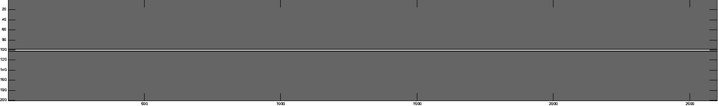
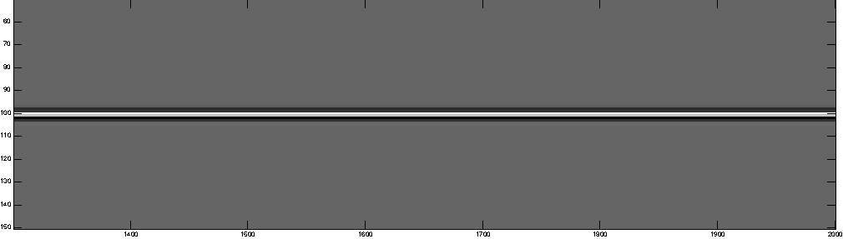
A numerical example of Claerbout III Stolt migration
for a single reflector
z(m)
x(m)
Zoom of the figure above (from x=1250m to x=1950m)
z(m)
x(m)
Yanglei Zou and Weglein, 2014
Notes:
The Claerbout III image shows an amplitude and shape consistent image. The exact same data was used in this simplest 1D earth prestack. Claerbout II and Claerbout III tests and comparisons indicate their intrinsic and substantive differences even in the simplest circumstances.

Slide 69
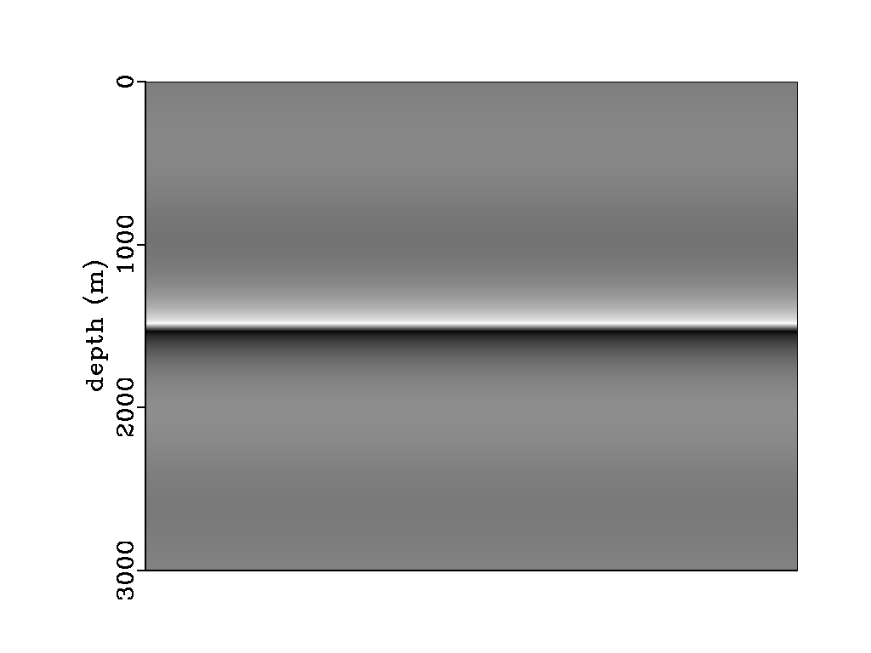
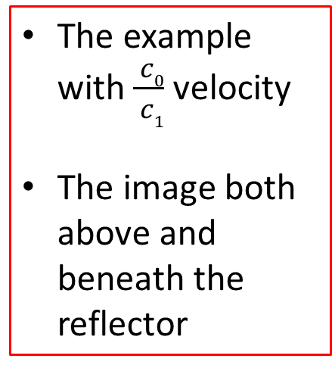
The new M-OSRP Claerbout III (Stolt extended) migration for 2 way wave propagation (for heterogeneous media)
The example with $\frac{ c0}{ c1}$ velocity
The image both above and beneath the reflector
Qiang Fu
No “rabbit ears”
Consistent image along the reflector
Light color – image from above
Dark color – image from below

Slide 70
The Claerbout II imaging principle provides an image for one shot record. However, the resulting inconsistency in the image is mitigated by summing over shots. Claerbout II has a somewhat ad hoc origin and an ad hoc ‘fix’.

Slide 71
In Claerbout III one shot record predicts the receiver at depth (not an image). The Green’s theorem weighted sum over shots then predicts the source at depth, leading to an image.
There is nothing that’s inconsistent or being fixed with the sum over sources in Claerbout III.

Slide 72
How do you know if a migration method has made a high frequency approximation?

Slide 73
(1) If there is a travel time curve of candidate images within the method, it is a high frequency ‘ray theory’ approximation/ assumption.
where,

Slide 74
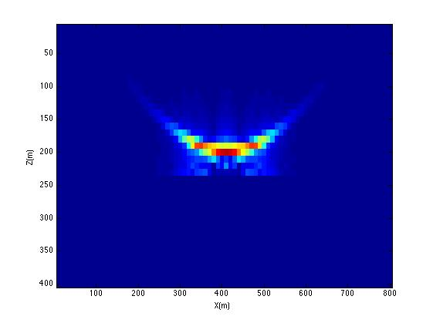
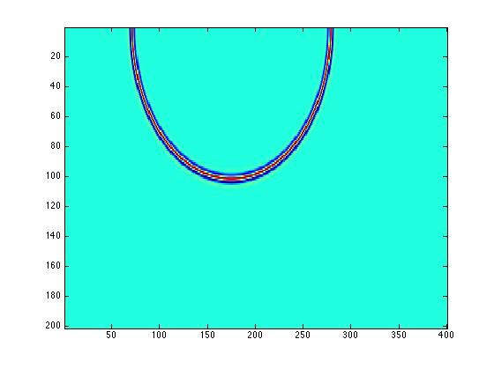
Imaging Conditions and High Frequency Assumptions
Claerbout III
Claerbout II
Stolt migration: one source one receiver
RTM(2D)
z
x
Yanglei Zou, 2015
No high frequency assumption
High frequency assumption

Slide 75
How do you know if a migration method has made a high frequency approximation?
(2) A stationary phase of other high frequency approximation is employed within the method.
(3) a propagation model that assumes one way wave propagation (for anything other than a homogeneous subsurface) is a high frequency approximation
  high frequency approximation can enter migration methods through (1) the imaging condition (all Claerbout II) or (2) through the propagation component (or both), that is, for example, assuming a one way propagation for a slowly varying velocity in Claerbout III

Slide 76
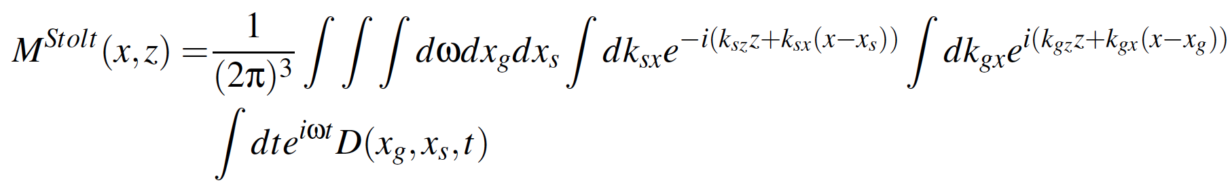
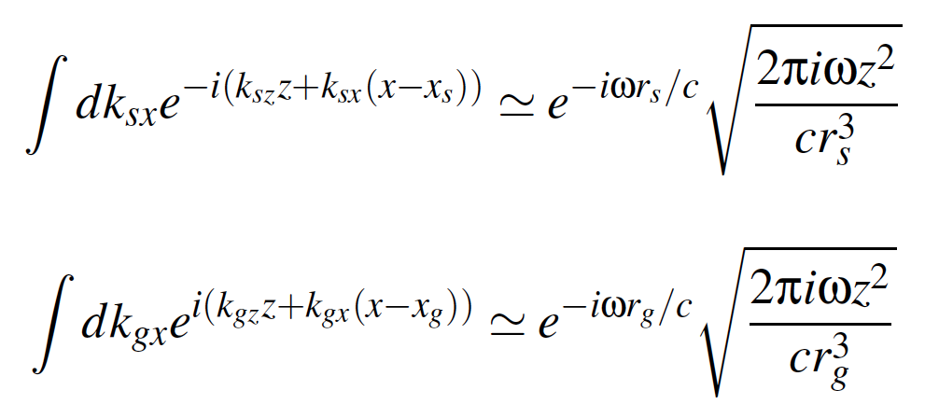
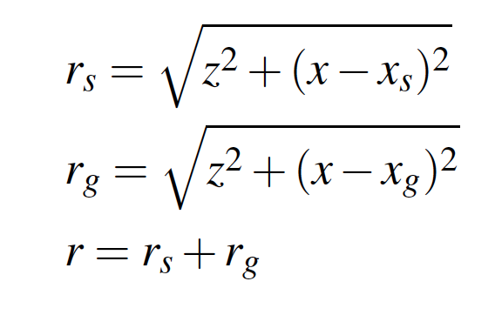
2D Stolt migration
An asymptotic approximation can be made with
the stationary phase approximation

Slide 77
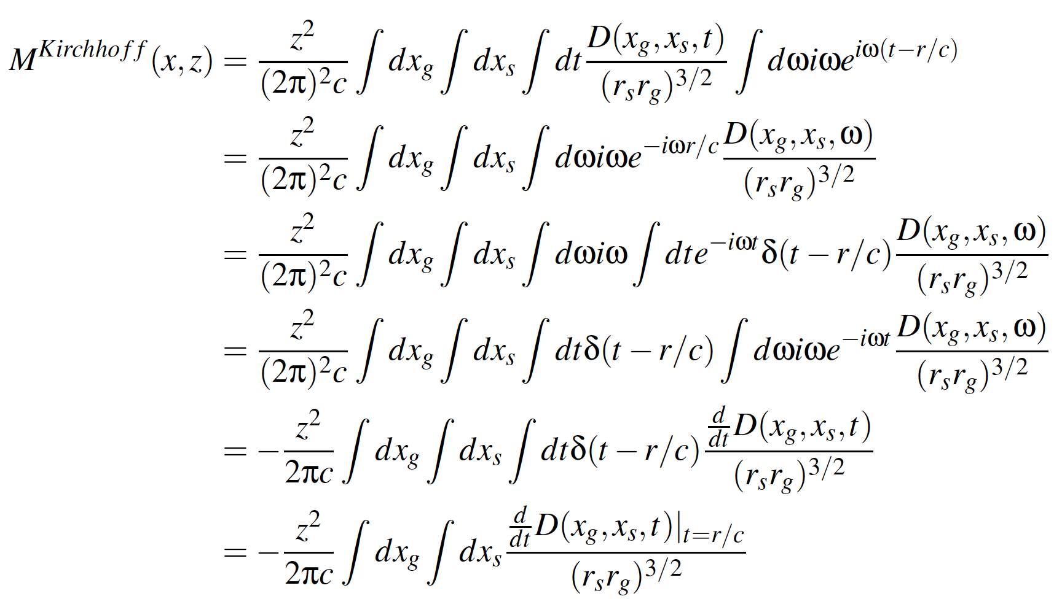
The Kirchhoff migration is an asymptotic approximation
of Stolt migration

Slide 78
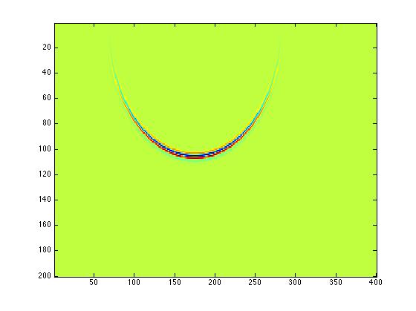
Kirchhoff migration for a single source and receiver
Kirchhoff migration (2D)
z
x
Yanglei Zou et al, 2015
High Frequency approximation from a stationary phase approximation
Notes:
----- Meeting Notes (5/28/15 03:35) -----
Kirchhoff migration shares some kind of behavior with RTM (Claerbout II), including producing candidate and depending on the coherent summing over candidate.

Slide 79
Claerbout II and III have been extended and generalized
For Claerbout II
  e.g., Yu Zhang, Sheng Xu and Norman Bleistein
    ----- introduce a geometric optics reflection coefficient model relating the reflection data and the incident source wavefield.
For Claerbout III
Stolt and collaborators
----- non-zero offset at t=0 provides amplitude information
----- outputs plane wave reflection coefficient or point scatterer reflectivity for specular and non-specular reflection

Slide 80
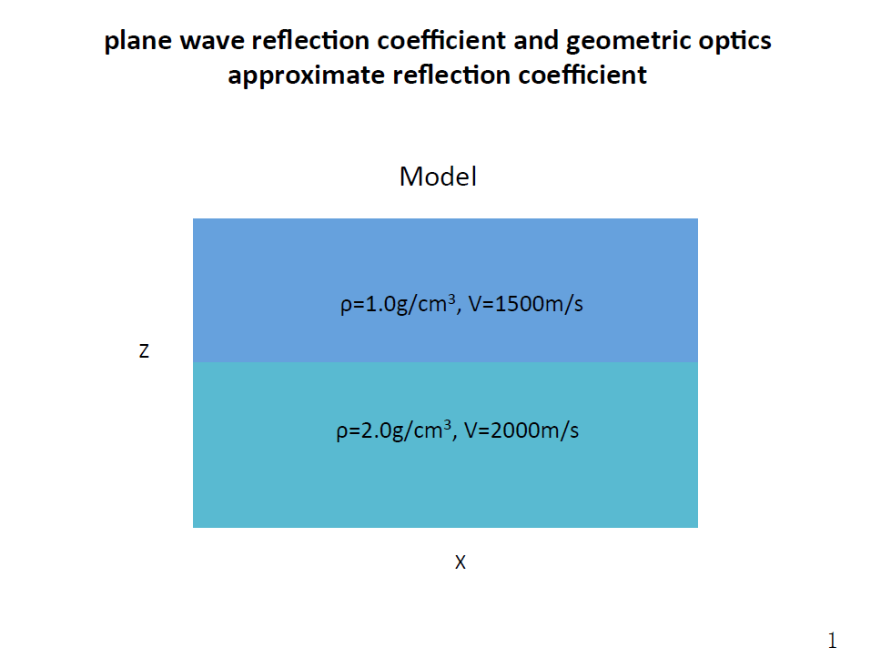

Slide 81
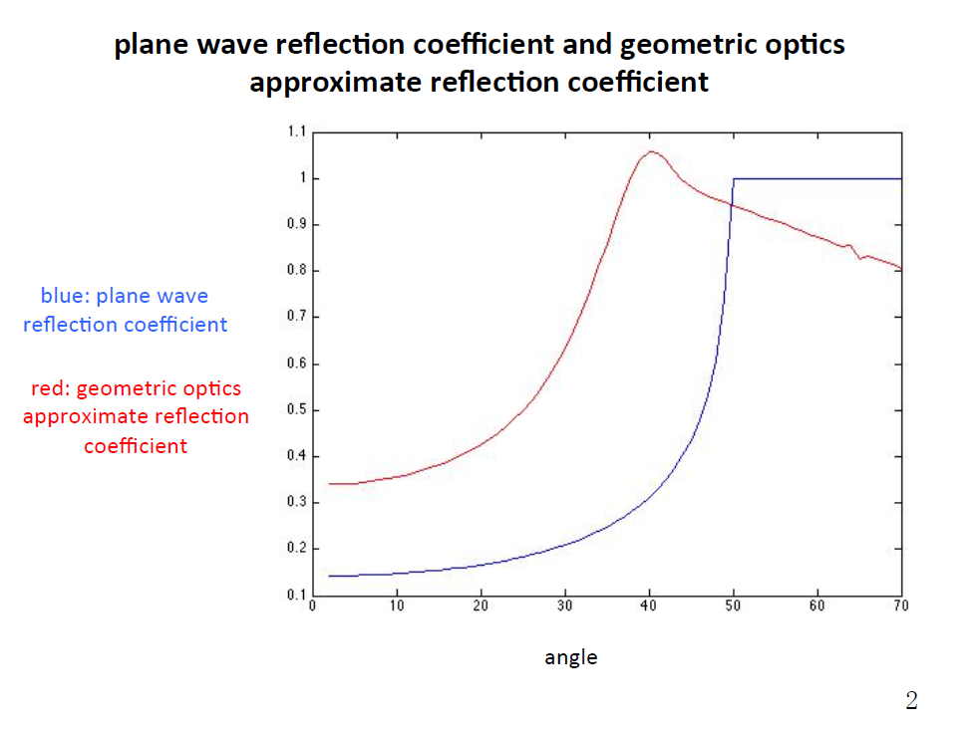
Yanglei Zou and Weglein, 2015

Slide 82
Benefits of Claerbout III imaging (extended by Stolt and colleagues) for specular and non-specular imaging
1
2
3
specular
non-specular
non-specular
1. Specular
outputs actual plane wave reflection coefficient data for
specular reflection (unique to Claerbout III )
2. Non-Specular reflection
a point scatterer model for structure and inversion of non-specular reflections (unique to Claerbout III )

Slide 83
All current “RTM” methods (for two way waves) correspond to imaging condition II, and do not correspond to (nor do they provide the benefits of) a coincident source and receiver experiment at depth at time equals zero

Slide 84
M-OSRP has recently pioneered and developed a new migration method that has Stolt’s extension of Claerbout III imaging inside a medium with two way waves
The new migration method provides four benefits

Slide 85
Recent new imaging development from M-OSRP (Weglein, A.B., Stolt, R. H., Mayhan, J. D., “Reverse-time migration and Green’s theorem: Part I — The evolution of concepts, and setting the stage for the new {RTM} method” Journal ofSeismic Exploration, 20, 73–90. February 2011; Weglein, A.B., Stolt, R. H., Mayhan, J. D., “Reverse time migration and Green’s theorem: Part II — A new and consistent theory that progresses and corrects current RTM concepts and methods” Journal ofSeismic Exploration, 20, 135–159. May 2011; THE FIRST WAVE EQUATION MIGRATION RTM WITH DATA CONSISTING OF PRIMARIES AND INTERNAL MULTIPLES: THEORY AND 1D EXAMPLES FANG LIU and ARTHUR B. WEGLEIN JOURNAL OF SEISMIC EXPLORATION 23, 357-366 (2014) 357) provides the predicted source and receiver experiment at depth beneath an overburden that has two way wave propagation
  A tool to analyze the role of primaries and multiples in imaging
  A more effective and interpretable RTM by realizing Stolt extended Claerbout III providing a more complete and realistic model for imaging and inverting specular and non-specular reflectors
  Provides the first migration method that is equally effective at every frequency component of recorded data (avoids asymptotic high frequency approximations) in both the imaging condition and in how the imaging condition is implemented.
  Imaging and inverting from above (and from below) a reflector without backscatter.

Slide 86
Use the new imaging method with two way propagating waves to examine the role of primaries and multiples in imaging and inversion
That provides a definitive response to the question of whether multiples are migrated

Slide 87
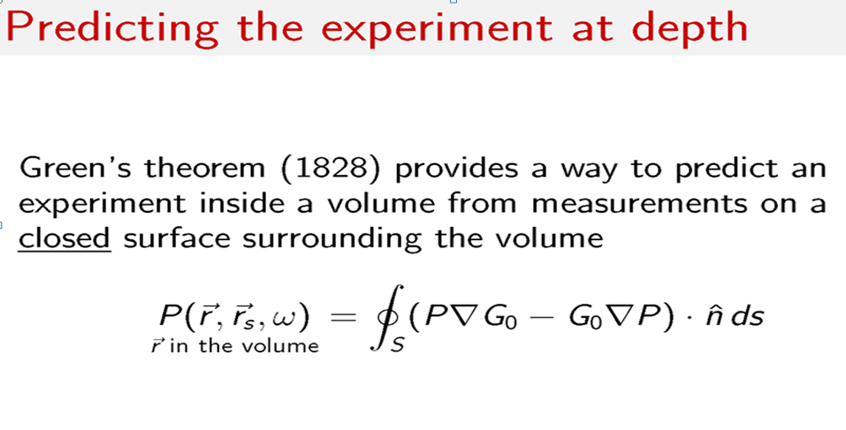
(1)

Slide 88
where
(2)
(3)
Where G₀ is any solution of (3) for on S and in V

Slide 89
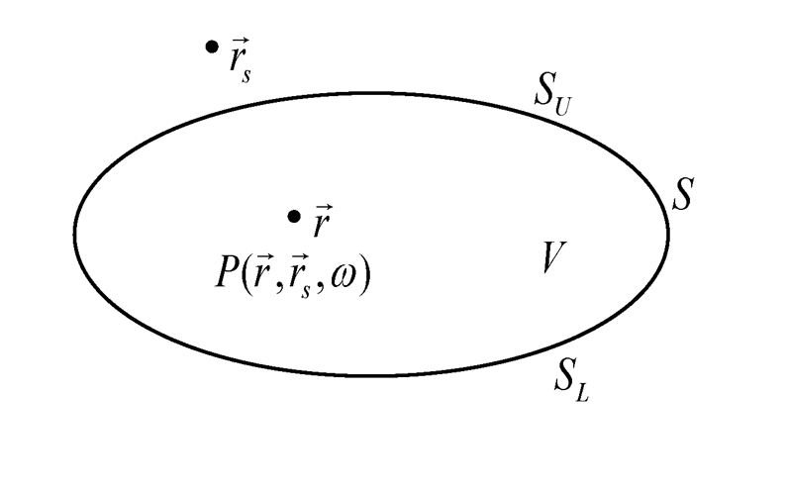

Slide 90
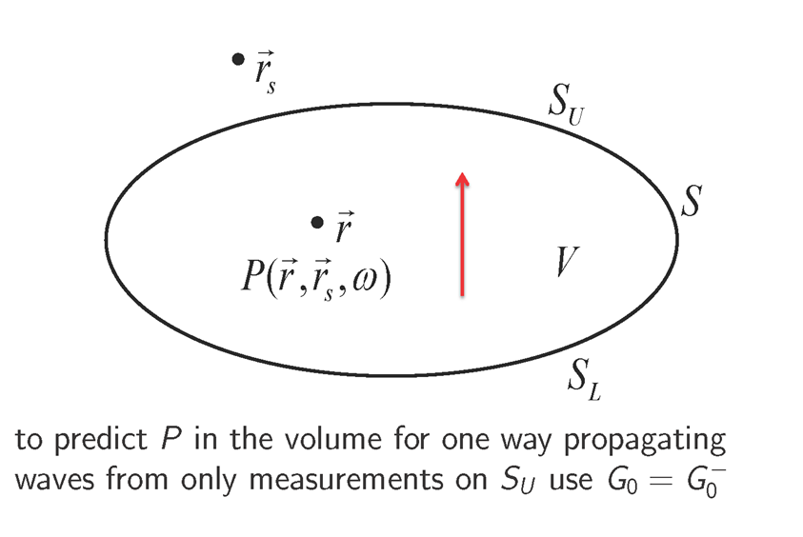

Slide 91
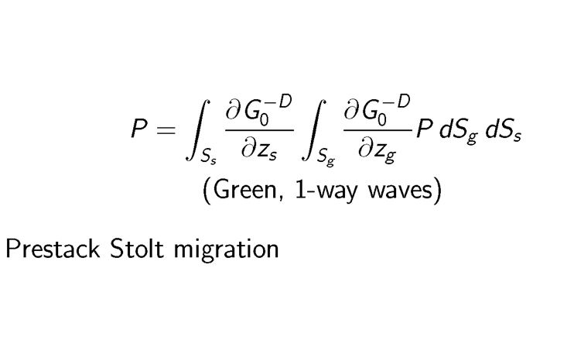

Slide 93
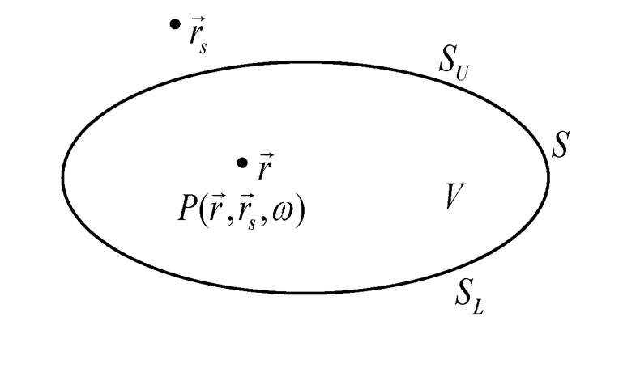

Slide 94
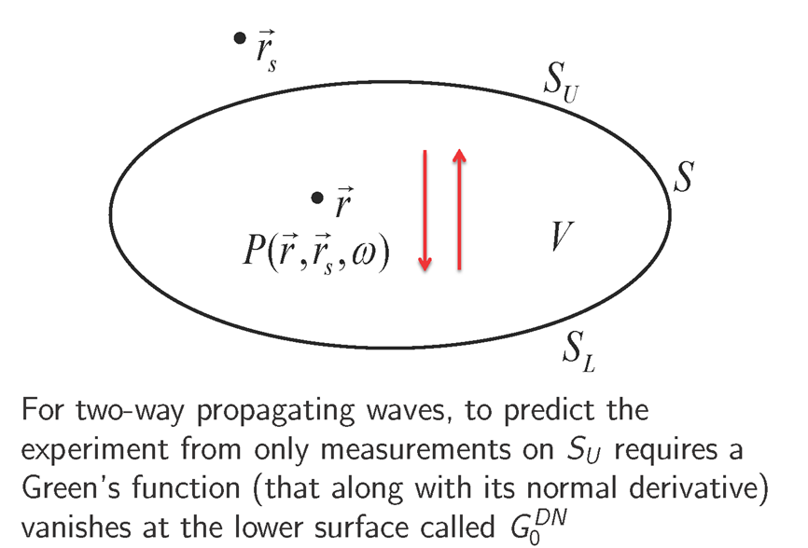

Slide 95
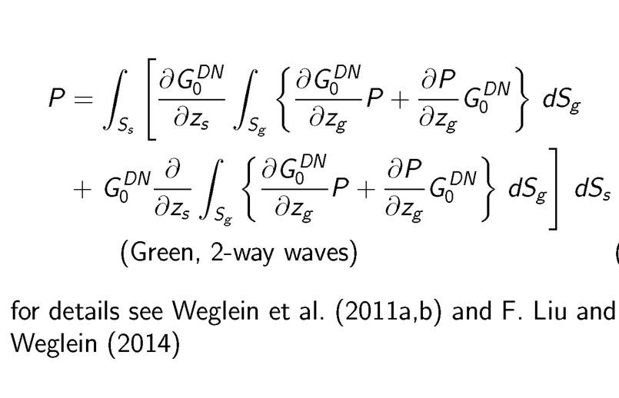

Slide 98
Migrating multiples?
We have described how to predict an experiment at depth inside a volume where there are two way propagating waves. For the first time, we follow and demonstrate how each individual surface recorded event (primaries, free surface multiples and internal multiples) contributes to the predicted experiment at depth, and when the t=0 imaging condition, for imaging and inversion. That will answer the question of whether multiples are signal or noise.

Slide 99
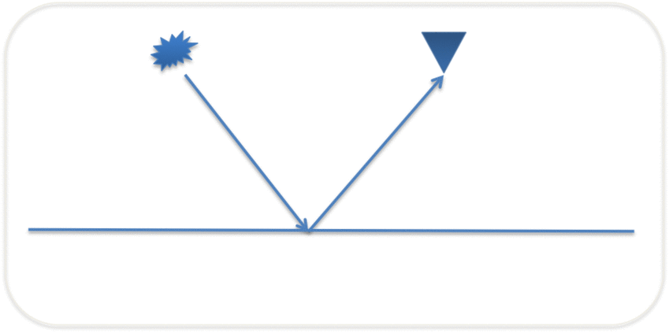
Case 1: a primary
99
Notes:
99

Slide 100
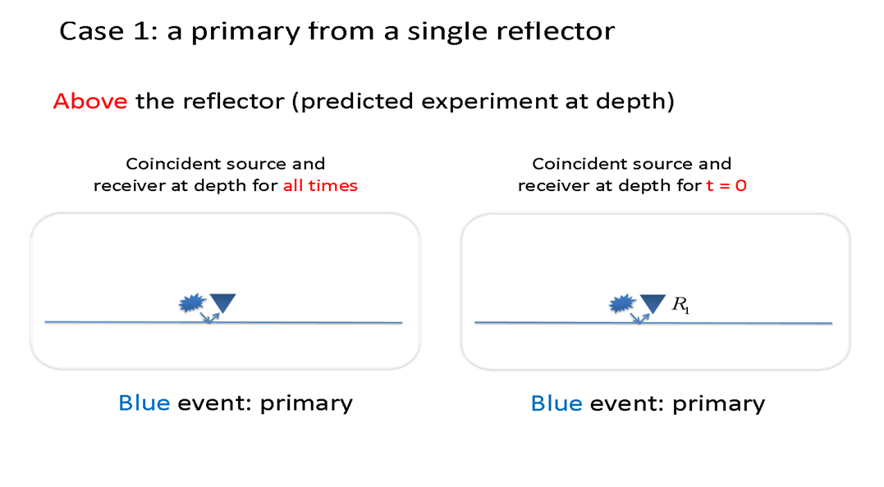

Slide 101
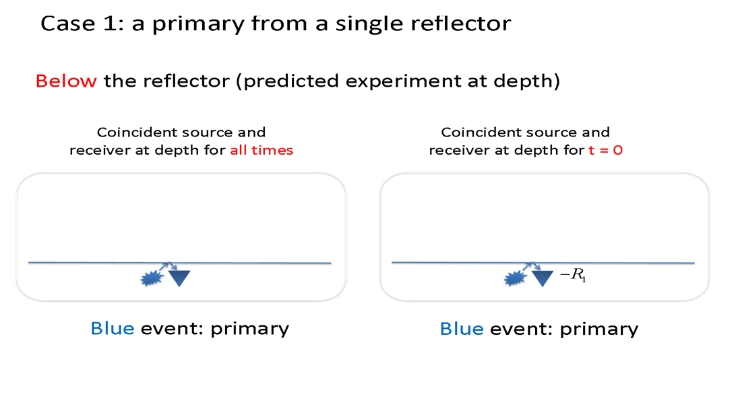

Slide 102
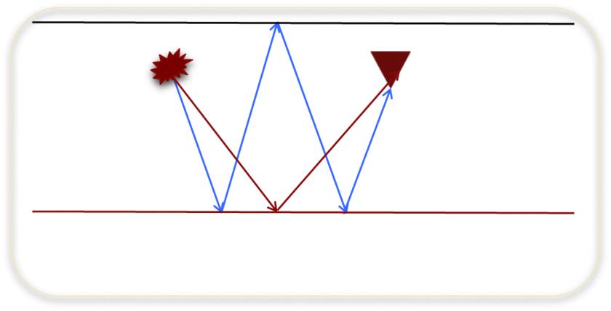
Case 2: a primary and free surface multiple
Notes:
102

Slide 103
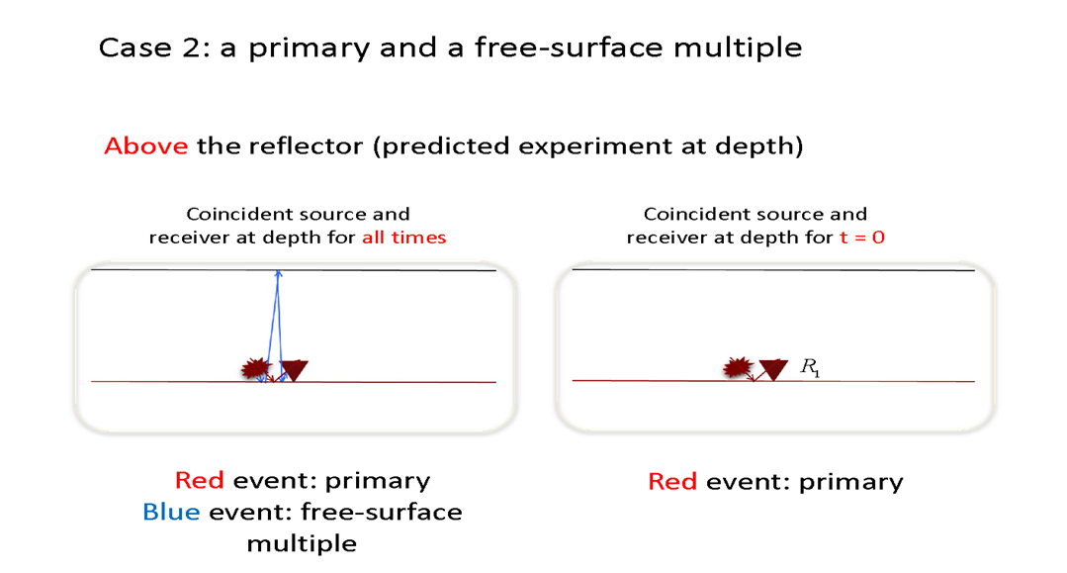

Slide 104
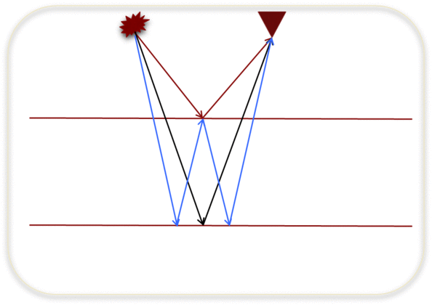
Case 3: two primaries and an internal multiples
Notes:
104

Slide 105
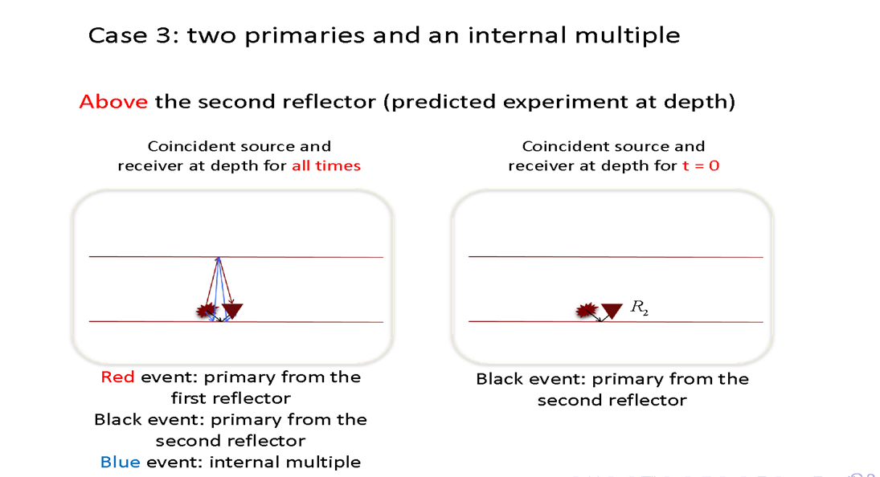

Slide 106
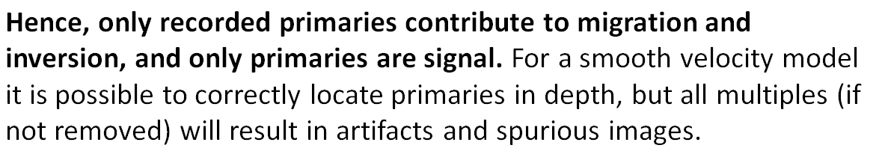

Slide 107
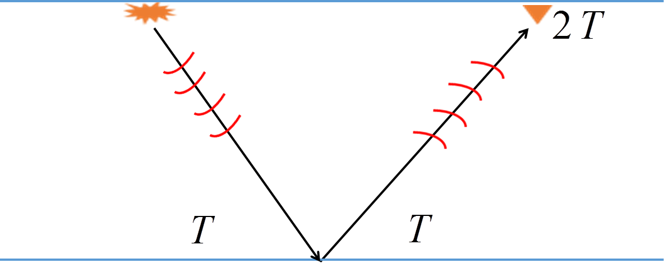
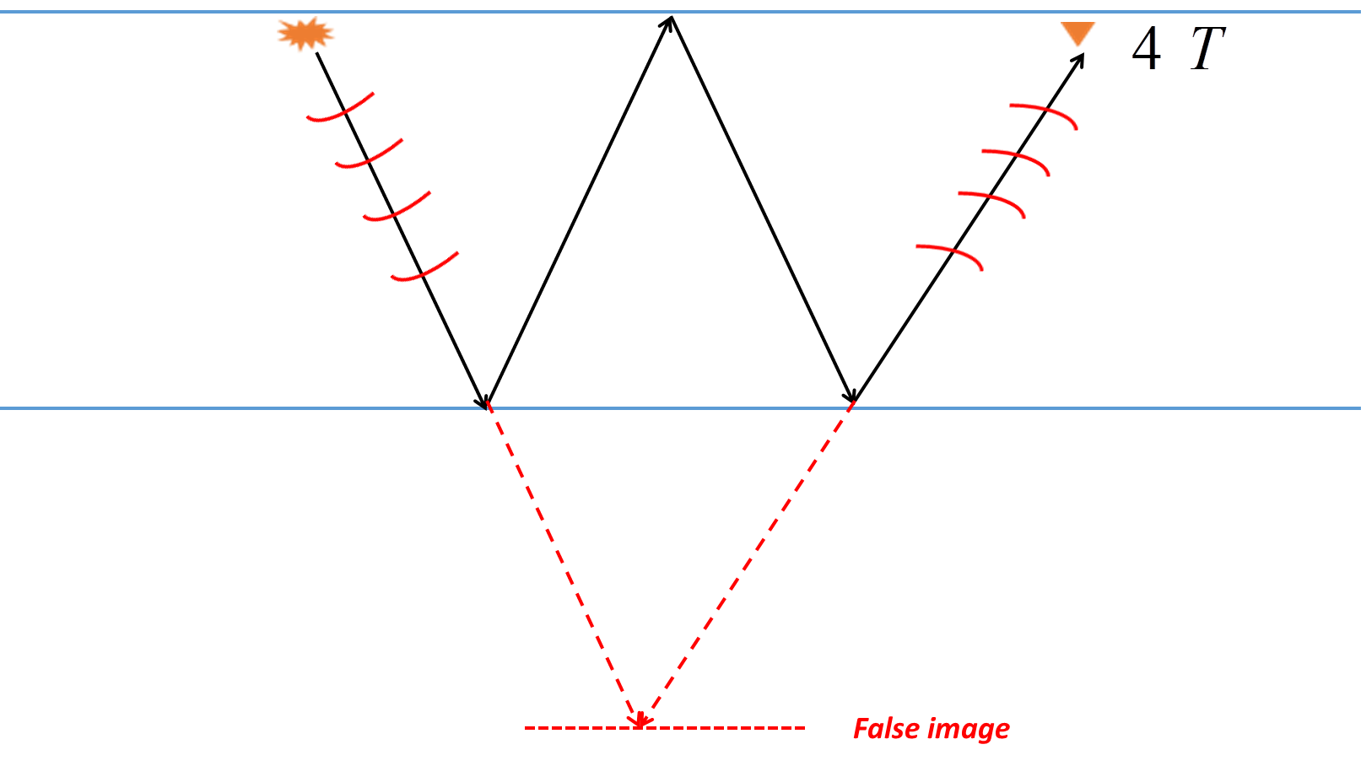


What happens to multiples with methods that image recorded primaries
Claerbout II
$$R_{1}$$
$${−R}_{1}^{2}$$
Multiples cause false images when migrating primaries

Slide 108
For smooth velocities, multiples produce false images and must be removed in any migration of primaries and multiples, the same is true for Claerbout III

Slide 109
What if the recorded primaries are insufficient/less than adequate?
Given the velocity model of the unrecorded primary, a recorded multiple can be used to find an approximate image of an unrecorded primary

Slide 110
Claerbout Imaging condition II
Space and time coincidence of upgoing and downgoing wavefield
(e.g., Claerbout, 1971; Whitmore, 1983)

Slide 111
Use of primaries for imaging with II
Down-going plane wave that starts at z = at t = t₀ = 0
Downgoing
Upgoing

Slide 112
Use of primaries for imaging with II
Applying the imaging condition

Slide 113
Using multiples to enhance imaging

Slide 114
Using multiples to enhance imaging
Downgoing
Upgoing

Slide 115
Using multiples to enhance imaging
Effective up & down wavefield separation
Downgoing
Upgoing

Slide 116
Using multiples to enhance imaging
Applying the imaging condition

Slide 117
Amplitude of the image of unrecorded primary is R₁. The amplitude of the image found by using a multiple is R₁³
in addition, the approximate image is Claerbout II and carries the limitations we described above

Slide 118
Amplitude of the image of unrecorded primary is R₁. The amplitude of the image found by using a multiple is R₁³
in addition, the approximate image is Claerbout II and carries the limitations we described above
Only recorded primaries can achieve Claerbout III levels of structural fidelity and amplitude analysis

Slide 120
These two figures have the same exact process in obtaining an approximate image of primary HIJ. To call that process migrating ABC…GIJ makes no sense. How can the migration of an event not care about the history of the event?

Slide 121
Imaging primaries
Imaging recorded primaries
Finding the approximate image of an unrecorded primary

Slide 122
Imaging recorded primaries

Slide 123
What happens to multiples with methods that image recorded primaries
Claerbout II
$$R_{1}$$
$${−R}_{1}^{2}$$
Multiples cause false images when migrating primaries

Slide 124
For smooth velocities, multiples produce false images and must be removed in any migration of primary and multiples, the same is true for Claerbout III

Slide 125
To image recorded primaries, using any imaging method, requires first effectively removing multiples without damaging primaries
While tremendous progress has occurred in the last 20 years (from ISS methods for FS and internal multiples), significant high priority challenges remain
Responding to those challenges is a strategic priority for the petroleum industry – if not, the information and value of recorded primaries will remain only partially accessible and delivered. Only recorded primaries can deliver Stolt extended Claerbout III imaging and inversion benefits.

Slide 126
Finding the approximate image of an unrecorded primary

Slide 127
Using a multiple to find an approximate image of an unrecorded primary
Outputs a amplitude challenged Claerbout II image of the unrecorded primary (that’s a very low bar for the claim of a new vision of seismic data). Since Claerbout II has an intrinsic high frequency approximation, the approximate image of unrecorded primaries will not only be amplitude and interpretation challenged but will not have equal effectiveness / fidelity at all frequencies. Only recorded primaries imaged with the Stolt extended Claerbout III imaging can have interpretable amplitude information and equal effectiveness at all frequencies.

Slide 128
Hence, to seek images of recorded primaries plus an approximate image of unrecorded primaries, requires, as a critical step, a very effective multiple removal for the first, and predicting multiples for the second.

Slide 129
The approximate image of unrecorded primaries cause cross-talk – since the method cannot predict a multiple unless all of its subevents are recorded – if all of its subevents are recorded the multiple is useless in providing an image of an unrecorded primary, since there are none – that circular reasoning leads to using the entire data set (that contain multiples) and the non-multiple events in the data are one of the causes of cross-talk.
This 'use of multiples' is an ad-hoc method, that doesn't derive from a comprehensive framework, without issues where problems and shortcomings can be addressed in a systematic fashion, by returning to the theory without the issues. There is no theory that ‘uses’ multiples, without causing false events due to cross talk.

Slide 130
The effective removal of multiples remains a priority for those serious about imaging and inversion objectives ---- the improvement in structure from using multiples to obtain an approximate image of an unrecorded shallow primary can be useful ---- but doesn't represent a new and superseding view of primaries and multiples and their roles in migrating and inverting data.

Slide 131
Summary
Claerbout II imaging is a high frequency approximation.
Claerbout III imaging is not a high frequency approximation.

Slide 132
Summary
The only medium that has one way wave propagation is a homogeneous medium.
Assuming one way wave propagation for a non-homogeneous medium is a high frequency approximation.
We have described and illustrated a new migration method that generalizes the (non-asymptotic) Stolt extended Claerbout III imaging principle and applies it for inhomogeneous media without high frequency/one way wave assumptions.

Slide 133
Summary
That combination will have equal effectiveness at all frequencies for the image and inversion at the target/reservoir.
Plan is to evaluate the added-value to structure and amplitude analysis and to deliver that capability in 2D and 3D to our sponsors.
To migrate recorded primaries, it requires the removal of multiples.
While there is progress in multiple removal, serious high priority challenges remain.

Slide 134
An important comment and noteworthy observation
In the inverse scattering series internal multiple attenuation algorithm method and algorithm ---- for example in 2D
Surface data
Change to incident plane wave data

Slide 135
Source and receiver at depth z
Time equal zero:
With change of variable
Source and receiver experiment at depth, that retains the information at

Slide 136
The Stolt extended and generalized Claerbout imaging III,
And the ISS internal multiple attenuation algorithm:

Slide 137
Return to data
Data with internal multiple attenuated

Slide 138
An important comment and noteworthy observation
The well-documented stand-alone capability of the ISS internal multiple attenuator is due to two factors:
It’s the only method that is direct and doesn’t need and require any subsurface information (and without any interpretive input or intervention) and is model type independent
The water speed migration input to the algorithm (the Stolt-extended and generalized Claerbout imaging III) is the basic reason the algorithm can accurately and effectively accommodate subevents that are caused by, for example, specular and non-specular reflections, diffractions, pinchouts, refractions and head waves.

Slide 139
The new Stolt extended Claerbout III migration, being developed within M-OSRP, will provide benefit as:
a new and more capable method for migration and migration-inversion for both structural plays and amplitude analysis for conventional and unconventional reservoir identification and
as one of two distinct strategies to provide the next (and necessary) level of internal multiple removal, taking us from internal multiple attenuation to internal multiple elimination.

Slide 140
The comparison of structural resolution differences with conventional and broadband data between CII and CIII
--Part I
Qiang Fu, Yanglei Zou, Chao Ma, and Arthur B. Weglein
Notes:
140
140

Slide 142
Four comparisons on CII and CIII
  Consistency of structural image
  Interpretability of the amplitude
  Migration with a discontinuous velocity model
  Frequency fidelity
  the image resolution at the target

Slide 143
The motivation of the comparison
From previous presentations we know in principle CII and CIII should be different in terms of treatment of different frequencies
But how significant are the differences?
We would like to compare the structural resolution differences with conventional and broadband data between Claerbout II (CII) and Claerbout III (CIII) imaging principles and quantify the results for the first time

Slide 144
The design of the comparison
Two factors may contribute to the imaging effectiveness
  Imaging principle itself
  Implementation of the imaging
We would like to isolate the impact of imaging principle itself, so we use a velocity model which is as simple as possible; and implementations for CII and CIII as perfect as we can
We focus on only the structural resolution differences

Slide 145
The scheme of the comparison
 | CIII | CII
Conventional data (Less low frequencies) | The relative amplitude of the first side lobe
Broadband data (More low frequencies)

Slide 146
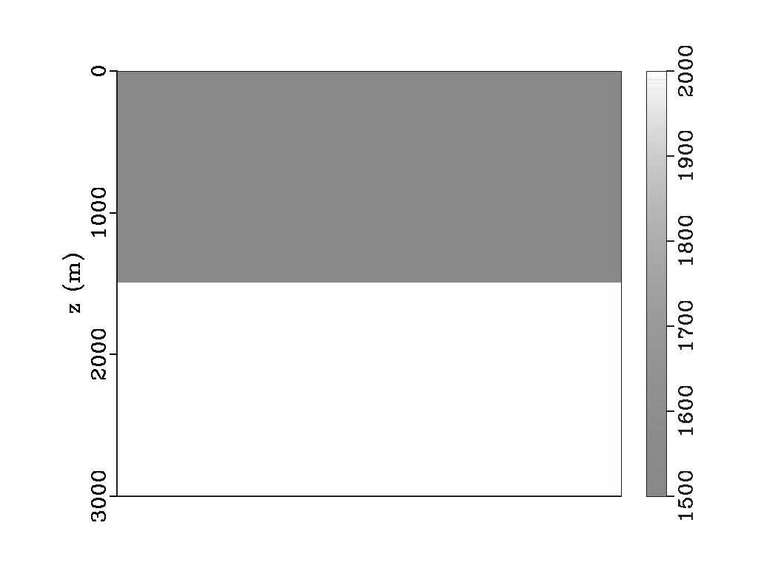
The velocity model of the data
1500m/s
2000m/s

Slide 147
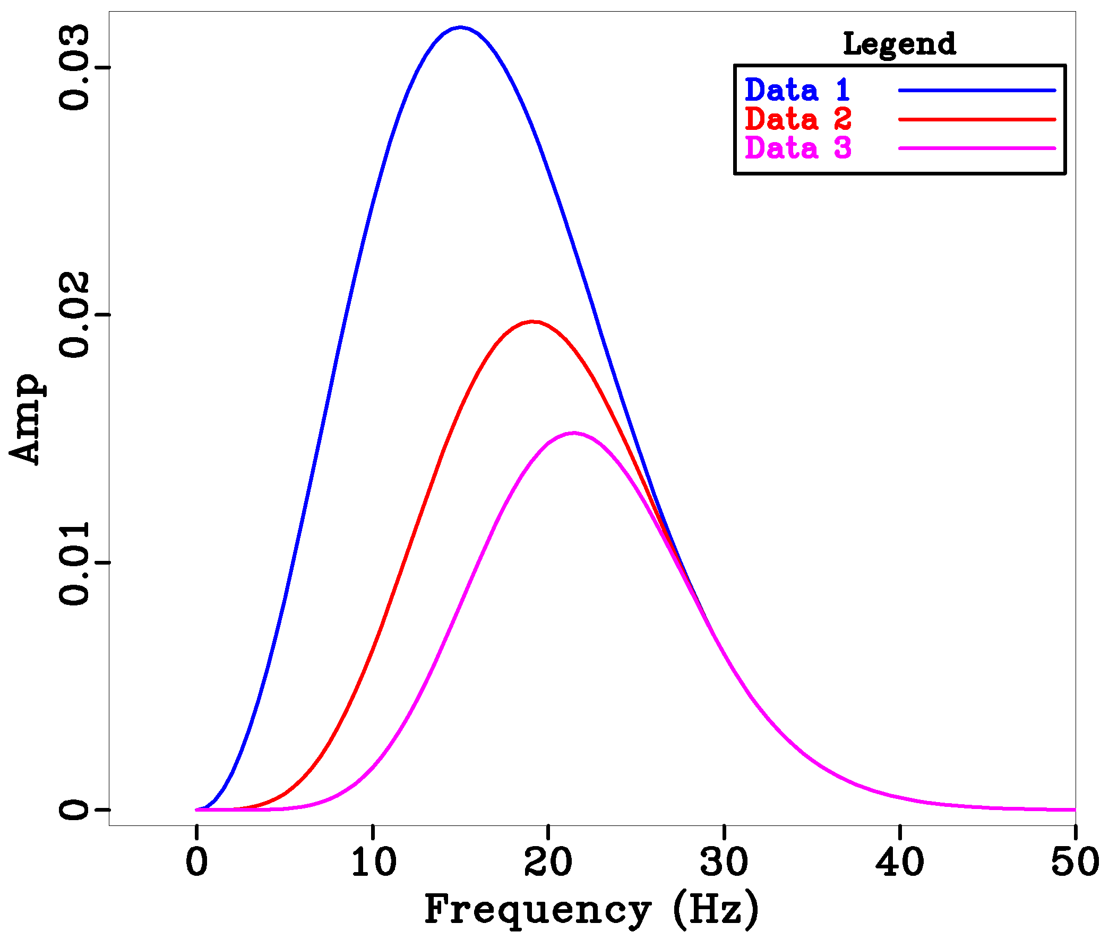
The spectra of the synthetic data
Data 1: Broadband data (More low frequencies)
Data 2: Conventional data (Less low frequencies)
Data 3: Even less low frequencies than Conventional data

Slide 148
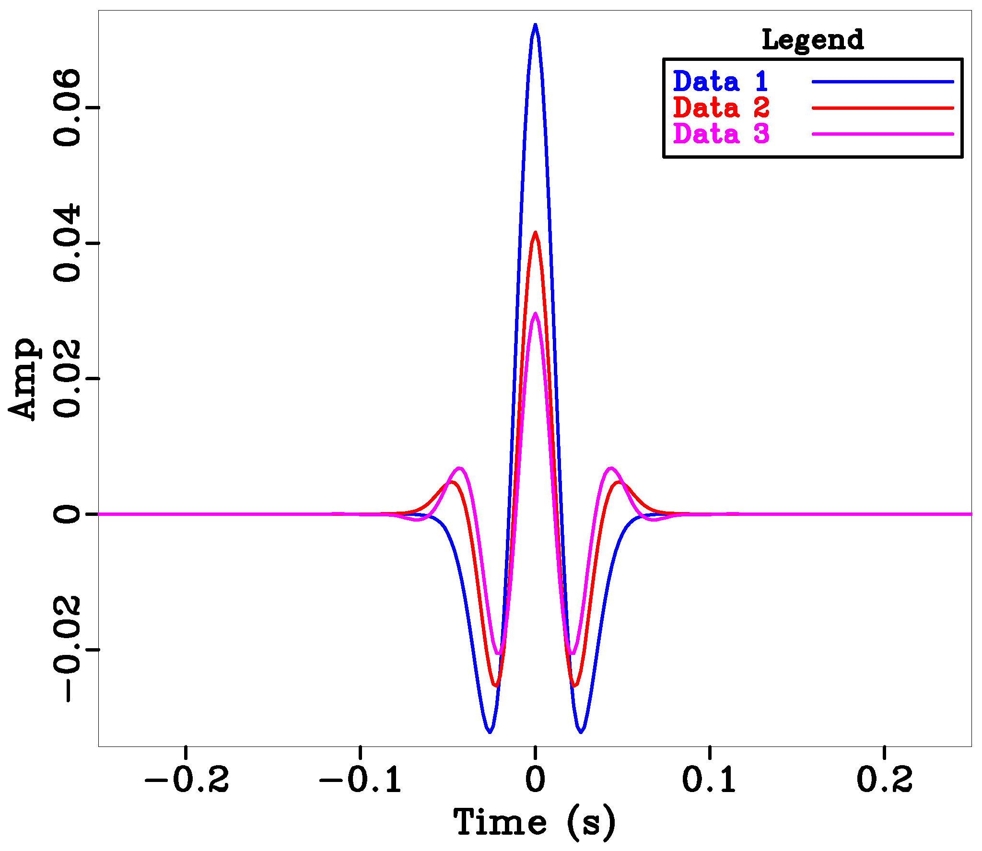
The difference in data (before imaging) – time domain
Data 1: Broadband data (More low frequencies)
Data 2: Conventional data (Less low frequencies)
Data 3: Even less low frequencies than Conventional data
Notes:
The side lobes and their moves become an indicator of the low frequencies arriving

Slide 149
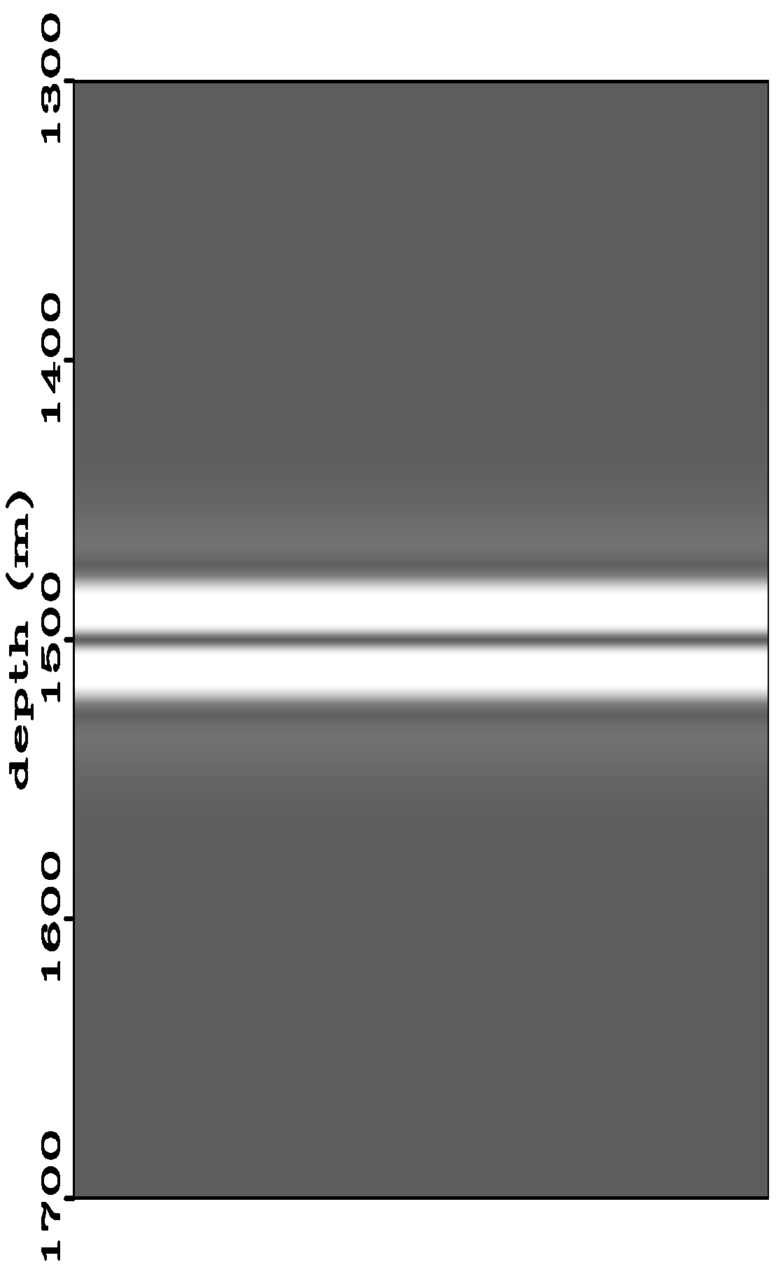

CIII imaging results
More low frequencies
Less low frequencies
Side lobe
Note: The plots here are the absolute values of the images

Slide 150
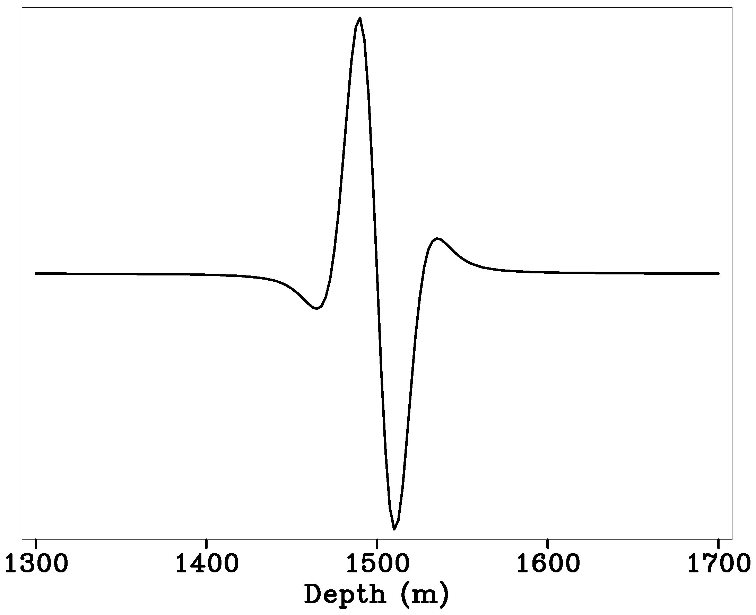

Quantitative comparison of images
normalized by the peak amplitude
More low frequencies
Less low frequencies
0.14
57%
0.33

Slide 151
Summary of part I
For CIII, by including low frequencies in the input data, the side lobes due to the missing low frequencies reduced 57% (from 0.33 to 0.14)
In the next part, My colleague Yanglei Zou will show you the comparison results for CII
And finally he will compare the sensitivity to low-frequency component of structural resolution between CII and CIII imaging principles

Slide 152
The comparison of structural resolution differences
with conventional and broadband data
between CII and CIII
--Part II
Qiang Fu, Yanglei Zou*, Chao Ma and Arthur B. Weglein
June 9, 2016
Notes:
152
152

Slide 153
Four comparisons
consistency of structural image
interpretability of the amplitude
migration with a discontinuous velocity model
frequency fidelity
the image resolution at the target

Slide 154

Claerbout imaging condition II RTM formula
(Baysal et al., 1983; Whitmore, 1983; McMechan, 1983)

Slide 155

The velocity model of the data
1500m/s
Z (m)
2000m/s
X (m)

Slide 156



Wavelets of the input data
Blue line represents broadband data.
Red line represents conventional data.
Pink line represents even less low frequencies than conventional data.
The reduction of the first side lobe amplitude with broadband data compared to conventional data is 26%.

Slide 157


Claerbout II RTM image
with low frequency
without low frequency
Z (m)
Z (m)
X (m)
X (m)

Slide 158

Claerbout II RTM image
with low frequency
without low frequency
Z (m)
Z (m)
X (m)
X (m)
Z (m)

Slide 159
Claerbout II RTM image
with low frequency
without low frequency
Z (m)
Z (m)
X (m)
X (m)
Z (m)
The reduction of the first side lobe amplitude with broadband data is only 20%.

Slide 160
There are side lobes in the structural image due to the missing low frequencies. With the new imaging method and broadband data the side lobes reduced more than 50% whereas the conventional leading edge RTM only 20%. The new imaging method is able to benefit from broad band data for structural resolution improvement to a much greater extent than the current best industry standard.

Slide 162
Innate algorithmic assumptions
The inverse scattering series states that all processing objectives can be achieved directly and without any subsurface information
Among processing objectives
  1. Free surface multiple removal
  2. Internal multiple removal
  3. Depth imaging
  4. Non-linear AVO
  5. Q compensation
All without subsurface information.

Slide 163



Inverse Scattering Series
Scattering theory = perturbation theory
(1)
Eq.(1) can be expanded in a forward scattering series,

Slide 164




The scattered field can be defined as
(2)
Where is the portion of that is order in .
The measured values of are the data
D, where

Slide 165




The inverse relation to (2), expands
(3)
as powers (orders) in the measured values of Ψs.
Substituting (3) into (2) and evaluating (2) on the
measurement surface results in
( )m
……

Slide 166
Therefore, the ISS is not only the only direct inversion method for a multidimensional acoustic, elastic, anelastic earth, but it further communicates that all inversion tasks/processing goals are able to be achieved directly and without subsurface information.
Direct and without subsurface information are two distinct and independent properties.

Slide 167
The combination represents a powerful and unique capability and unconventional thinking with stand-alone potential for addressing challenges that are caused by methods that are either indirect (and are necessary conditions, but not sufficient – and therefore are not equivalent to direct methods) and/or are dependent on a-priori information or other assumptions that cannot be adequately provided. The latter is especially significant as our exploration portfolios increasingly move to complex marine and on-shore plays.

Slide 168
That unique promise and potential is what the ISS, combined with the concept of isolated task subseries, offers.

Slide 169
Non-linearity (2 types)
Innate or intrinsic non-linearity
e.g., R.C. and material property changes.
Circumstantial non-linearity
- Removing multiples or depth imaging
primaries.

Slide 170
The inverse scattering series is (once again) unique in its ability to directly address either alone, let alone these two in combination.

Slide 171
The first term in a task specific subseries that addresses a potential circumstantial non-linearity first decides if its assistance and contribution is required in your data…
And only if decides that it is, then it starts to compute … if there is no nonlinear circumstantial issue to address, it computes an integrand which is zero.

Slide 172
The latter is a very sophisticated and impressive (and surprising) quality of task specific subseries
We call that property purposeful perturbation theory….
It decides if its assistance is needed before it acts!

Slide 173
Innate algorithmic assumptions
The inverse scattering series states that all processing objectives can be achieved directly and without any subsurface information
Among processing objectives
  1. Free surface multiple removal
  2. Internal multiple removal
  3. Depth imaging
  4. Non-linear AVO
  5. Q compensation
All without subsurface information.

Slide 174
multiple removal
174
Notes:
174

Slide 175


2D free surface multiple algorithm
The obliquity factor is defined as,

Slide 176

2D internal multiple attenuation algorithm
(Araujo 1994; Weglein et al. 1997)

Slide 177
Internal Multiple Removal in Offshore Brazil Seismic Data Using the Inverse Scattering Series
Master Thesis
Andre S. Ferreira

Slide 178

Multiple attenuation
Internal multiple attenuation results (stacked sections)

Slide 179

Multiple attenuation
Internal multiple attenuation results (stacked sections)

Slide 180
Conclusions
Multiple removal/attenuation is a major problem in seismic exploration
Free surface multiple removal results
  Multiple prediction is excellent
    Improved when source wavelet information was provided
  Anti-alias filter application is important
  Multiples from 3D structures are attenuated but not removed
  Adaptive subtraction required
Internal multiple attenuation results
  Multiple prediction is excellent
  Very high computer cost (both CPU time and memory)
  Adaptive subtraction required

Slide 181
Conclusions
ISS methods were able to attenuate both free surface and internal multiples in a very complex situation
  No a priori information about the dataset is necessary
  No other tested method was able to attenuate the sequence of internal multiples below the salt layers
  High computer cost (internal multiples)
  Adaptive subtraction requirement

Slide 182
Land application of ISS internal multiple
“Their (ISS internal multiple algorithm) performance was demonstrated with complex synthetic and challenging land field datasets with encouraging results, where other internal multiple suppression methods were unable to demonstrate similar effectiveness.”
- Yi Luo, Panos G. Kelamis, Qiang Fu, Shoudong Huo, and Ghada Sindi, Saudi Aramco; Shih-Ying Hsu and Arthur B. Weglein, U. of Houston, “The inverse scattering series approach toward the elimination of land internal multiples.” Aug 2011, TLE

Slide 183
The first Inverse-Scattering-Series internal multiple
elimination method
for a multi-dimensional subsurface
Yanglei Zou* Chao Ma and Arthur B. Weglein
June 9, 2016
Notes:
183
183

Slide 184
Numerical test for elastic PP data in a layered model
ISS internal multiple elimination in an elastic earth
( Numerical test I )

Slide 185
ISS internal multiple elimination in an elastic earth
( Numerical test I )
Courtesy of Schlumberger De-multiples Team
-2500m
12.5m
0
2500m
Z1=0m
Layer 1: ρ=1.0g/cm³, vp=1500m/s, vs=400m/s
Z2=300m
Layer 2: ρ=3.0g/cm³, vp=2000m/s, vs=1200m/s
Z3=800m
Layer 3: ρ=2.1g/cm³, vp=1500m/s, vs=900m/s
Z4=1900m
Layer 4: ρ=1.5g/cm³, vp=1500m/s, vs=1500m/s
Z5=2100m
Layer 5: ρ=1.8g/cm³, vp=2500m/s, vs=1500m/s
Z6=2400m
Yanglei Zou et al. (2014)

Slide 186

ISS internal multiple elimination in an elastic earth
( Numerical test I )

Slide 187
ISS internal multiple elimination in an elastic earth
( Numerical test I )
P primaries

Slide 188


ISS internal multiple elimination in an elastic earth
( Numerical test I )
internal multiples with s component in its history
S

Slide 189



ISS internal multiple elimination in an elastic earth
( Numerical test I )
1. Input data
2.Attenuation
3. Elimination

Slide 190
ISS internal multiple elimination in an elastic earth
( Numerical test I )
1. Input data
2.Attenuation
3. Elimination
internal multiple

Slide 191
ISS internal multiple elimination in an elastic earth
( Numerical test I )
1. Input data
2.Attenuation
3. Elimination
internal multiple

Slide 192
ISS internal multiple elimination in an elastic earth
( Numerical test I )
1. Input data
2.Attenuation
3. Elimination
converted wave
primary

Slide 193
ISS internal multiple elimination in an elastic earth
( Numerical test I )
1. Input data
2.Attenuation
3. Elimination

Slide 194
ISS internal multiple elimination in an elastic earth
( Numerical test I )
1. Input data
2.Attenuation
3. Elimination
internal multiple

Slide 195



ISS internal multiple elimination in an elastic earth
( Numerical test I )
1. Input data
2.Attenuation
3. Elimination
4.Primaries in the data
5.Data-attenuation
6.Data-elimination

Slide 196
Marchenko Imaging
Coen, S. , Cheney, M., and Weglein, A. B., Velocity and density of a two‐dimensional acoustic medium from point source surface data, Journal of Mathematical Physics 25, 1857 (1984)
Rose, J.H., ‘Single-side’ autofocusing of sound in layered materials, Inverse Problems”, 18, 1923–1934 (2002).
Wapenaar, K., Broggini, F., Slob, E., and Snieder, R., Three-Dimensional Single-Sided Marchenko Inverse Scattering, Data-Driven Focusing, Green’s Function Retrieval, and their Mutual Relations, PRL 110, 084301 (2013)
Wapenaar, K., Thorbecke, J., van der Nuet, J., Broggini, F., Slob, E., Snieder, R., Marchenko imaging, Geophysics, 79, 3, (2014)
Slob, E., Wapenaar, K., Broggini, F., Snieder, R., Seismic reflector imaging using internal multiples with Marchenko-type equations, Geophysics, 79,2, (2014)
Sing, S., Snider, R., Behura, J., van der Nuet, J., Wapenaar, K., Slob, E., Marchenko imaging: Imaging with primaries, internal multiples, and free-surface multiples, Geophysics, 80,5, (2015)
van der Nuet, J., Wapenaar, K., Adaptive overburden elimination with the multidimensional Marcheno equation, Geophysics, 81,5,(2016)
Loer, K., Curtis, A., Meles, G.A., Relating source-receiver interferometry to an inverse scattering series to derive a new method to estimate internal multiples, Geophysics, 81, 3, (2016)
Berkhout, A.J., Utilization of multiple scattering: the next big step forward in seismic imaging, Geophysics prospecting, 2016

Slide 197
Using multiples
Berkhout, A. J., and D. J. Verschuur, 1994, Multiple technology: Part 2, migration of multiple reflections: SEG Technical Program Expanded Abstracts, 1497–1500
Shan, G., 2003, Source-receiver migration of multiple reflections: SEG Technical Program Expanded Abstracts, 008–1011
Muijs, R., J. O. A. Robertsson, and K. Holliger, 2007, Prestack depth migration of primary and surface-related multiple reflections: Part i imaging: Geophysics, S59–S69.
Whitmore, N. D., A. Valenciano, W. Sllner, and S. Lu, 2010, Imaging of primaries and multiples using adual-sensor towed streamer: SEG Technical Program Expanded Abstracts, 3187–3192.
Lu, S., N. Whitemore, A. Valenciano, and N. Chemingui, 2011, Imaging of primaries and multiples with 3d seam synthetic: SEG Technical Program Expanded Abstracts, 3217–3221.
Ma, C. Weglein, A. B. , A clear example of using multiples to enhance and improve imaging. SEG Technical Program Expanded Abstracts 2016: pp. 4592-4595.

Slide 198
ISS Depth Imaging without A Velocity Model
Fang Liu and Arthur B. Weglein*
June 9, 2016
Houston, Texas
Notes:
198
198

Slide 200

Fang Liu

Slide 201

Fang Liu

Slide 202

Fang Liu
Fang Liu

Slide 203

Fang Liu

Slide 204

Fang Liu

Slide 205

Fang Liu

Slide 206

Fang Liu

Slide 207


Slide 208


Slide 209

Prestack FK water-speed image,

Slide 210


Slide 211

Kristin data ISS imaging: viability
Arthur B. Weglein
Notes:
211
211

Slide 212


Slide 213
Conclusion
ISS free surface and internal multiple removal had a game-changing impact on multiple elimination.
ISS direct depth imaging without a velocity model will have a game-changing impact on structural imaging and amplitude analysis.

Slide 214

A direct inverse solution for AVO/FWI parameter estimation objectives
Arthur B. Weglein
M-OSRP, University of Houston
Oct 20th, 2015

Slide 215
Modeling
Inversion
Indirect
Direct

Slide 216
Direct
Indirect
Search for x such that
is a minimum

Slide 217
Indicators of “indirect”
model matching
objective/cost functions
search algorithm
iterative linear “inversion”
necessary and not sufficient conditions, e.g., CIG flatness
Solving a forward problem in an inverse sense

Slide 218
There’s a role for direct and indirect methods in practical real world applications.

Slide 219
For a normal incidence plane wave on a 1D earth, a closed-form direct inverse solution exists (e.g., Ware and Aki, (1968) JASA)

Slide 220
Direct Inverse for a multi-dimensional subsurface
Relationship
(1)
An operator identity that follows from
Modeling

Slide 221
Relationship
(1)
Modeling
(2)
From
With

Slide 222
Direct Forward and Direct Inverse
Solve for r

Slide 223
Each term in the inverse series that inverts
for
is computed directly in terms of S and a.

Slide 224
When we consider the generalized Geometric Series
the inverse Geometric Series for
where each term is computed directly in terms of a (‘G₀’) and S (‘ ’ the recorded data).

Slide 225
The r₁, r₂, … equations generalize

Slide 226
Hence, the inverse scattering series is not only the only direct multidimensional inverse seismic solution, in addition, every term in the solution is directly computed in terms of a single unchanged reference and the recorded reflection data.

Slide 227
Direct Forward and Direct Inverse
Forward S in terms of V, inverse V in terms of S
(3)
where V_{n} is the portion of V, n-th order in the data
(2) is the forward series;
(3) is the inverse series.

Slide 228
The relationship (2) provides a Geometric forward series rather than a Taylor series.
In general, a Taylor series doesn’t have an inverse series; however, a Geometric series has an inverse series.
All conventional current mainstream inversion, including iterative linear inversion and FWI, are based on a Taylor series concept.
Solving a forward problem in an inverse sense is not the same as solving an inverse problem directly.

Slide 229
If (a linear exact relationship)
Then is solving the inverse problem directly and the forward problem in an inverse sense

Slide 230
But if the relationship is non-linear
n roots,
As , number of roots
However, from , we found the direct inverse
(one real root)

Slide 231
This provides a vivid illustration of how solving a forward problem in an inverse sense is not the same as solving the inverse problem directly.

Slide 232
In all current indirect ‘inversion’ methods

Slide 233
The terms in the inverse scattering series

Slide 234
Isolated Task Subseries of the ISS
If we imagine that the inverse machine that inputs reflection data and outputs earth properties needs to achieve certain tasks, then we can seek to locate terms within the general ISS that achieve those specific objectives.
Those tasks are:
  Free surface multiple removal
  Internal multiple removal
  Depth imaging
  Parameter estimation
  Q compensation without knowing or needing Q

Slide 235
Each of these tasks has a subseries that doesn't require subsurface information.
In addition, several of these tasks (and corresponding subseries) are model type independent. That is, there is one unchanged algorithm to achieve that task independent of whether you assume the earth is acoustic, elastic, anisotropic or inelastic.
To see how different the ISS direct inverse is from linear updating and model matching: It is not conceivable to perform model type independent model matching and updating, e.g., for multiple removal.
And the ISS free-surface multiple elimination method works one temporal frequency at a time. You cannot model match (and update models) to subtract multiples one frequency at a time.

Slide 236
Non-linearity (2 types)
Innate or intrinsic non-linearity
e.g., R.C. and material property changes.
Circumstantial non-linearity
- Removing multiples or depth imaging
primaries.

Slide 237
The inverse scattering series is (once again) unique
in its ability to directly address either alone, let
alone these two in combination.

Slide 238
The first term in a task specific subseries that addresses a potential circumstantial non-linearity first decides if its assistance and contribution is required in your data…
And only if decides that it is, then it starts to compute … if there is no nonlinear circumstantial issue to address, it computes an integrand which is zero.

Slide 239
The latter is a very sophisticated and impressive (and surprising) quality of task specific subseries
We call that property purposeful perturbation theory….
It decides if its assistance is needed before it acts!

Slide 240
For the purposes of this talk we focus on the parameter estimation, target identification or inversion task within the inverse scattering series.

Slide 241
（2D） Elastic (isotropic)
where

Slide 242
（2D） Elastic (isotropic)
where

Slide 243
The forward problem
(4)

Slide 244
The inverse problem
(solving for r in terms of S)
(5)

Slide 246
(6)
Hence, for any one of the four matrix elements of V requires

Slide 247
can be determined independently in terms of
but or requires
That’s what the general relationship requires
A direct non-linear solution order by order in the data matrix

Slide 248
ISS is not iterative linear inversion.
Iterative linear starts with
solves for V₁, changes the reference medium, finds a new L₀ and G₀ (and require generalized inversions of noisy band limited data dependent operators).
To find ,
(7)

Slide 249
The problem is much more serious than a different approach to solve (7) for .
If (7) is our entire basic theory, you can mistakenly think that
is sufficient to update
That step loses contact with and violates
for the elastic wave equation.

Slide 250
That is, it violates the basic relationship between changes in a medium, V and changes in the wavefield, G-G₀ for the simplest elastic model.
This direct inverse method gives you a platform for FWI and communicates when a “FWI” method should work in principle.
Iteratively inverting multi-component data has the correct data but doesn’t corresponds to a direct inverse algorithm.
To honor G=G₀+G₀VG, you need both the data and the algorithm that direct inverse prescribes.
A.B. Weglein and Jinlong Yang
  A first comparison of the inverse scattering series and iterative linear inverse for parameter estimation, M-OSRP (2015), SEG Abstract (2015).

Slide 251
There’s a role for direct and indirect methods in practical real world application.

Slide 252
4D Application

Slide 253

Discrimination between pressure and fluid saturation using direct non-linear inversion method: an application to time-lapse seismic data
Haiyan Zhang, Arthur B. Weglein, Robert Keys, Douglas Foster and Simon Shaw
M-OSRP Annual Meeting
University of Houston
May 10 –12, 2006

Slide 254


Slide 255
Key deliverables for the year of 2015-2016
1) On-shore preprocessing ( wave separation, ground roll removal) where the near surface is complex and unknown

Slide 256
Key deliverables for the year of 2015-2016
1) On-shore preprocessing ( wave separation, ground roll removal) where the near surface is complex and unknown
2) The Stolt extended Claerbout III imaging for V(x,y,z) for two way propagating (RTM) migration for imaging and inverting specular and non-specular targets

Slide 257
Key deliverables for the year of 2015-2016
1) On-shore preprocessing ( wave separation, ground roll removal) where the near surface is complex and unknown
2) The Stolt extended Claerbout III imaging for V(x,y,z) for two way propagating (RTM) migration for imaging and inverting specular and non-specular targets
3) 2D and 3D ISS internal multiple elimination --- with two distinct strategies and deliverables

Slide 258
Key deliverables for the year of 2015-2016
1) On-shore preprocessing ( wave separation, ground roll removal) where the near surface is complex and unknown
2) The Stolt extended Claerbout III imaging for V(x,y,z) for two way propagating (RTM) migration for imaging and inverting specular and non-specular targets
3) 2D and 3D ISS internal multiple elimination --- with two distinct strategies and deliverables
4) A new velocity analysis method based on ISS parameter estimation

Slide 259
Key deliverables for the year of 2015-2016
1) On-shore preprocessing ( wave separation, ground roll removal) where the near surface is complex and unknown
2) The Stolt extended Claerbout III imaging for V(x,y,z) for two way propagating (RTM) migration for imaging and inverting specular and non-specular targets
3) 2D and 3D ISS internal multiple elimination --- with two distinct strategies and deliverables
4) A new velocity analysis method based on ISS parameter estimation
5) Green’s theorem wave separation for de-ghosting and P₀ and Ps, for marine and on-shore plays where the acquisition surface is not planar or horizontal

Slide 260
M-OSRP Projects (2016)
Offshore and on-shore preprocessing for reference wave removal (including ground roll) and deghosting for arbitrary non-horizontal measurement surface
Multi-D internal multiple elimination for interfering target primaries and internal multiples
The first migration method that's equally effective at all frequencies at the target and reservoir - with a velocity model
Inverse scattering series depth imaging without a velocity model complex synthetic and field data - a game changing imaging capability
Inverse scattering series parameter estimation for target identification and velocity analysis - comparison with (current) iterative linear inversion (FWI)

Slide 261
Conclusion
ISS free surface and internal multiple removal had a game-changing impact on multiple elimination.
ISS direct depth imaging without a velocity model will have a game-changing impact on structural imaging and amplitude analysis.

Slide 262
Links
Executive Summary Video: The M-OSRP delivered added value and documented E&P impact, March 9, 2015 (http://mosrp.uh.edu/news/mar-9-exec-summary-video)
Key–note address , Abu Dhabi, March 31st , 2015 presented at the SEG FWI, Workshop Filling the gaps in Abu-Dhabi (http://mosrp.uh.edu/news/mar-30-apr-1-fwi-workshop-abu-dhabi)
M-OSRP Annual Meeting 2016 (http://mosrp.uh.edu/events/annual-meetings/meeting-16)
M-OSRP Annual Meeting 2016 Summary (https://www.youtube.com/watch?list=PLZKMHtPiTDJb8W3_M-3gDN9F9MnGvKVzR&v=rwMv1y_GYs8)
The first migration method for a heterogeneous medium that is equally effective at all frequencies (http://mosrp.uh.edu/news/a-first-migration-method-that-is-equally-effective-at-all-frequencies-arthur-weglein-dec-2015)
M-OSRP Invited Presentation at Petrobras Workshop on Game Changing Seismic Technology - Aug. 2016 (http://mosrp.uh.edu/news/invited-presentation-petrobras-workshop-aug-2016)

